Slide 1
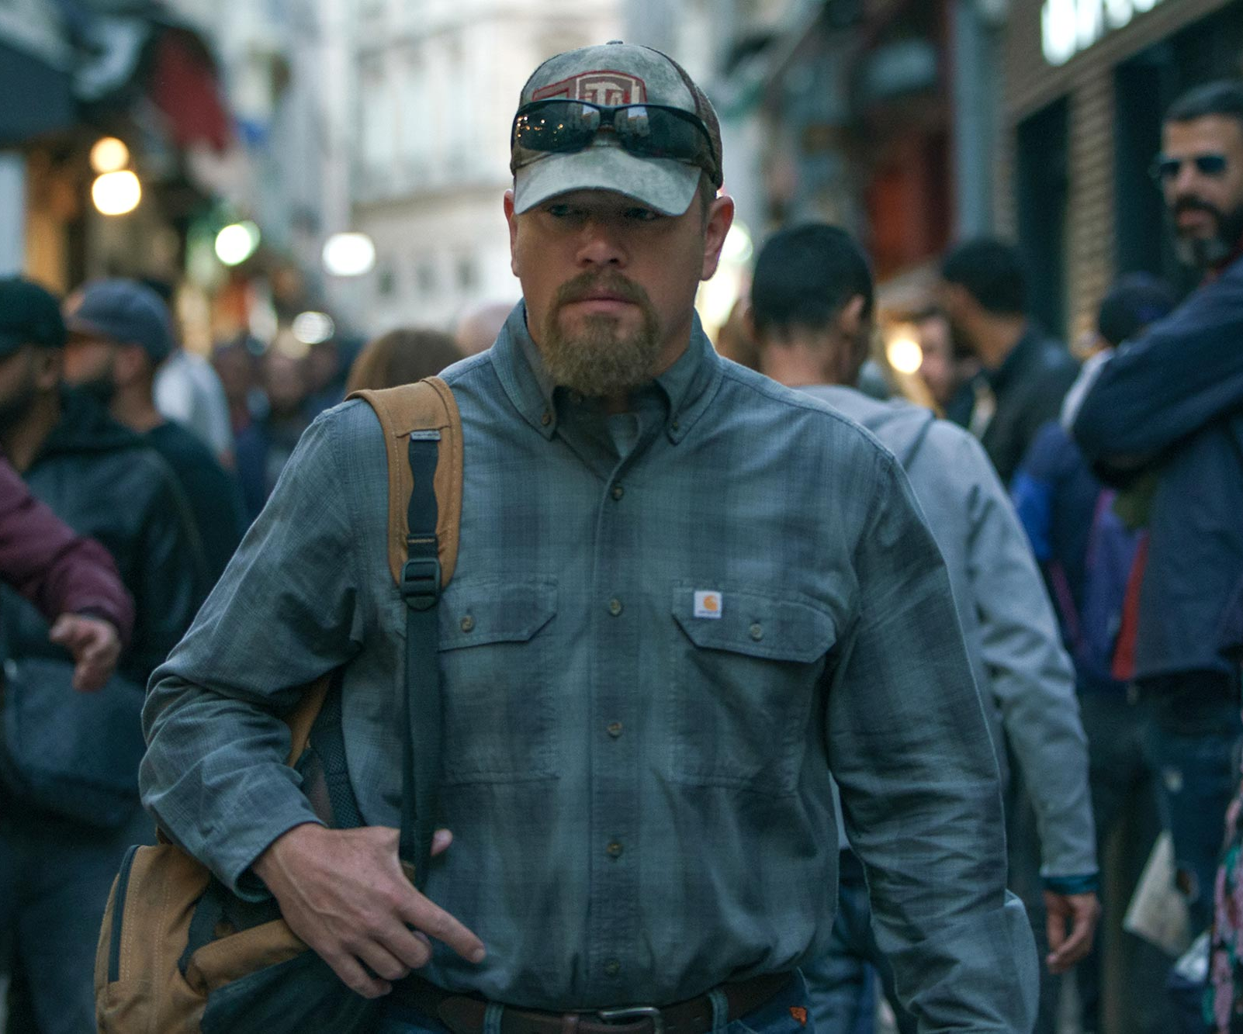
Stillwater
A globetrotting journey to find the truth
Release Date
6 August 2021
Cast
Matt Damon, Abigail Breslin, Camille Cottin
Director
Tom McCarthy (Spotlight)
Recommended if you like
Green Book
Reasons to buy into
Tom McCarthy showed an aptitude for deep and delicately-handled storytelling with the Best Picture-winner Spotlight, and Matt Damon is one of Hollywood’s highest-grossing stars.
Key audience info
ABC1 Men Index: 183
Est. DCM admissions
204k
A father travels from Oklahoma to France to help his daughter, who has been arrested for murder.
Plan your campaign

