Slide 1
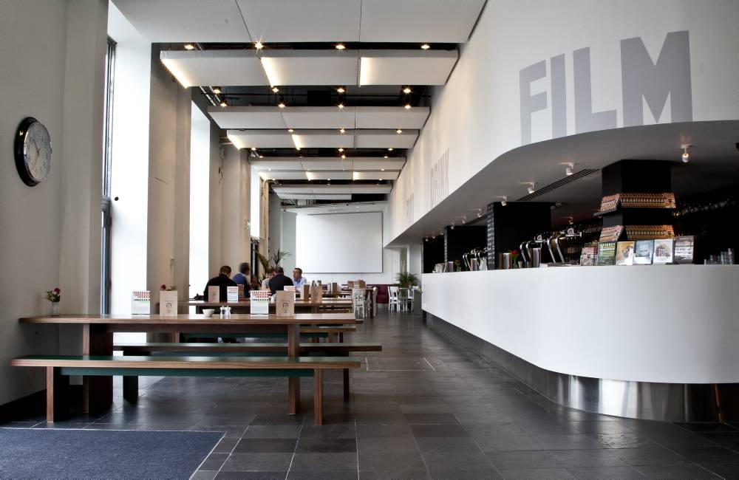
Spirit of the month
Give your brand the ‘bar star’ treatment
What is Spirit of the Month?
It’s a highly targeted, short-term (but flexible) sponsorship that puts your drinks brand in the spotlight at the UK’s leading independent cinema chain. Ensure VIP treatment in a highly premium environment inhabited by the cream of the cinema-going crop.
Sponsoring Spirit of the Month means your drinks are stocked at all Picturehouse bars, highlighted by a variety of physical and digital touch points, thereby gaining high visibility with the chain’s relaxed, sociable ABC1 audience.
Why become the Spirit of the Month?
Picturehouse bars are the bustling social centres of highly-cultured (and incomed) communities all over the country. They are frequented by many discerning socialites – some of whom visit even when they aren’t seeing a film.
Spirit of the Month is a fantastic opportunity to build brand association with the UK’s leading independent cinema chain by becoming an integral, intimate presence within a discerning and desirable social scene.
Take your brand centre-stage before an elite audience of movers and shakers.

Slide 2
SPIRIT OF THE MONTH
Give your brand the ‘bar star’ treatment
An Integral Presence
The sponsor will be stocked at all sites throughout the campaign dates. High visibility foyer POS will drive footfall into the bars, which are already bustling social centres of the cinemas in their own right. There, counter cards and drinks mats will further heighten awareness of the sponsorship.
The appetite for comfort and luxury as part of the cinemagoing experience is growing, especially among ABC1 25-44’s, and the opportunity to socialise in the bar before/after a film is a welcome one for this demographic.
78%
of Picturehouse audience are ABC1.
26%
More likely as an ABC1 25-44 year old to go for a drink immediately after the film than the average cinemagoer .
Investment
On Screen Optional specially created ident or 30” ad before all films within campaign timeline approved for alcohol advertising.
Asset | Est. 3 month Impacts | Gross Value (£)
30” ad @ 16 bar sites | 439,437 | £87,887
E-Newsletter x 3 | 1,119,000 | £12,000
Website | 55,836 | £1,000
1x Quad 2x Counter Cards | 732,396 | £22,800
Full page ad in quarterly magazine | 200,000 | £4,000
Total | 2,546,669 | £127,687
Online
Presence in Picturehouse’s monthly e-newsletter, and presence on the chain’s ‘Food & Drink’ page. Presence on the home pages of the cinemas to be negotiated based on brand/activity.
Foyer
Sponsorship will be highlighted by roller banners and quad in the foyer, with counter cards and post cards on the bar itself.
Magazine & Earned Media
The sponsorship will be highlighted by 1 full page ad in the quarterly Picturehouse Recommends magazine. Picturehouse will also promote the sponsorship through its social media channels, including regular tweets and Facebook updates.
3 month package investment (inclusive of all production hard costs*):
£75,000
Source: GB TGI Q2 2013 / Rentrak Admissions / CAA Film Monitor Coverage & Frequency / CAA FAME 2012. *Excludes creative and production costs. All assets creative subject to cinema approval and restricted by availability.

