Slide 1
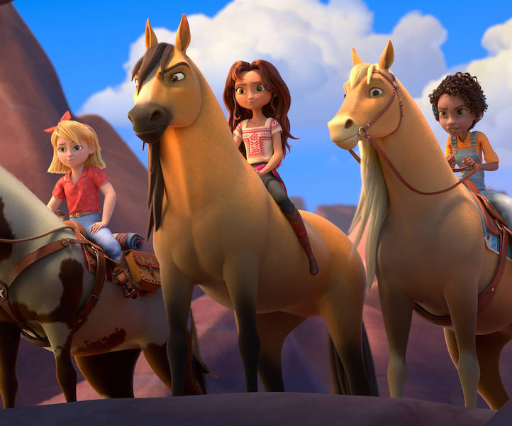
Spirit Untamed
An original animated adventure
Release Date
30 July 2021
Cast
Eiza Gonzalez, Mckenna Grace, Jake Gyllenhaal
Director
Elaine Bogan, Ennio Torresan (Feature debut)
Recommended if you like
How to Train Your Dragon
Reasons to buy into
This new animation from many of the creative minds behind the How To Train Your Dragon series also features an incredible all-star cast including Jake Gyllenhaal, Walton Goggins and Julianne Moore.
Key audience info
HW w/kids Index: 165
Est. DCM admissions
117k
A young woman’s life is changed forever when she moves from her home in the city to a small frontier town and befriends a wild mustang named Spirit.
Plan your campaign

