Slide 1
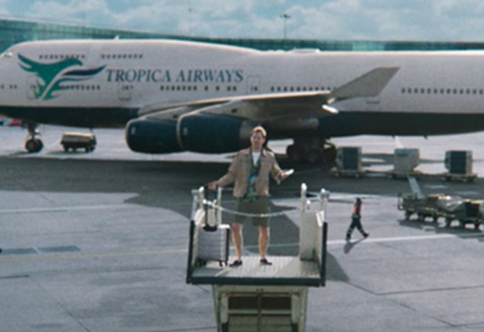
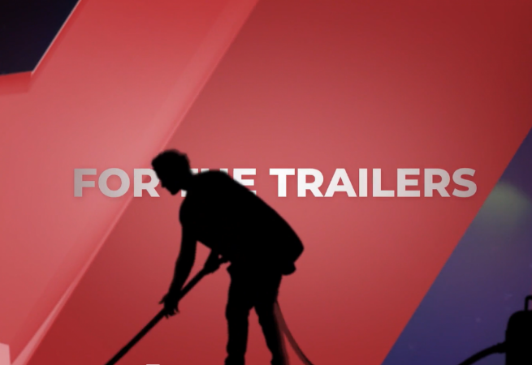
specsavers
DCM AWARDS WINNER
Grand Prix
Background
Specsavers wanted to bring the ‘Should’ve Gone to Specsavers’ campaign to cinema in a way that would stand out and drive brand likeability.
Plan
Specsavers ran a ‘Turn Your Phone Off’ creative, with a parody voiceover saying ‘Turn Your Phones On’ in addition to a Trailer spot & opening/closing idents created by DCM Studios that also followed a similar comedic theme to disrupt & engage.
Results
+42% uplift in recall across all TYPO, Trailer and Ident creatives - performing ahead of benchmarks
+51% uplift for ‘Specsavers is for people like me’
+30% uplift for ‘is a brand I trust’, showing that cinema was integral in boosting brand likeability

Slide 2

Specsavers
DCM AWARDS WINNER: Best Creative Use of Cinema & Grand Prix
MEDIA AGENCY | TARGET | BUYING ROUTE | COPY LENGTH
MGOMD | 18+ | Silver Spot | 10” 15” 30”
Should’ve Gone To Specsavers
Background
Specsavers wanted to launch the familiar ‘Should’ve Gone to Specsavers’ campaign in cinema in a way that would stand out and drive brand likeability.
Plan
In addition to their hero creative that ran across numerous platforms, Specsavers partnered with DCM Studios and Cineworld to run a 30” TYPO creative across an AGP, with a parody voiceover mistakenly saying, ‘Turn Your Phones On’, alluding that the voice actor needs glasses to read his lines accurately.
Additionally, 2x 30” Trailer spots and opening/closing idents (10” & 15”) were created, following a similar comedic theme. These multiple creatives were used to ultimately drive interest, engagement and disrupt audience attention during the reel.
RESULTS
Results for those exposed to the multiple creative assets in cinema improved significantly across several of Specsavers core brand metrics, including ad awareness, driving ‘quality’ & ‘fun’ perceptions, boosting recommendation and intention to book an appointment with Specsavers.
Notes:
Source: DCM / Puregym Conducted by; Differentology, Dec 2023.
Uplifts are control (unexposed to ad) vs test (exposed to ad)

Slide 3

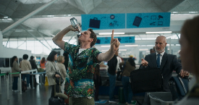

Specsavers
DCM AWARDS WINNER: Best Creative Use of Cinema & Grand Prix
Should’ve Gone To Specsavers
Recall
+42%
Maximising value perceptions
Cinema was particularly impactful in driving ‘best value for money’ perceptions (+41% TYPO / +32% Trailer), demonstrating how cinema can help boost brand image.
‘Is a brand
I trust’
+30%
The power of multiple assets
c.50% of respondents recalled seeing the TYPO, Trailer and Ident creatives - performing ahead of benchmarks and delivering strong cut through and memorability.
Recommendation
+57%
Engaging creative
Cinemagoers agreed the bespoke copy was ‘engaging’, ‘relevant’ and ‘memorable’, and demonstrates how contextually relevant creative can underpin strong performance across brand metrics.
Action
intended
+17%
Notes:
Source: DCM / Specsavers. Conducted by; Differentology Nov 2024. Results base: 18+. Uplifts are test (exposed to ad) vs control (unexposed to ad. Recall figure based on TYPO creative. (Left: Uplifts seen from Control. unexposed to cinema (TYPO) ad) vs Test (exposed to cinema ad)

