Slide 1
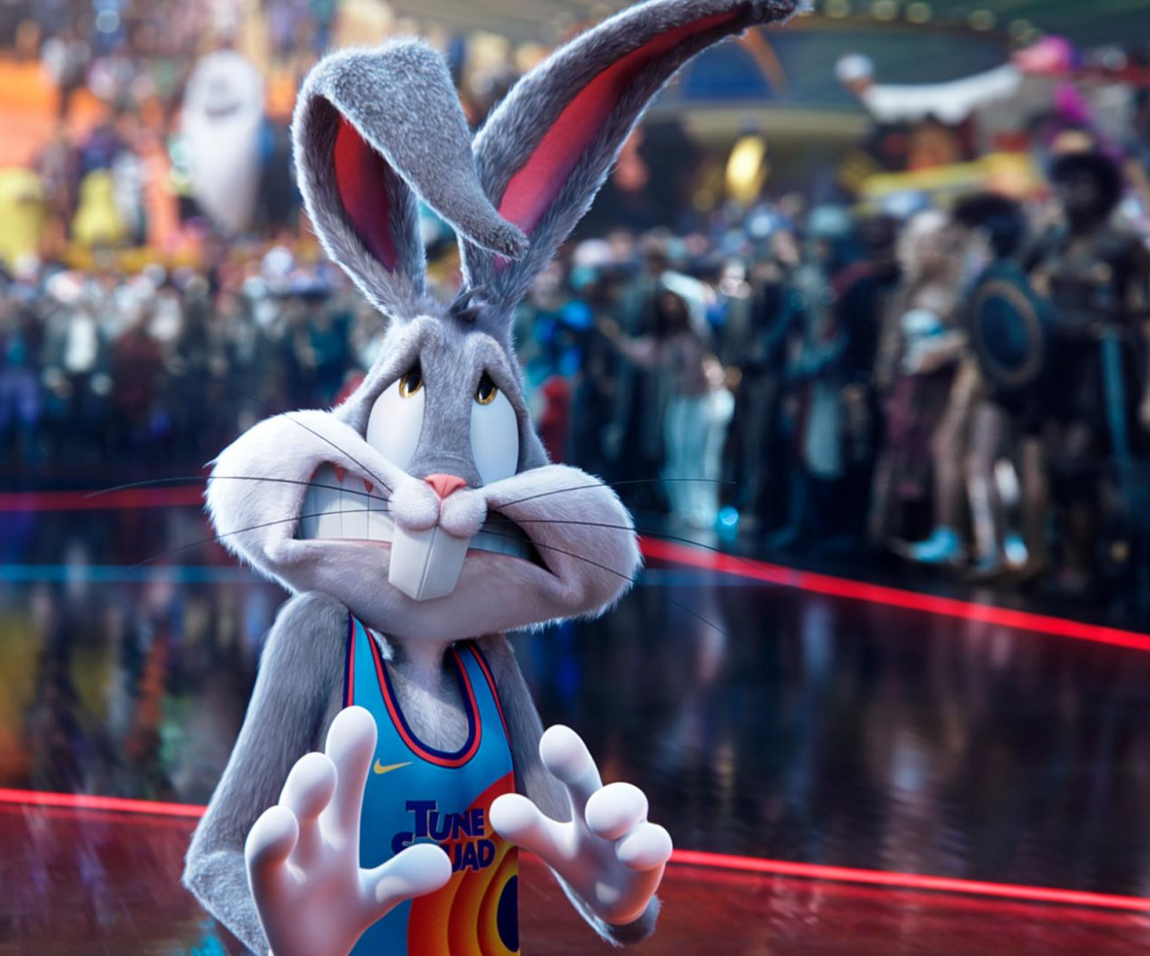
Space Jam: A New Legacy
The toons are back in town!
Release Date
16 July 2021
Cast
LeBron James, Zendaya, Sonequa Martin-Green
Director
Malcolm D. Lee (Girls Trip)
Recommended if you like
Ready Player One
Reasons to buy into
The first Space Jam has become an iconic nostalgia trip for an entire generation, and this star-studded sequel looks set to be another pop cultural slam dunk.
Key audience info
16-34 Adults Index: 143
Est. DCM admissions
700k
NBA superstar LeBron James teams up with Bugs Bunny and the rest of the Looney Tunes for this long-awaited sequel.
Plan your campaign

