Slide 1
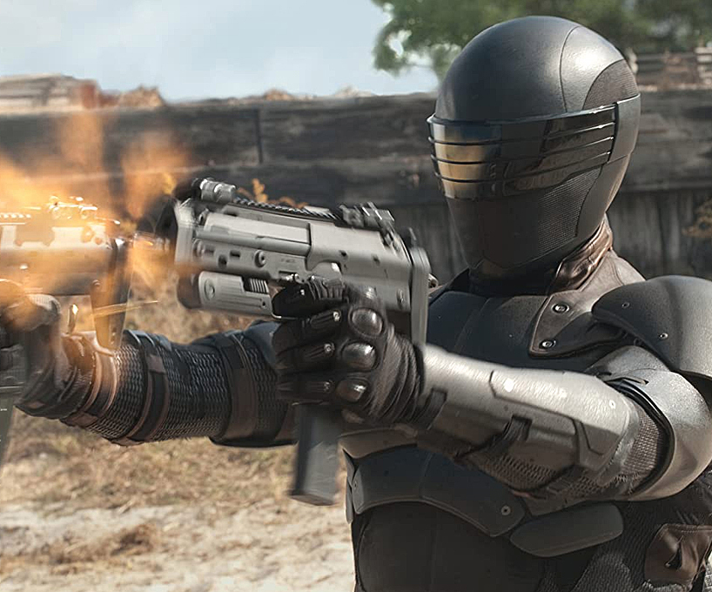
Snake eyes
Non-stop action from an American icon
Release Date
18 August 2021
Cast
Henry Golding, Samara Weaving, Ursula Corbero
Director
Robert Schwentke (The Divergent Series)
Recommended if you like
G.I.Joe Retaliation
Reasons to buy into
This new entry in the G.I. Joe franchise – one of America’s biggest action franchises – stars man of the moment Henry Golding as the series’ enigmatic antihero.
Key audience info
16-34 Adults Index: 139
Est. DCM admissions
467k
A spinoff G.I. Joe film focused on Snake Eyes – plot currently unknown.
Plan your campaign

