Slide 1
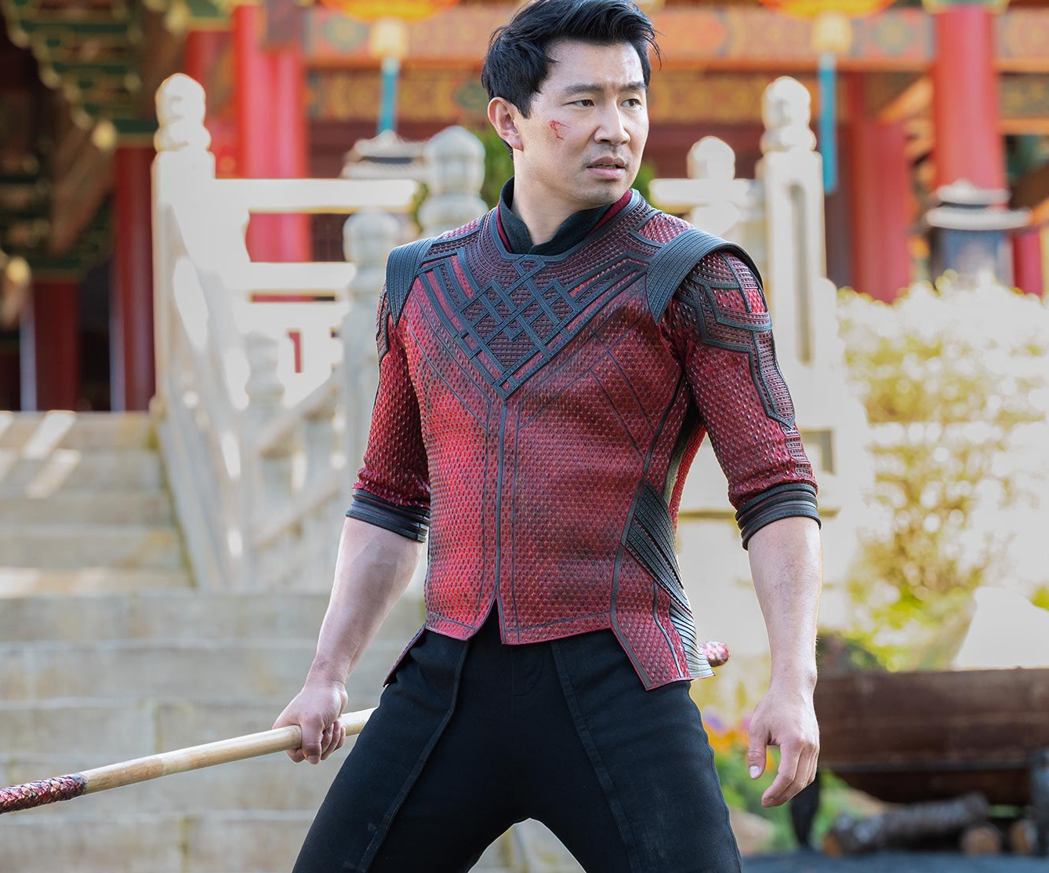
Shang-chi and the legend of the ten rings
Marvel brings a new character to the big screen
Release Date
3 September 2021
Cast
Simu Liu, Awkwafina, Tony Chiu-Wai Leung, Michelle Yeoh
Director
Destin Daniel Cretton (Just Mercy, Short Term 12)
Recommended if you like
Black Panther, Avengers: Endgame
Reasons to buy into
Marvel expands it’s diverse slate of superhero offerings with this China-set origin story brimming with reliable stars and fresh young talent.
Key audience info
16-34 Men Index: 286
Est. DCM admissions
1.6m
The movie, based on Marvel Comics, will focus on Shang-Chi; 'The Master of Kung-Fu'.
Plan your campaign

