Slide 1
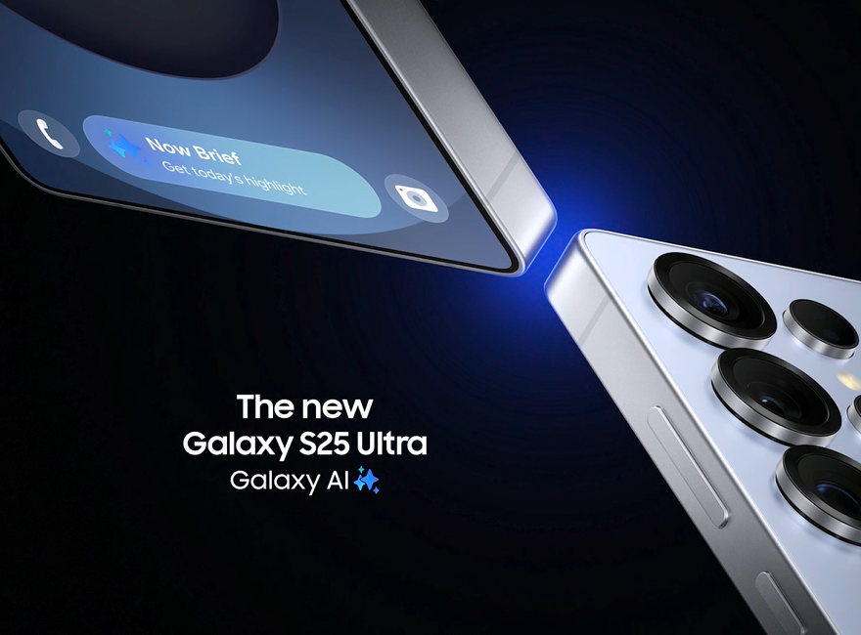
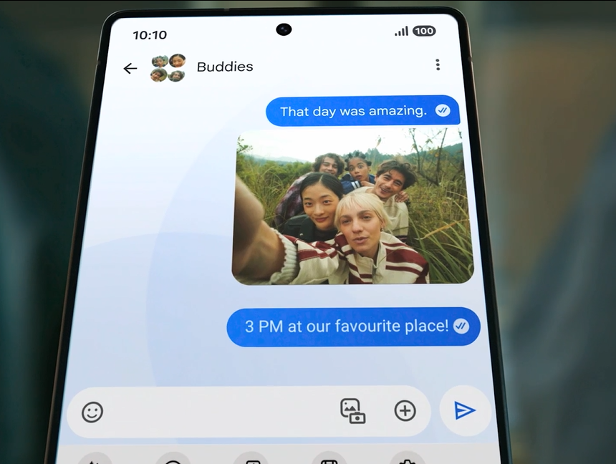
SAMSUNG
DCM AWARDS NOMINEE
Best Creative Use of Cinema
Background
Leveraging cinema’s ability to captivate audiences Samsung wanted to launch the Galaxy S25 with impact – delivering strong recall levels and ultimately driving purchase intent.
Plan
Samsung used DCM’s Cinemapper to strategically place its 30” ad in heavily trafficked cinemas near stores. They also added 5” end frames to create a seamless path from screen to store. The campaign ran across ABC1 Adult-targeted titles including Bridget Jones: Mad About The Boy and Captain America: Brave New World to maximise reach.
Results
Overall ad recall up was +38% vs. the initial target, with cinema delivering its second highest recall score for Samsung in 5 years, and a cost per recall point 50% cheaper than paid social.
Notes:
Source: DCM Awards 2025 Samsung Entry

Slide 2
SAMSUNG
DCM AWARDS NOMINEE: Best Creative Use of Cinema
MEDIA AGENCY | TARGET | BUYING ROUTE | COPY LENGTH
Starcom | ABC1 Adults | Film Packs + ABC1 AGP | 30” + 5” End Frames
“Galaxy S25”
BACKGROUND
Having had success using cinema previously, Samsung knew the importance of including it as part of the media mix for the launch of the new Galaxy S25. Cinema’s high attention would be used to achieve a higher level of recall, essential for this launch campaign.
PLAN
Samsung leveraged DCM’s Cinemapper—a proximity-driven targeting tool that maps cinemas to retail locations—to strategically place its 30″ ad in cinemas with high footfall and nearby stores. The campaign also incorporated 5″ geo‑targeted end frames to guide viewers from screen to store, creating a seamless in‑cinema path to purchase. The campaign ran across ABC1 Adult-targeted titles including Bridget Jones: Mad About The Boy and Captain America: Brave New World to maximise reach.
RESULTS
The campaign was a huge success, with cinema providing a cost-effective method of maximising recall.
BOOSTING RECALL
Cross-media measurement revealed that cinema delivered its second highest recall for the brand since 2021, with overall ad recall up +38% vs. the initial target.
COST EFFECTIVE MEDIA
Cost per recall point was 50% cheaper on cinema vs paid social.
Notes:
Source: DCM Awards 2025 Samsung Entry

