Slide 1
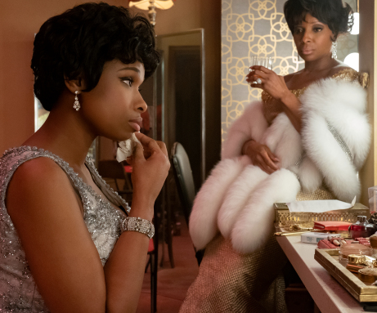
respect
A musical legend leaps onto the big screen
Release Date
10 September 2021
Cast
Jennifer Hudson, Forest Whitaker, Audra McDonald
Director
Lisel Tommy (Feature Debut)
Recommended if you like
Nina
Reasons to buy into
Jennifer Hudson is sure to attract huge awards buzz for her performance as the legendary Aretha Franklin.
Key audience info
ABC1 Women Index: 166
Est. DCM admissions
292k
A biopic detailing the life and achievements of legendary R&B singer, Aretha Franklin.
Plan your campaign

