Slide 1
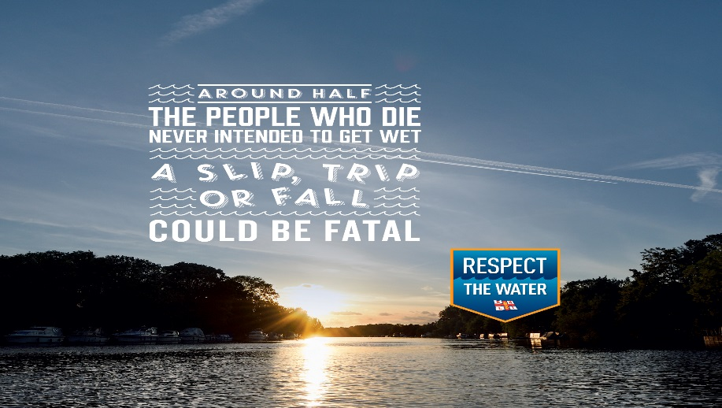
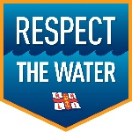
DCM CASE STUDY: rnli
CINEMA DELIVERS:
EFFICIENT GEOTARGETING
Respect the Water (2015)
Background
RNLI launched their behavioural change campaign in 2015, aiming to halve the number of people who lose their lives in the UK and Irish coasts by 2024
They were particularly targeting young men, and wanted to use multiple touchpoints to effectively demonstrate the dangers that water can present
With this in mind, they aimed to give their young male audience timely and consistent prompts along their journey to the coast, hammering home its potential dangers.
Why Cinema?
Drawn to cinema’s engaging and immersive qualities, RNLI utilised DCM’s Cinemapper tool to pinpoint cinemas near rivers and seas. Activity was upweighted in these cinemas
By upweighting in these coastal cinemas, RNLI were able to use a hard hitting AV creative alongside their outdoor campaign, prompting young men to think twice about irresponsible behaviour when temptation might be at its highest.
Respect the water
Campaign Details
Package | Site by Site/ Male AGP
Media Agency | OMD
Target Audience | 16-39 year old Men
Sector | Charities

Slide 2
Dcm case study: rnli
Respect the Water (2015)
Results
The campaign, with cinema as an integral contributor, was hailed as a significant success, delivering an uplift in total campaign awareness of 36%.
21% of 16-39 year old males were able to recall the campaign, demonstrating cinema’s efficiency in connecting with this hard-to-reach audience.
81% of people who recognized two or more elements of the campaign said they understood the dangers were relevant to them.
RNLI recognized cinema’s ability to drive important messages home to engaged and attentive audiences. Cinemapper allowed RNLI to ensure that this message was being driven home in the right place, to the right people.
This relevancy meant RNLI saw great results and delivered a strong kick-start to a ten year campaign to change behaviours.
Testimonials
“Cinemapper was instrumental in the planning of our RNLI campaign - by identifying cinemas close to bodies of water such as coastlines and rivers we were able to upweight our messaging in these areas.
This was perfect for the campaign as this allowed us to increase the volume of our messaging where accidents happen, this meant that we were hitting our audience with key messaging at just the right time.”
Jordan Calhau, Investment Manager, OMD
Case Study: DCM awards entry July 2015 – July 2016

