Slide 1
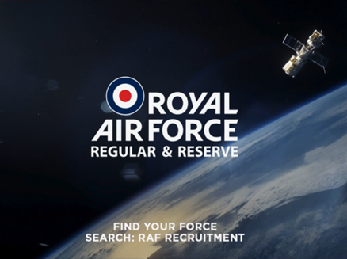
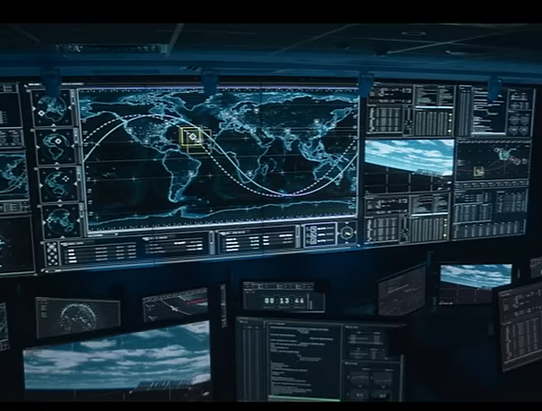
ROYAL AIR FORCE (RAF)
DCM AWARDS WINNER
Best Long-Term Use of Cinema
Background
To combat ‘old fashioned’ associations, the RAF wanted to demonstrate its new emerging remit of protecting British interests in space, hoping this would modernise perceptions and attract younger audiences to consider a career in the RAF.
Plan
RAF partnered with DCM & Cineworld for the “Thrill Seekers” campaign, accessing a plethora of creative formats including co-branded Idents, Screen X, 4DX & in-foyer digital screens.
Results
Exposure to the campaign in cinema drove c.20% uplift in agreement that RAF ‘is a modern and future facing force’.
Consideration of a career with the RAF increased by over 100% for those exposed to the campaign in cinema

Slide 2
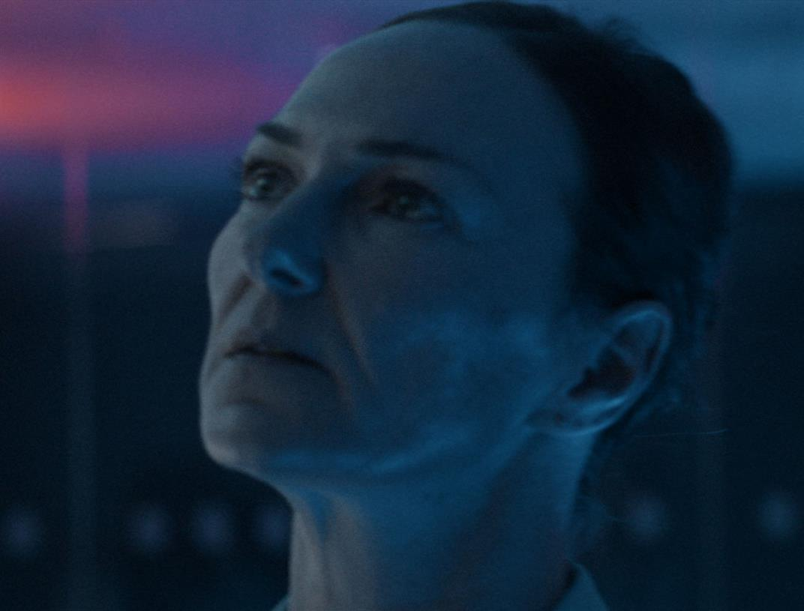
ROYAL AIR FORCE (RAF)
DCM AWARDS WINNER: Best Long-Term Use of Cinema
MEDIA AGENCY | TARGET | BUYING ROUTE | COPY LENGTH
MGOMD | 16-34 | ABC1 AGP | 60”
How creative formats can maximise perceptions & EOI
BACKGROUND
To combat ‘old fashioned’ associations, the RAF wanted to demonstrate its new emerging remit of protecting British interests in space, hoping this would modernise perceptions and attract younger audiences to consider a career in the RAF.
PLAN
RAF partnered with DCM & Cineworld for the “Thrill Seekers” campaign, accessing a plethora of creative formats including co-branded Idents, 4DX, in-foyer digital screens and Screen X to reflect the immersive & engaging experiences of being in the RAF. The campaign ran on screen across ABC1 Ads AGP titles to maximise reach.
RESULTS
The campaign has been an enormous success for the RAF, effectively driving positivity towards the RAF and the immersive nature of multiple formats driving uplifts in key metrics.
UPLIFTS ACROSS KEY PERCEPTIONS
Exposure to the campaign in cinema drove c.20% uplift in agreement that RAF ‘is a modern and future facing force’.
The addition of digital in-foyer screens also improved perceptions that ‘joining the RAF appeals to me’ by 126%
CAREER CONSIDERATION IMPROVED
Consideration of a career with the RAF was up +111% amongst those exposed to the standard ad, and +163% for 4DX viewers vs. those not exposed in cinema.
LIFT IN EXPRESSIONS OF INTEREST
EOI via RAF site increased 47% YoY and exceeded targets by 32% since the cinema partnership began.
Notes:
Source: DCM / RAF. Conducted by; Differentology, September 2023.
Results base: 16+. Uplifts are test 1 (exposed to ad in normal screen cinema) vs test 2 (exposed to ad in 4DX screen) vs control (not exposed to ad in cinema)
Media Agency: MGOMD
TARGET: 16-34
BUYING ROUTE: ABC1 AGP 4DX GOLD SPOT
COPY LENGTH 60”

