Slide 1
Partnership Opportunity 2019
Notes:
All elements on this page (not including the logo) need to be 1cm apart

Slide 2
INCREDIBLE FILMS
15+ STUNNING LOCATIONS
50+ UNFORGETTABLE EVENTS
Notes:
The line should be 1cm below the statement text and never placed above the statement text

Slide 3
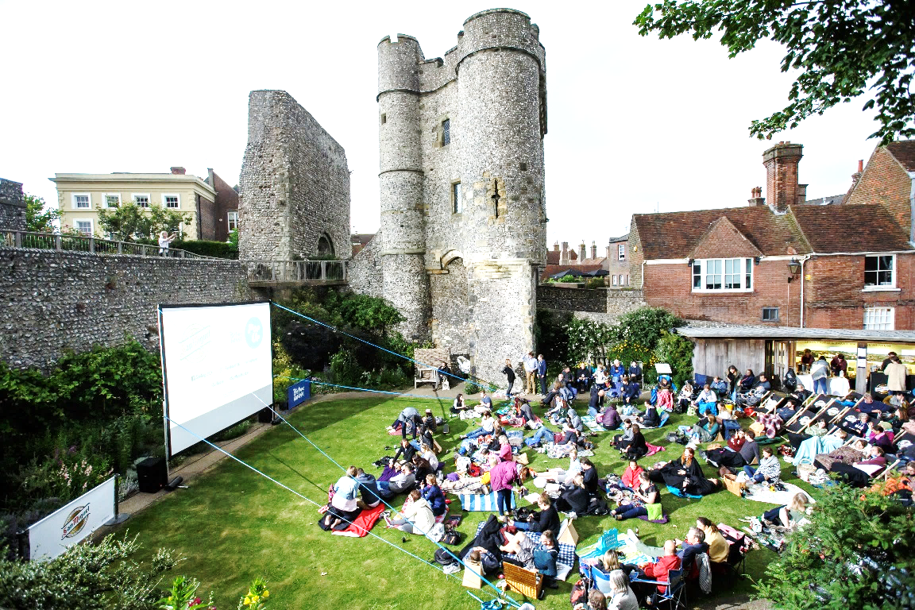
PICTUREHOUSE POP-UPS
Movies under moonlight
Returning for 2019, the Picturehouse Pop Up Season is back to deliver incredible cinematic experiences in some of the most striking, beautiful and unlikely cinema locations the UK has to offer.
In 15+ sites all over the country, the Picturehouse Team will be taking advantage of the glorious British summer to stage one-of-a kind cinema screening events for audiences to remember and talk about for the rest of the year.
In 2019, Picturehouse Pop Ups will be even bigger and better than before, creating an opportunity for a Headline Brand to own these incredible cinema moments.
Notes:
The line underneath the header should be 0.50cm away from the header
The sub header should line with the top of the image box
The copy should then be 1cm away from the sub header

Slide 4
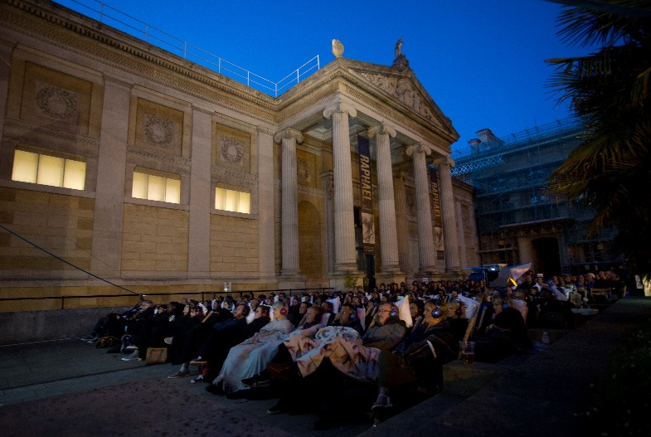
Working together
Placing brands at the centre
Picturehouse is the UK’s most popular boutique cinema chain, trusted by over 3m people each year to curate the best and most anticipated film content in it’s equally stunning cinema locations.
In 2019, both Picturehouse and the dedicated DCM Events Team want to make the summer pop up season BIGGER & BETTER than ever.
We want to deliver unique and memorable cinema events that will be talked for the rest of the year.
Both DCM and Picturehouse are looking to work together with a headline brand, interpreting a strong brief to create incredible themes and deliver a strong brand message within the already much loved Picturehouse Pop Up framework.
Notes:
The line underneath the header should be 0.50cm away from the header
The sub header should align with the top of the picture and the body copy should be 1cm beneath the sub header

Slide 5
Who and where
The Roadshow Route
Liverpool
York
Edinburgh
Stratford-Upon-Avon
Bath
Brighton
Henley-On-Thames
Oxford
Southampton
Brighton
Norwich
Henley-On-Thames
York
Norwich
Bromley
Exeter
Picturehouse Pop-Up Roadshow
The Picturehouse Audience
Upmarket cinema…
82% ABC1s
Generation Y cinema…
58% aged 25-34
Even gender split.
Big spenders…
15% over £75k HH income.
Notes:
The line underneath the header should be 0.50cm away from the header
The sub header is 0.50cm beneath the line
The copy should then be 1cm away from the sub header

Slide 6
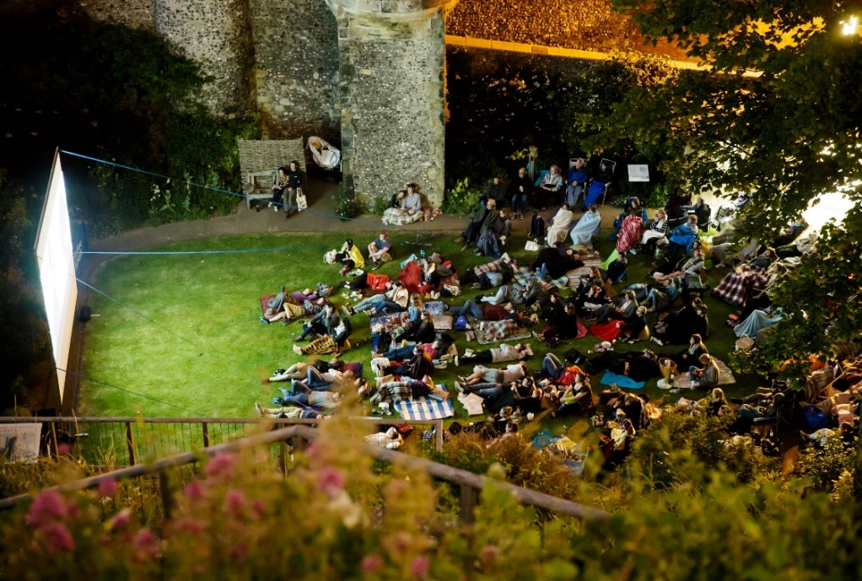
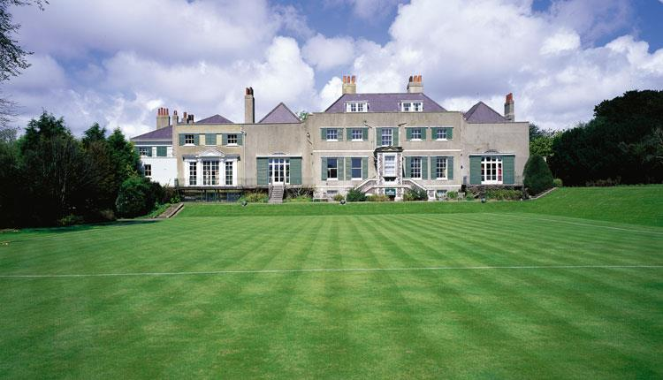
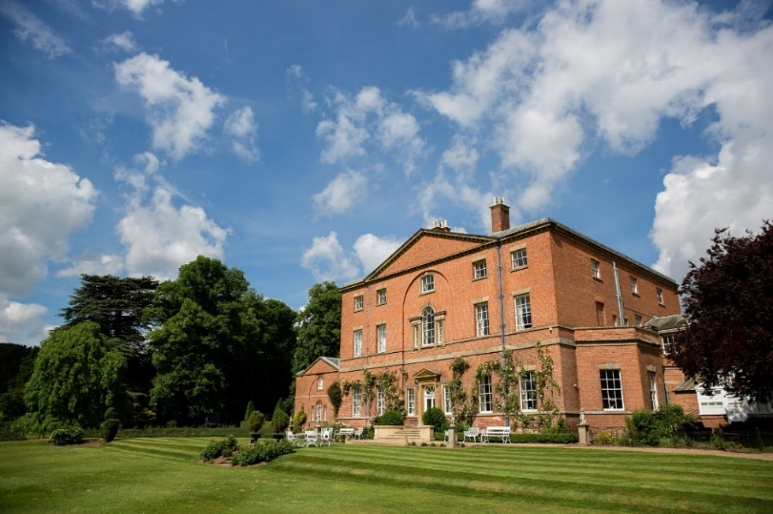
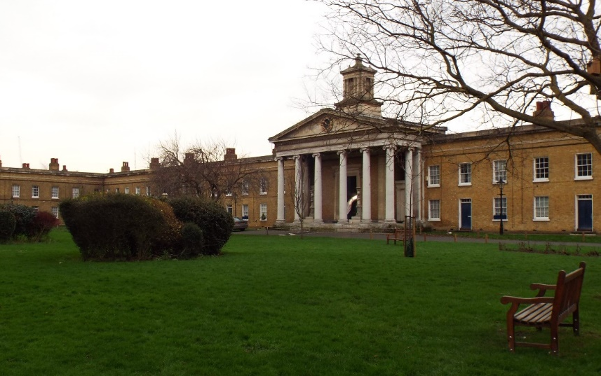
Venue imagery
Picturehouse Pop-Up Roadshow – Example Venues
Notes:
The line underneath the header should be 0.50cm away from the header
The sub header is 0.50cm beneath the line
The copy should then be 1cm away from the sub header

Slide 7
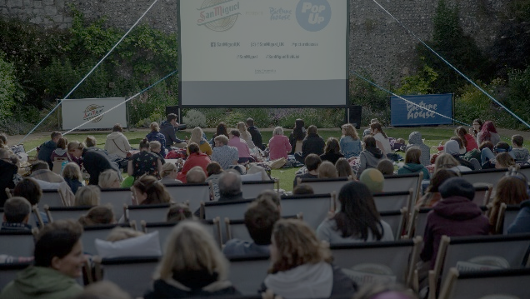
THE PACKAGE
Notes:
All elements on this page (not including the logo) need to be 1cm apart

Slide 8
The package
ON-SCREEN
IN-FOYER
ONLINE
Up to 4 minutes on screen at the screenings
Co-Branded trailer, running in premium position during Picturehouses marketing reel to promote the screenings
Posters promoting the Pop Ups in all Picturehouses across the country
Branding across dedicated Pop Up webpage
Co-branding inclusion in Picturehouses weekly newsletter
Social amplification via Facebook and Twitter
Notes:
The line underneath the header should be 0.50cm away from the header
The sub header is 0.50cm beneath the line
The copy should then be 1cm away from the sub header

Slide 9
At the events
Create an experience
The sponsor of Picturehouse Pop Ups has free reign to use the events as a platform to showcase experiential ideas.
DCM Studios will collaborate with Agency and Client to ensure we create the very best ideas on a brief-by-brief basis!
Alongside any activation brands can also have:
Bar Stocking Rights
Branded seats, blankets, cushions etc.
Sampling
Lets get creative!
Notes:
The line underneath the header should be 0.50cm away from the header
The sub header is 0.50cm beneath the line
The copy should then be 1cm away from the sub header

Slide 10
THANK YOU
Contact your DCM rep for more information

