Slide 1
PICTUREHOUSE
LEAD CATEGORY PARTNER 2021
Notes:
All elements on this page (not including the logo) need to be 1cm apart

Slide 2
PICTUREHOUSE LEAD PARTNERS
Drive brand affinity with a long term partnership at the UK’s most established boutique cinema chain.
The Picturehouse brand was founded in 1989 on a passion for great film coupled with a desire to deliver an unrivalled boutique cinema experience to customers. It has grown to become a nationally recognised and much-loved exhibition brand – boasting circa 150,000 paid up Members and over 25 sites around the UK.
The brand has consistently delivered a unique experience to its customers, from expert film curation played out in beautifully decorated venues to previews, star-studded Q&As, outdoor cinema offerings and the annual hosting of Sundance London – the UK’s biggest celebration of independent film.
Since Cineworld’s acquisition in 2012, the brand has managed to accelerate growth whilst retaining the quirky charm that made customers fall in in love with Picturehouse in the first place. After 30 years, Picturehouse balances the best of both worlds; possessing the technical expertise of a multiplex and the charm of an independent.
Beyond Sundance, the brand maintains its commitment to expertise and curation of independent film through its own distribution arm Picturehouse Entertainment (God’s Own Country, A Ghost Story) as well as a number of well-subscribed film strands designed for customers to enjoy seasons of cult classics and recently unearthed gems.
Following a logo rebrand in 2018, expansion and the latest new opening in London’s Fulham Road – there has never been a better time to partner with the UK’s most established boutique cinema exhibitor.
Notes:
The line underneath the header should be 0.50cm away from the header
The sub header is 0.50cm beneath the line
The copy should then be 1cm away from the sub header

Slide 3
BECOME SYNONYMOUS WITH THE PICTUREHOUSE EXPERIENCE
Notes:
The line should be 1cm below the statement text and never placed above the statement text

Slide 4
The Picturehouse experience
An essential part of the high street…
Community-centric venues
A complete social experience
Quality content for a discerning audience
Notes:
The line underneath the header should be 0.50cm away from the header
The sub header is 0.50cm beneath the line
Copy should be 0.50cm away from images

Slide 5
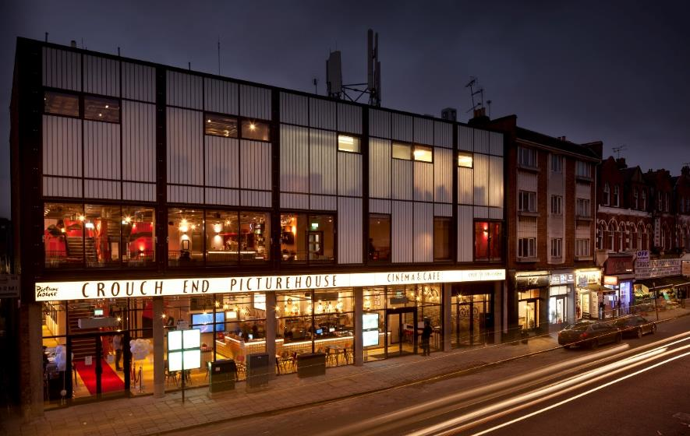
architecturally unique venues
A mix of classic and modern architectural beauty
Notes:
Several cinemas have celebrated their 100th birthdays – inhabiting classic buildings and stunning new buildings

Slide 6
At the heart of the community
Picturehouse look to open cinemas in the heart of communities that have previously been underserved by what they believe they can bring to the local area.
Brixton
Personalised messages, monthly film quiz, DJs, yoga and Disney Karaoke!
Hackney
Life drawing, documentary festivals and Black History Studies events
York
Comedy club, spoken word shows and record fairs
Notes:
The line underneath the header should be 0.50cm away from the header
The sub header is 0.50cm beneath the line
Copy should be 0.50cm away from images

Slide 7
Independent Cinema is Thriving
We are in the midst of unprecedented growth in the independent cinema sector
“Independent cinemas are broadening what they offer and
taking a more ­fundamental role in communities”
Ben Luxford, British Film Institute (BFI)
“Indie ­theatres are the new big thing. It’s looking like a new golden age”
Nada Farhoud, The Mirror
“Independent cinema has never known a time like it…reinventing themselves as the new entertainment hubs on the high street”
Rob Walker, The Guardian
Notes:
The line underneath the header should be 0.50cm away from the header
The sub header is 0.50cm beneath the line
Copy should be 0.50cm away from images

Slide 8
A NATIONAL FOOTPRINT
LONDON
REGIONAL
BRIXTON
BROMLEY
CENTRAL
CLAPHAM
CROUCH END
EAST DULWICH
FULHAM ROAD
GREENWICH
HACKNEY
HENLEY-ON-THAMES
NOTTING HILL
STRATFORD
WEST NORWOOD
ASHFORD
BATH
BRADFORD
BRIGHTON – DUKE OF YORK’S
BRIGHTON – KOMEDIA
CAMBRIDGE
EDINBURGH
EXETER
LIVERPOOL
NORWICH
OXFORD
SOUTHAMPTON
STRATFORD-UPON-AVON
YORK
Notes:
The line underneath the header should be 0.50cm away from the header
The sub header is 0.50cm beneath the line
The copy should then be 1cm away from the sub header

Slide 9
PICTUREHOUSE: GROWN UP CINEMA
Going to a Picturehouse isn’t just about the film for its customers, it’s about the whole experience
The majority of Picturehouse venues have bars and cafes/restaurants making cinema a true social destination – in fact they sell more beer and wine than popcorn!
Picturehouse cinemagoers love film but going to one of its cinemas isn’t just about the film – they go for the experience and the environment. It’s a chance to enjoy a complete night out in one location.
It’s this experience that’s led to c.150,000 people becoming Picturehouse Members – giving them access to preview events, priority booking and food/drinks discounts in cinema and with local partners
Notes:
The line underneath the header should be 0.50cm away from the header
The sub header is 0.50cm beneath the line
The copy should then be 1cm away from the sub header

Slide 10
Picturehouse cater for everyone
Each Picturehouse venue runs bespoke programming that caters for all ages and strives to make cinemagoing as accessible as possible for everyone.
Notes:
The line underneath the header should be 0.50cm away from the header
The sub header should line with the top of the image box
The copy should then be 1cm away from the sub header

Slide 11
THE PICTUREHOUSE AUDIENCE
LOYAL, DISCERNING,
AFFLUENT, ENGAGED
Notes:
All elements on this page (not including the logo) should be 1cm away from each other

Slide 12
THE PICTUREHOUSE AUDIENCE
Demographics
Lifestyle
Media habits
A highly affluent younger-skewing audience
Discerning and engaged
Seeking interesting & premium content
 | Regular Picturehouse cinemagoer | GB Profile
15-34 | 42% | 31%
35-54 | 28% | 32%
55+ | 31% | 38%
ABC1 | 75% | 56%
> £50k | 26% | 16%
I pay attention to where the products I purchase are made/grown (Index: 161)
I would be prepared to pay more for environmentally friendly products (Index: 155)
Have visited art gallery, museum or theatre in last 12 months (Index: 214)
Source: TGI GB 2021 March (February 2020 - January 2021)
Picturehouse = Cinema most visited often
Index vs. average GB adult

Slide 13
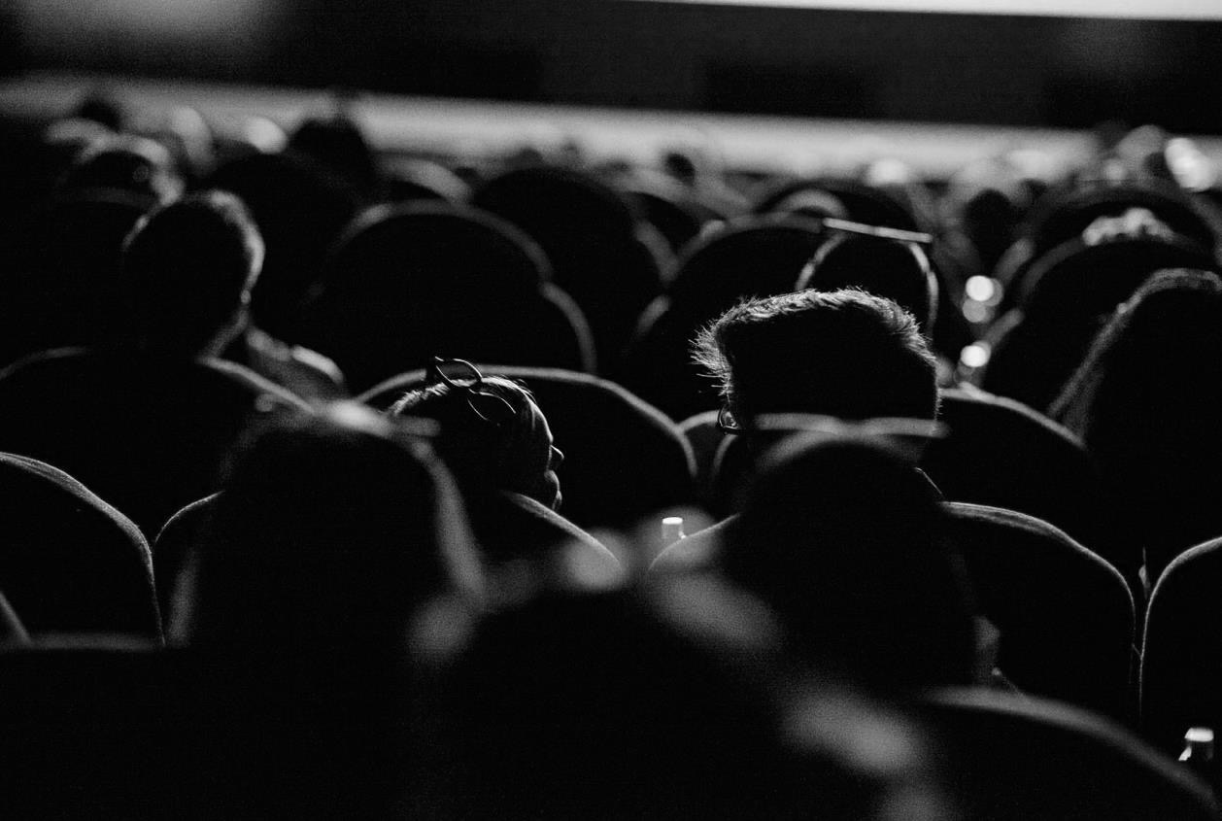
The Picturehouse audience
Lifestyle and attitude breakdown
Affluent, upmarket audience
39% AB / 66% ABC1
19% Senior director/Professional
(e.g. doctor/solicitor) (Index: 146)
10% Household income >£100k (Index: 223)
37% 15-34
28% 35-54
35% 55+
Progressive & ethically minded
Want to know where products are sourced, concerned about climate change and
prepared to make lifestyle comprises
to benefit the environment
At key points in their life¹
Buy a house/flat (13%, 183)
Change jobs/career (17%, 138)
Well travelled
53% are passionate about travelling (111)
76% plan on holiday/a short break in next 12 months. (120)
Love the arts and culture²
32% regularly visit a museum (277)
24% regularly visit the theatre (224)
25% regularly visit an art gallery (348)
Love a good tipple!
45% say it’s worth paying more for good quality beer (110)
…and 42% feel the same about a quality wine! (115)
Source: IPA TouchPoints 2020
Target: Visited Picturehouse in last 12 months
1: Life event planned in next 12 months. 2: at least once every 3 months
Notes:
The line underneath the header should be 0.50cm away from the header
The sub header should line with the top of the image box
The copy should then be 1cm away from the sub header

Slide 14
PICTUREHOUSE AUDIENCE & ALCOHOL
48% of Picturehouse cinemagoers drink alcohol
once a week or more
- 3% more likely than the average UK adult
28% of Picturehouse cinemagoers visit a pub or bar
once a week or more
- 66% more likely than the average UK adult
‘I like to try new drinks’
^{(Index: 108)}
‘It is worth paying more for
high quality beer’
^{(Index: 110)}
‘I pay more for good quality wine’
^{(Index: 115)}
Picturehouse cinemagoers are more likely
to be craft ale or lager drinkers
^{(Index: 106)}
Picturehouse cinemagoers are more likely to
Be gin drinkers vs the average UK adult.
^{(Index: 101)}
Source: IPA TouchPoints 2020
Target: Visited Picturehouse in last 12 months
1: Life event planned in next 12 months. 2: at least once every 3 months

Slide 15
PACKAGE BREAKDOWN

Slide 16
PACKAGE ASSETS
LEAD CATEGORY PARTNER
OFF SCREEN ASSET EXAMPLES
As an exclusive category partner, Picturehouse will work with your brand to create a unique and memorable long term partnership that offers both the brand and its customers special access to the UK
As well as placing your brand ad in reel across the estate, DCM Studios will work closely with you to create bespoke ideas that deliver on a brand strategy and goals.
Online
Co-branded assets across Picturehouse online channels including CRM email marketing web banners, social
Foyer
Sampling opportunity at bars, restaurants or a the foyer. Designed to develop integration with the brand and Picturehouse, as well as putting product in hand
Digital screen activity at Picturehouse Central and further digital sites.
Inclusion in Picturehouse Recommends Magazine
Added Value
4 x private screen hires to entertain employees, influencers or engage Picturehouse customers with free film screenings.
50 x comp tickets per month for employees or influencers to attend Picturehouse and sample the best in cinema for themselves!
Notes:
The line underneath the header should be 0.50cm away from the header
The sub header is 0.50cm beneath the line
The copy should then be 1cm away from the sub header

Slide 17
ACTIVATION OPPORTUNITIES

Slide 18
Picturehouse RECOMMENDS
A unique opportunity to align your brand with premium film.
Each month, the Picturehouse Team selects a few of the films they are most excited or intrigued about, curating these as their ‘Recommends’ strand.
These are given special prominence across Picturehouse’s assets including - uniquely - on screen in amongst their usual reel of trailers played out just before the Gold Spot.
A partner brand would have the opportunity to place 2 x 5” bumpers either end of the Picturehouse Recommends trailers creating in conjunction with Picturehouse their own section of the reel aligning the brand with the best the world of film has to offer each month.

Slide 19
THANK YOU!
Notes:
All elements on this page (not including the logo) need to be 1cm apart

Slide 20
LaphroAig – CASE STUDY
Picturehouse Reccomends Partnership 2019
Single Malt Whisky brand, Laphroaig has partnered with Picturehouse Cinemas in a unique collaboration that will bring together the worlds of whisky and cinema.
The campaign encourages people to discuss and share their opinions of the whisky and its unique flavour.
#OpinionsWelcome content will form part of the partnership, with bespoke idents being shown on-screen ahead of Picturehouse members screenings.
A number of on-screen branded advertisements in 60 and 30 second formats will run prior to feature length films.
With Laphroaig stocked across all Picturehouse venues as part of the partnership, bar staff will be trained in Laphroaig, enabling them to create the perfect cocktail for consumers and to educate guests on this famously unique liquid.
There will also be brand inclusion within Picturehouse newsletters and the printed magazine, as well as digital panel support and members content showcasing the partnership on-site.

Slide 21
SPECIAL TASTING EVENT
Members preview
As part of a series of special Laphroaig tasting events held at Picturehouse across the partnership, Picturehouse Central hosted a night of #OpinionsWelcome servings, cocktails and a masterclass of flavour before a free screening of an upcoming film.

