Slide 1
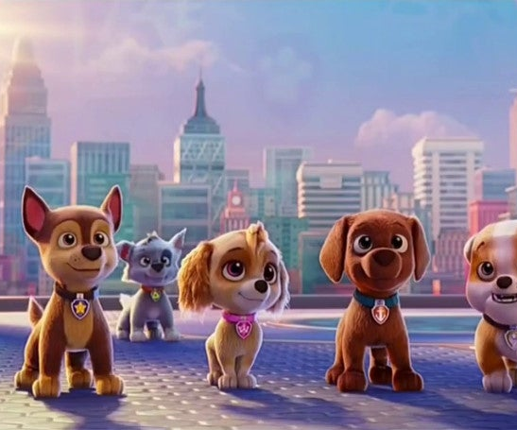
Paw Patrol: The Movie
A television icon goes cinematic!
Release Date
13 August 2021
Cast
Dax Shepard, Randall Park, Kim Kardashian
Director
Cal Brunker (The Nut Job 2: Nutty By Nature)
Recommended if you like
Wonder Park
Reasons to buy into
The Paw Patrol series is an international phenomenon among family audiences, and this big-screen adventure comes packed with an all-star voice cast.
Key audience info
7-15 Children Index: 393
Est. DCM admissions
411k
Ryder and the pups are called to adventure city to stop the bustling metropolis from turning into a state of chaos.
Plan your campaign

