Slide 1
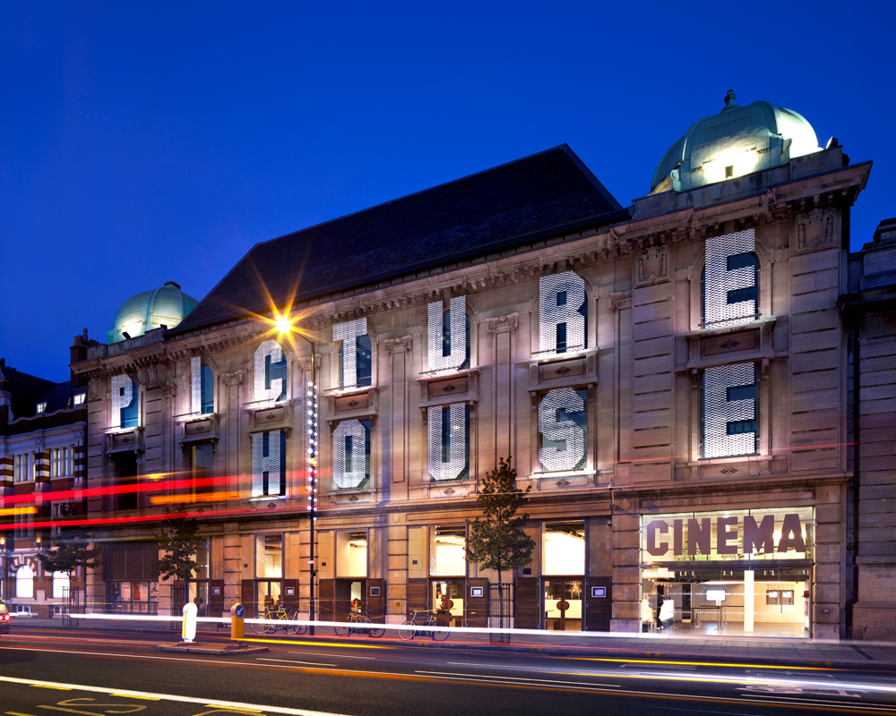
PICTUREHOUSE RECOMMENDS
Become the tastemakers’ tastemaker
What is Recommends?
Picturehouse Recommends is the quarterly film magazine from Picturehouse cinemas. It has a reputation as a stylish, in-depth overview of all upcoming major and arthouse releases, boasting a dedicated readership of 130,000 per quarter, plus a further 200,000 printed in cinemas.
The sponsorship is centred on the magazine, but combines off-screen and online branded assets – as well as opportunities to screen short, branded films – to create a multi-touch point sponsorship, thereby allowing your brand to get in with the most discerning and desirable ABC1 25-44 audience over an extended period.
Why Picturehouse?
Picturehouse is the UK’s leading independent cinema chain. Renowned and revered nationwide, it has become something of a cultural hub in cities across the country, especially for the more discerning, affluent and eclectic film aficionado.
If you want to speak to people who know their stuff and always want to know more (about anything and everything), Picturehouse is the place to do it.
Join the upmarket culture vultures
for an extended stay at the cinema.

Slide 2
PICTUREHOUSE RECOMMENDS
Long-term brand association with independent cinema
Preview Screenings
Once a month, Picturehouse members and Show Film First subscribers have the opportunity to attend free preview screenings of Recommended films. Your brand has the opportunity to be the exclusive on-screen partner for several cutting edge, award nominated or culturally significant short films.
80% of Picturehouse Recommends audience are ABC1 25-44.
6.2 Recommends members visits per year (vs national average of 3).
Investment
Asset | Est. annual Impacts | Gross Value (£)
5” Ident | 3,105,000 | £124,200
60” Ad | 2,846,250 | £455,400
5min solus brand content | 20,040 | £14,028
E-Newsletter x 52 | 373,000 per week | £208,000
Magazine (front cover joint branded logo + double page spread) | 800,000 | £12,826*
Website (MPU & tablet version coverage) | 4,800,000 | £12,826*
1 x Roller banner & 2x counter cards @ Recommends screenings | 20,040 | £68,400
1x Quad for the duration of campaign | 3,105,000 | £98,800
Total | 11,591,330+ | £981,654
On Screen Bespoke 5” on-screen idents book ending Recommends trailers, plus 60” ad before all films (excl kids films) across PH estate. Up to 5 min solus content before preview screenings
Online
Joint branded logo on all Picturehouse Recommends film content on the PH websites, and on the Ipad version of the ‘Recommends’ magazine.
Magazine
Headline sponsorship of the quarterly ‘Recommends’ magazine, including 1x full page spread and joint logo on relevant articles per quarter.
Extras
Foyer POS (counter cards & roller banners) will highlight the sponsorship. Picturehouse will promote the sponsorship through its social media channels, including regular tweets and Facebook updates. Preview screenings brand association.
Annual package investment (inclusive of all production hard costs**):
£280,000
Source: * Based on magazine front cover joint branded logo, double page spread plus MPU online and on tablet version of Recommends. Extended coverage options available at further cost. ** Includes initial production and delivery, then one copy change/refresh. All assets creative subject to cinema approval and restricted by availability.

