Slide 1
Picturehouse kids club
Get in on the family outing
What is the Kids Club?
On Screen
It’s Picturehouse answer to great family outings, with £1.75* tickets to family-themed films to entertain and inspire kids and parents alike. Before the screenings parents can have a natter and a coffee while the kids play.
As the Picturehouse Kids Club is just for families, your family-orientated messages are always 100% on-target, with incredible opportunities to convert morning viewers to afternoon shoppers in the many retail environments around the cinema.
Social
Online
The Partnership Package
The Kids Club takes place at 17 Picturehouse sites, delivering 75,000 admissions a year. Sponsorship gives you:
Branded assets throughout the customer journey to promote the partnership.
The chance to host ‘Fun & Games’ sessions before screenings (board games, toys etc)
Product demonstrations and sampling that integrates the brand into the live experience.
Opportunities for bespoke events and PR opportunities.
Experiential
Posters
Appeal to kids and parents when they’re at their happiest and more receptive – together.
* £2.50 for 3D films

Slide 2
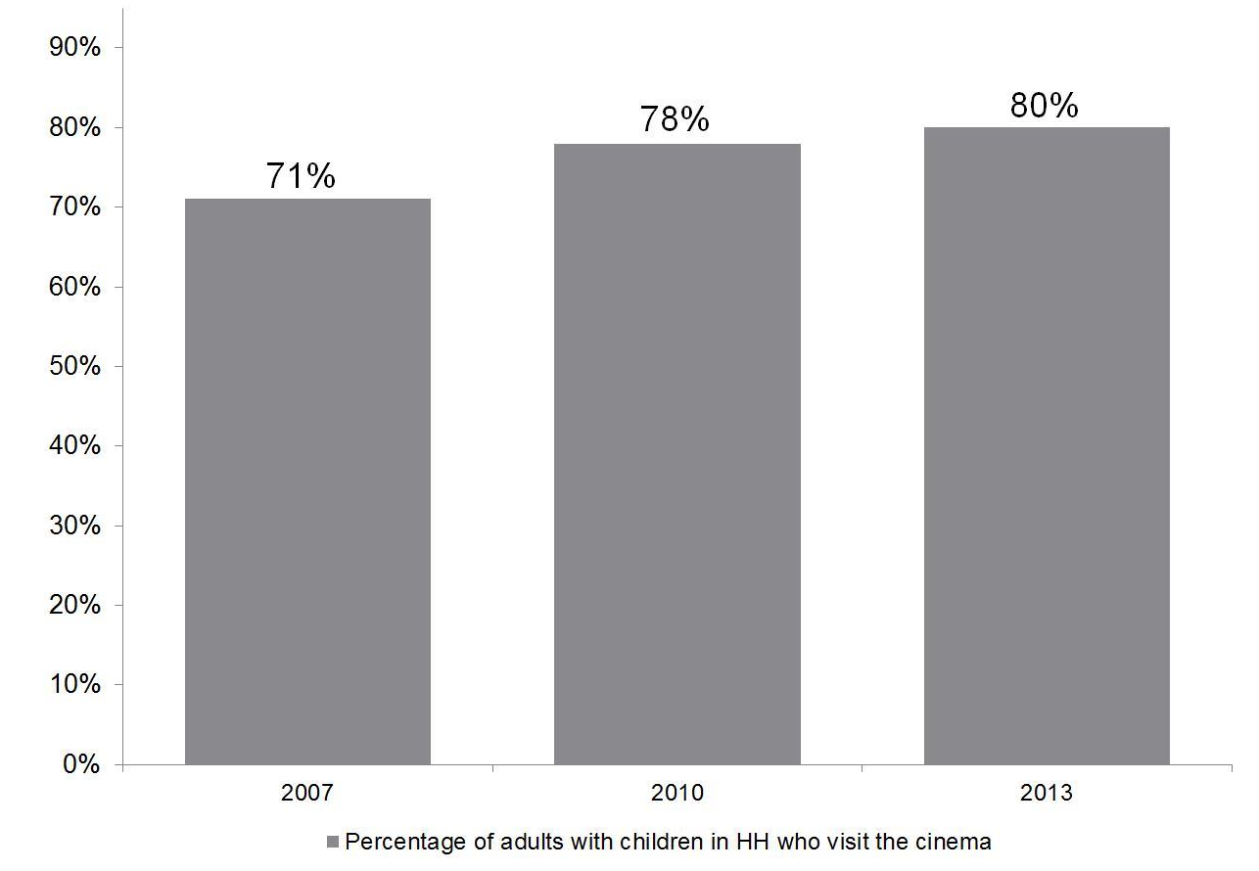
Picturehouse kids club
Reach a valuable parent and child audience
Investment
Asset | Annual OTS Estimate | Value
Up to 4 mins premium positioned brand content before Kids Club screenings | 75,000 | £20,400
30” on-screen trailer with all current release family films | 786,182 | £26,730
Permanent quad poster in foyers for sponsorship duration | 3,105,000 | £176,800
1x roller banners/totems & 2x counter cards during Kids Club screenings | 75,000 | £131,040
Magazine: full page ad x 4 issues | 1,320,000 | £24,000
Website & social | 150,780 | £7,500
E-newsletter x 4 | 1,492,000 | £208,000
Total | 6,253,192 | £834,030
66% of families say “There is no better place to watch films than at the cinema”¹.
3 children per every adult at Kids Club screenings; perfect for utilising ‘pester power’².
Family audiences continue to grow strongly³
Annual package investment (inclusive of all production hard costs*):
£100,000 gross
* Includes initial production and delivery, then one copy change/refresh. All activity is subject to prior approval by Cineworld and restricted by availability. Source: 1&3:FAME 2013 (BASE 11+). Targets adults who went to the cinema with in HH. 2: DCM Movies for Juniors research Q3 2013

