Slide 1
OUTDOOR CINEMA
SUMMER SEASON
In partnership with Picturehouse Cinemas
Notes:
All elements on this page (not including the logo) need to be 1cm apart

Slide 2
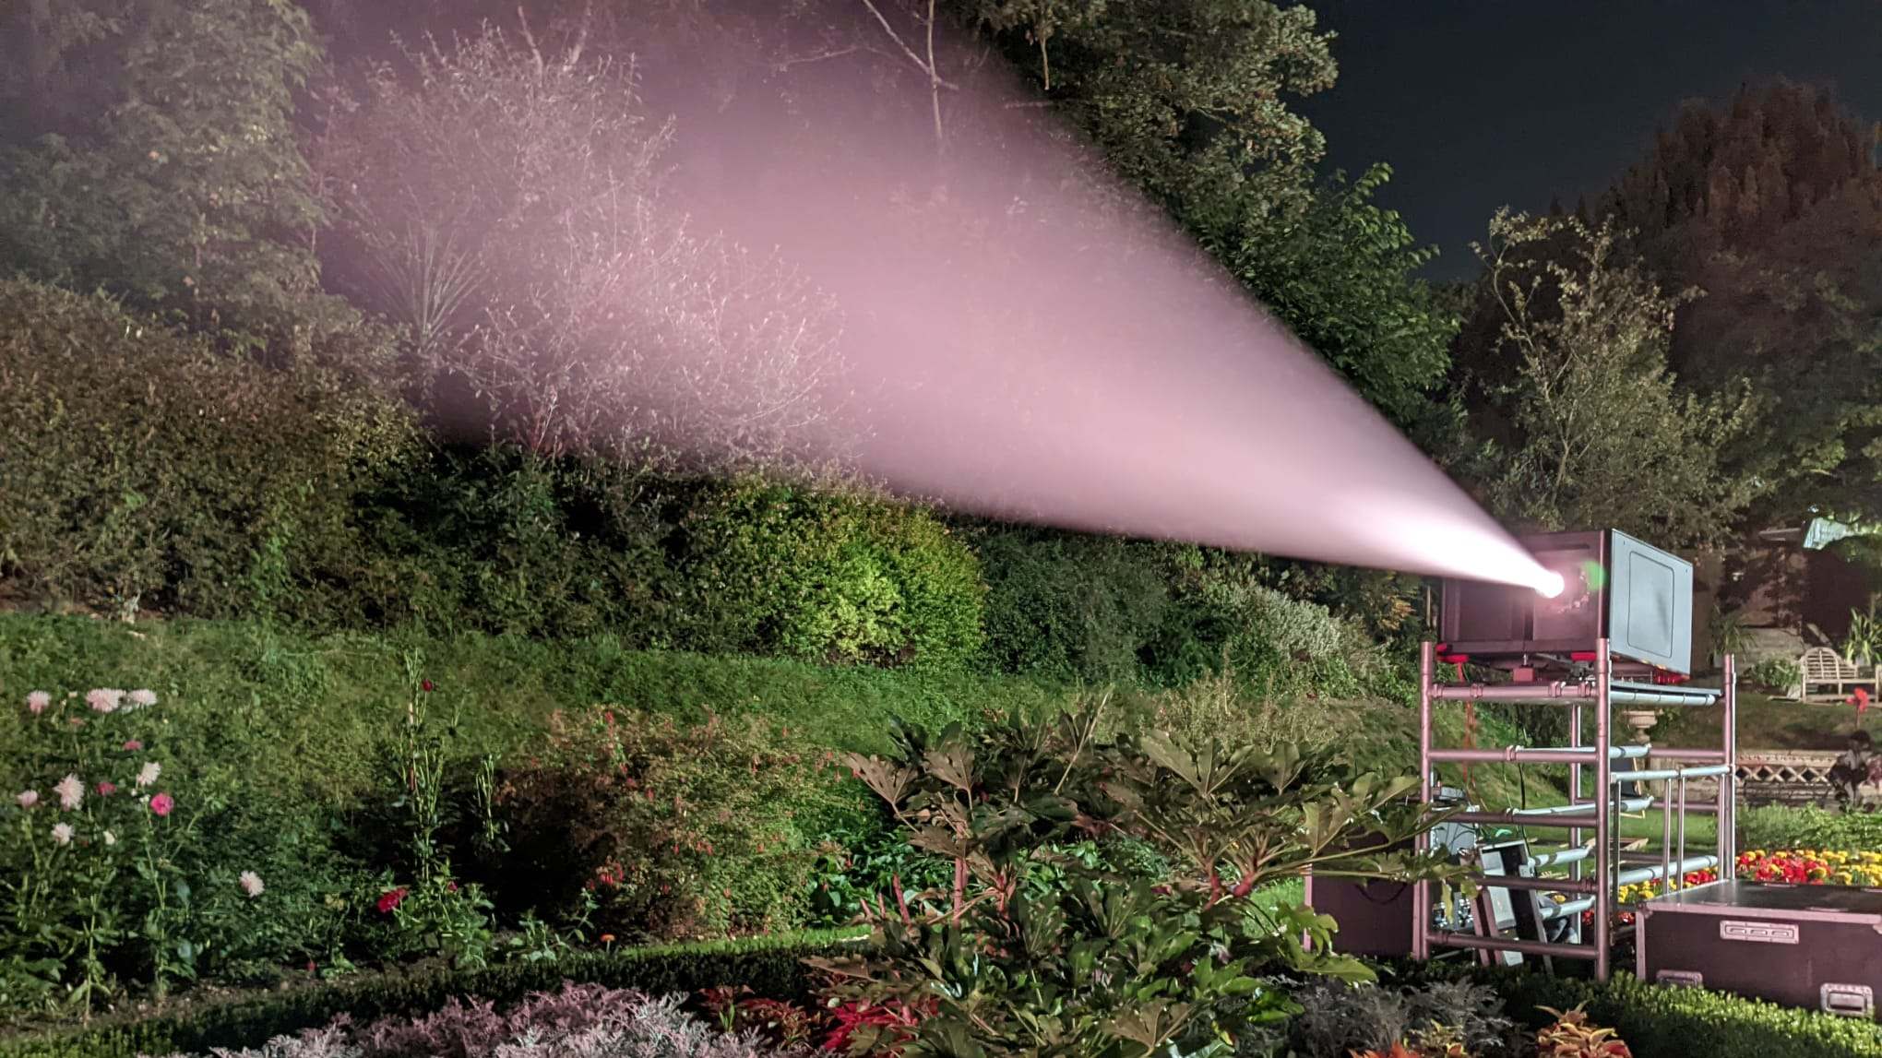
ENGAGE UPMARKET AUDIENCES AND
ALIGN WITH FILM CULTURE THIS SUMMER
THROUGH OUTDOOR CINEMA PACKAGES
TAILORED TO YOUR OBJECTIVES

Slide 3
DISCOVER THE GREAT OPPORTUNITIES AVAILABLE
HEADLINE PARTNER The top brand visibility and immersive branding opportunities. £170K + net (inc. £50K production budget to be allocated)* | SUPPORTING PARTNER High visibility to sit alongside other brands with event and branding opportunities. £110K net (inc. £30K production budget to be allocated) | OFFICIAL FOOD/DRINK PARTNER The official food or drink sponsor to own the space. £55K net (inc. £20K production budget to be allocated) | SAMPLING/SCREENTIME PARTNER Opportunity to sample your brands product across each location. £20k net + stock (Sampling or Screentime only. excludes all off screen media)
*Note that this cost may vary dependent on the brief provided

Slide 4
BECOME THE HEADLINE PARTNER
Top level sponsorship that unlocks exclusivity of this tier.
Partnership Promotion
Package of 30” screentime media to run in reel in Picturehouse cinemas across the summer
Logo inclusion on co-branded Outdoor Cinema Trailer running in premium marketing reel
Co-branded assets across Picturehouse CRM, Display, Social channels
Brand inclusion in press release
Event Presence
Up to 60” screentime media running in the Gold spot ahead of all showings*
Experiential activity
x150 complimentary tickets
920k
ADMISSIONS
7.1m
IMPRESSIONS
*HFSS / Alcohol restrictions apply
Notes:
All elements on this page (not including the logo) need to be 1cm apart

Slide 5
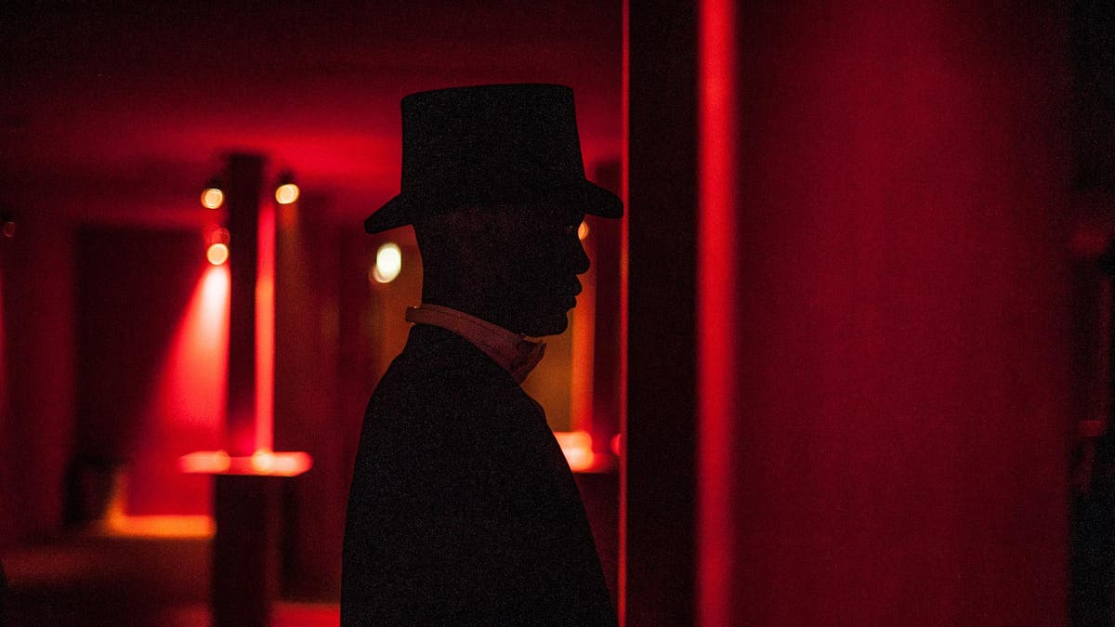
SECRET CINEMA
Secret Cinema is a trusted partner of DCM Studios, specializing in immersive and theatrical experiences.
Through this partnership, each production is one-of-a-kind, and the opportunities
for collaboration are tailored to your needs.
We collaborate with skilled producers and marketers who craft authentic brand experiences.
Our goal is to seamlessly integrate your brand’s values and messaging into the fabric of the show, creating unforgettable moments and unique experiences.
Over the past 17 years, Secret Cinema has brought over 60 stories to life,
captivating more than 1.5 million audience members.
As the headline sponsor, you’ll have the opportunity to partner with Secret Cinema
and create something truly exceptional.
Becoming the headline partner unlocks the opportunity to work with Secret Cinema*
*cost may vary based off the brief
Notes:
All elements on this page (not including the logo) need to be 1cm apart

Slide 6
BECOME THE SUPPORTING PARTNER
High visibility branding and category exclusivity across the summer season:
Partnership Promotion
Package of 30” screentime media to run in reel in Picturehouse cinemas across the summer
Logo inclusion on co-branded Outdoor Cinema Trailer running in premium marketing reel
Co-branded assets across Picturehouse CRM, Display, Social channels
Brand inclusion in press release
Event Presence
Up to 60” screentime media running in a Premium position ahead of all showings*
Activation and sampling opportunities across the event season
x110 complimentary tickets
675k
ADMISSIONS
6m
IMPRESSIONS
*HFSS / Alcohol restrictions apply

Slide 7
BECOME THE OFFICIAL FOOD/DRINKS PARTNER
The official food / drinks partner across the summer season:
Partnership Promotion
Logo inclusion on co-branded Outdoor Cinema Trailer running in premium marketing reel
Co-branded assets across Picturehouse CRM, Display, Social channels
Event Presence
30” screentime media running in reel ahead of all showings*
Activation and sampling opportunities across the event season
75 complimentary tickets
205k
ADMISSIONS
2.5m
IMPRESSIONS
*HFSS / Alcohol restrictions apply
Notes:
All elements on this page (not including the logo) need to be 1cm apart

Slide 8
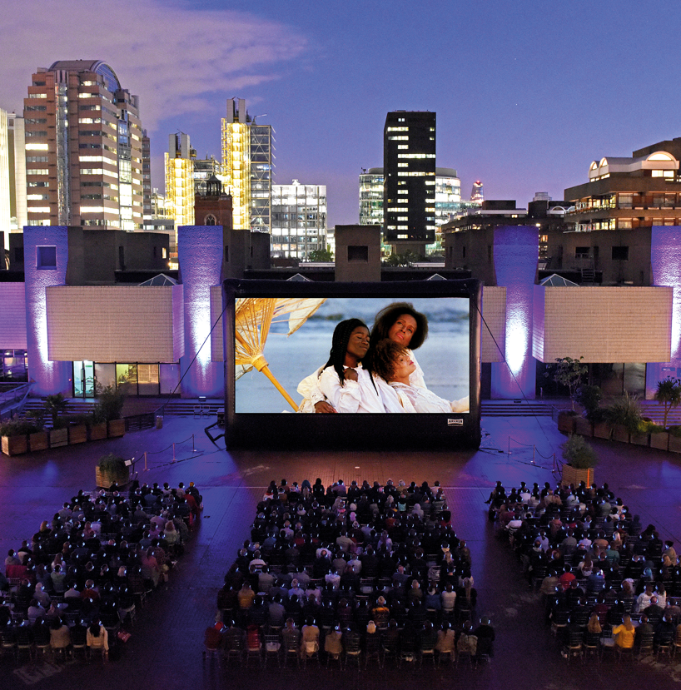
ADDITIONAL OPPORTUNITIES with the barbican
Collaborate with The Barbican to extend your outdoor season.
A truly unique outdoor cinema event attracting over 6,000 people and reaching over 3m at London's iconic Barbican Centre.
Align your band with one of London's Flagship Public Film Events through the delivery of brand marketing assets including prominent brand visibility across the outdoor cinema's marketing campaign.

Slide 9
THE DETAILS
Notes:
All elements on this page (not including the logo) need to be 1cm apart

Slide 10
WHAT FILMS TO EXPECT THIS YEAR
The general programming for 2025 outdoor will include a mixture of recent releases, concert style films and cult--classics. Each genre will take the spotlight each day. There is scope for your brand to have influence on the titles shown.*
*Note that requests for specific film titles are to be approved by Picturehouse, and the brand must be onboard by 1st April. ​

Slide 11
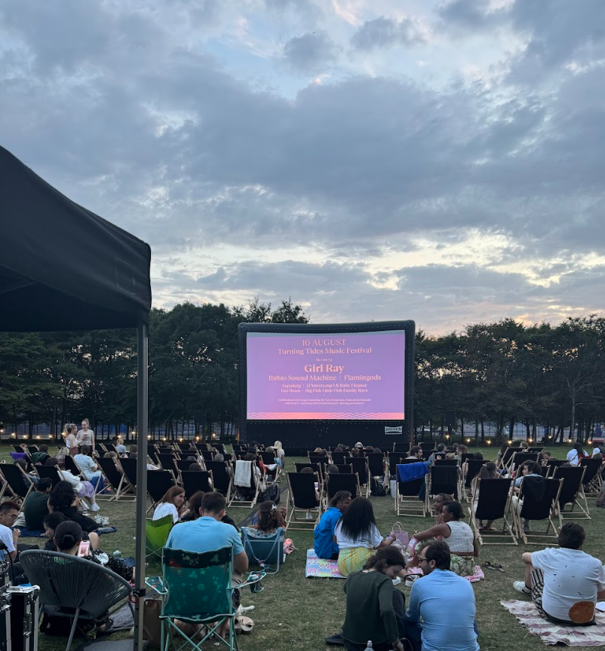
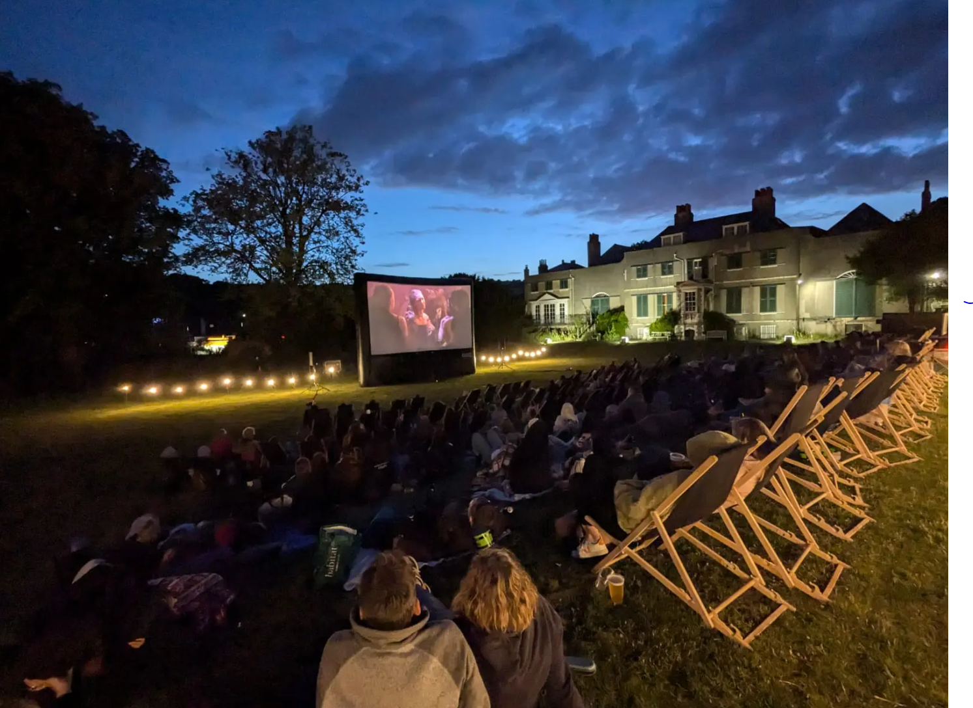
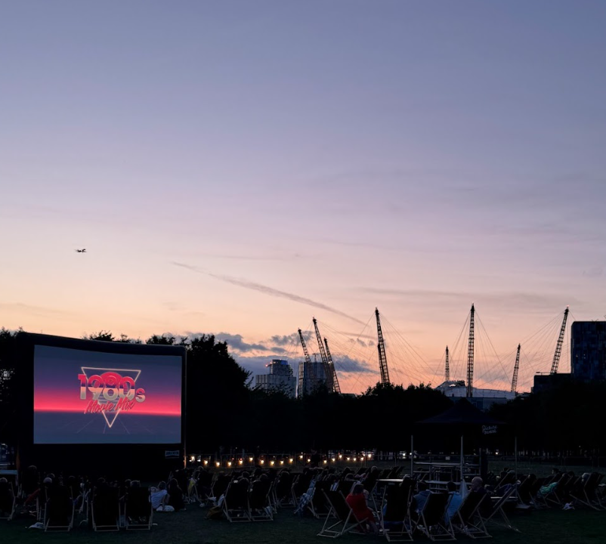
Dates and locations
The season will spread across venues including London Gunnersbury, Brighton Preston Manor, Norwich Plantation Gardens and Greenwich Peninsula.
Dates
20th June – 22nd June
27th June – 29th June
4th July – 6th July
11th July – 13th July
18th July – 20th July
25th July – 27th July
1st August – 3rd August
8th August – 10th August
15th August – 17th August
22nd August – 25th August (4 days)
29th August – 31st August
5th September – 7th September

Slide 12
CASE STUDIES

Slide 13
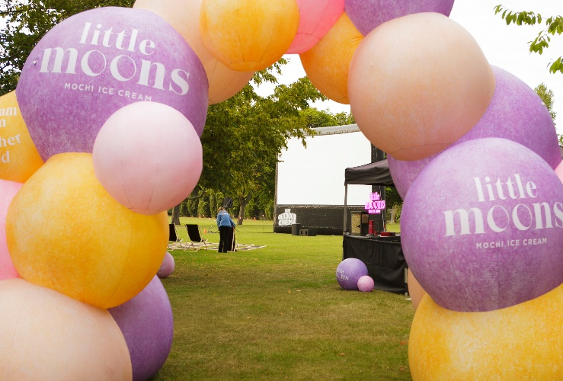
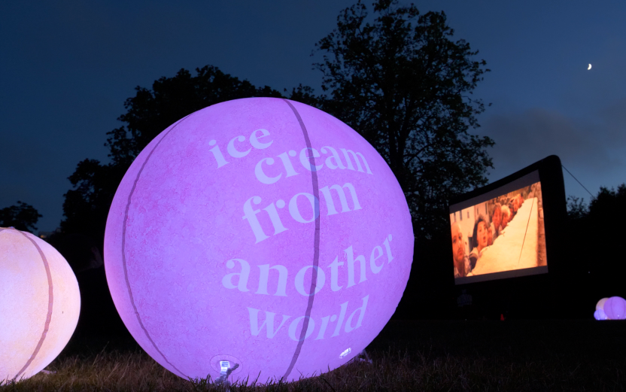
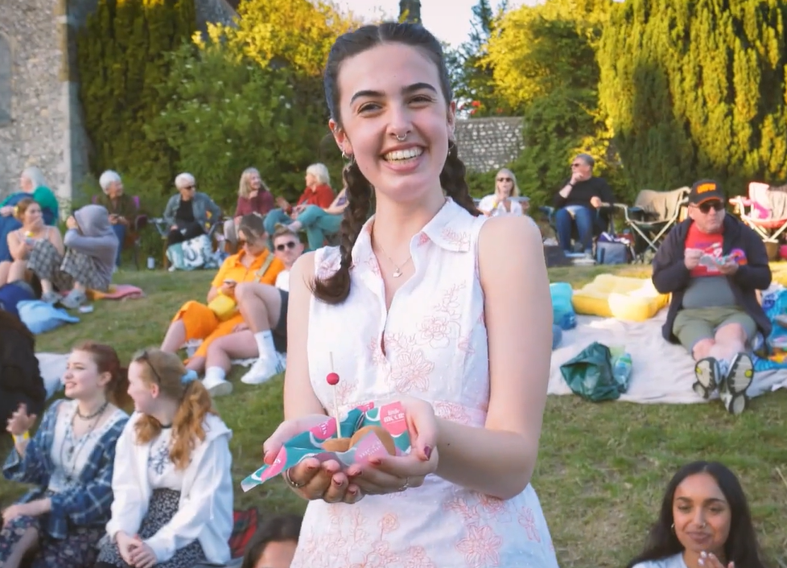
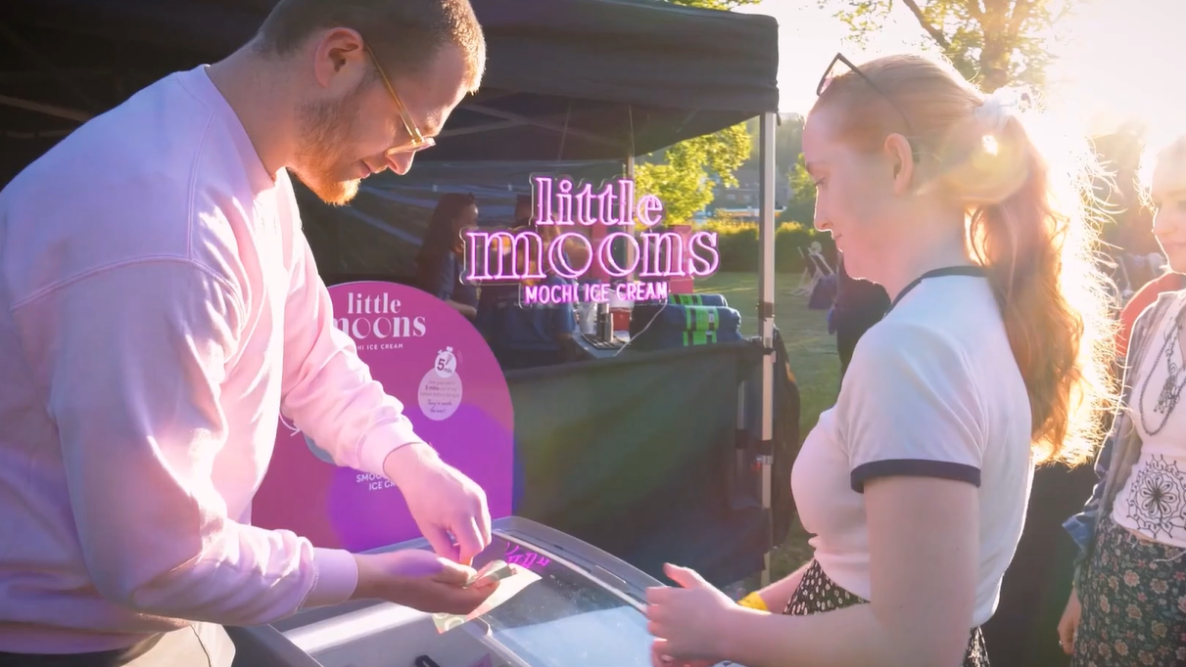
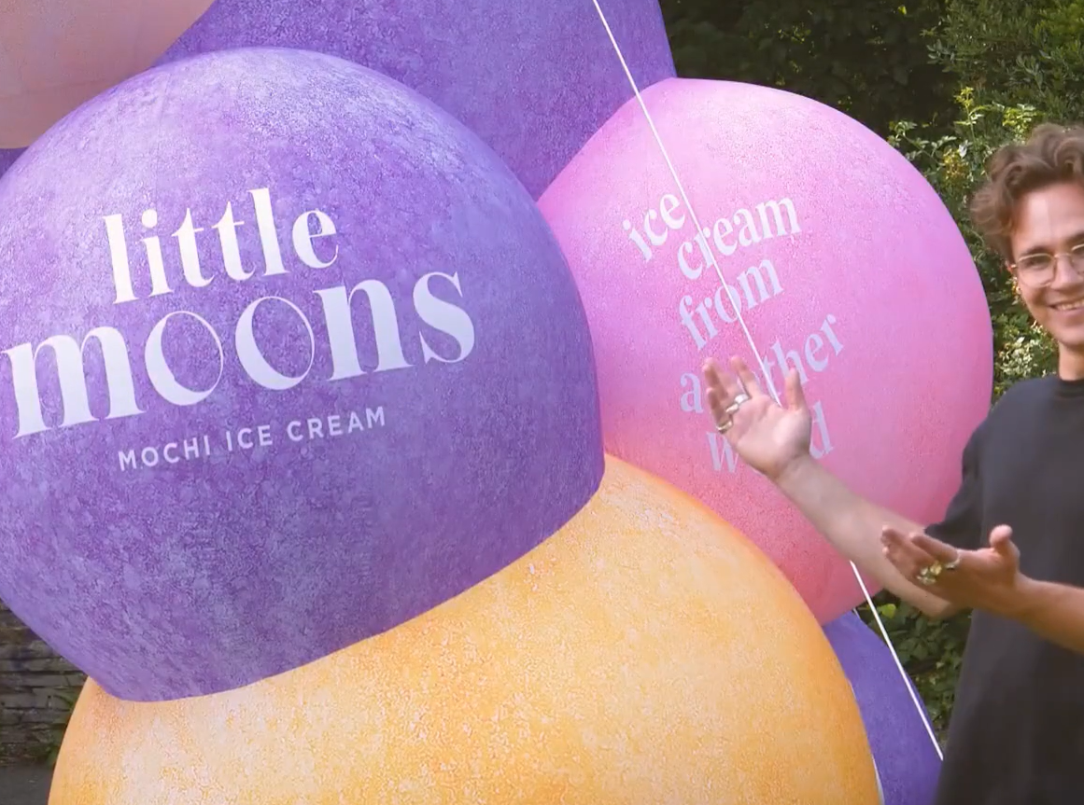
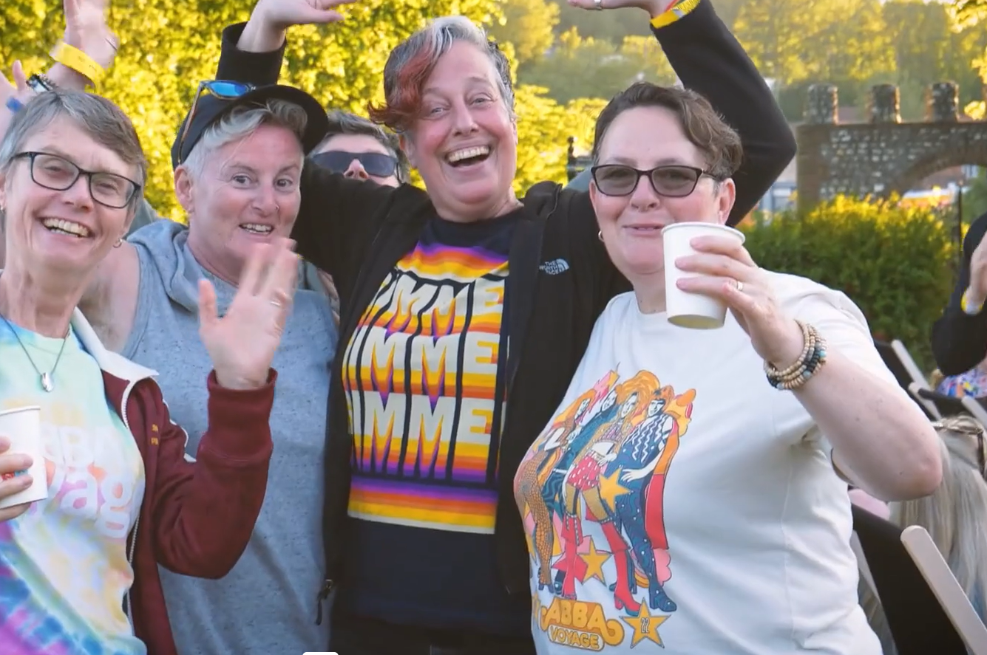
LITTLE MOONS
Background
In partnership with Little Moons and Picturehouse, DCM Studios created a series of outdoor Cinema events which ran across the summer, drawing over 5,000 attendees, called Movies Under the Moonlight.
Idea
Little Moons created a series of interactive pop-up events decorated with branded items. This was supported by a layer of screentime running in Picturehouse cinemas across the summer, showcasing the brand’s 2x 20” hero ads alongside an Outdoor Cinema promotional trailer.

Slide 14
LEFFE
Background
Leffe needed to stand out among the crowd as a premium craft beer and allow guests to taste the product for themselves in an interrupted environment.
Idea
At each event Leffe was paired with fine cheese and cured meats allowing cinemagoers to taste their way through the history of Leffe. Branded Leffe deck chairs, blankets and popcorn boxes added to the cultural experience and ensured the brand was central to the pop-up experience.​
Before the feature film began, audiences were served a Leffe and left to savour the taste, while being shown the 10-minute film, with no distractions.​

Slide 15
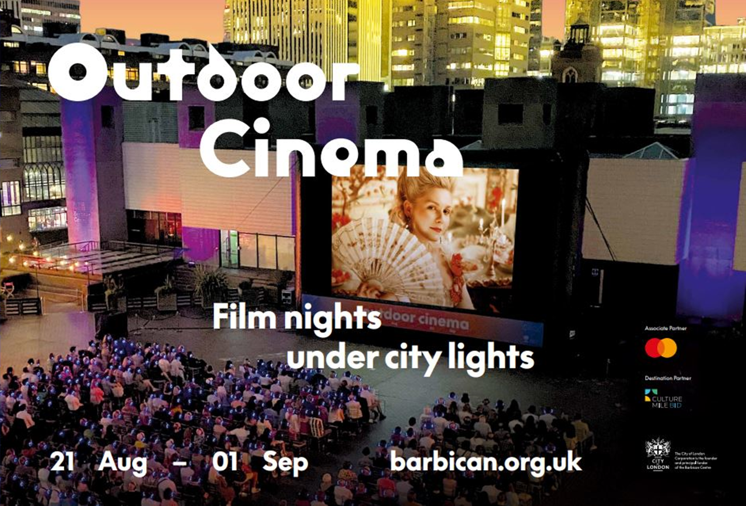
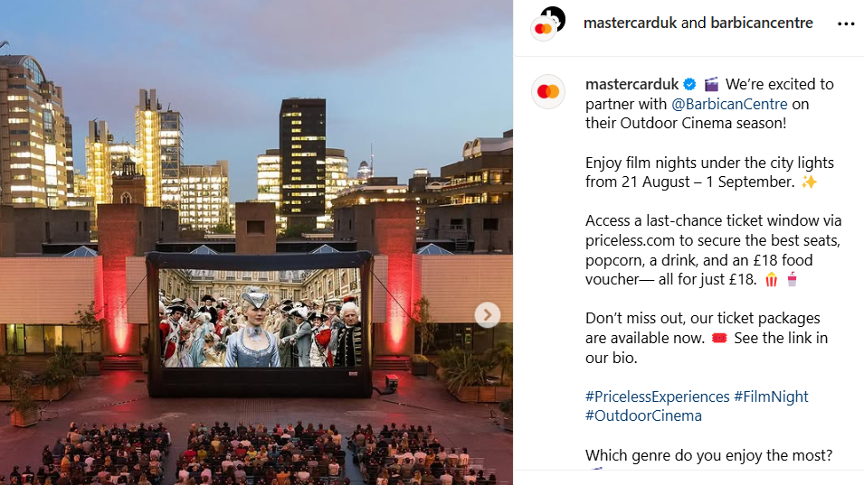
MASTERCARD
Background
We were approached by Mastercard who wanted to engage with an affluent audience through key calendar moments.
Idea
From 10am Monday 20 May until 10am on Thursday 23 May 2024 Mastercard cardholders had access to a presale window to purchase priceless Mastercard ticket packages. The ticket package includes premium seating, a complimentary popcorn, drink, and £18 food voucher to enjoy. Mastercard also sat across all pre-show comms via Barbican’s online assets.

Slide 16
APPENDIX
Notes:
All elements on this page (not including the logo) need to be 1cm apart

Slide 17
THE PICTUREHOUSE AUDIENCE
Demographics
A highly affluent younger-skewing audience
Lifestyle
Discerning and engaged
Media habits
Seeking interesting & premium content
 | Regular Picturehouse cinemagoer | GB Profile
15-34 | 35% | 30%
35-54 | 33% | 31%
55+ | 32% | 38%
ABC1 | 67% | 27%
> £50k | 26% | 17%
I pay attention to where the products I purchase are made/grown (Index: 115)
I would be prepared to pay more for environmentally friendly products (Index: 134)
Have visited music concert or theatre in last 12 months (Index: 226)
Source: GB TGI July 2022 (Jun 2021 – May 2022)
Picturehouse = Cinema most visited often
Index vs. average GB adult

Slide 18
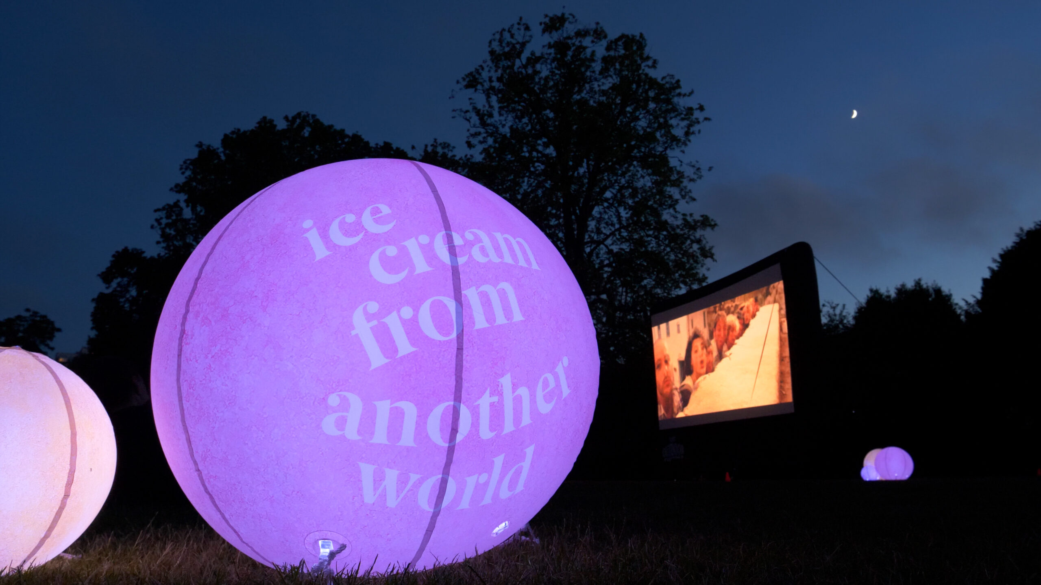
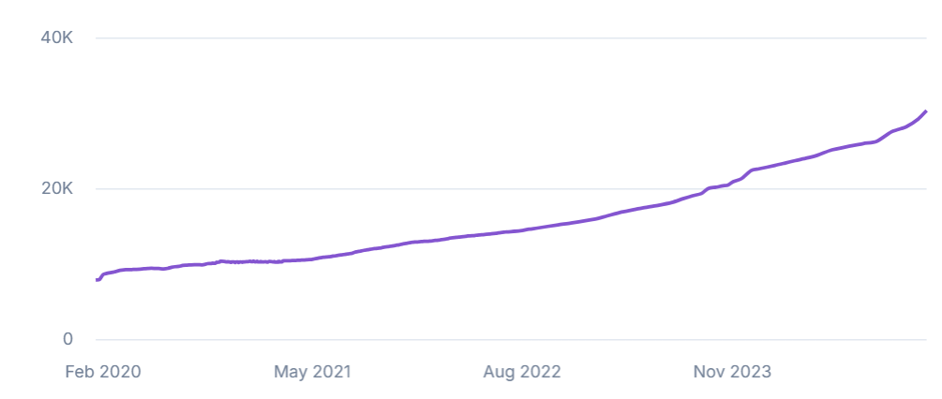
PICTUREHOUSE | INSTAGRAM
30.3k
FOLLOWERS
159
AVERAGE LIKES / POST
3.9k
AVERAGE VIEWS / POST
2.8k
AV. ESTIMATED REACH
@PICTUREHOUSES
ACCOUNT GROWTH RATE (Excellent)
31.59%
Yearly growth rate is significantly higher than the average for similar accounts, which typically grow by 15.59%
Estimated Reach
Post: 1.4k-4.2k Average
Posts are seen by an estimated 9.29% of the account’s followers
Stories: 410-1.2k
Stories are seen by an estimated 2.71% of the account’s followers

Slide 19
THE barbican AUDIENCE
Visitors
High proportion of visitors to the Barbican purchase outdoor tickets
Audience
Highly affluent and intentional
Audience Insights
An engaged audience
Average attendance:
525 seats out of 650 –5 sell out shows
Average of two tickets booked per transaction
30% Barbican first time bookers
28% booked more than one film (20% booked 2)
People book early: 45% of bookers booked up to 5 weeks before each screening
Audience Breakdown
Under 25 | 38%
25-54 | 54%
London Based | 75%
Income £50l+ | 38%
Income £100k+ | 39%
1.5m
Visitors
1m
Ticket Buyers
56% Female
44% Male

