Slide 1
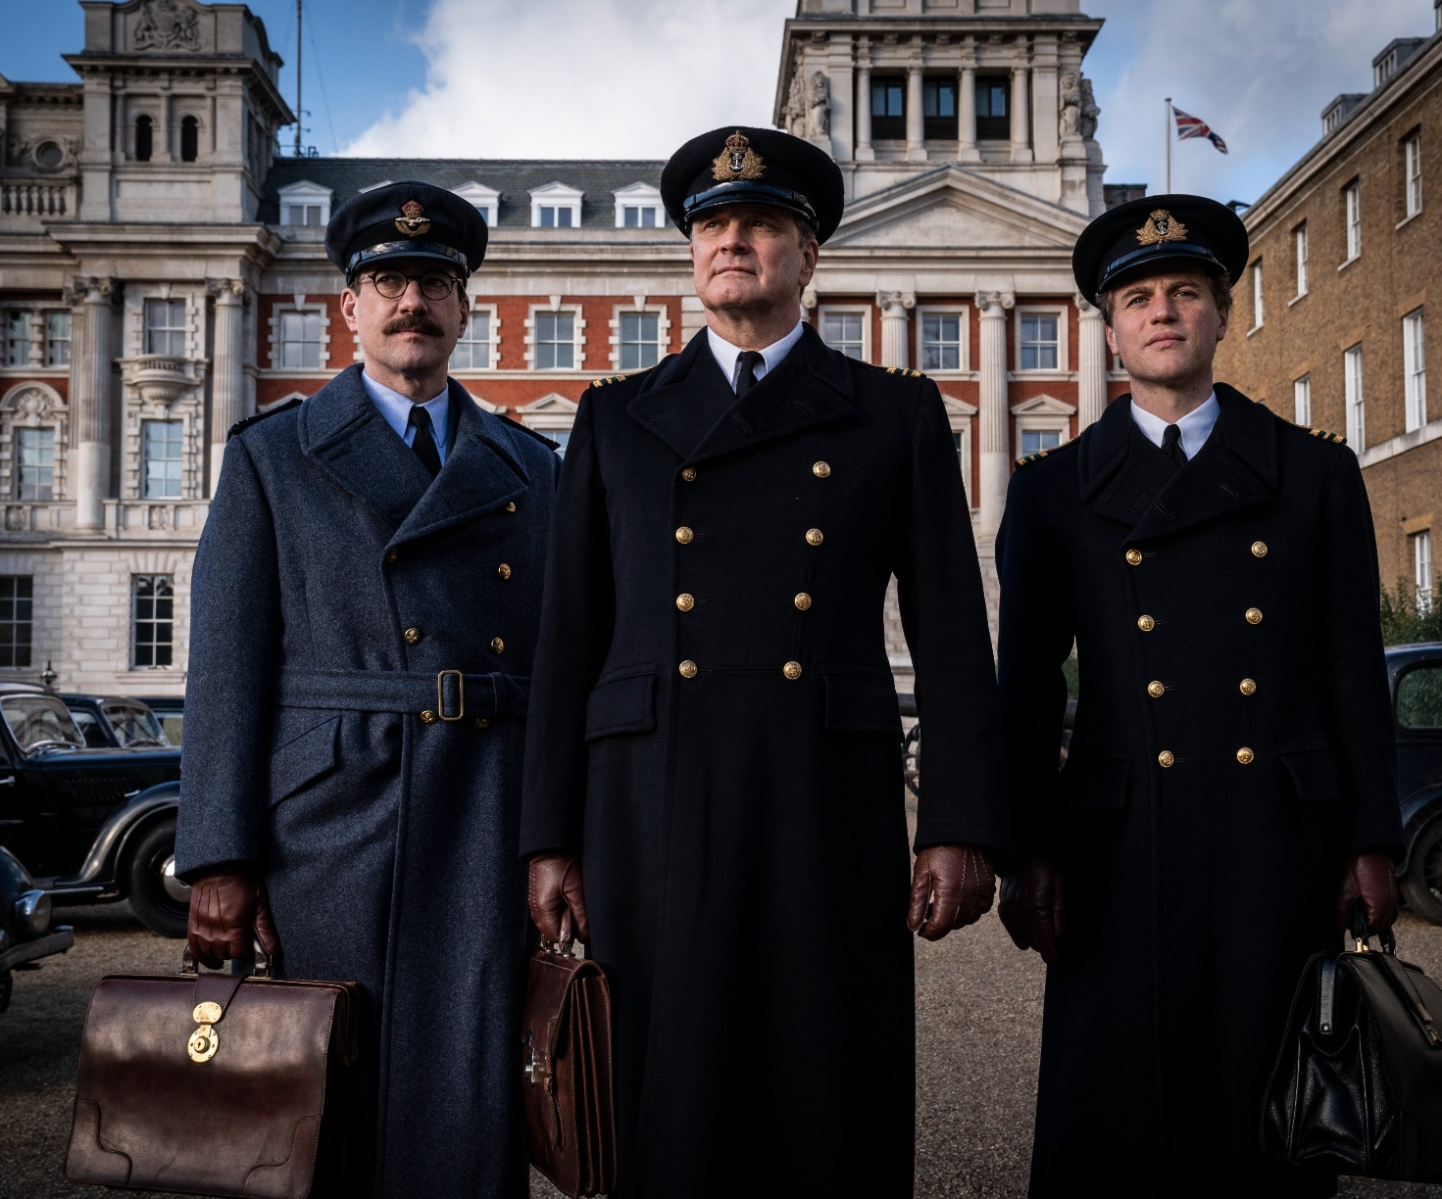
Operation Mincemeat
A very different war story…
Release Date
8 April
Cast
Colin Firth, Matthew Mcfadyen, Kelly Macdonald
Director
John Madden (Miss Sloane)
Recommended if you like
Six Minutes To Midnight
Reasons to buy into
Colin Firth leads a prestige British cast in this unusual but exciting premise, from a director with a big history of major awards (including 7 Oscars for Shakespeare In Love)
Key audience info
ABC1 Adults Index: 158
Est. DCM admissions
1m
During World War 2, two intelligence officers use a corpse and false papers to outwit German troops.
Plan your campaign

