Slide 1
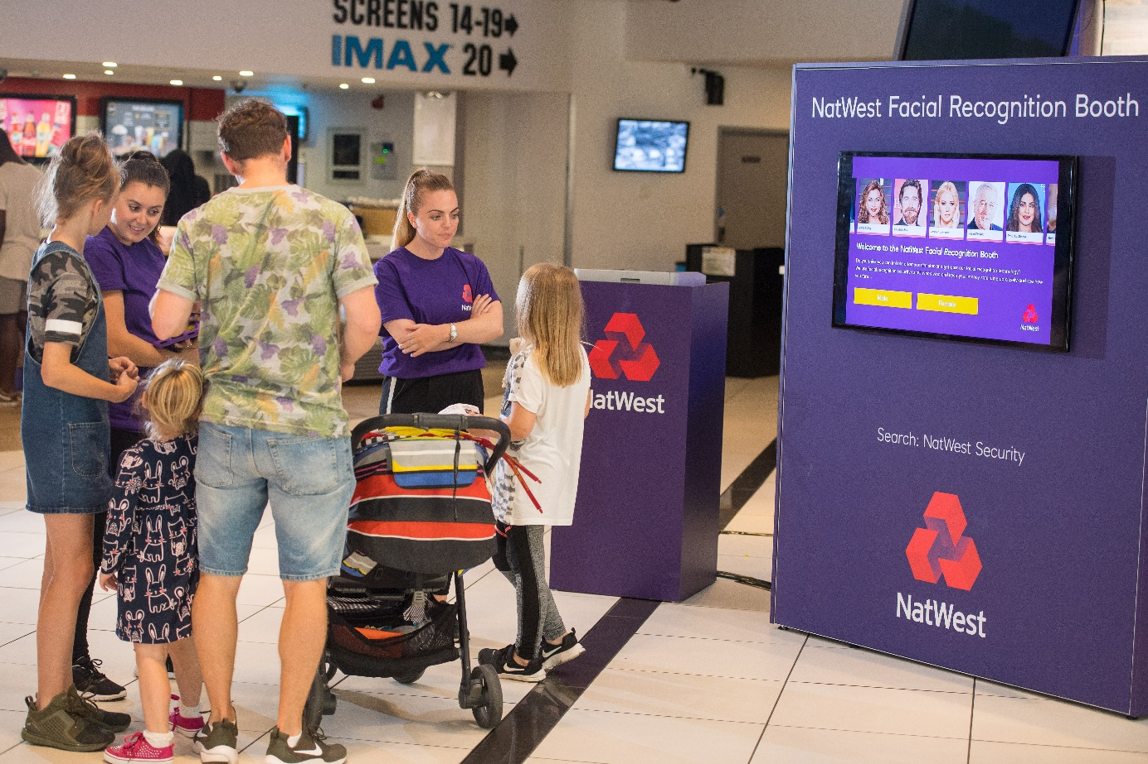
CASE STUDY – Natwest
‘Safety and Security’ - 2018
Background
NatWest wanted to raise awareness of the threats posed by a rapidly changing digital world and how their range of safety and security features help protect its customers and their money.
NatWest knew that its target audience of ambitious 25-54 adults are engaged with the idea of longer-term financial health and are concerned about being a victim of fraud. Bank safety and trust are therefore incredibly important issues for this key audience and NatWest wanted to position itself as the leading technology-led bank.
Idea
NatWest was looking for a media partner to help the bank bring to life this key message in an entertaining and engaging way. Working with DCM Studios, three films across 2018 were identified as perfect fits for the campaign’s themes of safety and security – Ocean’s 8, Mission: Impossible – Fallout and First Man.
Based on iconic imagery / settings from the films DCM Studios created bespoke cinema ads would run in the Silver Spots before each film. The bespoke content would have the look and feel of the films themselves but with a tongue in cheek tone that would help land NatWest’s all-important safety and security credentials.
Each bespoke ad would deliver a different safety and security message – fingerprint log-in and facial recognition for the bank’s mobile app and text alerts when the bank identifies potential suspicious activity.
In addition to the contextually-relevant copy running alongside the three films the ads also ran in a supporting Adult AGP across a broader range of titles to further extend reach of the campaign.
Campaign Details
Sector | Financial | Media Agency | Zenith
Target Audience | 25-54 Adults | Creative Agency | Recipe & DCM
Package | Silver Spots (Ocean’s 8, Mission: Impossible - Fallout, First Man) and Adult AGP | Duration | 40” Silver + 30”

Slide 2
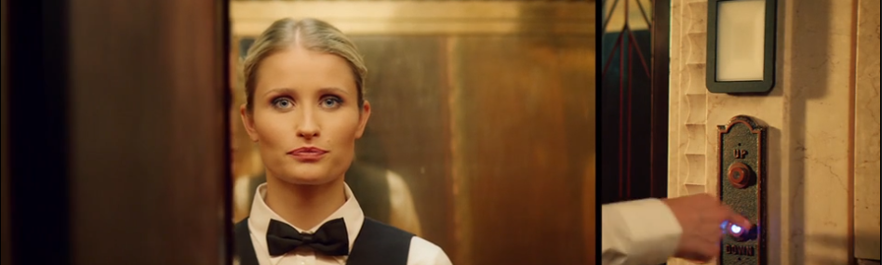
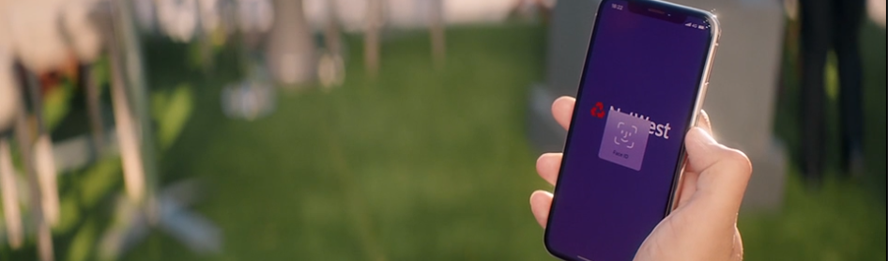
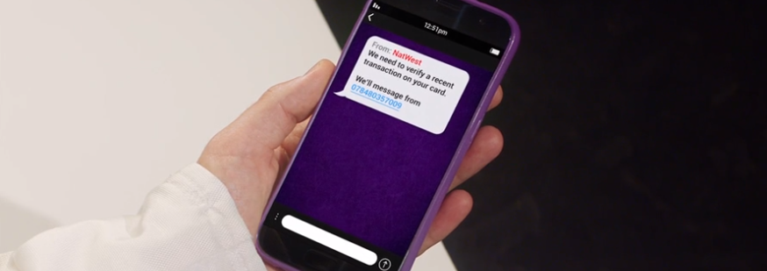
CASE STUDY – Natwest
‘Safety and Security’ - 2018
Source: DCM / NatWest
Conducted by; Differentology
‘Post’ levels are the average achieved across the 3 phases of cinema activity

Slide 3
CASE STUDY – Natwest
‘Safety and Security’ - 2018
Uplift in prompted comms awareness:
Those exposed to the cinema activity are 55% more likely to be aware of NatWest advertising vs. pre-campaign levels
Post = 34%, Pre = 22%
Summary
The bespoke cinema campaign delivered NatWest’s safety and security message in an entertaining and engaging manner and the film-relevant copy helped deliver significant uplifts for the bank across a series of key brand metrics.
Perceptions of NatWest as being proactive, innovative and digitally led and a trusted bank that keeps it customers’ finances safe and secure all increased significantly from pre-campaign levels - highlighting how the core themes of the bespoke ads resonated with the cinemagoing audience an helped shift views of NatWest.
The campaign has also driven a significant uplift in consideration amongst the key target audience of 25-54 adults for NatWest’s range of financial products.
Driving key perceptions further:
The cinema campaign has driven significant increases in NatWest being perceived as proactive, innovative and helping keep customers finances secure.
Uplift in consideration:
The cinema campaign has driven an 18% uplift in consideration of NatWest for financial services products (savings, credit card, mortgage etc.)
Source: DCM / NatWest
Conducted by; Differentology
‘Post’ levels are the average achieved across the 3 phases of cinema activity

