Slide 1
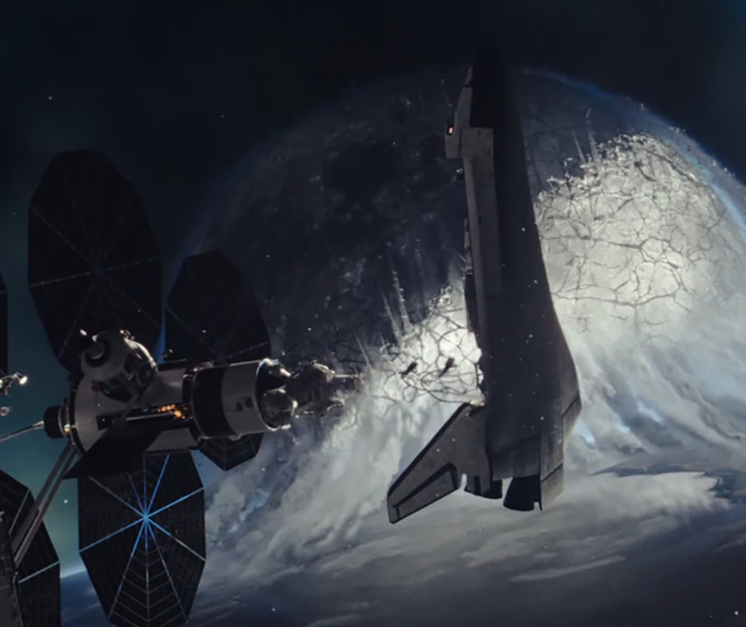
moonfall
A new threat to Earth
Release Date
4 February
Cast
Halle Berry, Michael Pena, Patrick Wilson, Donald Sutherland
Director
Roland Emmerich (Independence Day, The Day After Tomorrow)
Recommended if you like
Geostorm, Independence Day
Reasons to buy into
Roland Emmerich’s films have grossed billions at the global box office
Key audience info
16-34 Men Index:
Est. DCM admissions
351k
A mysterious force knocks the Moon from its orbit around Earth and sends it hurtling on a collision course with life as we know it.
Plan your campaign

