Slide 1
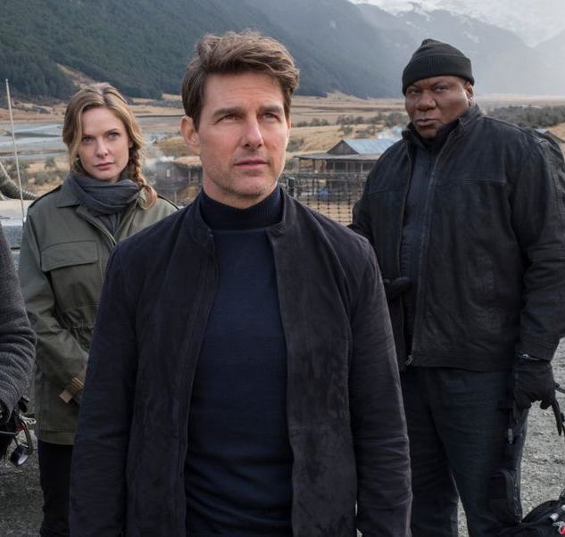
MISSION: IMPOSSIBLE 7
Get ready for another incredible action spectacular
How many film franchises deliver their best film on their sixth instalment? Not many, but Mission: Impossible managed it with Mission: Impossible – Fallout. Not only was it the best M:I film, it was one of the best action films of the 21st century, with Director, Christopher Macquarrie expertly marshalling things. Macquarrie is once again in the Directors chair for this seventh instalment so expect a similar level of jaw-dropping action. The Mission: Impossible films are always one of the best ways to reach ABC1 men, and with a great late-September release date, Mission: Impossible 7 is going to be no different.
CAST
Tom Cruise, Ving Rhames, Rebecca Ferguson, Simon Pegg, Vanessa Kirby, Hayley Atwell
KEY STATS
An enduring star – Tom Cruise’s last film, Mission: Impossible – Fallout, was his second highest grossing film ever in the UK, with £24.2m¹
Consistent male audience – on average, Cruise’s last five films profiled 66% male
(Index: 128)²
EST. INDUSTRY ADMISSIONS
3.0m
REACH / IMPACTS / TVRs³
Adults (16+): 4.9% / 2.7m / 5.5
Men (16+): 6.4% / 1.8m / 7.3
ABC1 Men: 8.6% / 1.3m / 9.8
16-34 Men: 10.1% / 917k / 11.8
Source: 1. IBOE. 2. CAA Film Monitor database. 3. CAA C+F Planner – using comparative film information.
RELEASE DATE: 28 SEPTEMBER 2022

Slide 2
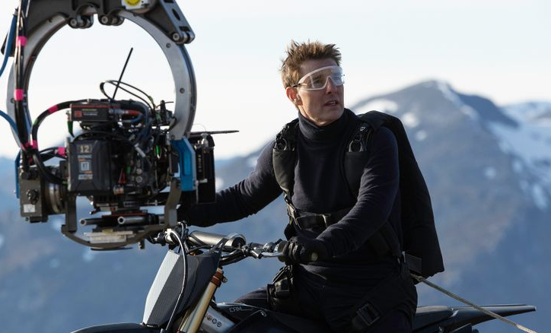
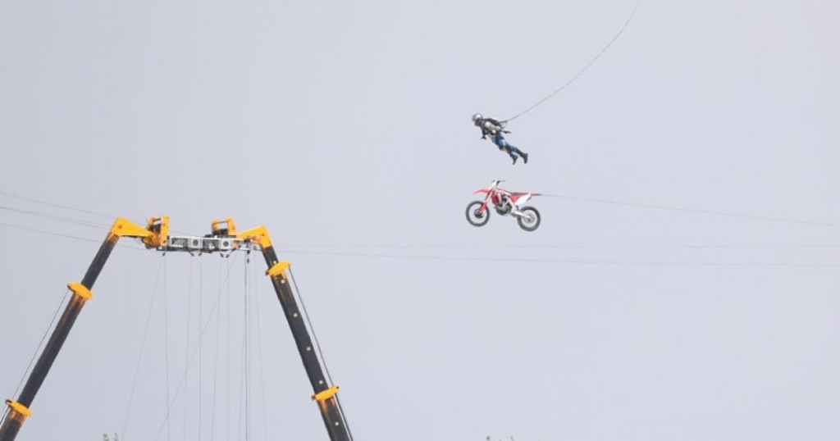
TOM CRUISE CONTINUES TO PUSH THE BOUNDARIES OF ACTION SPECTACLE
Increasingly known for his commitment to stunts and creating spectacular action sequences Cruise continues to push further in the next instalment
“Even as a star whose career is defined by daredevil stunts, Tom Cruise is taking it to the next level with his latest high-stakes escapade.
The actor and producer has famously always done his own stunts on the Mission: Impossible films, but there were a few reasons why his motorcycle ride off the edge of a cliff for the forthcoming seventh chapter in the franchise mattered more than the rest.
And not just because it was the single most dangerous thing he’d ever done”
Source: Empire

Slide 3
Success at the uk box office is a mission FAR FROM Impossible for this franchise
The Mission: Impossible franchise has been going from strength to strength in the UK since 2011’s Ghost Protocol.
16-34 adults
38%
Index 130
Women (16+)
59%
Index 129
ABC1 (16+)
67%
Index 138
Source: IBOE

Slide 4
Effectively reach affluent men with mission: impossible 7
The majority of cover for advertisers is unique, with the film forecast to deliver over 9 ABC1 Men TVRs and 11 16-34 Men TVRs
16-34 adults
38%
Index 130
Women (16+)
59%
Index 129
ABC1 (16+)
72%
Index 150
Source: CAA C+F Planner. Predicted industry admissions

