Slide 1
BUILDING BOX OFFICE BRANDS IV
MISSION 16-34
LAUNCH, LAND, IMPACT
Notes:
Mission 16-34: Launch, Land, Impact is the fourth edition of DCM’s industry-leading Building Box Office Brands series.
Created in partnership with independent insight and strategy agency Differentology, the study explores the different roles that AV media play in the lives of young people and how cinema helps brands launch and land their messages with impact.

Slide 2
objective
To investigate the role of AV media in the lives of 16-34 UK adults and the implications for brands.
LIVE TV
VOD
YOUTUBE
SOCIAL VIDEO
CINEMA
Notes:
The aim of the research was to better understand the role that different AV media – live TV, VOD, YouTube, social video (e.g. Facebook, Instagram) – play in the lives of 16-34 adults in 2018 and how does cinema continue to fit into this AV world and ultimately what this means for brands and their AV campaigns.

Slide 3
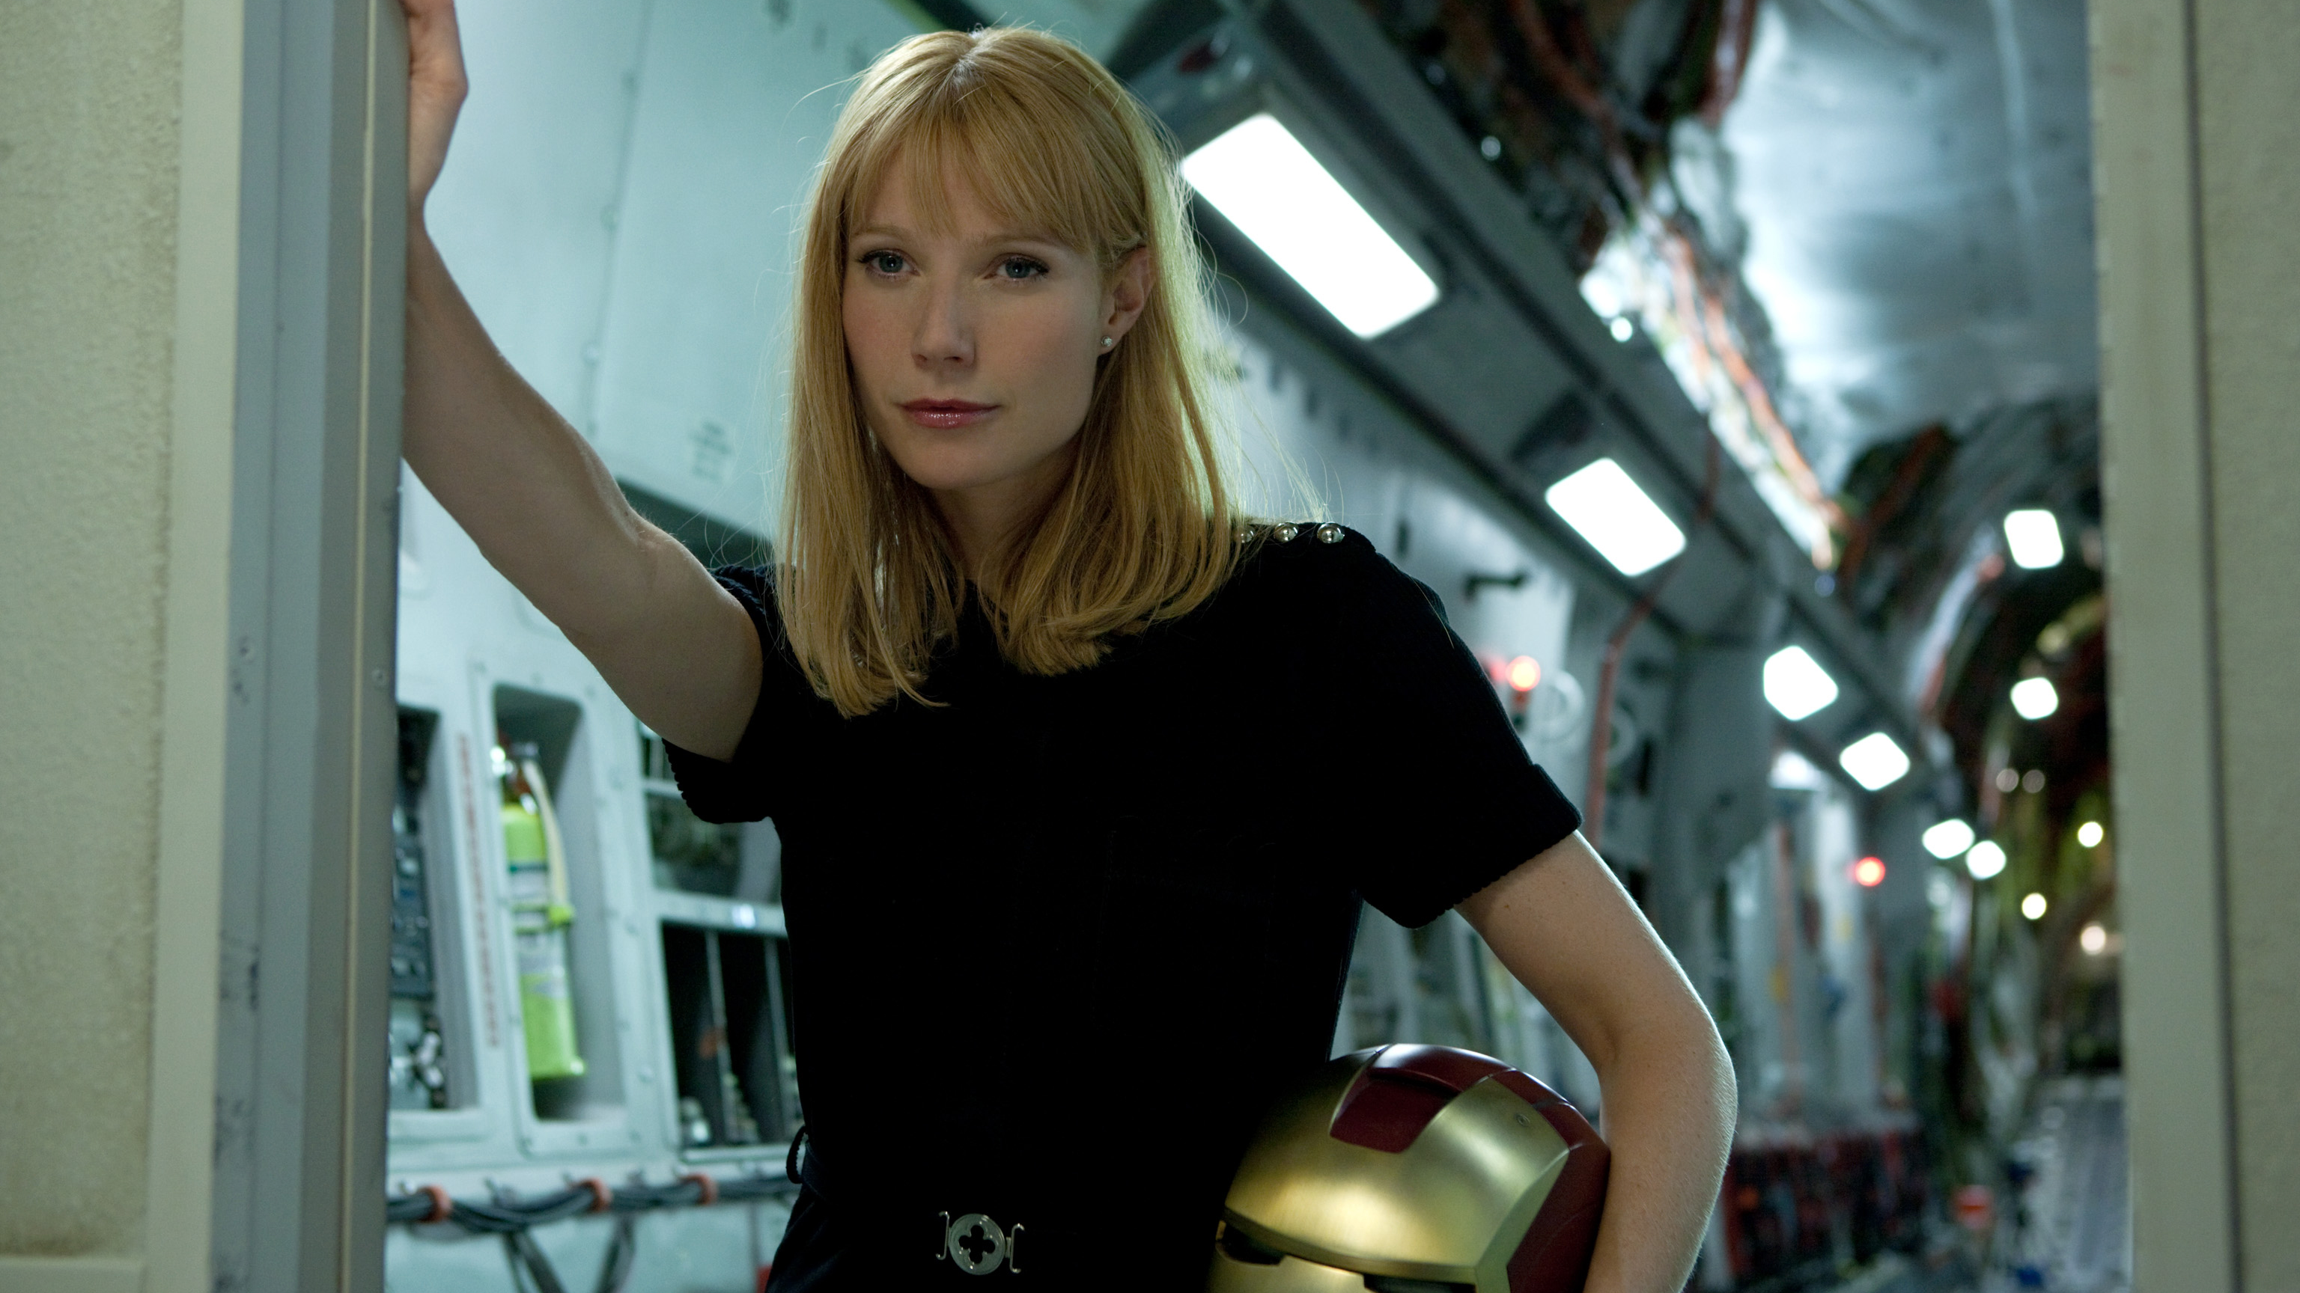

“Well, how are you going to do that?”
PEPPER POTS, IRON MAN

Slide 4
THE APPROACH
EXPLORE
AV HABITS
DEFINE
CINEMA EXPERIENCE
QUANTIFY
KEY THEMES
15 participants were recruited from across the UK (Birmingham, Edinburgh, London & Manchester)
Took part in a 5-day online community designed to capture AV habits and explore the role of different content
12 participants were invited to the cinema where they were exposed to a typical 11-min ad reel in-situ
They then took part in a 90 minute focus group designed to unearth the specifics of the cinema experience and define the impact of cinema advertising
Nationally representative sample of 1,000 16-34s completed a 15 minute survey designed to further understand and quantify the themes discovered in the Explore & Define stage
Differentology also undertook a meta-analysis of 12 cinema ad effectiveness projects to understand the average uplifts delivered by cinema.
Notes:
Differentology undertook a three-stage approach to tackle our objectives of understanding AV consumption and cinema’s role within this for the 16-34 audience:
EXPLORE: All participants aged 16-34, consumed the full range of AV channels (TV, VOD, Online video) and go to the cinema at least 3 times a year (to capture the spectrum of cinemagoing rather than just the heaviest cinemagoers)
DEFINE: 12 participants were exposed to a typical 11-min ad reel in a cinema and then discussed the cinema experience, advertising and some broader cinema journey topics in a 90 minute focus group.
QUANTIFY: Having unearthed key themes in the two qualitative stages of the project we wanted to understand the scale of these and so commissioned Differentology to run a survey amongst 1,000 nationally representative 16-34s. To investigate the impact of cinema amongst this audience Differentology also undertook a meta-analysis of 12 cinema ad effectiveness projects they’d run to reveal average uplifts on key brand metrics.

Slide 5

WHAT WE LEARNT ABOUT 16-34s

Slide 6
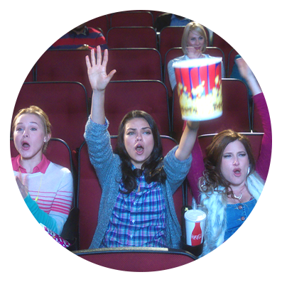
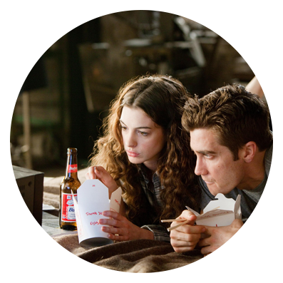
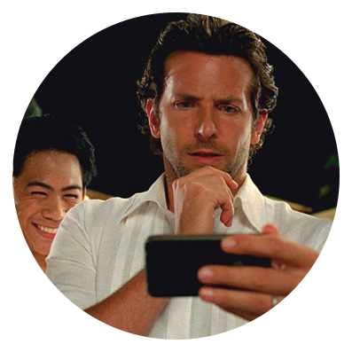

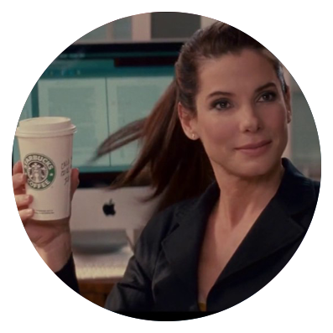
Five key themes
Happiest when
co-viewing
Heavy on demand consumers
Easily distracted when viewing
Advertising avoiders
Still passionate about brands
Notes:
During the project we discovered five key themes about the way 16-34s consume AV content and their relationship with/perception of advertising and brands.
A lot of AV consumption (e.g. watching clips on YouTube, Netflix, social video) is consumed solo, but we found that occasions where co-viewing happens (e.g. cinema and some TV/VOD occasions) are seen as the happiest AV occasions with respondents talking about these occasions most effusively.
It’s no surprise that the 16-34 audience are heavy on-demand consumers – on-demand/catch-up has grown significantly in volume of hours watched and range of occasions for viewing. This audience are keen to watch what they want, when they want rather than be tethered to traditional schedules. We found that almost all respondents in the diary stage engaged with at least one ‘binge’ across the five day study, highlighting how prevalent this behavior and appetite for longform content is becoming.
For many of the diary respondents, they see multi-screening as their default setting when viewing content on their own on a TV screen, laptop or tablet. Mobile phone usage whilst viewing programming was high, but we noticed it to be particularly prevalent amongst younger female viewers. It’s not only digital distractions that tend to lure attention away from content, but many respondents were also engaging in ‘analogue’ distractions (e.g. crafts, cooking, packing) while having TV/YouTube/VOD etc. on in the way background.
An increasing number of 16-34s are installing ad-blockers, multi-screening while watching broadcaster VOD, and recording live TV specifically to skip ad breaks. 16-34s are also citing a lack of ads as the primary advantage of SVOD platforms like Netflix (even above the range of content available) – and now that they’re so readily using services like Netflix & Spotify Premium broadcast and online ads seem all the more interruptive.
During the diary stage we asked respondents about their favourite brands. You might think that this younger audience would reel off a list of niche or disrupter brands, but actually the majority of the ‘favourite brands’ listed were generally mass-market brands with mainstream appeal (e.g. Starbucks, Adidas, Cadbury’s). These brands are seen as familiar, comforting and trustworthy and despite their mass appeal 16-34 consumers still feel a personal, emotive connection to them.

Slide 7
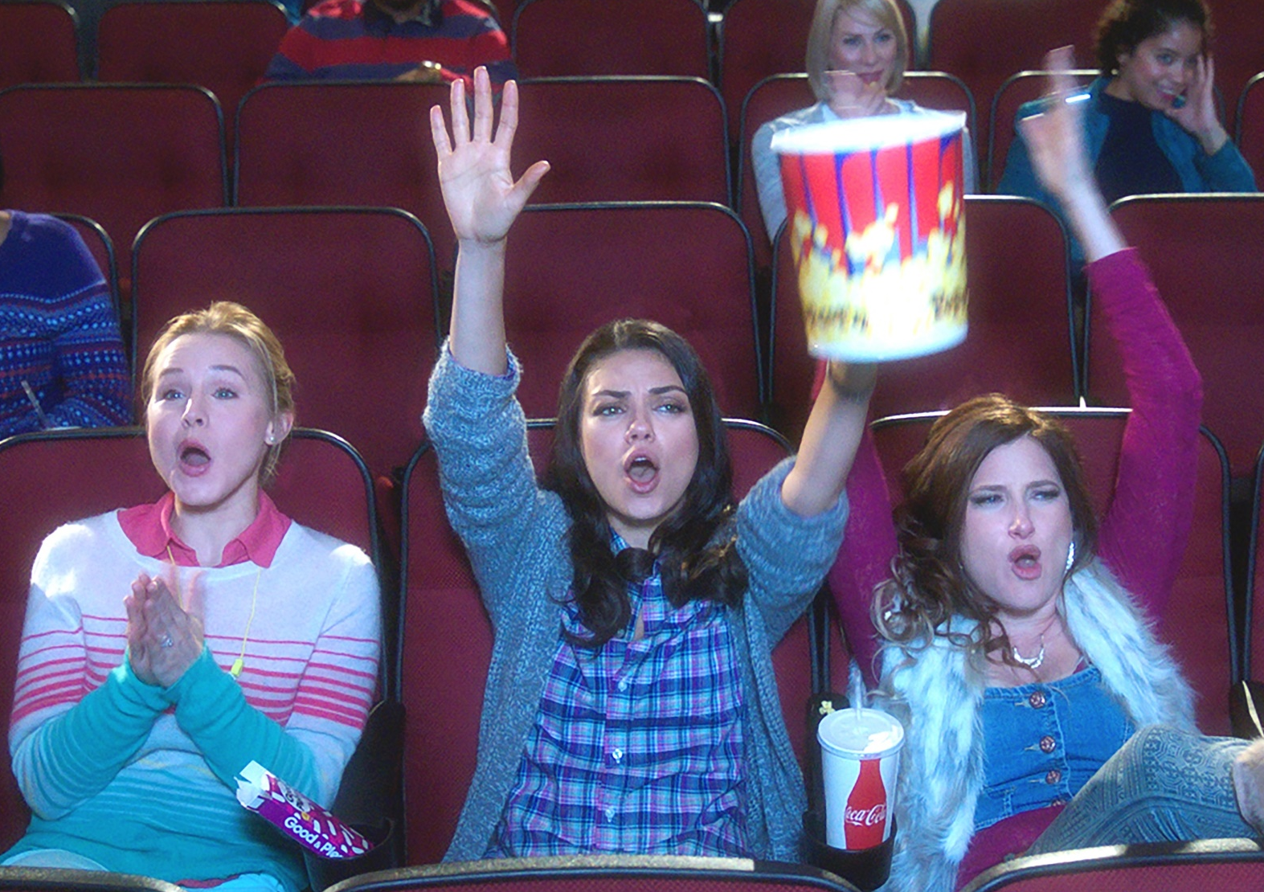
They are happiest when co-viewing
“Me and my partner save our favourite
show to watch together.”
Female, 23
“I tend to be more lively and energetic
when watching with other people.”
Male, 31
Notes:
A lot of AV consumption (e.g. watching clips on YouTube, Netflix, social video) is consumed solo, but we found that occasions where co-viewing happens (e.g. cinema and some TV/VOD occasions) are seen as the happiest AV occasions with respondents talking about these occasions most effusively.

Slide 8
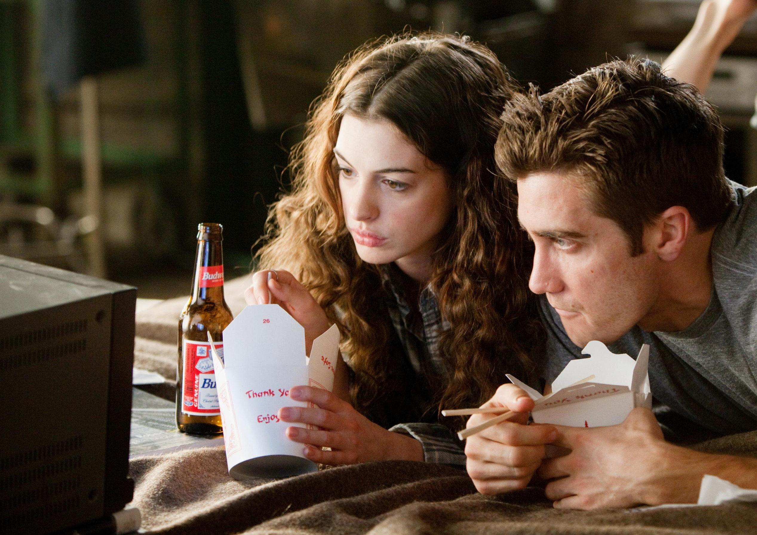
They are heavy on demand consumers
“With catch up TV you can watch practically anything at anytime now.”
Female, 18
“We are currently binge watching
Red Dwarf.”
Male, 27
Notes:
It’s no surprise that the 16-34 audience are heavy on-demand consumers – on-demand/catch-up has grown significantly in volume of hours watched and range of occasions for viewing.
This audience are keen to watch what they want, when they want rather than be tethered to traditional schedules.
We found that almost all respondents in the diary stage engaged with at least one ‘binge’ across the five day study, highlighting how prevalent this behavior and appetite for longform content is becoming.

Slide 9
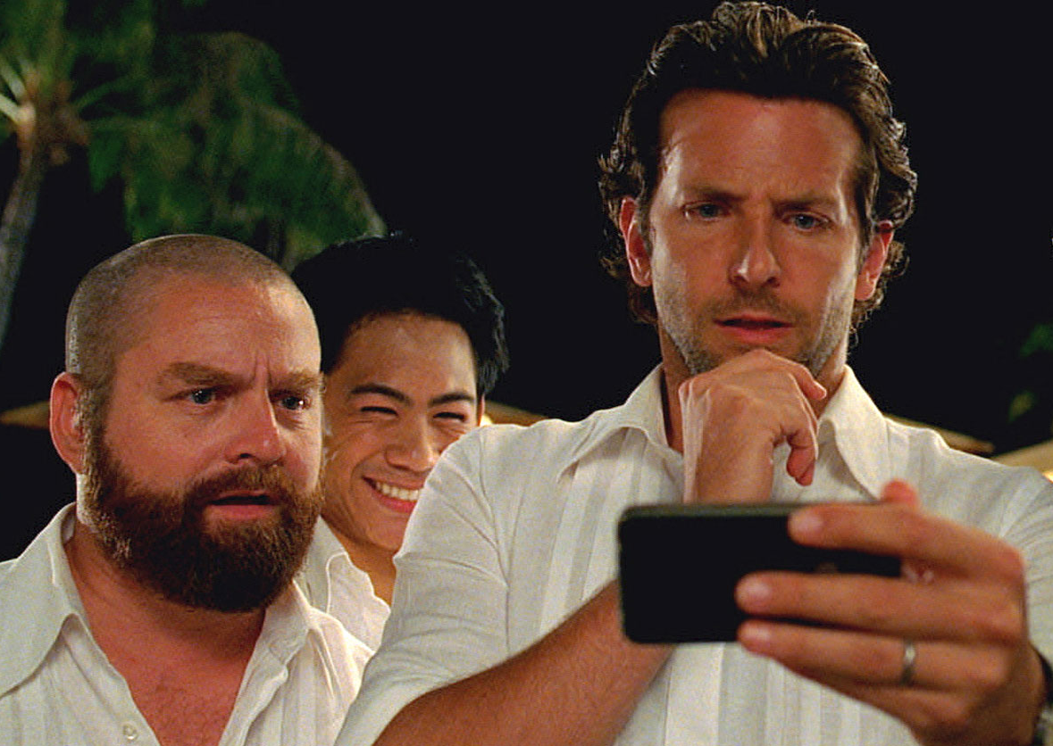
They are easily distracted while viewing
“I was on social media at the same
time as watching…as usual.”
Female, 34
“I wanted something a bit interesting to
engage me a little whilst packing a
case, not too much though.”
Female, 20
Notes:
For many of the diary respondents, they see multi-screening as their default setting when viewing content on their own on a TV screen, laptop or tablet.
Mobile phone usage whilst viewing programming was high, but we noticed it to be particularly prevalent amongst younger female viewers.
It’s not only digital distractions that tend to lure attention away from content, but many respondents were also engaging in ‘analogue’ distractions (e.g. crafts, cooking, packing) while having TV/YouTube/VOD etc. on in the way background.

Slide 10

They AVOID ADVERTISING
“It feels a bit more annoying, especially
when it’s in the middle of a show.”
Male, 31
“I don’t want to sit through them [ads].”
Male, 18
2 IN 5 16-34s
HAVE INSTALLED AD
BLOCKING SOFTWARE*
*Q. Do you currently have ad blocker software on any of your devices?
Base: 1000 ‘16-34s’
Notes:
An increasing number of 16-34s are installing ad-blockers, multi-screening while watching broadcaster VOD, and recording live TV specifically to skip ad breaks.
16-34s are also citing a lack of ads as the primary advantage of SVOD platforms like Netflix (even above the range of content available) – and now that they’re so readily using services like Netflix & Spotify Premium broadcast and online ads seem all the more interruptive.

Slide 11
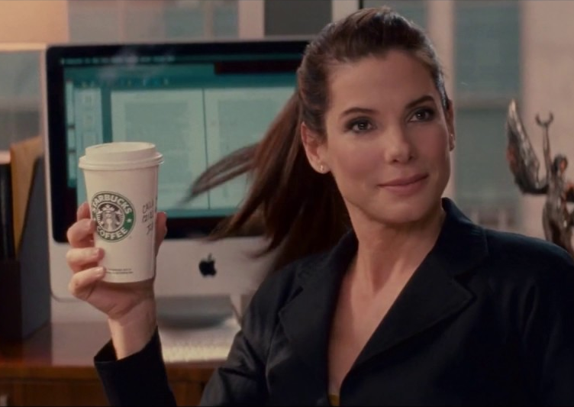



TheY STILL FEEL CONNECTED TO BRANDS
“I first chose the brand
as my family also buy it.” Female, 30
“I have purchased Adidas shoes and rugby boots since I was 5 years old.”
Male, 22
“It was really nice having
a comforting, warm drink.”
Female, 19
Notes:
During the diary stage we asked respondents about their favourite brands. You might think that this younger audience would reel off a list of niche or disrupter brands, but actually the majority of the ‘favourite brands’ listed were generally mass-market brands with mainstream appeal (e.g. Starbucks, Adidas, Cadbury’s).
These brands are seen as familiar, comforting and trustworthy and despite their mass appeal 16-34 consumers still feel a personal, emotive connection to them.

Slide 12
7 IN 10
16-34s FEEL ‘HOUNDED BY ADVERTISING’
Q. To what extent do you agree or disagree with the following statements? (10 point scale – top 5 responses shown)
Base: 1000 ‘16-34s’
Notes:
However in amongst this all, there’s a key challenge for advertisers trying to positively engage the 16-34 audience. Audiences are increasingly feeling bombarded by the amount of advertising they are being exposed to – specifically online advertising which people in our focus groups referred to as ‘hounding’ them.
It’s this perception of overwhelming amounts of targeted advertising driving this tech-savvy audience to install ad blockers (40% of 16-34s have ad blocker software on a device they own) and adds to the attractiveness of services such as Netflix and Spotify Premium that provide quality content with no ads.
So our industry has created a challenge for itself - how do you actually positively engage with this key audience when they’re now feeling hounded by advertisers and actively seeking ways to minimize the amount of advertising they’re seeing, in most contexts.
We wanted to investigate the role of AV channels in people’s life off the back of this and specifically understand the value of cinema in engaging with this audience….

Slide 13
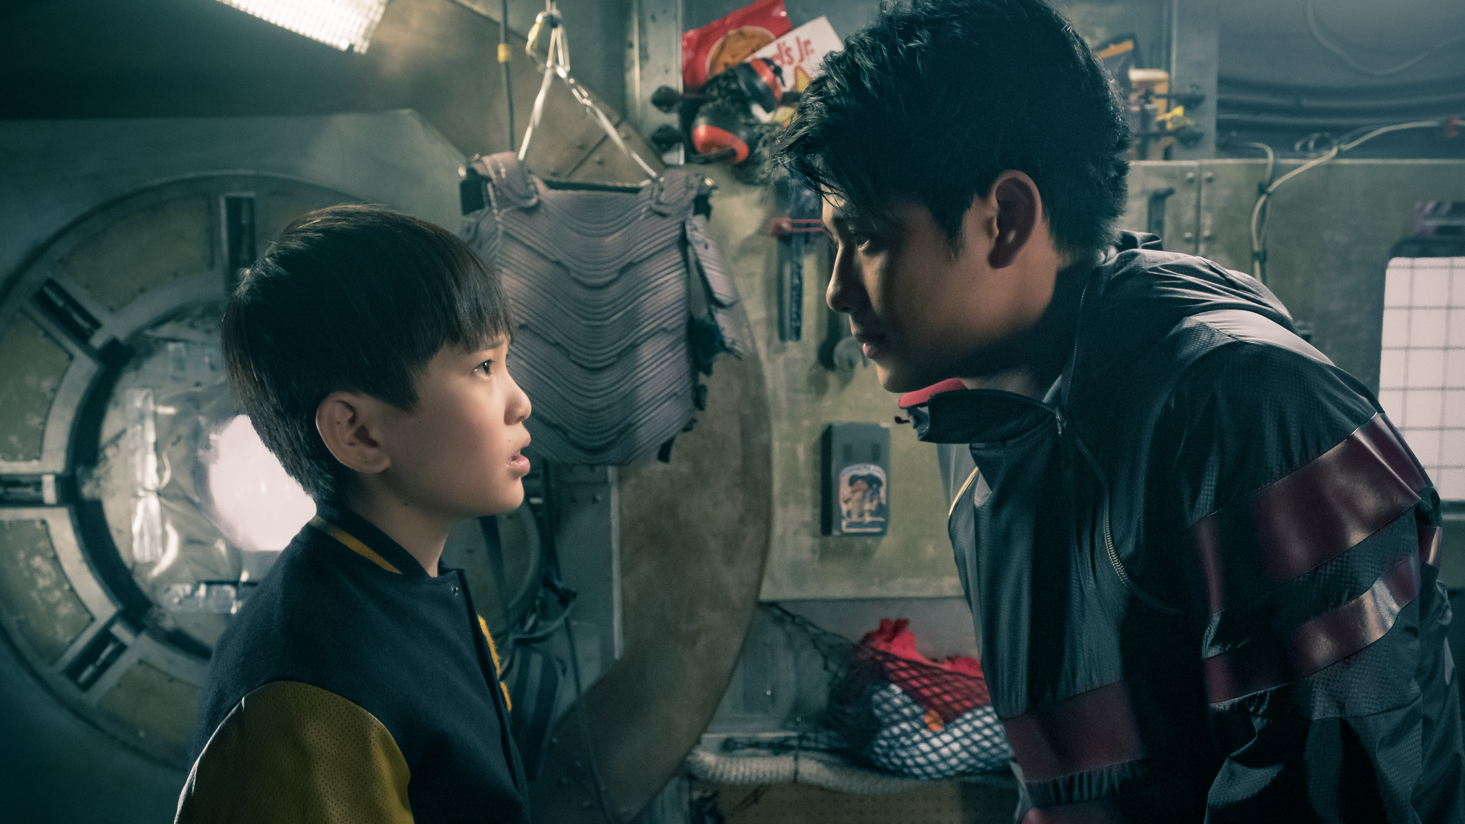
“WHAT are they watching?”
SHO, READY PLAYER ONE

Slide 14
CINEMA OCCUPIES A UNIQUE ROLE IN THE WORLD OF AV
LIVE TV
Fill time | 30%
Background viewing | 26%
Comforting | 18%
VOD
Binge viewing | 27%
Fill time | 25%
Quality content | 19%
YOUTUBE
Fill time | 43%
Helps me escape | 28%
Binge viewing | 27%
SOCIAL VIDEO
Fill time | 38%
Low Attention | 27%
Spontaneous | 20%
CINEMA
Shared experience | 37%
High attention | 34%
Quality content | 31%
Q. Which of the following words and phrases do you associate with […]?
Bold phrases indicate highest association for this phrase
Base: 1000 ‘16-34s’
Notes:
Across the first two qual phases we collated a list of different phrases and descriptions of the different viewing experiences people had with the different AV media. In the survey to 1,000 16-34s we asked them to select which descriptors they most associated with viewing content on each of the AV platforms.
This slide highlights the Top 3 phrases selected for each AV platform and showcases the unique position that cinema occupies in the AV landscape.
At a basic level, Live TV, VOD, YouTube and videos on social are broadly seen as ways to fill time with some slight differences for each platform:
Live TV provides a comforting accompaniment.
VOD is the place to binge on favourite shows.
YouTube is a temporary escape from other tasks (e.g. popping to YT for a quick video to distract yourself from work)
Videos on Social Media are far more spontaneous and often given less attention.
Whereas, Cinema is perceived as a shared experience, highly attentive and providing quality content – offering something unique to audiences and highlights why cinema remains in such strong health with the 16-34 audience.

Slide 15
LIVE TV
LIVE TV REMAINS A VERSATILE SOURCE OF ENTERTAINMENT
“I couldn’t find anything I really wanted to watch. So I decided to put on The Chase [whilst eating food].”
Male, 21
“I watched Bake Off live so I could discuss with my friends in our WhatsApp group
and avoid spoilers.”
Female, 20
Notes:
Live TV is still important in the AV landscape with most of our 16-34s watching every day.
It has the ability to play different roles and fulfil different needs, being driven by either ‘context’ or ‘content’.
Throughout the week, live TV viewing is mostly spontaneous and the choice is generally random – ‘grazing’ without a fixed idea of what to watch.
There are occasional ‘appointments-to-view’ for content which ‘must’ be watched live (like reality TV series, or sporting events).

Slide 16
Video on demand (VOD)
VOD PROVIDES FAVOURITES TO BE BINGED AND ENJOYED TOGETHER
“I ended up watching several more episodes before falling asleep.
I don’t quite know when.”
Male, 24
“I’m watching the show with my partner so I waited for her
to be in before watching.”
Female, 19
Notes:
VOD plays very different roles when viewed ‘solo’ compared to viewing in a ‘social’ context.
Most of the solo viewing we recorded was often long ‘bingeing’ occasions, late at night or throughout the day on weekends.
Social viewing provides the occasions where engagement is highest: ‘our show’ which couples watch together, generally a high-quality drama series. This provides a chance to escape together into a shared story.

Slide 17
YOUTUBE
YOUTUBE IS A DISTRACTION THAT CAN LEAVE VIEWERS GOING DOWN A RABBIT HOLE
“I can easily get sucked into YouTube and spend hours without realising.”
Male, 27
“I watched [2 videos] as a short break having been reading a more serious news article.”
Female, 34
Notes:
YouTube provides a quick distraction when 16-34s aren’t willing to invest the time or effort in a longer AV episode.
The passive and addictive nature of ‘auto-play’ turns short sessions into much longer ones, almost by accident.
It’s used as background in a wide range of contexts, from getting ready, to cooking, to working.

Slide 18
Social video
SOCIAL VIDEO IS SPONTANEOUS, PERSONAL
AND OFTEN LOW-ATTENTION VIEWING
“[Snapchat and Instagram] videos will be more people
I know….Facebook is
more random.”
Male, 18
“The majority are funny videos or useful tips and tricks, I watch while I have breakfast or on breaks while I’m at work.”
Female, 30
Notes:
AV is different here: it’s part of the broader social media experience, rather than a channel in it’s own right.
Video viewing is very unstructured. Depending on what catches the eye occasions can last a few seconds or as long as TV episodes.
Instagram and Snapchat content was perceived as more ‘personal’, while Facebook is great for stumbling across funny or interesting videos (but has a lot of low-quality content which needs to be sifted through).

Slide 19
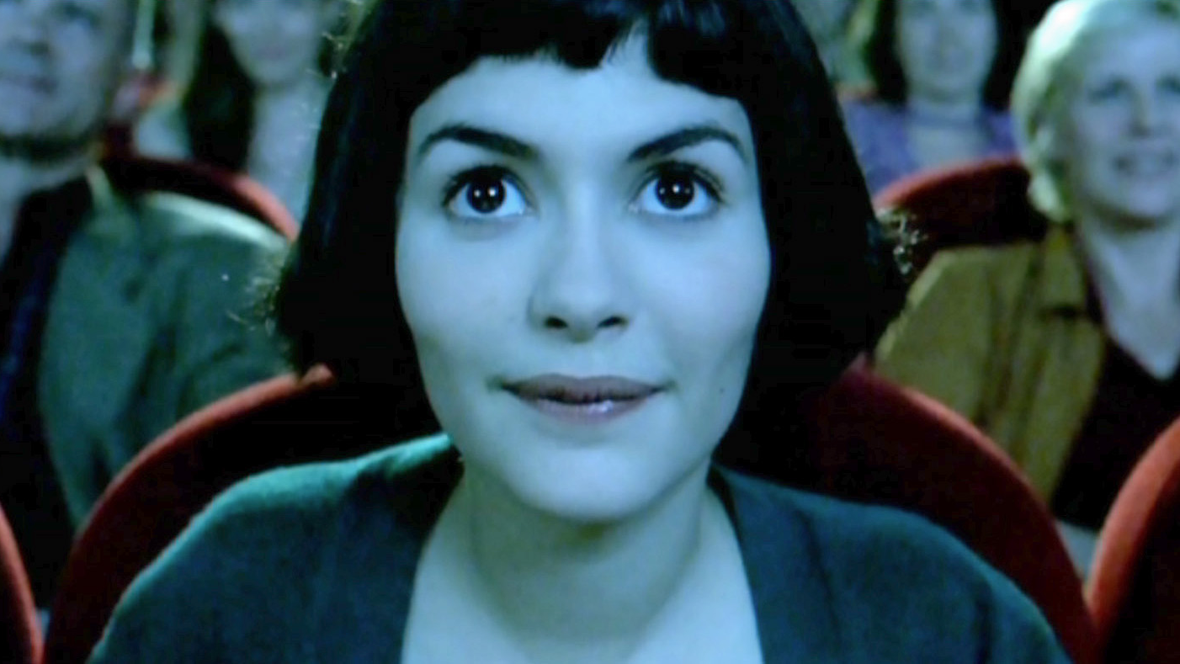
The cinema experience
Notes:
We know that cinema delivers a unique experience for audiences but we wanted to further understand this, the role that it plays for audiences and what this could mean for advertisers.

Slide 20
Cinema meets different needs at a range of levels
Society
Social
(peer group)
Individual
Notes:
The research showed that cinema meets different needs for audiences and is able to fulfill a range of different roles – at an individual level, a social (peer group) level and also at a broader societal and cultural level.

Slide 21
Cinema provides cultural moments
Cinema brings people together from all walks of life, and delivers ‘big moments’. It is the entry point for shared stories we follow over years or even decades.
25%* of all 16-34s in the UK went to see Avengers: Infinity War at the cinema (where a decade long narrative came to a culmination).
They wanted to be part of the conversation.
Society
Social
(peer group)
Individual
51% OF 16-34s AGREE THEY “DON’T LIKE MISSING OUT ON THINGS THAT OTHER PEOPLE ARE TALKING ABOUT”
* Source: CAA Film Monitor C&F Data 2018
Notes:
Film remains a valued ‘passion point’ for many and something that connects people together. Blockbuster films are big cultural moments that audiences enjoy sharing together – particularly true of those films which form part of years/decades-long franchises and worlds.
In recent years we’ve seen this with the likes of Star Wars, Fast & Furious and most recently Avengers – the beginning of the culmination of a decade long narrative was a huge cultural moment in 2018 and to be part of the conversation audiences have to go and see the movie at the cinema, otherwise they’ll miss out on the moment and have to wait months for the DVD/home ents release.
This is why 25% of ALL 16-34s in the UK went to see Infinity War at the cinema. Young audiences don’t want to miss out on the moment and that’s why cinema admissions have continued to grow – with a slate of big blockbuster titles designed for a 16-34 audience, cinemagoers continue to come in big numbers for the quality content, and to be part of that conversation.

Slide 22
Above all it’s an experience they share with those they’re closest with.
Cinema provides A SHARED EXPERIENCE
Society
Social
(peer group)
“We all live in different places now but cinema is something that brings us all together – it’s the glue”
Male, 30
Individual
74% OF 16-34s AGREE THAT “CINEMA IS AN EXPERIENCE THAT BRINGS ME AND MY FRIENDS CLOSER TOGETHER.”
Q. To what extent do you agree or disagree with the following statements? (10 point scale – top 5 responses shown)
Base: 1000 ‘16-34s’
Notes:
Whereas a lot of AV consumption is solus these days (e.g. watching catch-up on your phone on the commute, watching YouTube on your own laptop or watching Instagram Stories on your phone) going to the cinema remains a fundamentally social activity we share with a core group of close friends and family.
95% of all cinema visits by 16-34s are shared with others so it’s an inherent social experience and cinema importantly fulfils the need for human connection that we as social beings all feel. Cinema is a way for friendship groups, partners and families to connect over something together.
And cinema isn’t just a social experience in terms of the people you’ve gone with – it’s a broader social experience where you’re sat in a room full of strangers all engaging and watching the same thing at the same time – even if you’re never talking to these strangers.

Slide 23
ShARING AMPLIFIES THE VIEWING EXPERIENCE
Society
Social
(peer group)
Social but Silent
Psychologist Erica Boothby’s hypothesis*
“IT IS WITH CLOSE OTHERS THAT WE OFTEN MAKE MEANING OUT OF LIFE AND ESTABLISH A SHARED SENSE OF REALITY.”
Individual
*Boothby, E. J., Smith, L. K., Clark, M. S., & Bargh, J. A. (2017). The world looks better together: How close others enhance our visual experiences. Personal Relationships, 24(3), 694-714.
Notes:
Psychologist Erica Boothby was interested by these moments she termed “social but silent“ – think cinema trips, art galleries or gigs. There are occasions where you can be sharing the same experience with hundreds, if not thousands of strangers. Boothby & her colleagues were interested in whether experiences are amplified in a social context - even if we aren’t directly communicating with others.
Through a series of experiments they found that social contexts (e.g. a group cinema viewing) provide an elevated emotional response – reactions are more powerful and memorable when the experience has been shared with others (even silently) than when experienced alone.
This is incredibly powerful for advertisers – not only are your naturally tapping into a more positive mindset when engaging with people at the cinema but you’re also gaining the benefit for the shared experience – which will elevate emotional reaction to the content on the big screen too.

Slide 24
As individuals, cinema takes them on a journey
Society
“You don’t have to worry about anything. You’re taken away from everything for a couple of hours.”
Male, 31
Social
(peer group)
“There’s something really nice about sinking down into that seat… and that’s it, you don’t have to move for two hours.”
Female, 34
Individual
77% OF 16-34s AGREE THAT “CINEMA IS AN IMMERSIVE EXPERIENCE THAT TAKES YOU AWAY FROM THE DAY-TO-DAY”
Q. To what extent do you agree or disagree with the following statements? (10 point scale – top 5 responses shown)
Base: 1000 ‘16-34s’
Notes:
Cinema also plays an important role at an individual level for cinemagoers – it continues to provide an environment for immersive experiences, away from the everyday and mundane.
At the core of this are stories and narratives we can get emotionally involved in and properly switch off from the outside world for 2-3 hours – a rarity these days when the 16-34 audience feel that they are constantly connected and overly reliant on your devices etc.
The mental break that cinema provides and the fact that it takes their full attention, with no distractions ‘allowed’ is incredibly valued.

Slide 25
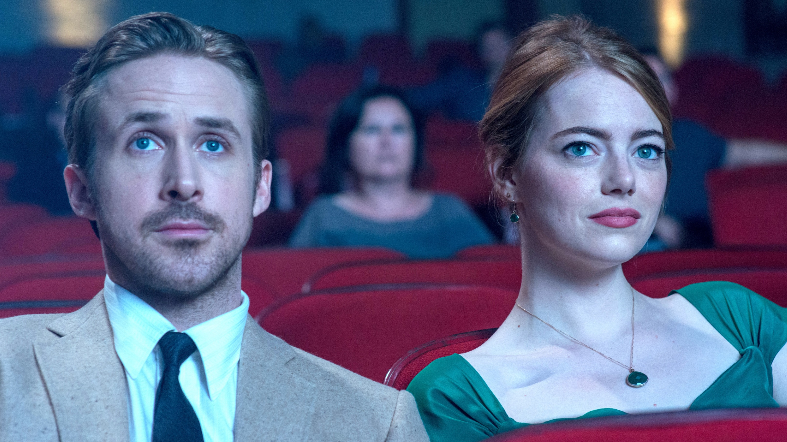
CINEMA ‘RITUALS’

Slide 26
‘formalised rituals’
The cinema experience is shaped by important rituals.
WELL-ENGRAINED RITUALS REINFORCE POSITIVE ASSOCIATIONS WITH CINEMA
“I always do the cinema my way.”
Male, 18
“It’s all part of the routine you have to follow.”
Female, 20
“When we get there immediately we’re going
for popcorn and snacks.”
Female, 19
Notes:
The cinema experience is full of important rituals that shape how people behave there.
These rituals provide an emotional and psychological break from the audience’s everyday routines.
By providing a well-defined, ‘formal’ pattern to follow, these rituals bring comfort and excitement. They allow us to access positive emotions quickly and easily that we don’t experience in the everyday.

Slide 27

EVERYONE HAS THEIR OWN CINEMA RITUALS
(Although each trip follows a clear pattern).
Pre-cinema
The Foyer
Entering the Theatre
Ads
Trailers
The Film
Post Film
Discussion
Gathering space
Entering the cinema “bubble”
The main event
Notes:
Gathering space
It’s a common area for everyone to meet their own group. Once everyone is gathered, the social experience gets underway.
Enterting the cinema “bubble”
This sets up a transition from everyday life to something different - closed off from the world.
The main event
The stage is now set for an intense, emotional experience.

Slide 28

They ‘switch off’ to ‘switch on’
(Although each trip follows a clear pattern).
Pre-cinema
The Foyer
Entering the Theatre
Ads
Trailers
The Film
Post Film
Discussion
Etiquette involves ritualistic detaching
“It’s literally the only time I ever don’t look
at my phone for that long, apart from when I’m asleep.”
Female, 30
“It’s actually really nice to not look at your phone for a while.”
Female, 18
Notes:
Cinema etiquette requires the audience to detach from the technologies that they so readily rely on throughout the rest of the day.
Dependency on our phones and other devices is replaced by meaningful and powerful stories that 16-34s can get emotionally involved in (without distraction).

Slide 29
Ads have a clear role within the rituals of cinema
Pre-cinema
The Foyer
Entering the Theatre
Ads
Trailers
The Film
Post Film
Discussion
The ad reel tees up the film
Notes:
The ad reel as a whole tees up the film by providing miniature narratives that we can momentarily lose ourselves in.

Slide 30

This puts cinema ads in a unique context
1
Rituals are central to the cinema experience
2
Cinema ads are a key part of these rituals
3
Which sets them apart from other ad formats
“The beauty of cinema advertising is that you have gone there for a purpose and you are definitely focused on the screen.”
Female, 23

Slide 31
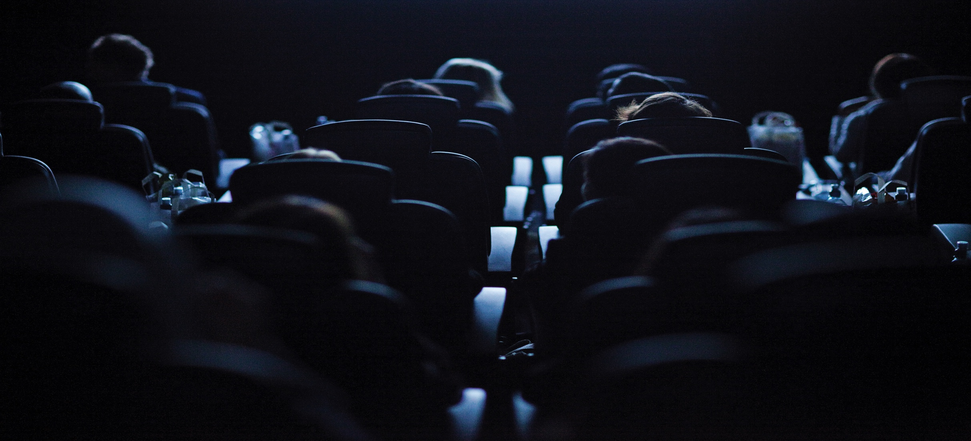
The unique power of cinema advertising
Notes:
In the Explore stage of the project we were keen to further understand the cinema experience in terms of the 16-34 audience perceive cinema advertising and it’s impact on them.

Slide 32
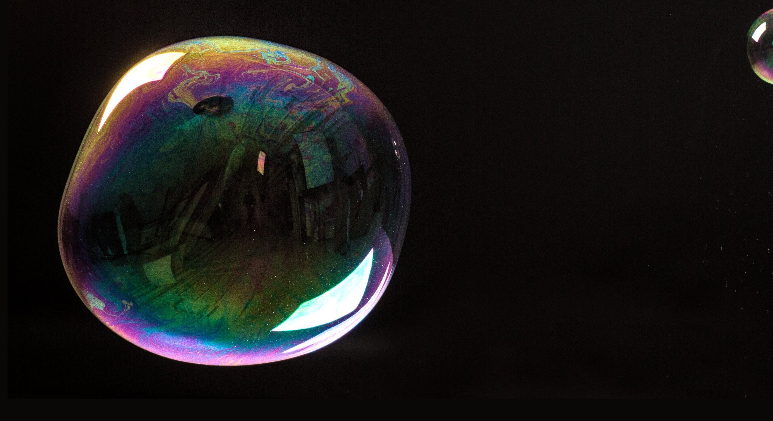
Cinema ads bring the viewer into a ‘bubble’
72% OF 16-34s AGREE
THAT “CINEMA IS A BUBBLE WHERE THE OUTSIDE WORLD CAN’T INTRUDE”
Q. To what extent do you agree or disagree with the following statements? (10 point scale – top 5 responses shown)
Base: 1000 ‘16-34s’
Notes:
In the focus groups one cinemagoer referred to experience of entering the screen as entering into a “bubble” – and almost three quarters of the 16-34 audience agree that a trip a cinema places them into a bubble where the outside world can’t intrude.
This true escapism is welcomed by the audience and the benefit for advertisers is that cinema ads are actually seen as part of the experience…

Slide 33
THEY ARE IMMERSIVE RATHER THAN INTERRUPTIVE
CINEMA ADS DRAW THE VIEWER INTO A BUBBLE
Where other AV ad formats push the viewer out
Q. To what extent do you agree or disagree with the following statements? (10 point scale – top 5 responses shown)
Base: 1000 ‘16-34s’
Notes:
The 16-34 audience are receptive to cinema ads (as we know from other research conducted by Kantar Millward Brown) and this is in part is due to the fact that they perceive the ads as part of that ‘bubble’ experience. The ads indicate the beginning of the big screen showcase and are part of the ritual/process where the audience begin switching off from the outside world and losing themselves in content on the big screen.
This is unlike other AV ad formats where the ad breaks are actually interruptive to the experience, the ads jarring and pulling the viewer out of the “bubble” rather than helping draw them in, like they do in cinema. Audiences know they have ten minutes of ads, ten minutes of trailers before the film begins interrupted and therefore perceptions of ads in this environment are far more positive.

Slide 34
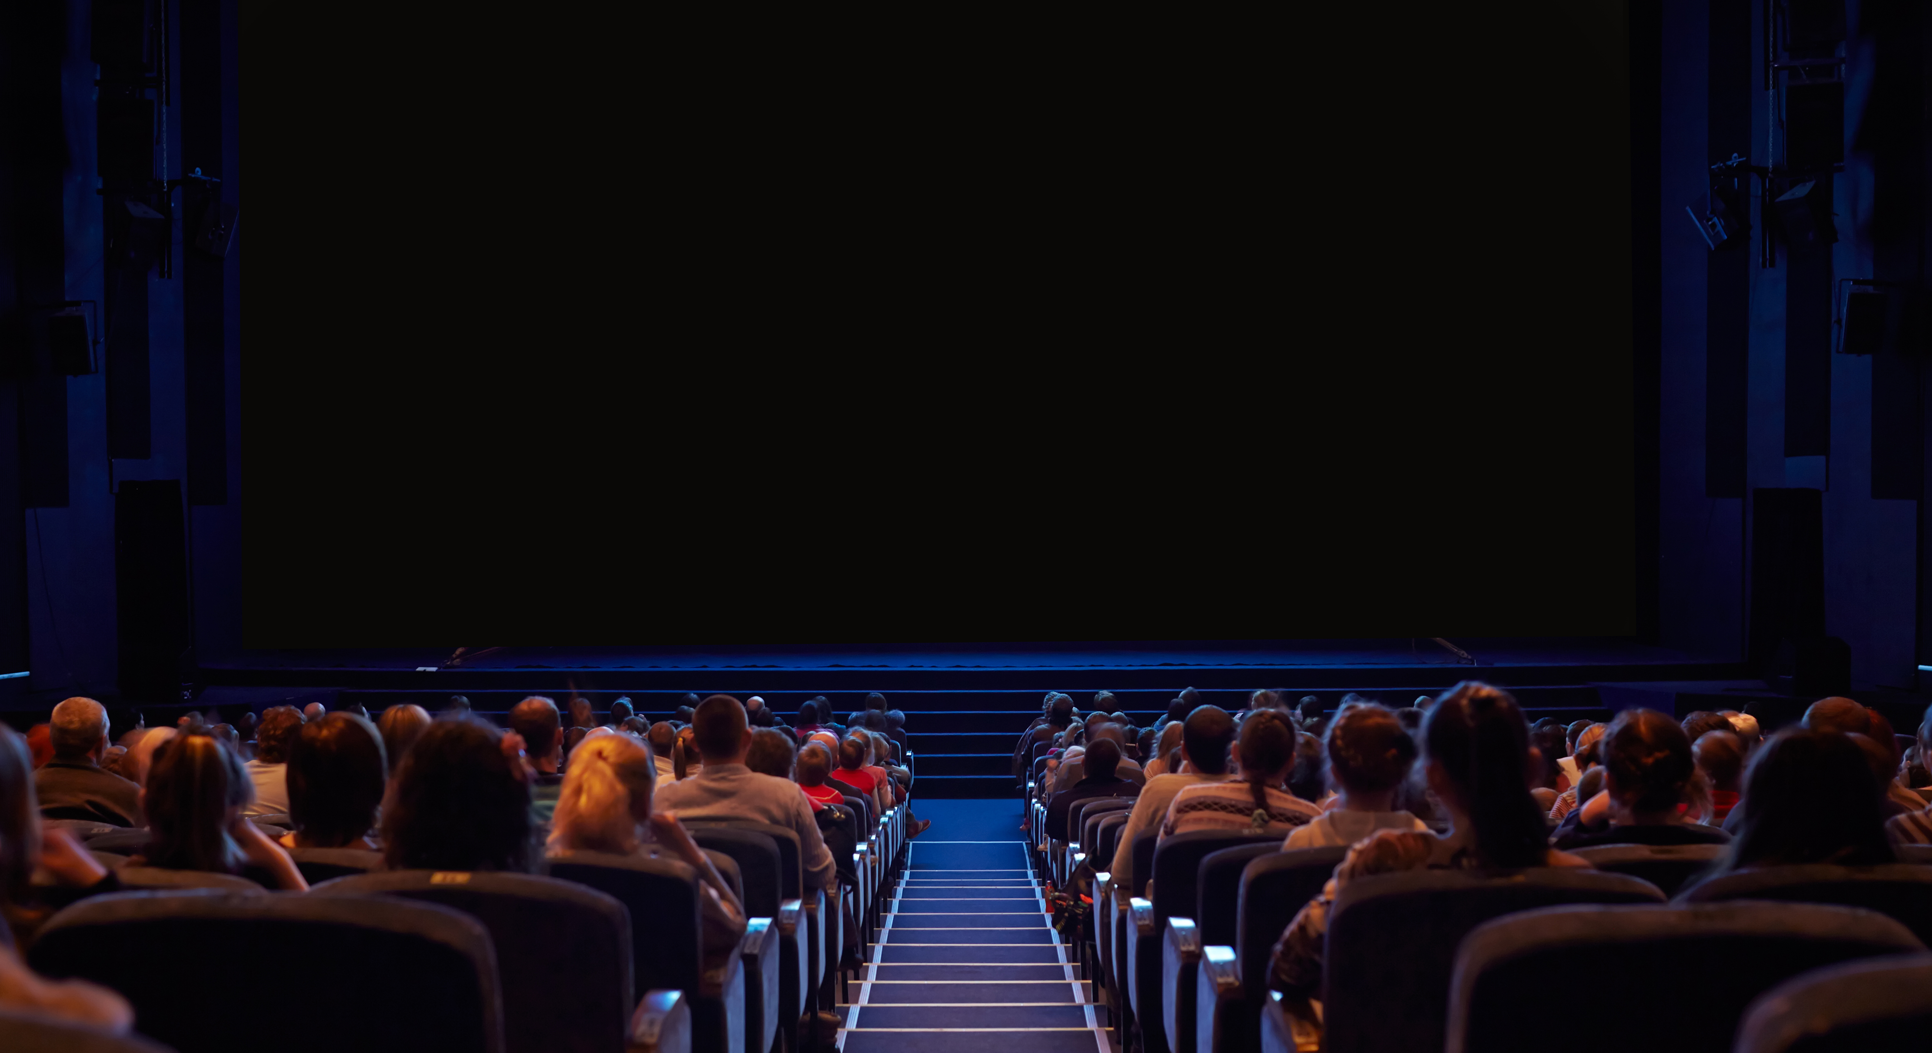
THE THEATRE LAYOUT HELPS TO DRAW
VIEWERS IN
Notes:
The fact that we all face forwards means that we are in prime position to enter into a ‘bubble’ as the lights go down, the adverts begin and we engage with what’s on the big screen in front of us.

Slide 35
BY BEING PART OF THE CINEMA EXPERIENCE,
ADS ARE LESS ‘INTRUSIVE’
INTRUSIVE ADS
Social Media | 31%
YouTube | 25%
TV | 21%
Commercial TV catch-up/on demand services | 12%
Cinema | 11%
% agree “I pay more attention to ads in cinema than elsewhere”
All 16-34s
16-34 ‘Ad Avoiders’
Q. Please can you rank the following in order of how intrusive you find adverts on each of them (% who ranked each platform first)
Q. To what extent do you agree or disagree with the following statements about cinema? (10 point scale – top 5 responses shown)
Base: 1000 ‘16-34’s, 176 ‘16-34 Ad Avoiders’
Notes:
In the survey, we asked the 1,000 16-34s to rank the different AV platforms on how intrusive they felt the ads were on each. The table shows the % of people who selected each channel for being the “most intrusive” – social media and YouTube are first and second, indicative of the annoying and interruptive formats of advertising used in those spaces. Cinema was least likely to be seen as intrusive – again highlighting how audiences are comparatively far more positive about advertising in this context.
It’s not just that they find cinema less intrusive – but they’re also paying more attention. Two thirds of 16-34s agreed that they do pay more attention to ads in cinema then elsewhere, and interestingly this increases to almost 75% for 16-34 Ad Avoiders.
These are people defined in our survey as currently using ad blocker software and subscribing to services such as Netflix & Spotify Premium. By virtue of minimizing/eradicating advertising as much as possible, cinema is one of few place where this audience actually see advertising.
Even the harder to reach 16-34 ‘Ad Avoiders’ can’t help but be dragged in, giving cinema adverts their full attention.

Slide 36
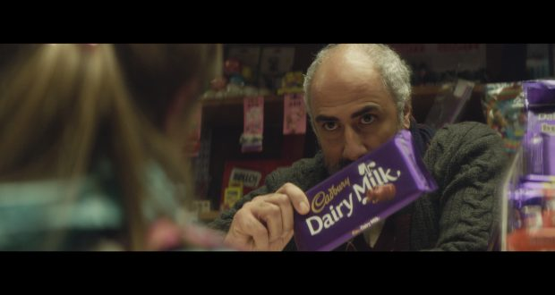
CINEMA IS THE PLACE FOR BRANDS TO TELL THEIR ‘FULL STORY’
16-34s thought cinema was the best environment to showcase longer ads
“Social media moves fast and we want to be onto the next story so I think shorter advertising makes more sense there and on YouTube. However cinema is more immersive and has more of our attention so has good potential for longer advertising.”
Female, 18
“I loved that it’s a story.”
Female, 25-34
Most commonly selected timelength by platform
Q. You have to run a video advert on each of the 6 following platforms. Please can you select by (dragging and dropping) what length of video you think is the most suitable to run on each platform.
Base: 1000 ‘16-34s’
Notes:
In the survey, we gave the 16-34 audience a planning challenge. They were told that they had a series of ads (5”, 10”, 30”and 60” ads) and needed to decide which versions they would choose to run across the following platforms: Instagram, Facebook, Youtube, BVOD, Live TV and Cinema.
We found that the 16-34 audiences are far more open to longer length copy appearing in cinema – and this was the only place they really wanted to see this length of ad. Viewers are primed already to get ‘lost’ within a story – and the advert break acts as a warm-up for the longer and deeper stories to come.
If brands have 60” ads, cinema is the only place those ads should be showcased. Audiences don’t want to see them in other channels because they don’t believe they give enough attention/spend enough time on that platform to justify seeing a longer piece of copy.

Slide 37
Discussing each ad is also part of the ‘fun’
% agree “I talk to the people I go to the cinema with about the ads (whilst watching them)”
All 16-34s
16-34 ‘Ad Avoiders’
Q. To what extent do you agree or disagree with the following statements about cinema? (10 point scale – top 5 responses shown)
Base: 1000 ‘16-34’s, 176 ‘16-34 Ad Avoiders’
Notes:
Cinema doesn’t just allow brands the chance for this hard-to-engage, ad avoiding audience to actually see their ads (in full) – it gives them the opportunity to get this challenging audience to actually engage with the brand and the campaign.
7 in 10 of the 16-34 Ad Avoiders agree that they talk to the people they’re with at the cinema about the ads while they’re watching them. This audience deem cinema ads as not only worthy of their time, but also a converstion. No mean feat given their behavior of trying to minimize advertising experiences in other contexts.

Slide 38

“I need someone to show me my place in all of this”
REY, STAR WARS: THE LAST JEDI

Slide 39
Brands can benefit from a transfer of positive attributes
ADS MAKE YOU FEEL MORE POSITIVE TOWARDS A BRAND
Cinema | 30%
TV | 25%
YouTube | 20%
Social Media | 17%
VOD | 8%
PREMIUM
Cinema | 48%
TV | 17%
YouTube | 16%
Social Media | 11%
VOD | 9%
TRUSTWORTHY ADS
Cinema | 36%
TV | 31%
YouTube | 16%
Social Media | 10%
VOD | 9%
% ranked first
Notes:
With this project we were interested in understanding how the perceptions of cinema and its unique environment could benefit advertisers. In the survey we asked 16-34s to rank each AV platform based on how premium they thought each was, and how trustworthy they thought the advertising on each was too.
Cinema was most likely to be seen as premium (almost half of 16-34s picked cinema as the most premium) and the AV platform with the most trustworthy advertising – with the traditional channels (TV and Cinema) being far more likely to be highly thought on this metric vs. online advertising formats.
We then asked them to rank each platform based on where they felt ads made them feel more positively towards a brand – and again cinema came out top, being selected most frequently as the best place for making them feel more positive towards a brand.
Cinema’s ability to engage the 16-34 audience with brand advertising is crucial for advertisers for creating the right impression and building a trusted brand that people will perceive as premium quality.

Slide 40
Cinema delivers at an ‘emotional’ and ‘rational’ level
Meta-analysis of 12 recent cinema campaigns
‘Better impression’
‘Rational’
brand perceptions
‘Emotional’
brand perceptions
+30%
+42%
+60%
Meta-analysis consists of 12 campaigns
Sectors include finance, travel, entertainment & leisure, FMCG and charity
Notes:
We wanted to go one step further and prove that cinema’s positive attributes and unique environment actually do pay off for brands too amongst the 16-34 audience.
Differentology undertook a meta-analysis of 12 campaigns that they had measured the effectiveness of amongst the 16-34 audience across the last 18 months and found that those exposed to cinema were 30% more likely to have been left with a positive impression of the brand as a result of the campaign.
Furthermore, the highly attentive audience in cinema makes it the perfect environment for landing brand messages – results of the meta-analysis highlight that being exposed to cinema led to a 42% increase in rational brand perception agreement and 60% uplift in emotional brand perception agreement.
Highlighting the valuable role that cinema can play in both communicating key messages and positively engaging the 16-34 audience with brands.

Slide 41
Key findings
Cinema meets different needs across societal, social and individual levels.
The unique cinema experience creates an immersive,
non-intrusive, ‘bubble’
of attention that no other AV format can provide.
Brands can benefit from a positive transfer of attributes that cinema possesses including being seen as premium and trusted.
The immersive ‘bubble’ of cinema is also the perfect environment to land key messages –both emotional & rational – and creating a better brand impression.

Slide 42
THANK YOU

