Slide 1

MEN
Dcm audience insights

Slide 2
MEN: 4 fast facts
2
1
77% are cinemagoers
71.4 million
admissions
6
3
42% of all UK
cinema admissions
4
Visits per year
Source: 1. TGI GB 2017 Q1 - up 15% from 2011 (Source: TGI GB Q1 2012)
2-4. CAA Film Monitor Coverage & Frequency 2016

Slide 3
GETTING TO KNOW THEM
Who are they?
What does
cinema mean
to them?
Love innovation and new tech
Passion point
Keen sense of adventure
Best way to watch movies
Enjoy a night out after a busy day
Enduring entertainment

Slide 4
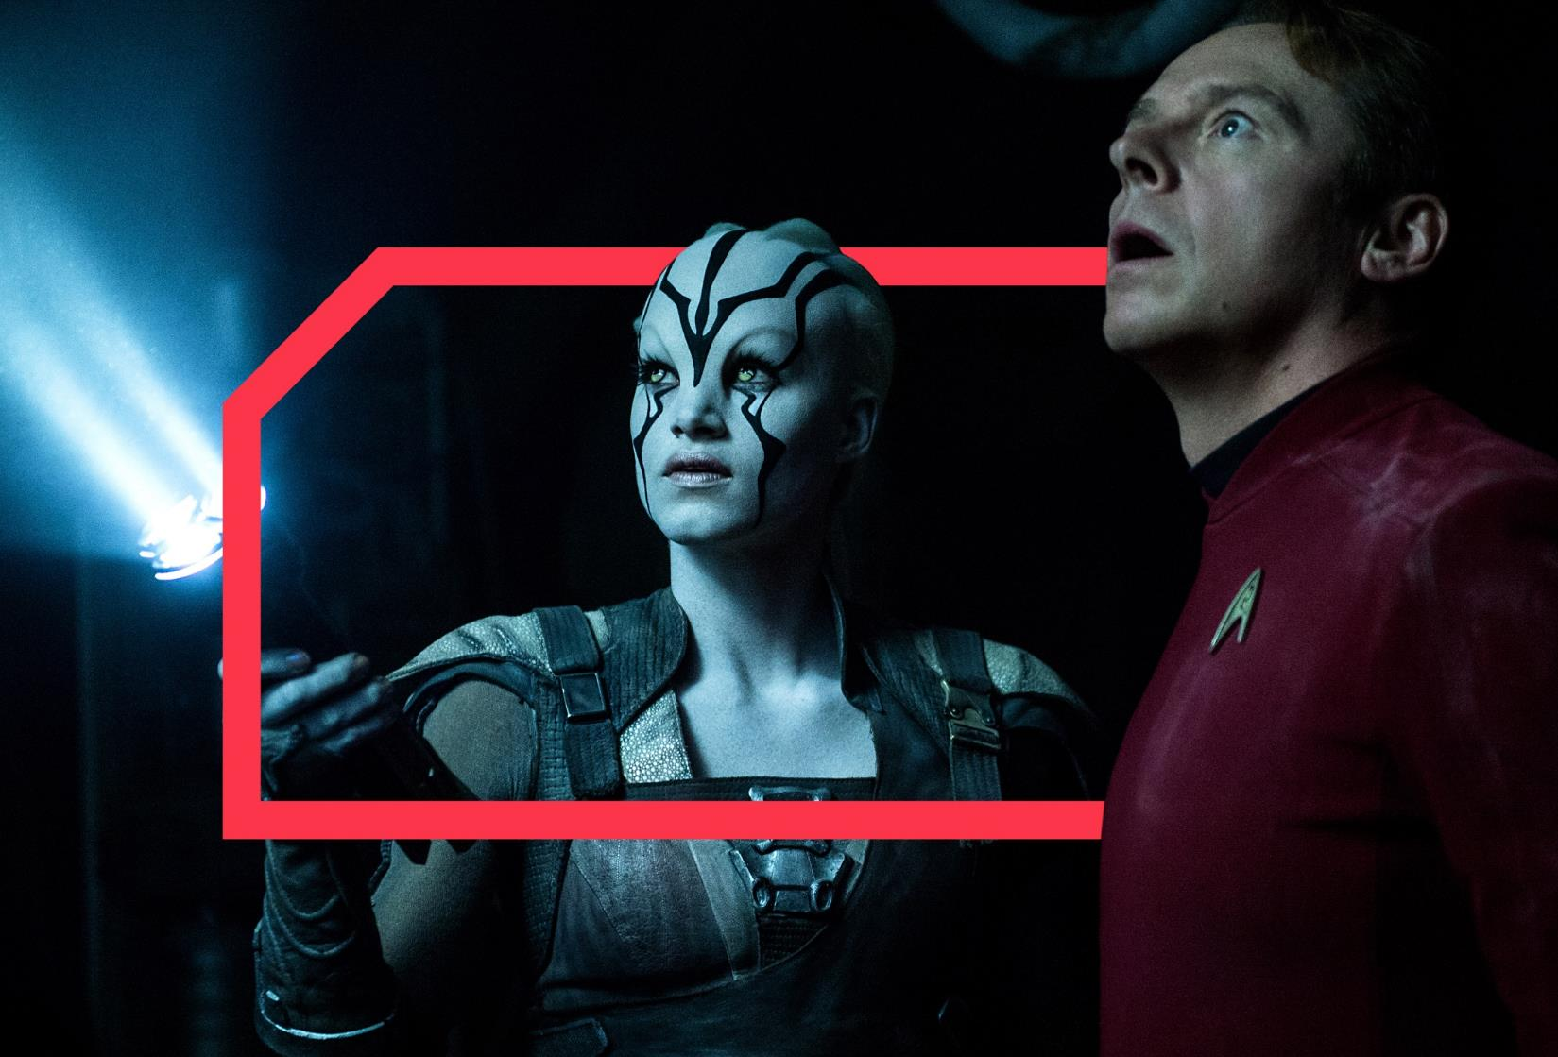
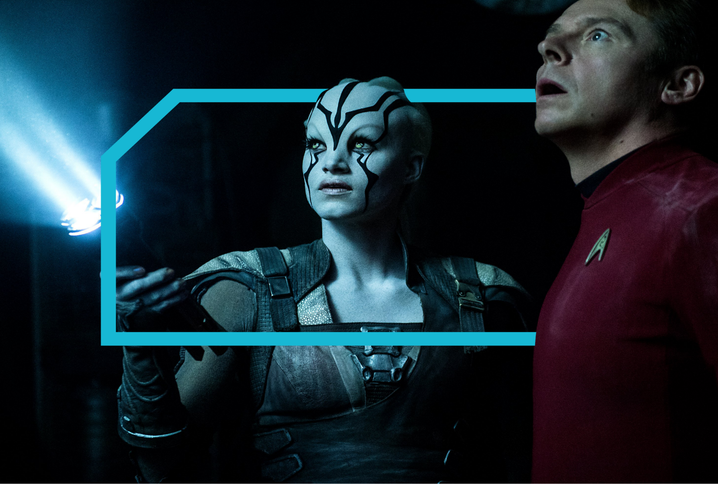
MEN SPEND
4 HOURS 5 minutes
PER DAY CONSUMING AV
Source: IPA TouchPoints 2016

Slide 5
av consumption
How it breaks down for men
Live tv
  BBC, ITV,
  C4, Sky 1
CATCH UP/
ON DEMAND
  Netflix, iPlayer,
  All 4, Sky+ etc.
online
video
  YouTube,
  Facebook etc.
Average time per day
Men (2016)
2 hours 59 minutes
51 minutes
10 minutes
Average time per day
Men (2015)
3 hours 5 minutes
43 minutes
8 minutes
Source: IPA Touchpoints 2016 + IPA TouchPoints 6 (2015)

Slide 6
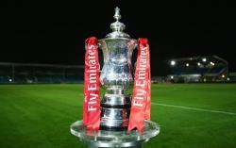

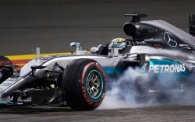

av consumption
16+ Men are more likely to be light commercial TV viewers and spend more time using services such as Netflix
62%
of 16+ men are ‘Light Commercial TV Viewers’
34%
of 16+ men have watched live TV online in last year
(Ix. 117)
13%
of 16+ men have used Netflix in
last 4 weeks
(Ix. 102)
KEY TV SHOWS FOR 16+ MEN
FA Cup
Index: 162
England International Football
Index: 155
F1 Grand Prix
Index: 146
Game Of Thrones
Index: 117
Source: IPA Touchpoints 2016 & GB TGI Q2 2017

Slide 7
MEN REALLY love film
55%
52%
…Used an online film service
in the past 3 months
…Bought a DVD/Blu-Ray
in past 3 months
CINEMA FUELS THEIR FILM HABIT FURTHER!
Source: FAME 2016

Slide 8
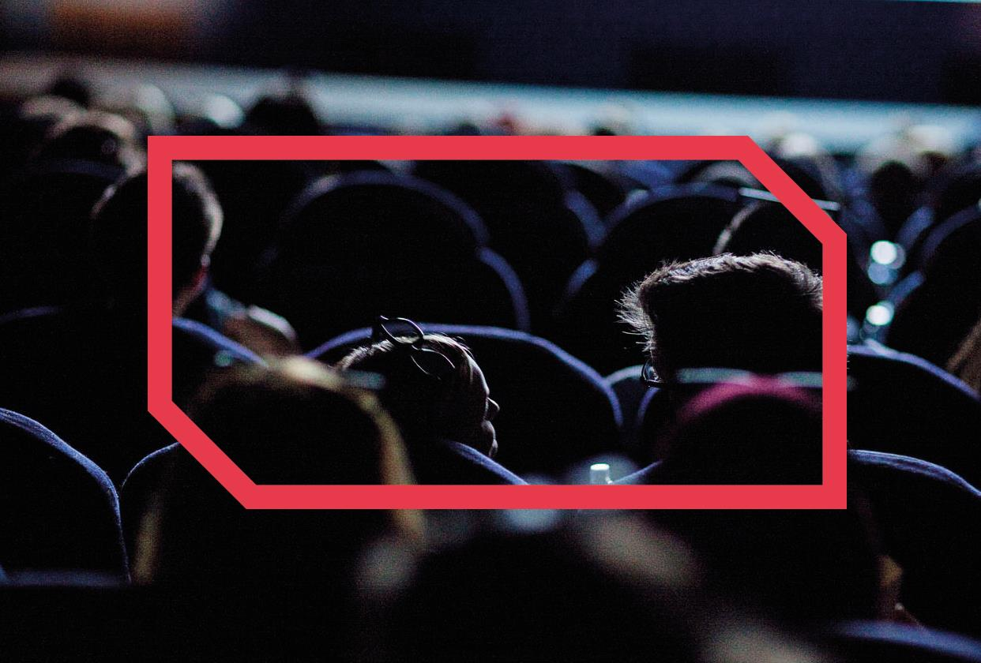
LET’S GO TO THE cinema WITH…
men

Slide 9
In the cinema foyeR
Here’s what they’re doing…
53%
spent money on food/drinks
2.5 average group sIze
44%
39%
Go with THEIR PARTNER
BOUGHT THEIR TICKETS
IN ADVANCE
Source: FAME 2016

Slide 10
THE ADS AND TRAILERS ARE PART OF THE EXPERIENCE
92%
Make sure they’re seated before
anything is on screen (ever)
Source: FAME 2016

Slide 11
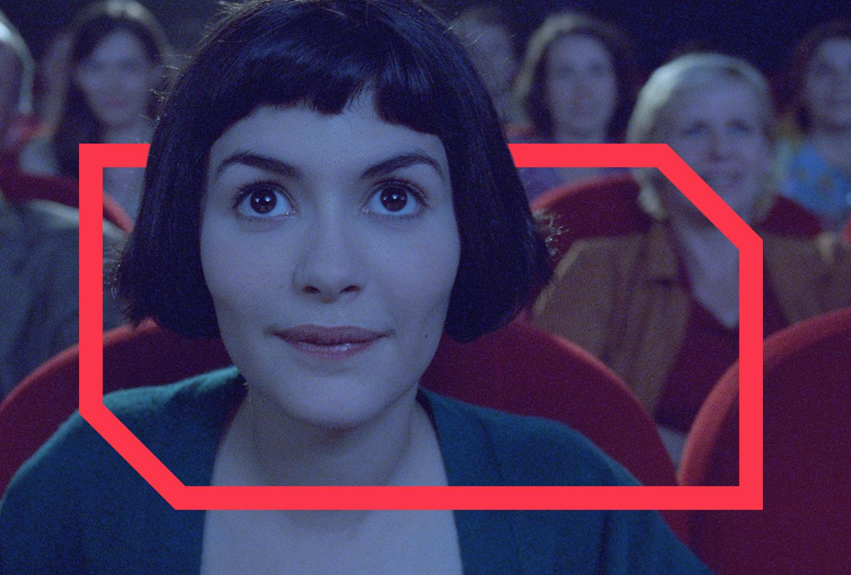
The big screen creates big emotions

Slide 12
Cinema creates positive emotions
More than any other AV channel
Live tv
Longform vod
cinema
Short online video
86%
67%
67%
63%
Positive emotions
Source: IPA TouchPoints 2016.
% of all time spent consuming each media associated with positive emotions

Slide 13

MEN HELP drive
the box office

Slide 14
men help drive the box-office…
39%
Go to the cinema within
a week of film opening
(Index: 107)
Source: FAME 2016

Slide 15
Why do MEN go to the cinema?
43%
29%
“I love the hype that surrounds big film releases”
(Index: 111)
“An IMAX cinema is the best place to watch films”
(Index: 128)
Source: FAME 2016

Slide 16










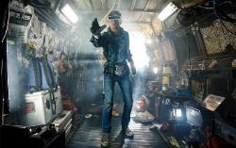

HOW TO REACH THEM
Top upcoming releases for Men
Action
adventure
COMEDY
Sci-Fi & Fantasy
THRILLERS
Kingsman:
The Golden Circle
The LEGO Ninjago Movie
Blade Runner 2049
The Snowman
Black Panther
Daddy’s Home 2
Star Wars: The Last Jedi
Red Sparrow
Tomb Raider
Jumanji: Welcome To The Jungle
Ready Player One
The Papers

Slide 17
After the film
Here’s what men do after the credits roll…
47%
20%
19%
Went for food
and/or drink
(Index: 127)
Went grocery shopping
(Index: 127)
Went non-grocery shopping
(Index: 135)
Source: FAME 2016. Activities do immediately after / on same day as cinema visit

Slide 18
KEY CATEGORY INSIGHTS
51%
33%
INTEND TO BUY A NEW VEHICLE IN THE NEXT TWO YEARS
AGREE ITS WORTH PAYING MORE FOR GOOD QUALITY BEER
47%
64%
AGREE THEY LOVE TO BUY NEW GADGETS AND APPLIANCES
AGREE IT’S IMPORTANT MY HOUSEHOLD IS EQUIPPED WITH LATEST TECHNOLOGY
Source: GB TGI Q1 2017. Base: ABC1 male cinemagoers
1. Index vs. average UK adult: 121 2. Index 137 3. Index 131 4. Index 137

Slide 19
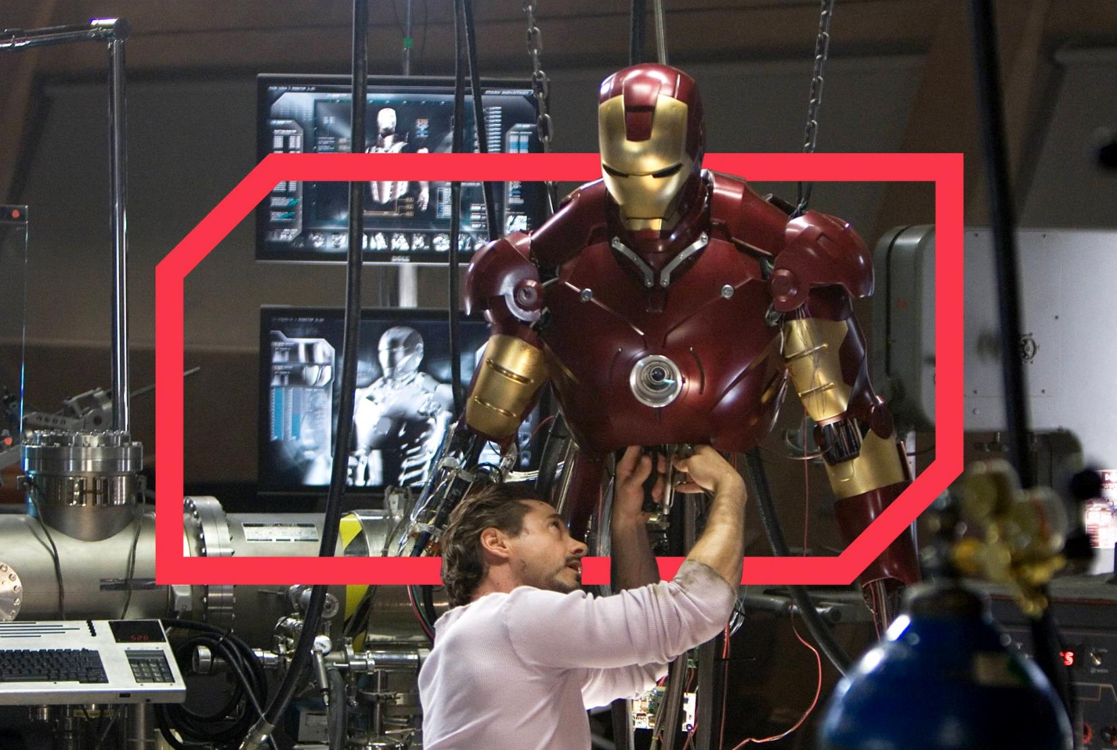
TOOLKIT

Slide 20
How to Buy Cinema
Reaching Men
Male AGP
Alcohol agp (18+)
FILM PACK
Ratecard CPT
Ratecard CPT
Ratecard CPT
Ratecard CPT
£70
£65
£80
£100
Non-blockbuster
Blockbuster
Ratecard CPT
£120
Super Blockbuster
Source: CAA Film Monitor Coverage & Frequency 2016

Slide 21
Toolkit
AGP - Audience Reach – Men
reach
Time period
Audience
(000’s)
Reach %
frequency
1 week
1374
3591
5445
6690
7608
8328
9178
11498
6
15
23
29
33
36
39
49
1.00
1.53
2.02
2.46
2.89
3.30
3.89
6.21
1 month
2 months
3 months
4 months
5 months
6 months
12 months
Source: CAA Film Monitor Coverage &amp; Frequency 2015

