Slide 1
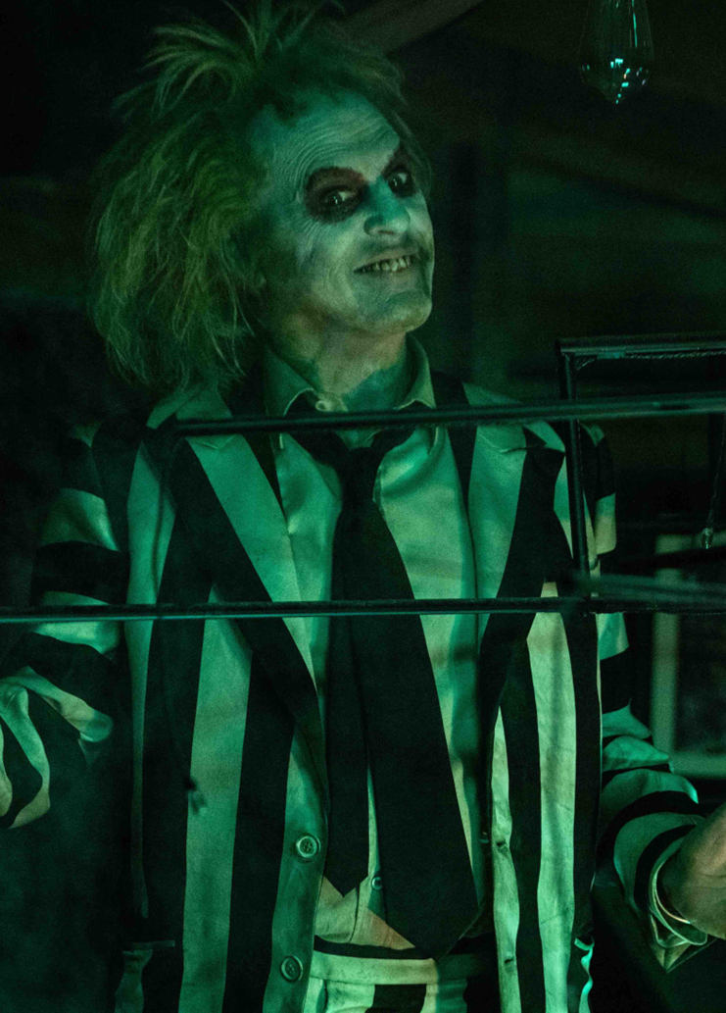
Beetlejuice beetlejuice
A sequel to one of Tim Burton’s classic comedy horrors
RELEASE DATE | INDUSTRY ADMISSIONS | GENRE | HFSS BRANDS | ALCOHOL/GAMBLING BRANDS
6 Sept 2024 | 1.8m | Horror | Yes | Yes
THE PLOT
Three generations of the Deetz family return home to Winter River after an unexpected family tragedy. Still haunted by Beetlejuice, Lydia's life soon gets turned upside down when her rebellious teenage daughter discovers a mysterious portal to the afterlife. When someone says Beetlejuice's name three times, the mischievous demon gleefully returns to unleash his very own brand of mayhem.
THE BUZZ
Fans of the original "Beetlejuice" film are eagerly anticipating the sequel, particularly because it will feature returning cast members Michael Keaton, Winona Ryder, and Catherine O’Hara, but additionally Jenna Ortega, known for her significant contributions to the horror genre, gaining prominence for her roles in Wednesday, as well as in Ti West’s X and the recent Scream reboot instalments.
THE AUDIENCE
Set to attract both its original audience and new horror enthusiasts, this film is poised to be an ideal opportunity for brands targeting ABC1 25+ adults. With the Olympics concluding in August, Beetlejuice Beetlejuice is an efficient way to extend reach from summer campaigns during a light month skewing toward an affluent 25+ audience.
KEY AUDIENCE REACH
ADULTS (16+)
1.8M
6 TVRs
16-34 ADULTS
950K
6 TVRs
16-34 MEN
530K
7 TVRs
25-44 ABC1
558K
6 TVRs
► TRAILER
TVRs based on industry admissions and comparative film profile

Slide 2
The original Beetlejuice was Tim burton’s directorial debut
Spanning over 36 years, Tim Burton’s directorial work is eclectic, with his most notable work mentioned below alongside Sweeny Todd (2007), Miss Peregrine's Home For Peculiar Children (2016) and Dumbo (2019). Across his work, Burton has won 8 Academy Awards, 5 BAFTAs & 4 Golden Globe Awards.
Beetlejuice (1988)
Grossed £3.6m at UK box office and Burton received a nomination at the 1988 Saturn Awards
Edward Scissorhands (1991)
Grossed £4.3m at UK box office and won the Hugo Award for Best Dramatic Presentation[48] and the Saturn Award for Best Fantasy Film..
Charlie And The Chocolate Factory (2005)
Grossed £37.7m at UK box office and has been described as ‘authentic and sentimental’.
Entertainment Weekly and Variety, respectively ranked Charlie and the Chocolate Factory as Tim Burton's third and fourth-best film
Batman (1989)
Grossed £12m at UK box office and Batman held the record for being the highest-grossing superhero film of all time until it was taken by Spider-Man in 2002
Planet Of The Apes (2001)
Grossed £17m at UK box office, the second-highest opening weekend of 2001, after Harry Potter and the Sorcerer's Stone
Alice in Wonderland (2010)
Grossed £42.6m at UK box office and at the 83rd Academy Awards, the film received three nominations: Best Art Direction, Best Costume Design and Best Visual Effects and won the former two

Slide 3
Tim burton fans & THE CULTURAL RESONANCE OF FILMS
Those who agreed they are fans of Tim Burton agreed that films have a cultural impact, with agreement that films can influence popular culture and are an essential part of their own cultural life – implying they are likely to watch the new sequel.
79%
‘Films can influence popular culture’
(Index: 113)
80%
‘Films can start conversations or encourage discussion of new topics’
(Index: 112)
62%
‘Films are an essential part of my cultural life’
(Index: 116)
73%
‘Watching a film at the cinema gives me something to talk about with friends and family’
(Index: 112)
Source: FAME 2023
Those who are fans of Tim Burton vs. avg GB adult

Slide 4
Beetlejuice beetlejuice is an efficient add to your broader av plan FOR ABC1 ADULTS
Over 2 in 3 of the film's audience are forecast to be ABC1 – making it a more efficient buy than many TV spots for reaching this audience around the same time of year.
Sources: Adwanted Connected, top rating ABC1 adults shows September – November 2023
% of adult (16+) audience that are ABC1. Beetlejuice Beetlejuice based on comparative profile.

Slide 5
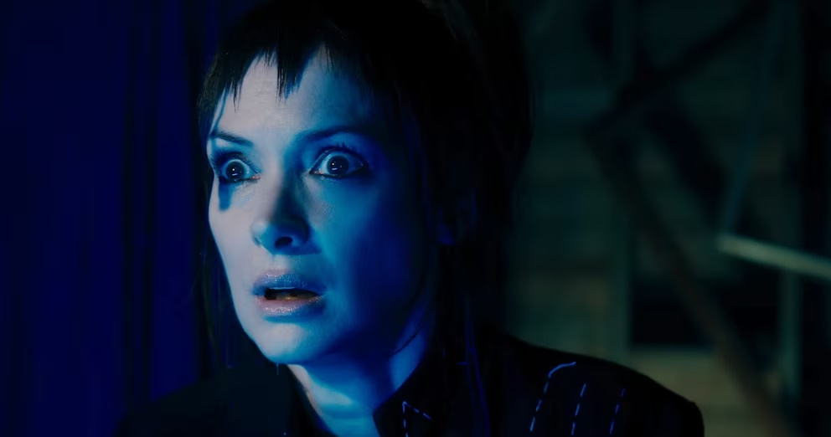
AUDIENCE SNAPSHOTS
25-44 ABC1 cinemagoers are more likely to be in market for a new car, new tech, are into active fashion & are more concerned about sustainability.
INTEND TO BUY CAR WITHIN THE NEXT YEAR
Index: 130
INTEND TO BUY A NEW LAPTOP/TABLET
Index: 139
‘I WEAR SPORTS/LEISUREWEAR EVEN WHEN I AM NOT EXERCISING/ TAKING PART IN SPORTS’
Index: 133
IT'S WORTH PAYING MORE FOR ORGANIC FOOD
Index: 152
INTEND TO BUY A NEW RATHER THAN SECONDHAND CAR
Index: 120
INTEND TO BUY A NEW MOBILE PHONE
Index: 145
AGREE THEY HAVE AN ACTIVE LIFESTYLE
Index: 134
I AM WILLING TO PAY MORE FOR SUSTAINABLE CLOTHING
Index: 144
‘I LIKE INNOVATIVE CARS’
Index: 152
I TRY TO KEEP UP WITH DEVELOPMENTS IN TECHNOLOGY
Index: 129
‘I LIKE TO KEEP UP WITH THE LATEST FASHION TRENDS’
Index: 172
I LIKE TO BUY PRODUCTS FROM COMPANIES WHO GIVE SOMETHING BACK TO SOCIETY
Index: 122
Source: TGI GB May 24
25-44 ABC1 who are cinemagoers vs. avg GB adult

Slide 6
DEAD GOOD FILMS
PREMIUM HORROR & THRILLER PACKAGE

Slide 7
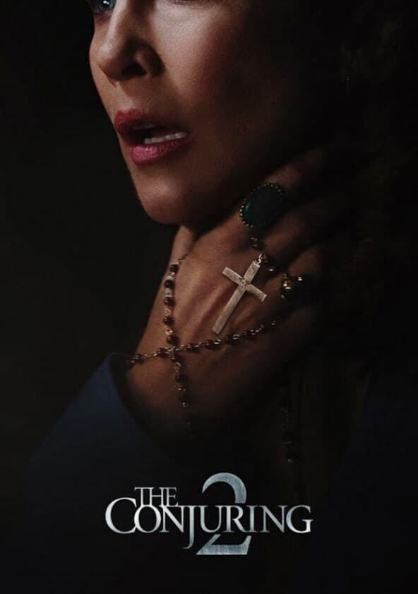
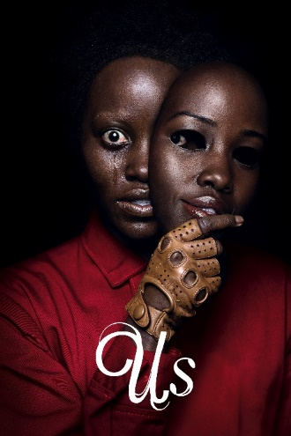
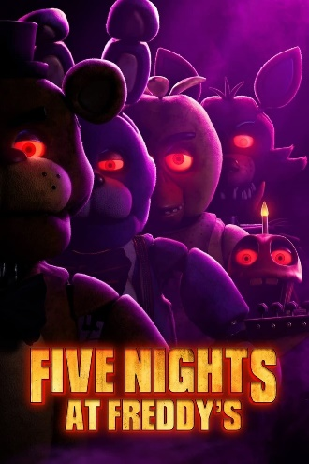
Horror/thrillers HAVE BECOME BIG BUSINESS at the box office
Horror admissions have significantly increased across the last 8 years, taking a great proportion of box office, driven by successes including It, Get Out, Smile, and A Quiet Place, The Conjuring and Halloween universes.
Selected highlights & genre % of admissions, by year
2015 | 2016 | 2017 | 2018 | 2019 | 2021 | 2022 | 2023
2.3%
2.6%
4.0%
5.8%
4.7%
7.8%
5.1%
6.1%
Horror genre % of DCM cinema admissions.
*2020 removed, only one major horror release due to pandemic closures

Slide 8
Horror/thrillers index more 16-24 than TikTok and love island
Horror film audiences are more 16-24 than average TikTok user and hit TV shows including Bridgerton, MAFS, Emily In Paris, and Love Island
Source: GB TGI May 2024. Tiktok used in last 4 weeks. 2023 Horror films.

Slide 9
Why brands should embrace the horror & THRILLER genre
Advertisers are missing a trick – horror movies give them a chance to engage a key youth audience
25%
more likely to watch a film on its opening weekend
2x
more likely to go to the cinema with 5-6 other people
2x
more likely to find cinema the most useful when making a purchase decision
Source: FAME 2022 Multibased with TGI GB Apr 2023. Target: Cinemagoers who love horror films. Index vs avg. UK adult.
Notes:
60% Cinema goers who have seen horror int eh past year agree with ‘I like to have technology that
1st bubble
3x more likely to go to the cinema weekly (TGI)
-
More likely than any other (mass) genres
2nd bubble
Pending Emily but predicting 8TVRS
3rd Bubble
66% of Horror fans are tech enthusiasts (ix.107) (IPA Touchpoints)
-
(A/A I like to have technology that makes life easier at home ~ Technology OR A/A I love to buy new gadgets and appliances ~ Technology)

Slide 10
HIGHLIGHTS COMING ACROSS THE NEXT 18 MONTHS
28 Years Later
The Exorcist: Deceiver
Heretic
SEP
OCT
NOV
DEC
JAN
FEB
MAR
APR
MAY
JUN
JUL
AUG
SEP
OCT
dec
Flight Risk

Slide 11
DEAD GOOD FILMS PARTNERSHIP
Creating ownership around the most exciting and best loved film genre among hard-to-reach 16-34s
GOLD
SPOT*
DCM IDENT TAKEOVER*
Own the last commercial message before all ‘Dead Good Films’
Bespoke
co-branded idents in all ‘Dead Good Films’ driving frequency
ODEON sponsorship targeting the Horror & Thriller genre.
Includes access exclusive distributor content
*Cineworld, ODEON & VUE only
Notes:
Until recently, brands have been missing a trick when it comes to Horror and Thriller content, underestimating the outstanding platform it provides to engage with a young audience.
Sponsorship of Dead Good Films is an opportunity to capitalise on this and to begin to build ownership around the most efficient genre when it comes to 16-34s.
Our work in the branded content space has demonstrated the power of bespoke content to make your cinema campaigns work even harder. We want to work together to celebrate and own the visceral nature of Horror, exploring the exciting and rich creative territory for your brand to play.
We have some exciting activations within the Dead Good Films package, including the opportunity to present the newly launched ‘Thrills & Chills’ sub-brand at ODEON in an exciting Media First. Working in partnership with the film distributors ‘Thrills & Chills’ curates and identifies the most exciting upcoming films for Horror fans, solidifying Odeon as THE ultimate destination for audiences to immerse themselves in the genre.

Slide 12
OWNING THE DEAD GOOD FILMS AD REEL
60” T&C ODEON
CONTENT
AFTER THE
FILM TRAILERS
60” AD
PREMIUM
POSITION
OPENING IDENT INCLUDED AS ADDED VALUE.
1.
DCM
OPENING IDENT
10”
2.
BRAND
ADS
3.
BRONZE
SPOT
4.
DCM
CLOSING
IDENT
15”
5.
SILVER SPOT
6.
FILM TRAILERS
7.
ODEON THRILLS & CHILLS TRAILER
60”
8.
GOLD SPOT
60”
9.
FILM
DEAD GOOD FILMS
CO-BRANDED IDENTS

Slide 13
MORE INFORMATION & COSTINGS
PLEASE CONTACT YOUR
DCM STUDIOS REP

Slide 14
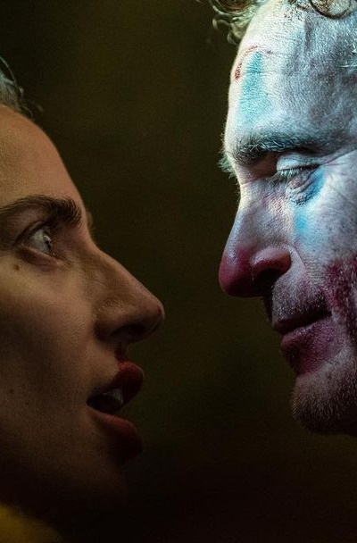
JOKER: Folie à Deux
The biggest film of the year for the 16-34 audience
RELEASE DATE | EST. INDUSTRY ADMISSIONS | GENRE | HFSS BRANDS | ALCOHOL/GAMBLING BRANDS
4 October 2024 | 4.3m | Thriller | Yes | Yes
SYNOPSIS
Plot is currently under wraps but will see Joaquin Phoenix, reprising his role as the Joker, and Lady Gaga as Harley Quinn.
CAST
Joaquin Phoenix, Lady Gaga, Zazie Beetz, Brendan Gleeson, Catherine Keener
THE DCM TAKE
2019’s Joker was a box office behemoth grossing over £58m in the UK, and propelled Joaquin Phoenix to a Best Actor win at the Oscars. Coming off committed and crowd-pleasing performances in House of Gucci and A Star Is Born, Lady Gaga joins the cast as Harley Quinn in what will surely be 2024’s most electric on-screen pairing.
We are forecasting that the film will deliver 19 16-34 Adult and 22 16-34 Men TVRs making it the year’s biggest film for these two audiences, and a must have for brands in Q4 across categories including motors, tech, alcohol, gaming and entertainment/leisure.
 | Adults (16+) | 16-34 Ads | 16-34 Men | ABC1 Ads | ABC1 Men
REACH | 7.8% | 15.9% | 18.0% | 10.0% | 12.6%
IMPACTS | 4.4m | 2.9m | 1.7m | 3.0m | 1.9m
TVRS | 9 | 19 | 22 | 11 | 15
Source: DCM, based on forecast industry admissions and comparative film profile

Slide 15
JOKER is the most successful dceu film of all time
Joker is the highest grossing DCEU film at the UK box office, ahead of all-time fan favourites such as The Dark Knight Rises and The Batman.
Sources: IBOE, Comscore Movies

Slide 16
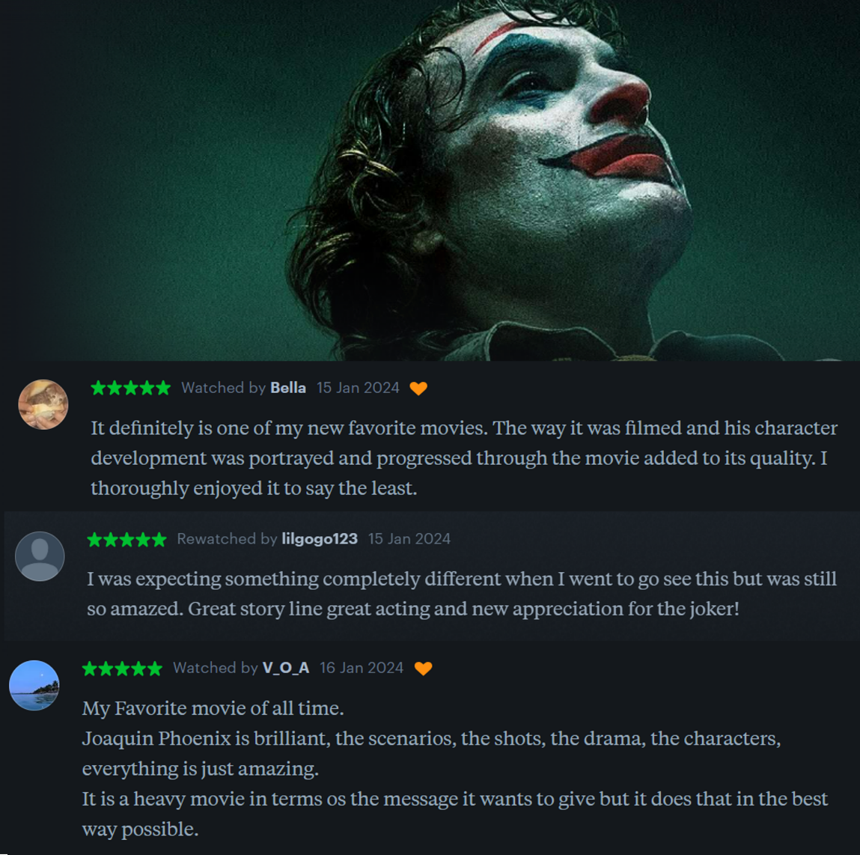
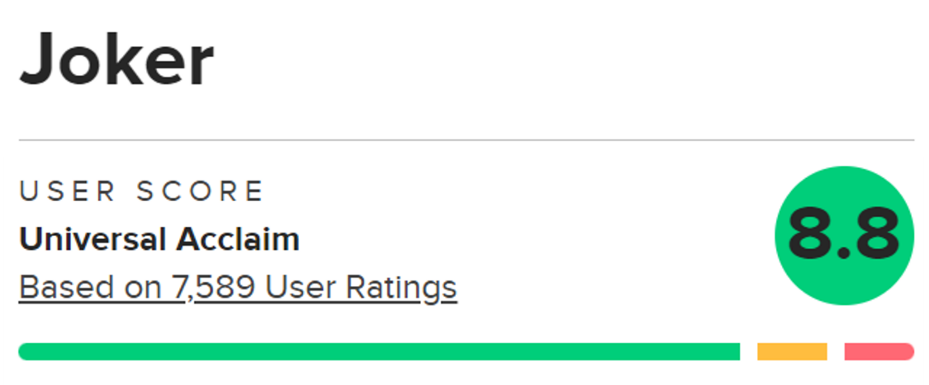
Audience reaction to the first movie was incredibly positive too
Joker was not only well received by critics, but audience reaction was very positive too. So, we anticipate a strong return performance for the sequel with audiences keen to see how the story continues, especially with the new additions to the cast.
Audience reactions across Metacritic, Rotten Tomatoes, Letterboxd
Source: Metacritic, Rotten Tomatoes & Letterboxd

Slide 17
JOKER: Folie à Deux is FORECAST TO BE the biggest film for young adults this year
Out of the forecasted top 10 blockbusters this year, Joker: Folie a Deux is forecast to deliver the biggest 16-34 TVRs of any title - 18 TVRs – ahead of Deadpool 3.
Jan Dec
Source: DCM, Jan 2024. Based on industry admissions forecasts and comparative film profiles

Slide 18
JOKER: Folie à Deux WILL DELIVER A YOUNG male AUDIENCE
Based on current forecasts we estimate that Joker will deliver just under 22 16-34 Men TVRs in its opening 10 weeks
Source: CAA C+F Planner. Predicted industry admissions.

Slide 19
JOKER: Folie à Deux is an efficient 16-34 men add to your broader av plan
c.40% of Joker’s audience are forecast to be 16-34 Men – making it a more efficient buy than many TV spots for reaching this audience
Sources: Adwanted Connected, top rating 16-34 Men shows (top episodes for each series), January-October
% of adult (16+) audience that are 16-34 Men. Joker Folie A Deux based on profile of first film.

Slide 20
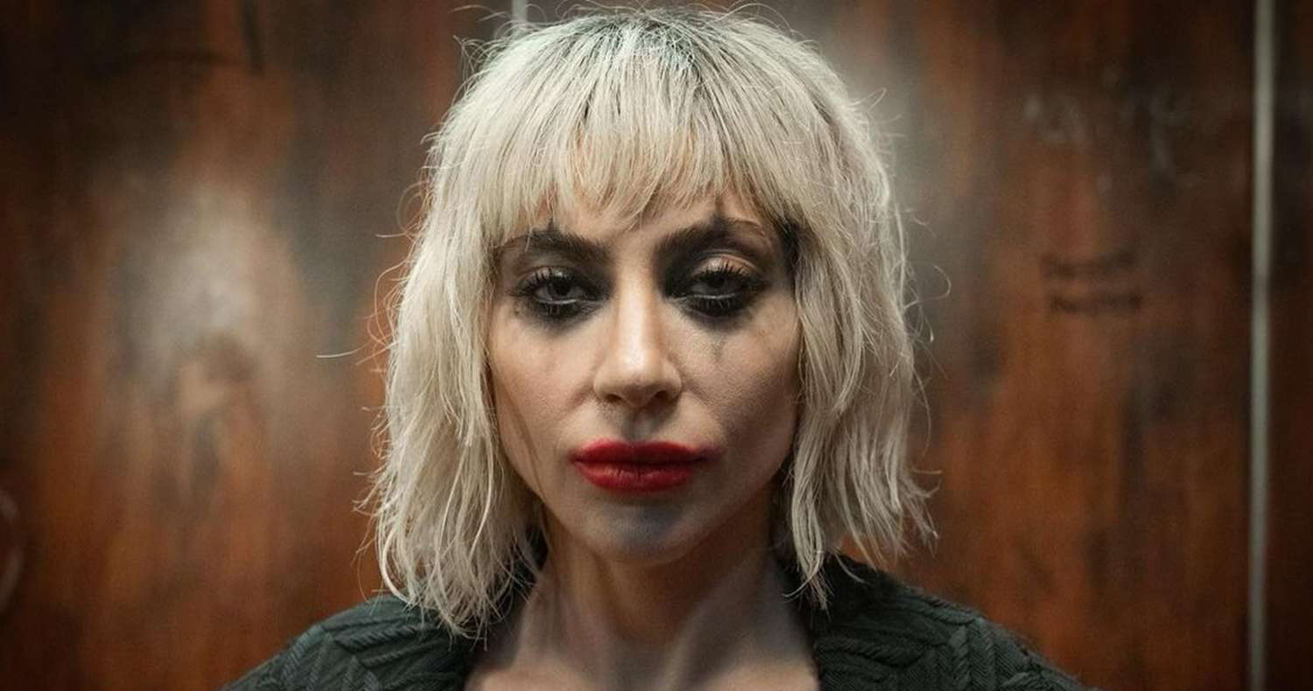
AUDIENCE SNAPSHOTS
16-34 male cinemagoers are more likely to be in market for a new car, new tech, financial products and alcoholic drinks.
INTEND TO BUY CAR IN NEXT 12 MONTHS
Index: 122
INTEND TO BUY A NEW LAPTOP/TABLET
Index: 123
CURRENTLY HAVE AN ISA
Index: 117
CONSUME ALCOHOLIC DRINKS
Index: 115
INTEND TO SPEND >£45K ON NEW CAR
Index: 116
INTEND TO BUY A NEW MOBILE PHONE
Index: 112
CURRENTLY HAVE A MORTGAGE
Index: 122
CONSUME NON-ALCOHOLIC BEERS, WINES & SPIRITS
Index: 116
ADVERTISING & BRAND IMAGE ARE KEY CRITERIA FOR CHOICE OF CAR
Index: 130
INTEND TO BUY A NEW SMART TECH
Index: 118
OPENED A NEW CURRENT ACCOUNT IN LAST 12M
Index: 118
67% AGREE ‘I LIKE TO TRY NEW DRINKS’
Index: 109
Source: TGI GB Oct 2023.
16-34 Men who have been to cinema in last 12 months vs. average 16-34 man

Slide 21
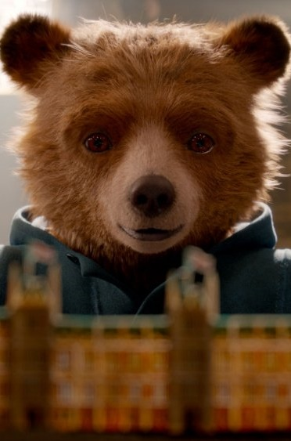
Paddington in peru
A third adventure for one of the nation’s most beloved characters
RELEASE DATE | EST. INDUSTRY ADMISSIONS | GENRE | HFSS BRANDS | ALCOHOL/GAMBLING BRANDS
8 November 2024 | 5m | Adventure | No | No
SYNOPSIS
Paddington and the Browns visit Aunt Lucy in Peru, but a mystery sends them to the Amazon rainforest & up Peruvian mountains.
CAST
Ben Whishaw, Hugh Bonneville, Olivia Colman, Antonio Banderas, Emily Mortimer, Imelda Staunton, Jim Broadbent, Julie Walters
THE DCM TAKE
Seven years on from Paddington 2 everyone’s favourite marmalade-obsessed bear is back for another adventure. Both films so far have been incredibly charming tales that have delivered £38m-£43m at the UK box office and secured multiple BAFTA nominations. Dougal Wilson, who cut his directing teeth on many of the classic John Lewis Christmas ads, takes over the reins for this film with Simon Farnaby (co-creator of BBC hit comedy Ghosts) returning as co-writer so charm, comedy and tear-jerker moments are guaranteed.
The film takes Paddington to South America so perfect thematic fit for travel brands wanting to entice audiences with holiday ideas, and of course with a release date of 8 November it’s perfectly timed for launching any festive campaign. Brands are already keen, as at the time of writing, we’ve already had significant interest in premium positions. Watch the trailer here
 | Adults (16+) | 16-34 Ads | Houseperson with Children | ABC1 Ads | ABC1 Women
REACH | 6.8% | 5.6% | 11.6% | 8.5% | 10.0%
IMPACTS | 3.9m | 908k | 1.5m | 2.6m | 1.6m
TVRS | 8 | 6 | 14 | 10 | 12
Source: DCM, based on forecast industry admissions and comparative film profile

Slide 22
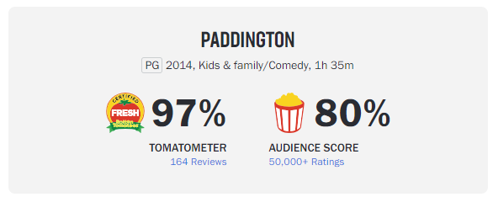
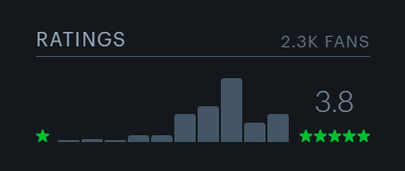
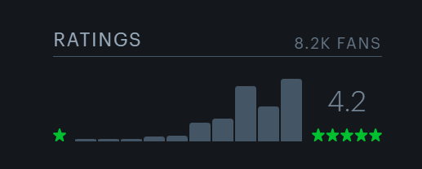
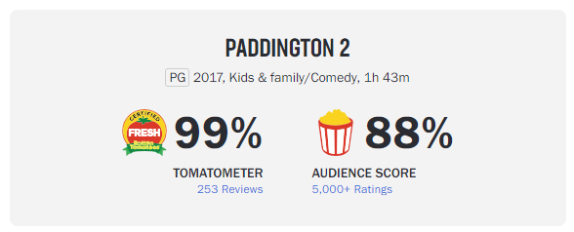
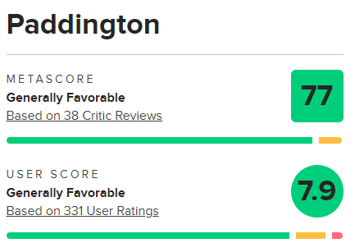
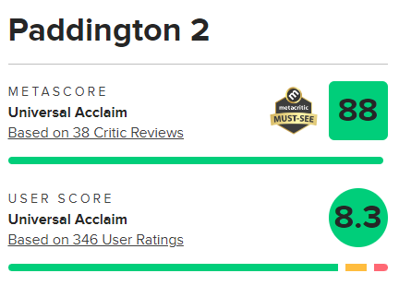
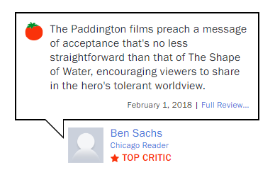
The uk’s national treasure
Not only was Paddington well received by audiences and critics alike, Paddington 2 performed even stronger, delivering higher audience scores and critic reviews.
Audience reactions across Rotten Tomatoes, Time Out, Metacritic & Letterboxd
1
2
Source: Metacritic, Rotten Tomatoes & Letterboxd

Slide 23
reach families and affluent audiences with Paddington in Peru
The film is forecast to deliver 12 ABC1W TVRs and 10 ABC1 Adult TVRs within its opening 10 weeks.
Source: CAA C+F Planner. Predicted industry admissions

Slide 24
One of the most BIGGEST CULTURAL MOMENTS TO ADD TO YOUR FESTIVE AV PLAN
Paddington in Peru is forecast to be a more efficient buy than many TV spots for the lead up to Christmas.
Sources: Adwanted Connected, top rating shows (avg. impacts for episodes for each series), October – December 2023
Paddington In Peru based on comparative profile

Slide 25
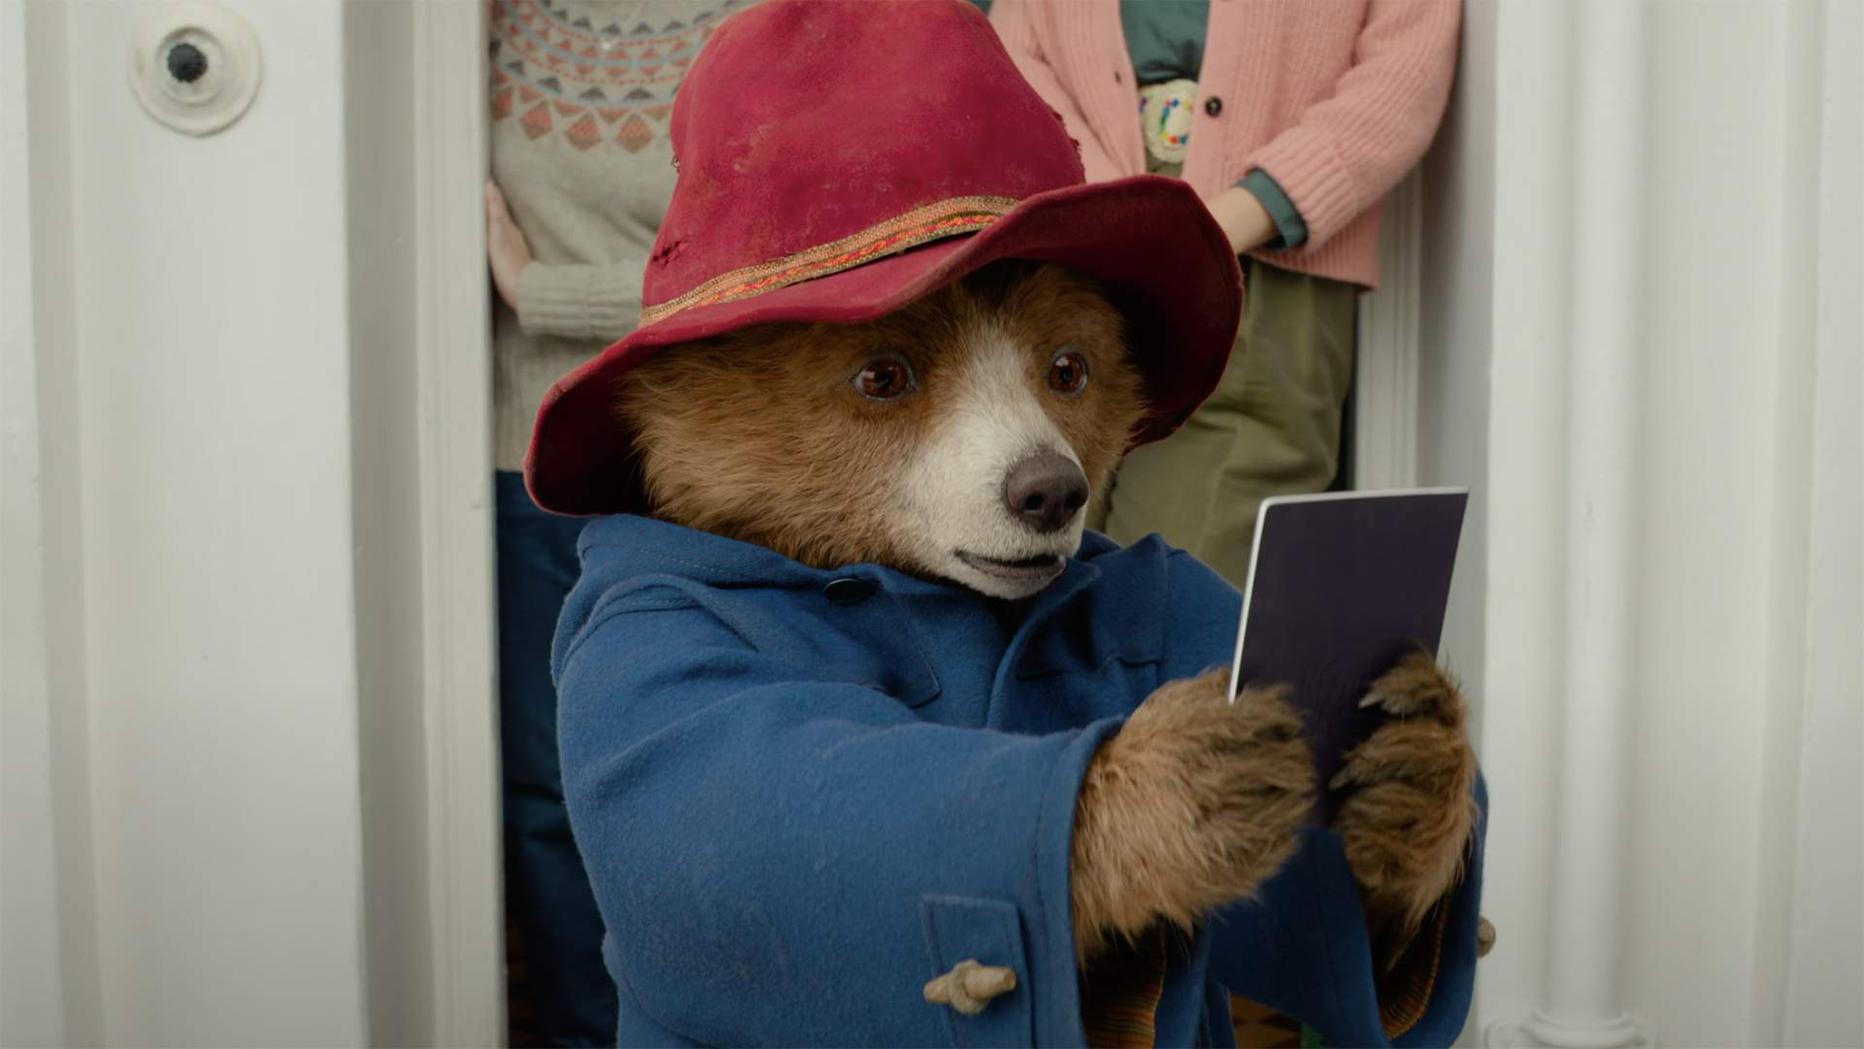
AUDIENCE SNAPSHOTS
Frequent affluent cinemagoers are more likely to be in market for new tech, a holiday and innovative household items.
Travel & Holiday
Food
DIY & Household
Health & Beauty
Tech & Automotive
53%
Plan to book a holiday in the next year
(Index: 112)
74%
‘I like to try out new food products’
(Index: 124)
62%
‘I'm always looking for new ideas to improve my home’
(Index: 143)
55%
Beauty/Styling products help me feel good about myself
(Index: 140)
70%
More likely to agree they like innovative cars
72%
‘I am passionate about travelling’
(Index: 146)
64%
More likely to agree they are tempted to buy products they have seen advertised
44%
More likely to agree they like innovative household devices and appliances
2x
More likely to be interested in innovations in cosmetics
54%
More likely to be in the market for a mobile phone or headphones
Source: TGI GB Jan 2024.
ABC1 heavy cinemagoers vs. average GB adult

Slide 26
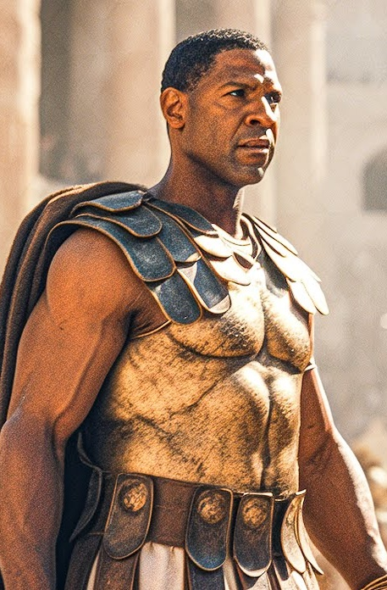
GLADIATOR II
The follow-up to the 2000 classic epic and Best Picture winner
RELEASE DATE | EST. INDUSTRY ADMISSIONS | GENRE | HFSS BRANDS | ALCOHOL/GAMBLING BRANDS
15 November 2024 | 2.4m | Action | Yes | Yes
SYNOPSIS
After being saved by Maximus in Gladiator, Lucius, the nephew of Commodus, is now a grown man.
CAST
Denzel Washington, Paul Mescal, Pedro Pascal, Connie Nielsen, Joseph Quinn, Derek Jacobi
THE DCM TAKE
Gladiator was a huge hit in the UK, taking £31m at the box office back in 2000, and was the #1 movie at the UK box office for 7 weekends – a feat only matched by Avatar and Tenet since. Director Ridley Scott reunites with screenwriter David Scarpa (Napoleon) to revisit this historical epic and pick the story up years later, with internet favourites Paul Mescal and Pedro Pascal now in leading roles.
We expect this film will play well with an ABC1-skewing male audience, and with a release date at the end of November is perfectly timed for extending reach and cut through with this audience in the lead up to the key festive period.
 | Adults (16+) | 16-34 Ads | 16-34 Men | ABC1 Ads | ABC1 Men
REACH | 4.6% | 6.0% | 8.0% | 6.0% | 7.3%
IMPACTS | 2.4m | 992k | 677k | 1.3m | 1m
TVRS | 5 | 6 | 8 | 6 | 8
Source: DCM, based on forecast industry admissions and comparative film profile

Slide 27
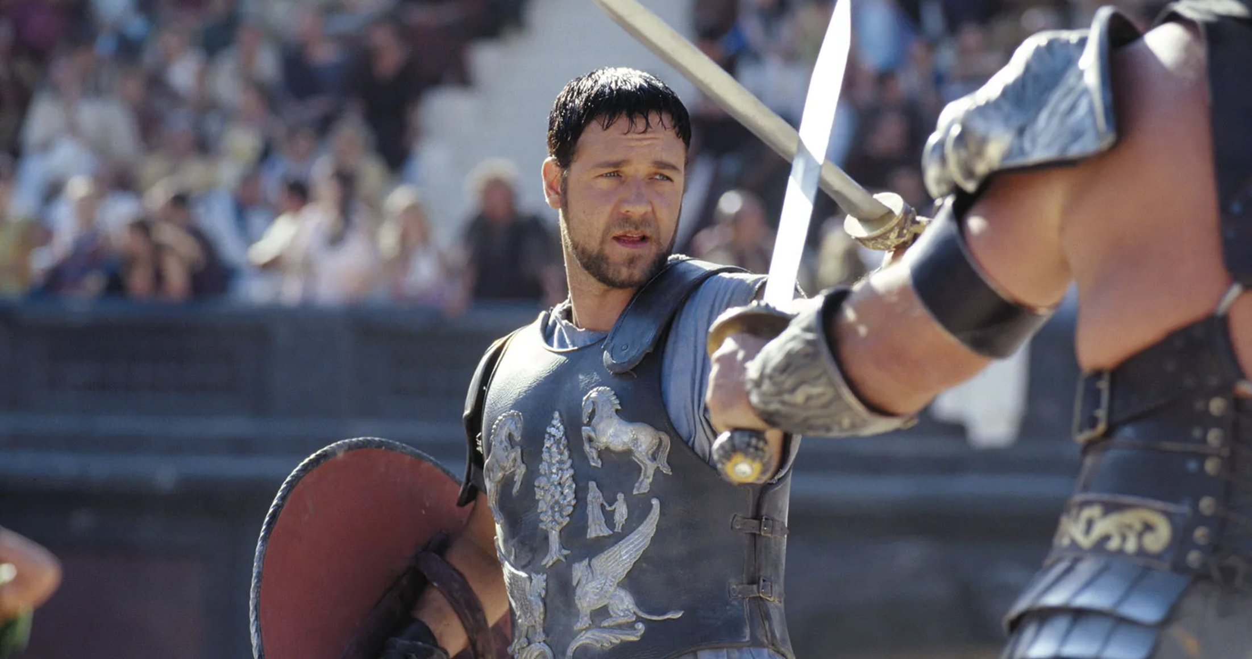
The acclaimed predecessor
The first movie released in 2000 to box office success, critical acclaim and awards success.
£31m
UK box office – the second-biggest box office film of 2000 behind Toy Story 2
5
Academy Awards won, including two of the biggest prizes for Best Picture and Best Actor
#36
In the IMDB Top 250
Source: IBOE, Academy Awards Database, BAFTA Awards Database

Slide 28
Ridley Scott HAS BEEN A CONSISTENT HIT-MAKER AT THE UK BOX OFFICE
Ridley Scott consistently delivers big cinematic events that draw in audiences to see the blockbusters in the best possible viewing environment
Prometheus
£25m UK BO
Alien: Covenant
£13m UK BO
Napoleon
£14.5m UK BO
The Martian
£24m UK BO
House Of Gucci
£10m UK BO
Source: Comscore Movies

Slide 29
Gladiator 2 will be ONE OF the most efficient films for upmarket Men in 2024
This sequel is predicted to be one of the most efficient titles for ABC1 Men in 2024.
60% of GB population are ABC1
49% of GB population are male
Source: DCM Plannet, Film Monitor profiles based on comparative titles

Slide 30
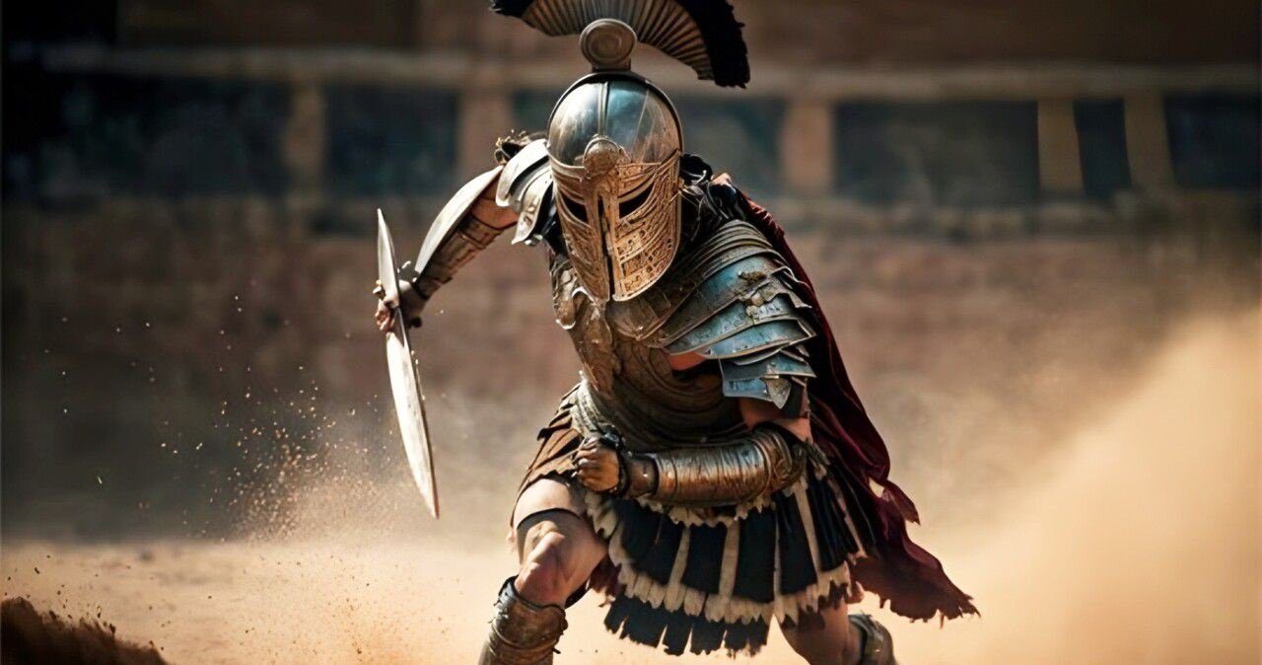
AUDIENCE SNAPSHOTS
ABC1 male cinemagoers are more likely to be in market for a new car, new tech, financial products and alcoholic drinks.
INTEND TO BUY CAR IN NEXT 12 MONTHS
Index: 145
INTEND TO BUY A NEW PC/LAPTOP
Index: 164
CURRENTLY HAVE A PREMIUM/PACKAGED CURRENT ACCOUNT
Index: 117
CONSUME ALCOHOLIC DRINKS
Index: 115
INTEND TO SPEND >£45K ON NEW CAR
Index: 228
INTEND TO BUY A NEW MOBILE PHONE
Index: 126
CURRENTLY HAVE A MORTGAGE
Index: 144
CONSUME NON-ALCOHOLIC BEERS AND CIDERS
Index: 133
ADVERTISING & BRAND IMAGE ARE KEY CRITERIA FOR CHOICE OF CAR
Index: 207
INTEND TO BUY A NEW SMART TECH
Index: 145
USE A PRICE COMPARISON WEBSITE TO MAKE PURCHASES
Index: 122
67% AGREE ‘I LIKE TO TRY NEW DRINKS’
Index: 109
Source: TGI GB October 2023.
ABC1 Men who have been to cinema in last 12 months vs. GB Avg

Slide 31
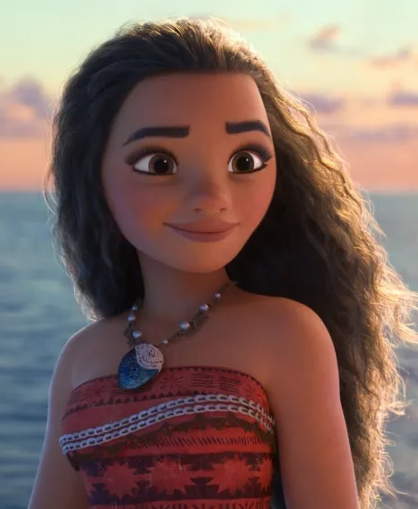
Moana 2
Long-awaited sequel to the hit animated musical film
RELEASE DATE | EST. INDUSTRY ADMISSIONS | GENRE | HFSS BRANDS | ALCOHOL/GAMBLING BRANDS
27 November 2024 | 2.7m | Family | No | No
SYNOPSIS
Moana journeys to the far seas of Oceania after receiving an unexpected call from her wayfinding ancestors.
CAST
Auliʻi Cravalho, Dwayne Johnson
THE DCM TAKE
Eight years after the original Moana, Disney have announced that a sequel is on its way in 2024, bringing back its stars Auliʻi Cravalho as Moana and Dwayne Johnson as Maui. Moana grossed £20.6m at the UK box office back in 2016 and won 14 awards across several industry categories, and in the years since it’s stature has only grown and it has consistently been one of the most watched films on streaming platforms. Released at the end of November, this animated musical film is perfectly timed for brands looking to reach affluent family audiences in the lead up to Christmas.
Reactions for the animation have been positive, with the most recent trailer becoming the studio’s most watched ever for an animated movie, clocking 178m views in 24 hours, outperforming previous record holders such as Inside Out 2 (157m) and Frozen 2 (116m). You can watch the trailer here
 | Adults (16+) | 16-34 Ads | Female Houseperson with Children | ABC1 Ads | ABC1 Women
REACH | 3.9% | 6.8% | 8.6% | 4.6% | 5.3%
IMPACTS | 2m | 1.1m | 558k | 1.3m | 795k
TVRS | 4.2 | 7.4 | 9.2 | 5.0 | 5.8
Source: DCM, based on forecast industry admissions and comparative film profile

Slide 32
One of the most efficient films for hp+ch to add to your broader av plan
A third of Moana 2’s audience are forecast to be HP+CH – making it a more efficient buy than many TV spots for reaching this audience
Sources: Adwanted Connected, top rating HP+CH shows (top episodes for each series), October – December 2023
% of adult (16+) audience that are HP+CH. Moana 2 based on comparative profile & who are female HP+CH

Slide 33
reach families and affluent audiences with moana 2
The film is forecast to deliver 11 HP+CH TVRs and 7 16-34 TVRs within its opening 8 weeks.
Source: CAA C+F Planner. Predicted industry admissions

Slide 34
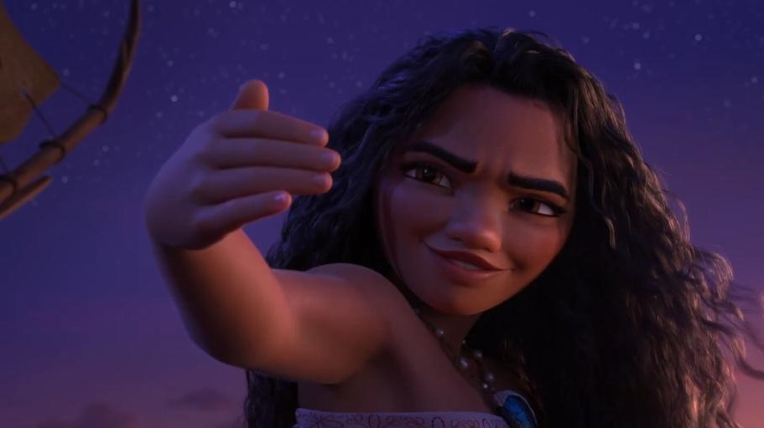
The family audience
Mainshoppers with children are more likely to be in market for household products and a holiday abroad.
More likely to plan to spend a lot of money on buying a new smartphone
(Index: 177)
‘I like to try out new food products’
(Index: 179)
More likely to plan to spend a lot of money going on holiday abroad
(Index: 200)
‘I like innovative household devices/appliances’
(Index: 139)
Intending on buying smart technology for home
(Index: 147)
‘I am tempted to buy products I’ve seen advertised’
(Index: 182)
‘I am always looking for inspiration on where to go for holidays’
(Index: 148)
Spend on avg. 10 hours
gaming (3 more hours than the average UK adult)
“It is important my household is equipped with the latest technology”
(Index: 139)
I often try new household cleaning products
(Index: 155)
‘I am passionate about travelling’
(Index: 123)
More likely to love to buy new gadgets and appliances
(Index: 178)
Source: TGI GB May 24
Mainshopper with children in the household vs. avg GB adult

Slide 35
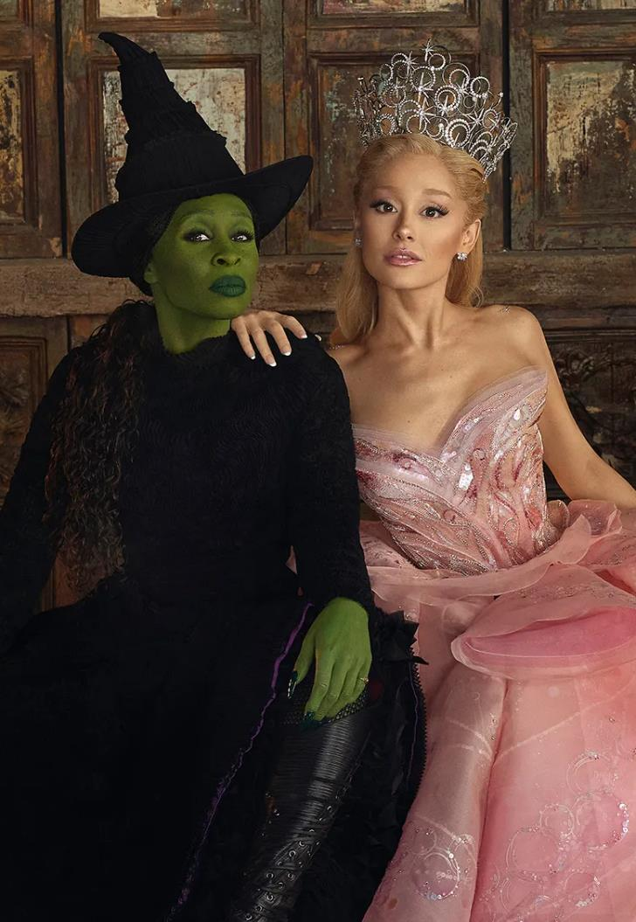
WICKED
The highly anticipated adaptation of one of the most popular musicals
RELEASE DATE | EST. INDUSTRY ADMISSIONS | GENRE | HFSS BRANDS | ALCOHOL/GAMBLING BRANDS
28 November 2024 | 4.9m | Musical | Yes | No
SYNOPSIS
The story of how Elphaba, a green-skinned woman framed by the Wizard of Oz, becomes the Wicked Witch of the West.
CAST
Ariana Grande, Cynthia Erivo, Jonathan Bailey, Michelle Yeoh, Jeff Goldblum, Bowen Yang
THE DCM TAKE
Looking to follow the path set by smash-hits of Les Misérables and Mamma Mia!, the long-awaited big screen adaptation of Wicked is coming and the anticipation is high. The stage show has been a huge hit in the UK - running in London’s West End since 2006 and seen by over 12 million people across 6,500+ performances. Director Jon M. Chu (Crazy Rich Asians) is coming off musical adaptation In The Heights which showcased his pedigree for creating thrilling musical moments. With a leading cast of Grande and Erivo, the film is bringing together one the world’s best popstars and a Tony-award winning musical theatre performer and multi-Oscar nominee.
Wicked will be one of the best ways for brands to reach an affluent, young-skewing female audience – and is perfectly timed to help maximise reach and cut through for festive campaigns.
 | Adults (16+) | 16-34 Ads | 16-34 Women | ABC1 Ads | ABC1 Women
REACH | 7.0% | 8.4% | 11.3% | 9.5% | 12.5%
IMPACTS | 3.9m | 1.4m | 956k | 2.8m | 1.9m
TVRS | 8 | 9 | 12 | 10 | 15
Source: DCM, based on forecast industry admissions and comparative film profile

Slide 36
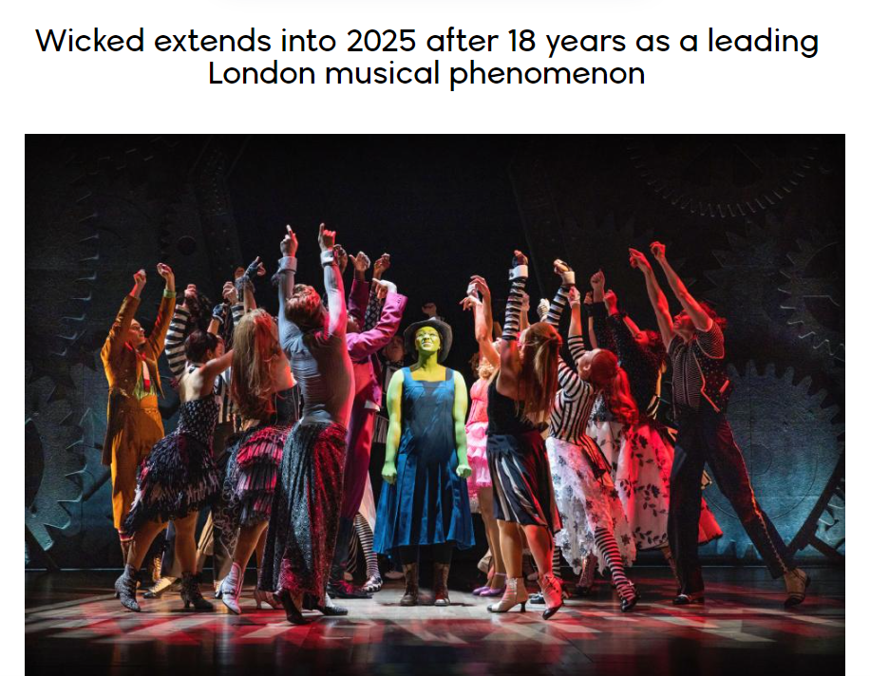
One of the most successful musicals of all time
In addition to critical acclaim, for the past 20 years Wicked has been majorly influential in numerous popular culture moments, contributing to its success worldwide.
Wicked is already the 11th longest-running West End production in history.
An integral and trusted part of London’s visitor landscape since its UK premiere in 2006 and the winner of more than 100 global awards, Wicked successfully welcomes over 800,000 people every year to London’s Apollo Victoria Theatre and has gained over 50m worldwide ticket sales since its debut on Broadway in 2003.
Source: https://www.scotsman.com/arts-and-culture/theatre-and-stage/wicked-global-success-story-flying-high-on-acclaim-1552260

Slide 37
reach affluent women with wicked
The film is forecast to deliver 15 ABC1W TVRs and 12 16-34W TVRs
Source: CAA C+F Planner. Predicted industry admissions

Slide 38
wicked THE MOST EFFICIENT FILM FOR REACHING AFFLUENT WOMEN IN Q4
Wicked is one of the strongest ABC1 films during an efficient time for premium audiences
51% of GB population are female
54% of GB population are ABC1
Selected 2024 titles from Q4, demographics based on comparative Film Monitor profiles.
Dotted lines represent GB population profile

Slide 39
One of the most efficient films for abc1 + 1634 women to add to your av plan
Wicked’s audience is very efficient both affluent and younger-skewing than many major peak TV spots
Sources: Adwanted Connected, top rating shows (top episodes for each series), Nov – Dec 2023
% of adult (16+) audience that are ABC1 Women. Wicked based on comparative profile.

Slide 40
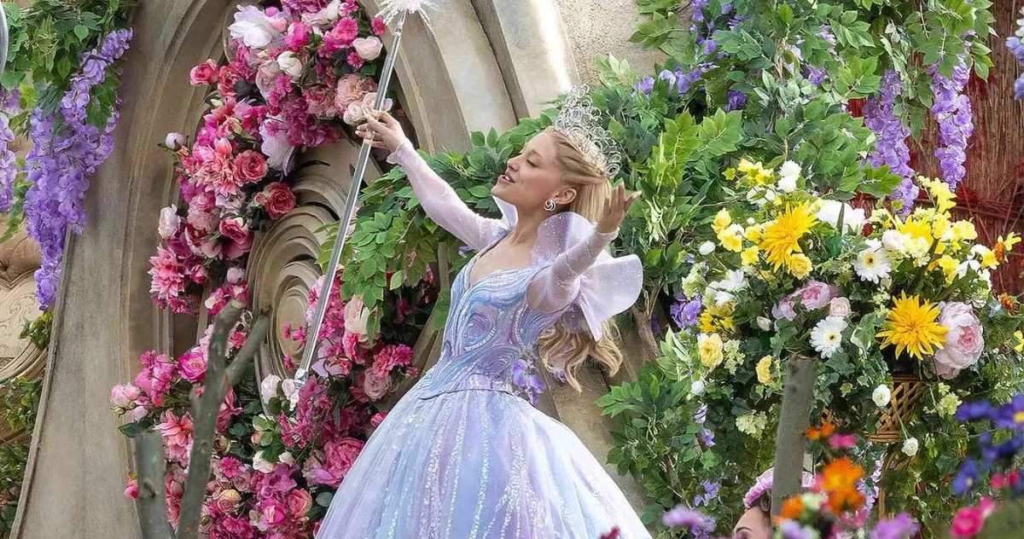
AUDIENCE SNAPSHOTS
Fans of musical films are more likely to be in market for innovative household items and plan to book a holiday.
Travel & Holiday
Food
DIY & Household
Health & Beauty
66%
Plan to book a holiday in the next year
(Index: 127)
67%
‘I like to try out new food products’
(Index: 112)
50%
‘I'm always looking for new ideas to improve my home’
(Index: 111)
51%
Beauty/Styling products help me feel good about myself
(Index: 129)
60%
‘I am passionate about travelling’
(Index: 119)
65%
Spend money on food up to 3 days a week
(Index: 117)
46%
agree they like innovative household devices and appliances
(Index: 109)
24%
More likely to be interested in innovations in cosmetics
Source: TGI GB Mar 2024.
Fans of musical films vs. average GB adult

Slide 41
FILM SLATE 2025
TRON
ARES
Insidious (Sequel)
BALLERINA
VICIOUS
JAN
Feb
Mar
APR
MAY
JUN
JUL
AUG
SEPT
OCT
NOV
DEC
28 Years Later

