Slide 1
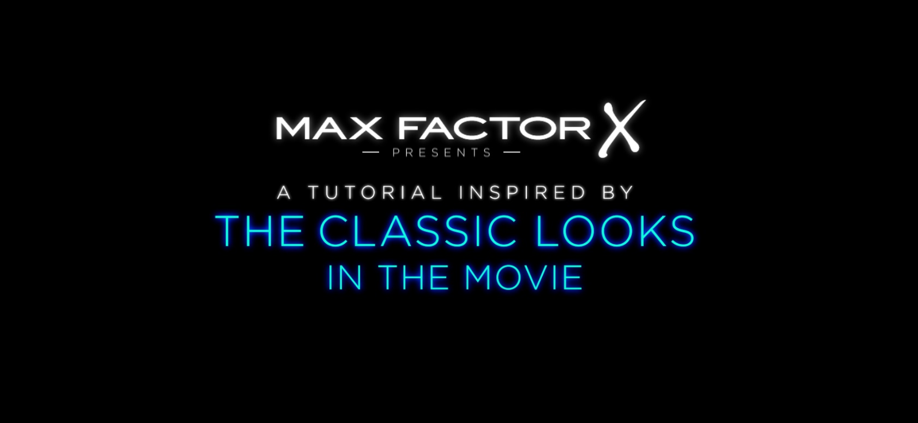
CASE STUDY – MAX FACTOR
Get The Look
Background
Despite having a strong heritage and vision, Max Factor was experiencing a disconnect with its consumers due to an inundation of new entrants to the cosmetics market.
Brand awareness was high, so the challenge was to make the public’s relationship with Max Factor more meaningful, using its rich heritage as the springboard. The brand needed to cement its position as the experts in make-up artistry through driving relevance, consideration and brand love among its target audience.
Idea
Max Factor has been responsible for creating some of the most glamorous looks for iconic actresses and the brand wanted to re-connect with its Hollywood heritage. Murder On The Orient Express and The Greatest Showman presented a great opportunity to engage its target audience of affluent women 35-54.
We suggested creating bespoke content for cinema in the form of make-up tutorials that would dovetail with Max Factor’s Get The Look campaign and inspire cinemagoers to see how easy it was to recreate the ‘film-star’ look by using Max Factor products.
Plan
Looking to reach an affluent female audience, Max Factor became the first event partner of DCM’s flagship boutique estate cinemas: Curzon, Everyman & Picturehouse. Alongside screen time activity running across all titles in these cinemas the partnership also extended to off-screen activations including exclusive premiere events, online & social media presence and competitions.
Campaign Details
Sector | Cosmetics & Personal Care | Media Agency | Zenith
Target Audience | Women 35-54 | Creative Agency | Recipe
Package | Boutique Partnership (Curzon, Everyman & Picturehouse) | Duration | 60”

Slide 2
CASE STUDY – MAX FACTOR
Get The Look
Uplift in unprompted comms awareness:
Cinema exposed are 13% more likely to be aware of Max Factor advertising vs. control (no exposure in cinema)
Cinema exposed = 26%, Control = 23%
SUMMARY
The campaign was a glittering success delivering a significant impact amongst the brand’s target audience of 35-54 female cinemagoers.
The cinema activity helped re-affirm Max Factor’s association with Hollywood glamour and re-enforced perceptions of quality. The tutorial creatives also helped drive consideration of Max Factor’s key products and ultimately helped drive sales.
Healthy Skin Harmony saw 3.5% value sales growth when the foundation category is in overall decline and Max Factor was the number 1 selling brand in Boots across the key December period.
Driving key perceptions further:
Those exposed to the cinema activity are 17% more likely to agree that Max Factor have ‘quality products’ vs. control
All agree: Cinema exposed = 48%, Control = 41%
Uplift in consideration:
Those exposed to the cinema activity are on average 30% more likely to consider Max Factor five core products vs control

