Slide 1
MARVEL CINEMATIC UNIVERSE
The upcoming releases from cinema’s biggest franchise

Slide 2
MARVEL CINEMATIC UNIVERSE:
THE BIGGEST CINEMA
FRANCHISE OF ALL TIME
TAKING OVER £850M AT
THE UK BOX OFFICE ALONE
Source: IBOE

Slide 3
Fans of the mcu are more likely to be young, male and ABC1.
Marvel films should be an attractive proposition for any brands wanting to engage with a young male audience
Source: GB TGI March 2022 – Fans of Marvel franchise and are cinemagoers

Slide 4
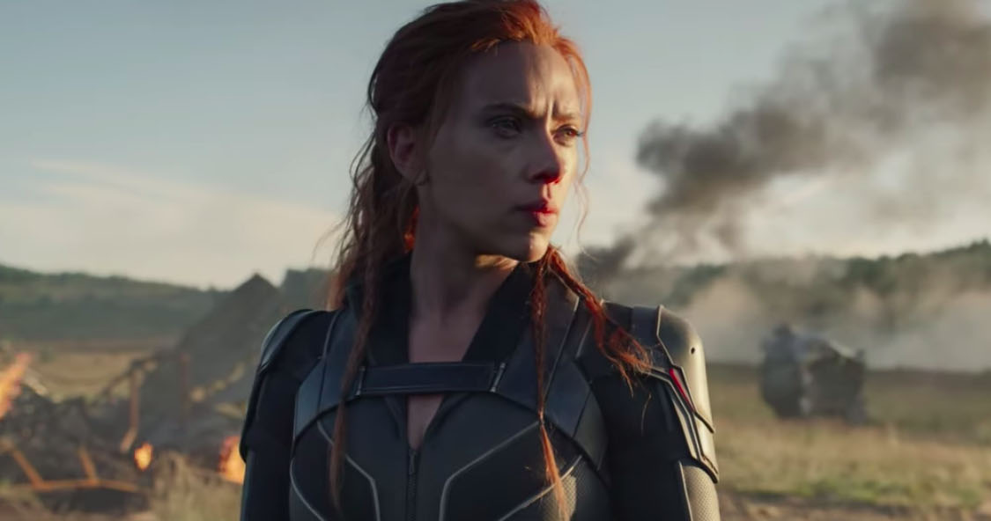
AUDIENCE SNAPSHOTS: MARVEL FANS
Category insights
MOTORS
FOOD
RETAIL
“I LIKE INNOVATIVE CARS”
Index: 126
“I LIKE TO TRY NEW RECIPES”
Index: 113
VISITED MAJOR
SHOPPING CENTRES
Index: 113
INTEND TO BUY CAR IN NEXT 24 MONTHS
Index: 121
“I LIKE TO EAT TAKEAWAY MEALS”
Index: 127
AMOUNT SPENT ON ONLINE SHOPPING IN LAST SIX MONTHS
Index: 107
INTEND TO BUY – NEW (NOT SECONDHAND)
Index: 117
EATEN AT A RESTAURANT
Index: 114
“BUY NEW PRODUCTS BEFORE MOST OF MY FRIENDS”
Index: 108
Source: TGI GB March 2022, Film Franchise Fans – Marvel, Index vs GB average

Slide 5
THE MARVEL AUDIENCE IS A PERFECT MATCH FOR GAMING & TECH BRANDS
Marvel fans: Gaming & Tech insights
CONSOLE GAMERS
Index: 174
“LOVE TO BUY NEW GADGETS & APPLIANCES”
Index: 131
INTEND TO PURCHASE: LAPTOP/TABLET
Index: 129
“MY FAVE PASTTIME IS PLAYING VIDEO GAMES”
Index: 143
“TRY TO KEEP UP WITH TECH DEVELOPMENTS”
Index: 117
INTEND TO PURCHASE: SMARTPHONE
Index: 134
INTEND TO PURCHASE: GAMES CONSOLE
Index: 195
“I LIKE INNOVATIVE H/HOLD DEVICES”
Index: 120
INTEND TO PURCHASE: HOME OR PERSONAL SMART TECH
Index: 149
Source: TGI GB March 2022, Fans of the Marvel film franchise.
Indexes vs average GB adult (15+)

Slide 6
2022 CINEMA RELEASES
After a year of mostly introducing new characters to the MCU, Marvel’s 2022 features on sequels starring well-established characters
Doctor Strange In The Multiverse of Madness
Thor: Love and Thunder
Black Panther: Wakanda Forever
5 May 2022
8 July 2022
11 November 2022

Slide 7
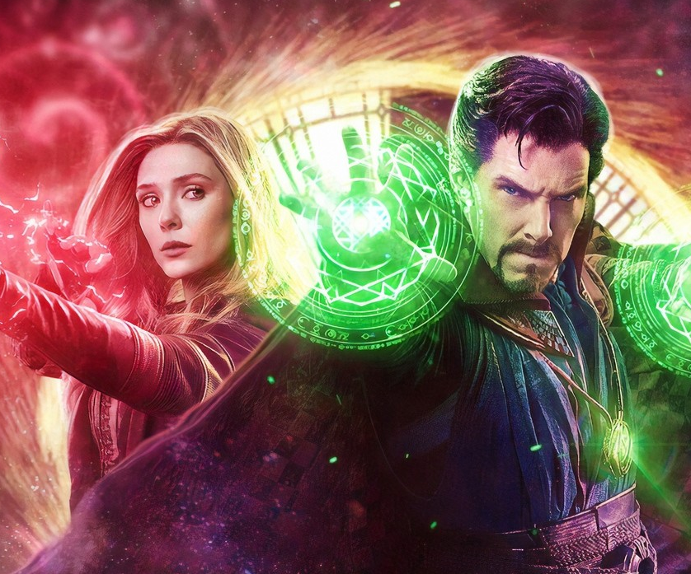
DOCTOR STRANGE IN THE MULTIVERSE OF MADNESS
Phase four of the MCU gets deep into the multiverse
If you saw the box office behemoth that was Spider-Man: No Way Home, you’d know that it was Dr. Stephen Strange casting questionable spells that caused the multiverse to open up and all manner of old characters to return to the big screen. In May 2022 he gets another of his own films where he once again casts a forbidden spell that opens the door to the multiverse, including an alternate version of himself, whose threat to humanity is too great for the combined forces of Strange, Wong, and Wanda Maximoff. Expect some No Way Home style surprises along the way too.
CAST
Benedict Cumberbatch, Elizabeth Olsen, Chiwetel Ejiofor, Rachel McAdams and Benedict Wong
KEY STATS
Spider-Man: Far From Home – which heavily featured Dr Strange and set up the events of this movie - delivered over 3.5m industry admissions¹ in its opening five days and the fourth biggest opening at the UK box office² of all time. It’s expected to deliver 9m industry admissions overall.
EST. INDUSTRY ADMISSIONS
5.1m
REACH / IMPACTS / TVRs³
All adults (16+): 7.4% / 4.5m / 9.2
16-34 adults: 15.2% / 3.1m / 20.0
16-34 men: 19.2% / 2.1m / 26.6
Source: 1. DCM Admissions Cube 2. IBOE . 3. Industry figures.
RELEASE DATE: 5 MAY 2022

Slide 8
DOCTOR STRANGE IN THE MULTIVERSE OF MADNESS WILL DELIVER A YOUNG MALE AUDIENCE
Based on current forecasts we estimate that Doctor Strange In The Multiverse In Madness will deliver over 25 16-34 Men TVRs
16-34 adults
38%
Index 130
Women (16+)
59%
Index 129
ABC1 (16+)
72%
Index 150
Source: CAA C+F Planner. Predicted industry admissions.

Slide 9
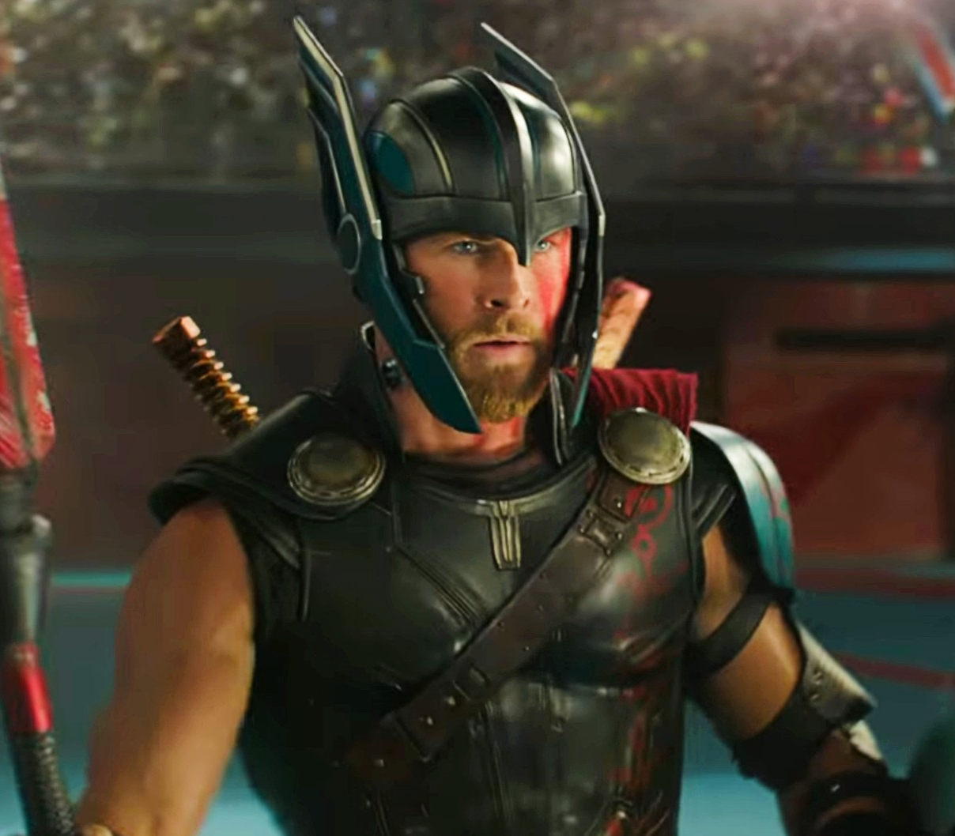
THOR: LOVE AND THUNDER
Big things are happening in the world of Thor
Taika Waititi’s Thor: Ragnarok, with its offbeat, self-referential humour transformed the Marvel Cinematic Universe and Waititi is back to helm the potentially huge Thor: Love And Thunder. It’s packed full of big news too – Natalie Portman returns as Jane Foster, and is all set to take over as Thor (yes she wields the hammer), Christian Bale returns to superhero films for the first time since The Dark Knight Rises, and the Guardians Of The Galaxy are involved too. Spider-Man: No Way Home has set the bar high for the MCU in 2022 but Thor: Love And Thunder could well be up to for the challenge.
CAST
Chris Hemsworth, Natalie Portman, Tessa Thompson, Christian Bale, Chris Pratt, Karen Gillan, Taika Waititi, Russell Crowe
KEY STATS
Thor: Ragnarok grossed £31m at the UK box office¹ – the most successful of the Thor movies so far.
EST. INDUSTRY ADMISSIONS
5.7m
REACH / IMPACTS / TVRs²
All adults (16+): 8.0% / 4.9m / 10.0
16-34 adults: 16.7% / 3.4m / 22.1
16-34 men: 17.2% / 1.8m / 23.0
Source: 1. IBOE . 2. Industry figures.
RELEASE DATE: 7 JULY 2022

Slide 10
THOR: LOVE AND THUNDER WILL DELIVER A YOUNG MALE AUDIENCE
Based on current forecasts we estimate that Thor: Love and Thunder will deliver over 21 16-34 Men TVRs
16-34 adults
38%
Index 130
Women (16+)
59%
Index 129
ABC1 (16+)
72%
Index 150
Source: CAA C+F Planner. Predicted industry admissions.

Slide 11
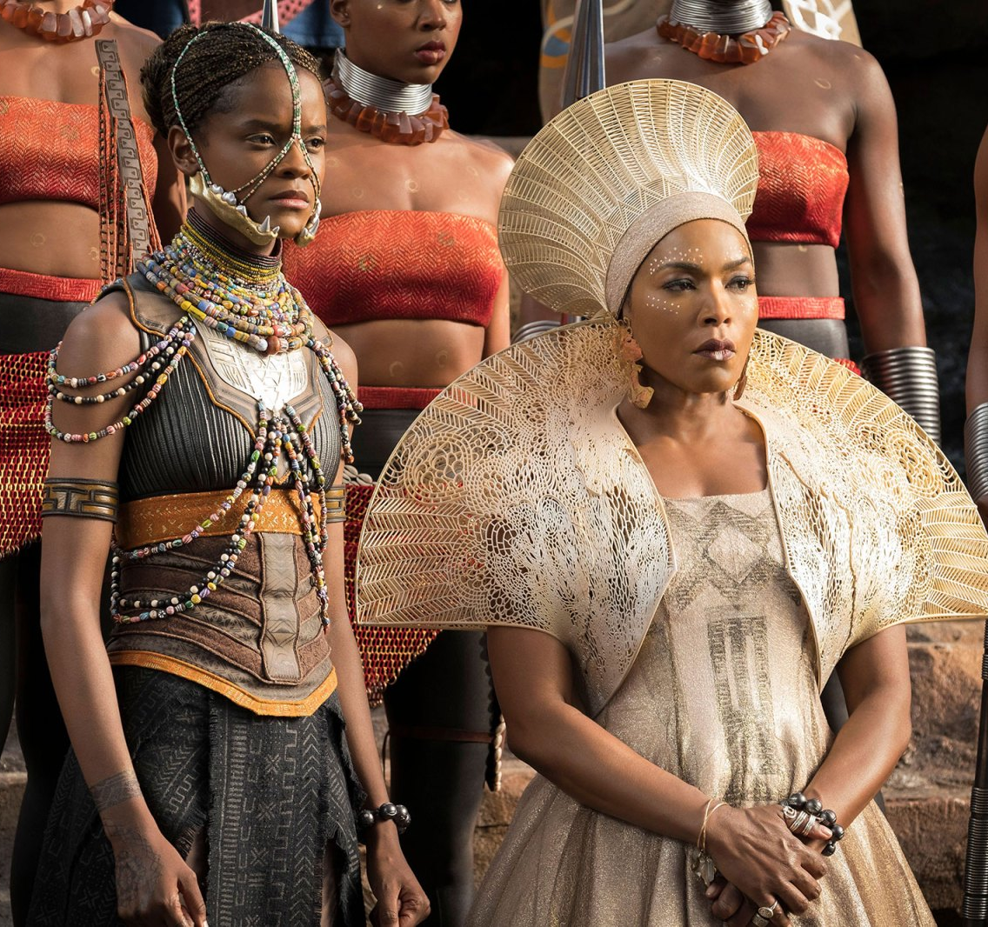
BLACK PANTHER: WAKANDA FOREVER
One of the best MCU films get a feverishly anticipated sequel
Black Panther was the first solo Marvel Cinematic Universe film to perform like an Avengers film at the box office. It took the world by storm and set a new benchmark for later films to strive for. It featured a terrific performance by Chadwick Boseman in the lead and we’ll get to see how the immensely talented cast, and Director Ryan Coogler continue the story after the tragic passing of Boseman. Michaela Coel has joined the cast, which can only be good news and it has a prime November release date, so there’s no better way to reach 16-34 adults in the run-up to Christmas.
CAST
Lupita Nyong’o, Danai Gurira, Letitia Wright, Martin Freeman, Angela Bassett, Winston Duke, Michaela Coel
KEY STATS
Black Panther grossed £50.8m at the UK box office¹ – the fourth most successful film of 2018 – making it the highest grossing solo-Avenger title.
EST. INDUSTRY ADMISSIONS
5.7m
REACH / IMPACTS / TVRs³
All adults (16+): 8% / 4.7m / 9.5
16-34 adults: 18% / 3.5m / 23.0
16-34 men: 21% / 2.3m / 28.9
Source: 1. IBOE 2. Industry figures.
RELEASE DATE: 11 NOVEMBER 2022

Slide 12
Black panther: Wakanda forever WILL DELIVER A YOUNG MALE AUDIENCE
Based on current forecasts we estimate that Black Panther: Wakanda Forever will deliver 23 16-34 Adult TVRs and 29 16-34 Men TVRs
16-34 adults
38%
Index 130
Women (16+)
59%
Index 129
ABC1 (16+)
72%
Index 150
Source: CAA C+F Planner. Predicted industry admissions.

Slide 13
2023 CINEMA RELEASES
Next year is again full of big hitting Marvel titles with major Avengers characters returning for the next instalments of their stories.
Ant-Man and The Wasp: Quantumania
Guardians of the Galaxy: Vol. 3
The Marvels
17 February 2023
5 May 2023
28 July 2023

