Slide 1
FAMILY FILMS in 2025
How you can target the HP+CH audience using cinema in 2025

Slide 2
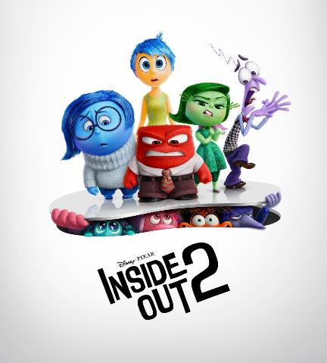
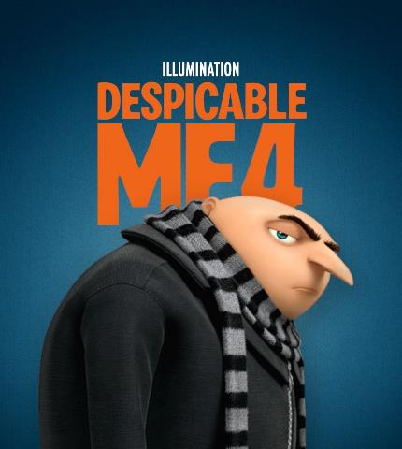
HP+CH films have an abundance of scale
2024 has demonstrated the success, desire and need to watch these sophisticated family films
Inside Out 2
Despicable Me 4
Kung Fu Panda 4
The sequel grossed an impressive $1.675 billion globally, making it the eighth highest-grossing film of all time. It also became Pixar's highest-grossing film and the top-grossing animated movie ever.
The Despicable Me franchise is a banker.
Films 1, 2 and 3 all delivered between £47m - £48m at the UK Box Office.
Despicable Me 4 is currently on £45.8m…
5th highest grossing film at the UK Box Office YTD. Its performance highlights the franchise's lasting appeal, with Kung Fu Panda 4 emerging as one of the top animated films of the decade so far.

Slide 3
Maximise: houseperson with children reach with cinema
Redistributing weight from linear TV into cinema can increase total campaign weight for key audiences – as seen below with this £2.5m AV budget example.
73.3%
HPCH
REACH
79.0%
HPCH
REACH
CINEMA MAXIMISES REACH BY ADDING 5.7 PTS
Source: DCM AV Reach Maximiser, powered by IPA TouchPoints data

Slide 4
Family Films give a more efficient opportunity to reach hp+ch
Films within the HP+CH AGP are a more efficient buy than many TV spots for reaching this audience
13% of GB population are
mainshoppers with children
Sources: Adwanted Connected, top rating HP+CH shows (top episodes for each series), 2023, 2024 YTD.
% of adult (4+) audience that are HP+CH. DCM films based on comparative profiles HP+CH against base of 16+ Individuals

Slide 5
Frequent cinemagoing families are more affluent CONSUMERS
Those families who are frequent cinemagoers over-index for being younger, more affluent and having more fragmented media consumption – making cinema an ideal environment to engage them.
Demographics
A highly affluent younger-skewing audience
Lifestyle
Indulgent and engaged
Media habits
More fragmented media consumption
 | Non-cinemagoing families | Cinemagoing families
18-34 | 30% | 35%
ABC1 | 56% | 60%
£40k+ HH income | 35% | 48%
‘I love anything new’ (Index: 151)
32% more likely to agree they tend to go for premium rather than standard goods & services
‘I'm tempted to buy products I've seen advertised’ (Index: 171)
Source: GB TGI Dec 2024. Mainshoppers who have children in the household who are cinemagoers. Index vs. avg. GB adult

Slide 6
81% of parents who last went to the cinema with their child said that the child influenced the film they saw
Source: FAME 2023 Target: Parents who last went to the cinema with their child Index vs the avg. GB adult

Slide 7
Families favour story-telling escapism
Families love the cinematic experience, seeing it as a positive experience and a way to spend quality time with each other
DOWNTIME
QUALITY
ESCAPISM
UNIQUE EXPERIENCE
76%
71%
71%
72%
‘Going To The Cinema Allows Me To Have Some Well-Needed Time Out From My Day-To-Day Life’
‘The Cinema Is A Great Way To Spend Quality Time With Family And Friends’
‘A Trip To The Cinema Lets Me Escape From Everyday Life’
‘You Can't Replicate The Cinema Experience On TV, Laptop, Tablet, Mobile’
Source: FAME 2023 Target: Female main shopper responsible for children aged 0-14 Index vs the avg. GB adult

Slide 8
THE CINEMA EXPERIENCE IS THE MOST FAVOURABLE COMPARED TO OTHER MEDIUMS
Whilst consuming each media, cinema comes out on top as the most favourable platform when it comes to boosting mood.
Engaged
Excited
Bored
Distracted
Cinema
45%
45%
2%
5%
TV
31%
17%
13%
15%
Internet
33%
13%
13%
17%
Radio
21%
11%
9%
14%
Source: FAME 2023 Target: Female main shopper responsible for children aged 0-14 Index vs the avg. GB adult

Slide 9
Family ticket sales ALIGN WITH key HOLIDAY periods
Family ticket sales typically peak in alignment with school holidays at Easter, Summer and Christmas
Easter
Summer Holidays
Christmas
Source: DCM admissions cube, % of total annual family/adult ticket sales.

Slide 10
THE family AUDIENCE
Travel lovers, tech enthusiasts and foodies.
‘I value car manufacturers who are
socially and environmentally committed’
(Index: 135)
77% agree they like to try out
new food products
(Index: 129)
44% more likely to agree they are always looking for inspiration on where to go for holidays
57% more likely to love to buy new gadgets and appliances
71% agree ‘I try to eat healthily but not at the expense of what I enjoy’
Spend on avg. 5 more hours
gaming than the average UK adult
54% more likely to plan to
buy new smart tech for their home
‘I like to go on holiday where activities are organised
for me’
(Index: 172)
Source: TGI Dec 2024
Target: Mainshoppers with children in household who are cinemagoers. Index vs. average GB adult.

Slide 11
DOG MAN
RELEASE DATE | EST. INDUSTRY ADMS | GENRE | HFSS BRANDS | ALCOHOL/GAMBLING BRANDS
7 February 2025 | 1.4m | Action/Comedy | No | No
A new hero in town…
SYNOPSIS
When a police officer and his faithful police dog get injured in the line of duty, a harebrained but life-saving surgery fuses the two of them together -- and Dog Man is born. As Dog Man learns to embrace his new identity, he must stop feline supervillain Petey the Cat from cloning himself and going on a crime spree.
CAST
Isla Fisher, Pete Davidson, Stephen Root
 | Adults (16+) | HP+CH | 16-34 Adults | 16-24 Adults | Children 7-15
REACH | 2.1% | 4.8% | 3.8% | 3.3% | 5.5%
IMPACTS | 1.1m | 572k | 607k | 255k | 357k
TVRS | 2 | 5 | 4 | 4 | 6
Source: Based on industry admissions and comparative film profile

Slide 12
A Minecraft movie
RELEASE DATE | EST. INDUSTRY ADMS | GENRE | HFSS BRANDS | ALCOHOL/GAMBLING BRANDS
4 April 2025 | 3m | Adventure / Comedy | Yes | No
A new hero in town…
SYNOPSIS
A mysterious portal pulls four misfits into the Overworld, a bizarre, cubic wonderland that thrives on imagination. To get back home, they'll have to master the terrain while embarking on a magical quest with an unexpected crafter named Steve.
CAST
Jason Momoa, Jack Black, Emma Myers, Danielle Brooks, Jennifer Coolidge
 | Adults (16+) | HP+CH | 16-34 Adults | 16-34 Men | Children 7-15
REACH | 4% | 6% | 7% | 7% | 11%
IMPACTS | 2.2m | 1m | 1m | 608k | 766k
TVRS | 5 | 7 | 7 | 8 | 12
Source: Based on industry admissions and comparative film profile

Slide 13
ZOOTROPOLIS 2
RELEASE DATE | EST. INDUSTRY ADMS | GENRE | HFSS BRANDS | ALCOHOL/GAMBLING BRANDS
28 November 2025 | 3m | Adventure / Animation | No | No
SYNOPSIS
Brave rabbit cop Judy Hopps and her friend, the fox Nick Wilde, team up again to crack a new case, the most perilous and intricate of their careers.
CAST
Jason Bateman, Fortune Feimster, Ginnifer Goodwin
 | Adults (16+) | HP+CH | 16-34 Adults | 16-24 Adults | Children 7-15
REACH | 4% | 10% | 7% | 8% | 12%
IMPACTS | 2.2m | 1.1m | 1.2 | 615k | 810k
TVRS | 5 | 11 | 8 | 9 | 13
Source: Based on industry admissions and comparative film profile

Slide 14
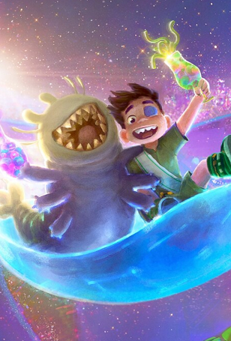
Family Films to look forward to across the summer of 2025
These films are a perfect way to reach families across the summer school holidays!
8 TVRS
6 TVRS
5 TVRS
6
TVRS
TITLE | Lilo & Stitch
RELEASE DATE | 23 May 2025
IND ADMISSIONS | 2.4m
TITLE | Elio
RELEASE DATE | 13 June 2025
IND ADMISSIONS | 1.8m
TITLE | Smurfs
RELEASE DATE | 18 July 2025
IND ADMISSIONS | 1.4m
TITLE | The Bad Guys 2
RELEASE DATE | 1 August 2025
IND ADMISSIONS | 1.9m
Source: DCM, based on forecast industry admissions and comparative film profile.
TVRs based on housepersons and children profile

Slide 15
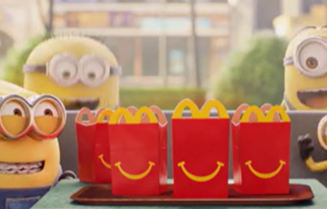
Cinema DELIVERS POSITIVE OUTCOMES FOR targeting families
Looking at our brand lift study databank, it’s evident that cinema drives significant uplifts for your key brands metrics across the full funnel.
Meta-analysis of 9 cinema campaigns: Average uplifts seen from Control (unexposed to cinema ad) vs Test (exposed to cinema ad)
+30%
Recall
+22%
Birds Eye
McDonald’s needed to find a solution that provided them with an environment they could reach dual viewing more effectively, reconnecting with families to drive nostalgia and remind them all the reasons why they love Happy Meal – and ultimately improve ROI.
McDonald’s ran various 30” creatives across the year to reflect the current in-store Happy Meal promotions and was featured in the reel ahead of titles including Space Jam: A New Legacy, Peter Rabbit 2 and The Croods 2.
The Bronze Spot laydown worked incredibly well for McDonald’s delivering significant reach among its key parent + child audience as well as driving key brand metrics including awareness, perceptions and consideration.
After re-evaluating its media strategy and insight, Center Parcs discovered its advertising had the greatest impact on parents when seen in co-viewing moments with the whole family.
Moving to an ‘always-on’ approach, Centre Parcs bought into efficient family focused films and upweighting budgets around key blockbusters including Christopher Robin and Mary Poppins Returns.
The cinema activity exceeded all expectations for Center Parcs, going above and beyond annual targets to register a 4.9% increase in revenue year-on-year. Moreover, cinema helped Center Parcs tackle its primary business challenge with the value of each customer visiting the holiday village increasing by 10%.
Consideration
+18%
Action Intended
Source: Differentology Cinema Effectiveness Databank (2016 – 2024). Meta-analysis consists of 9 cinema campaigns that all targeted HP+CH Uplifts based on relative difference between Control (unexposed to ad) vs Test (exposed to ad). Results for all respondents

Slide 16
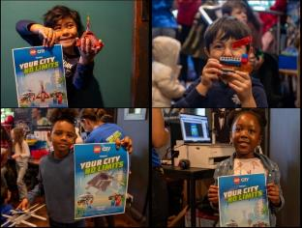
Spotlight case study: LEGO
LEGO City & Picturehouse Kids’ Club - Build Their Love For Cinema
DCM Awards Winner
Best Use of Cinema (Small)
SECTOR | TARGET AUDIENCE | PACKAGE | MEDIA AGENCY | COPY LENGTH
Retail | Boys 3-5 | Partnership & Idents | Initiative | 30”, 10”
BACKGROUND
LEGO were faced with a challenge – interest among young boys had begun to drop and sales were slowing. To addressing these issues, LEGO wanted to re-establish strong brand loyalty with kids that would last the test of time. Looking to build awareness, drive engagement and convert interest into sales LEGO needed an immersive environment to succeed.
While parents are typically the decision-makers when it comes to purchasing toys for their kids, they often need inspiration amidst an overwhelming sea of options. LEGO saw the opportunity that the ‘family cinema trip’ could offer them – reaching parents and kids together and being able to harness the immersion of cinema to introduce them to a whole new world of play with LEGO City, coining the ‘"Build Their Love for Cinema” proposition.
PLAN
LEGO partnered with Picturehouse Cinemas and their Saturday Kids' Club, featuring hands-on LEGO City activations across nine Picturehouse cinemas – allowing kids to play with LEGO bricks for free before the screenings, take home samples, and create their own movie posters.
In addition to the activation, LEGO ran a 30” ad in Picturehouse’s Family AGP, in addition to a bespoke 10” Kids Club ident that drove awareness of the partnership and further cemented the brand at the heart of family trips to the cinema. LEGO also had a huge presence across the Picturehouse website boosting awareness of the partnership and the activations taking place at their local cinemas.
LEGO also ran 8 monthly competitions giving fans the chance to win LEGO City bundles, to further drive product desirability and trial among families.
RESULTS
In summary, the "Build Their Love for Cinema" campaign revitalised LEGO City, driving brand love and engagement among young audiences and their parents.
AWARENESS
Increased +6% YOY to almost 70%, exceeding expectations.
SUCCESSFUL ACTIVATION
The LEGO City activations were also a success for Picturehouse Cinemas, with those cinemas hosting the activations seeing a +74% increase in Kids Club admissions.
INCREASED PRODUCT SHARE
The active consumer share among boys aged 3-5 grew by +18%, surpassing LEGO’s goal and showcasing the effectiveness of the high impact and hands-on media strategy.
Source: Lego x DCM Awards Entry 2024

