Slide 1
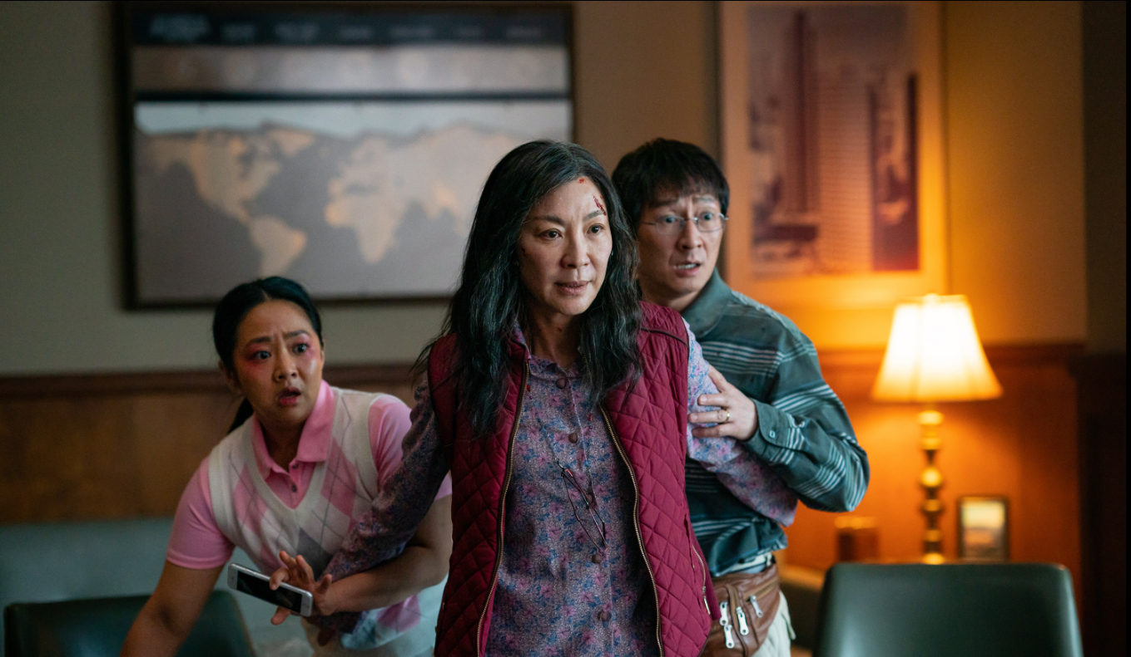
Main shopper with children

Slide 2
HOUSEPERSONS WITH CHILDREN MEDIA CONSUMPTION: A SUMMARY
Families regularly want to spend more time together, using media to create shared experiences or purchase trusted brands
79%
39%
    Of families are cinemagoers
    Where they are 27% more likely to be heavy cinemagoers vs the avg. UK adult
    More likely also be heavy online video consumers (Netflix, BBC iPlayer etc)
55%
85%
    Of heavy cinemagoers watch TV everyday
    11% down from the average UK adult
    Of cinemagoers regularly use the internet for shopping
Source: TGI GB 2022. Target: Families who are heavy cinemagoers / cinemagoers. Index vs the avg. UK adult

Slide 3
CINEMA IS A treat for kids & a break for the parents
The children chose the film, the parents buy the popcorn
29%
59%
3x
£26.69
    more likely to visit
    the cinema for a treat
    Agree that a cinema trip is ‘well needed time out from day-to-day life’
    more likely to visit the cinema because their children we’re desperate to see the film
    spent on food/drink treats – vs. £15.54 for the average cinemagoer
Source: FAME 2021. Target: Main shoppers with children who are cinemagoers
Index vs. average GB cinemagoer.

Slide 4
Families are more likely to visit a cinema over the weekend
The cinema is a collective experience of parents waiting until the weekend so that families can watch together
Source: FAME 2021 – Target: Families who went with children in the last cinema visit. Index vs All Adults

Slide 5
Your advertising can ALSO have instant impact
Cinema is typically part of a wider trip out of the family home so you can reach Main shoppers with children before they go on to the shops.
23%
16%
46%
More likely to online shop (non-grocery) later the same day
More likely to shop on the high-street immediately after the cinema
Checked their mobile phone to browse the internet after watching a film
98% OF DCM CINEMAS ARE WITHIN ONE MILE OF A RETAIL LOCATION
Source: FAME 2021. Activities do immediately after / on same day as cinema visit. Index vs. average GB cinemagoer.

Slide 6
MAINSHOPPERS: heavy Cinemagoing statements
Families love the cinematic experience, primarily for escapism and spending quality time with each other
61%
62%
63%
60%
57%
    I Love The Hype Surrounding Big Film Releases At The Cinema
    ^{(Index: 127)}
    The Cinema Is A Great Way To Spend Quality Time With Family And Friends
    ^{(Index: 107)}
    A Trip To The Cinema Lets Me Escape From Everyday Life
    ^{(Index: 111)}
59%
62%
62%
    You Can't Replicate The Cinema Experience On TV/Laptop/Tablet/Mobile
    ^{(Index: 106)}
    I Feel Left Out If My Friends Are Talking About A Film I Haven't Seen
    ^{(Index: 145)}
    Going To The Cinema Allows Me To Have Some Well-Needed Time Out From My Day-To-Day Life
    ^{(Index: 106)}
    Films Are An Essential Part Of My Cultural Life
    ^{(Index: 120)}
    I Get Completely Absorbed Into The Story When I Watch A Film At The Cinema
    ^{(Index: 106)}
Source: FAME 2021 Target: Mainshoppers who are heavy cinemagoers who have presence of children in the household Index vs the avg. UK adult

Slide 7






key launch opportunities for family films
An incredible slate of family-friendly films awaits across the next months
Tad The Lost Explorer And The Curse Of The Mummy
3 Sept 2022
Index: 192
Lyle, Lyle, Crocodile
14 Oct 2022
Index: 186
Strange World
25 Nov 2022
Index: 215
Matilda
2 Dec 2022
Index: 153
Puss In Boots: The Last Wish
3 Feb 2023
Index: 161
Super Mario Bros.
7 Apr 2023
Index: 184

Slide 8
WHAT CAN CINEMA ADD TO THE PLAN?
Research from Sky showcases how co-viewing an ad with family enhances content engagement and ad recall.
The value of reaching families together in a ‘shared viewing’ moment
+38%
+18%
=
+
Co-Viewing
Content
Engagement
Ad Recall
Source: BDRC Continental & Sky - Engagement Study with Households with Children 0-10.

Slide 9
Family ticket sales ALIGN WITH key HOLIDAY periods
Family ticket sales typically peak in alignment with school holidays at Easter, Summer and Christmas
Easter
Summer Holidays
Christmas
Source: DCM admissions cube, % of total annual family/adult ticket sales.

Slide 10
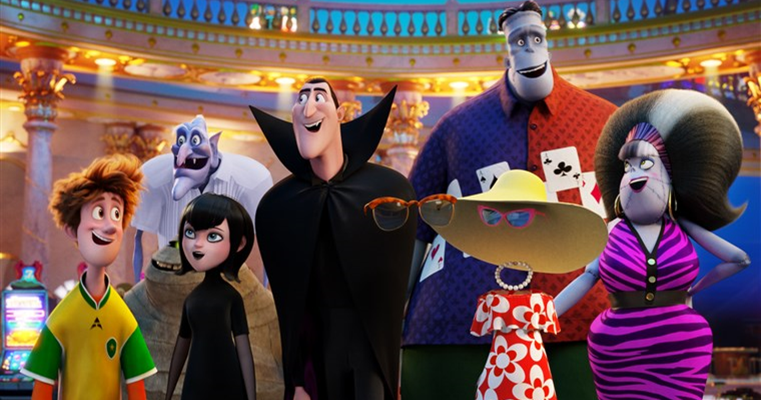

MAIN SHOPPER WITH CHILDREN CINEMAGOERS: 2022 SNAPSHOT
Those who are heavy cinemagoers are more likely to be in the market for…
141
Plan to buy a car
187
Plan to buy smart home tech
122
Planning to book a holiday or short break in the next year
188
‘I am tempted to buy products I’ve seen advertised’
155
Plan to buy mobile phone
2x
More likely to plan to buy a games console
77%
Like to try out new food products
2x
More likely to agree that they spend a lot of money on clothes
Source: TGI Q1 2022
Target: Heavy cinemagoers. Index vs. average GB adult

