Slide 1
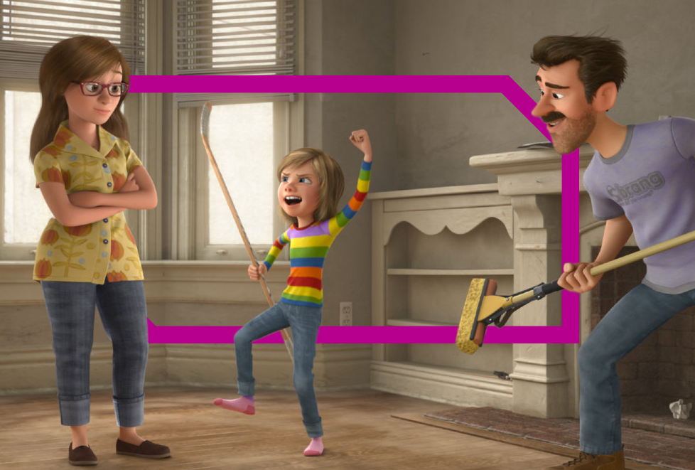
MAIN SHOPPER WITH children
Dcm audience insights

Slide 2
Main shopper with children: 4 fast facts
2
1
89% are cinemagoers
36 million
admissions
5.6
3
21% of all UK
cinema admissions
4
Visits per year
Source: 1. TGI Q2 2016 2-4. CAA Film Monitor Coverage & Frequency 2015

Slide 3
GETTING TO KNOW THEM
Who are they?
What does
cinema mean
to them?
Difficult to balance busy life
Affordable family activity
Love their family time
Quality bonding time
Happy kids = happy parents
Entertainment for kids

Slide 4
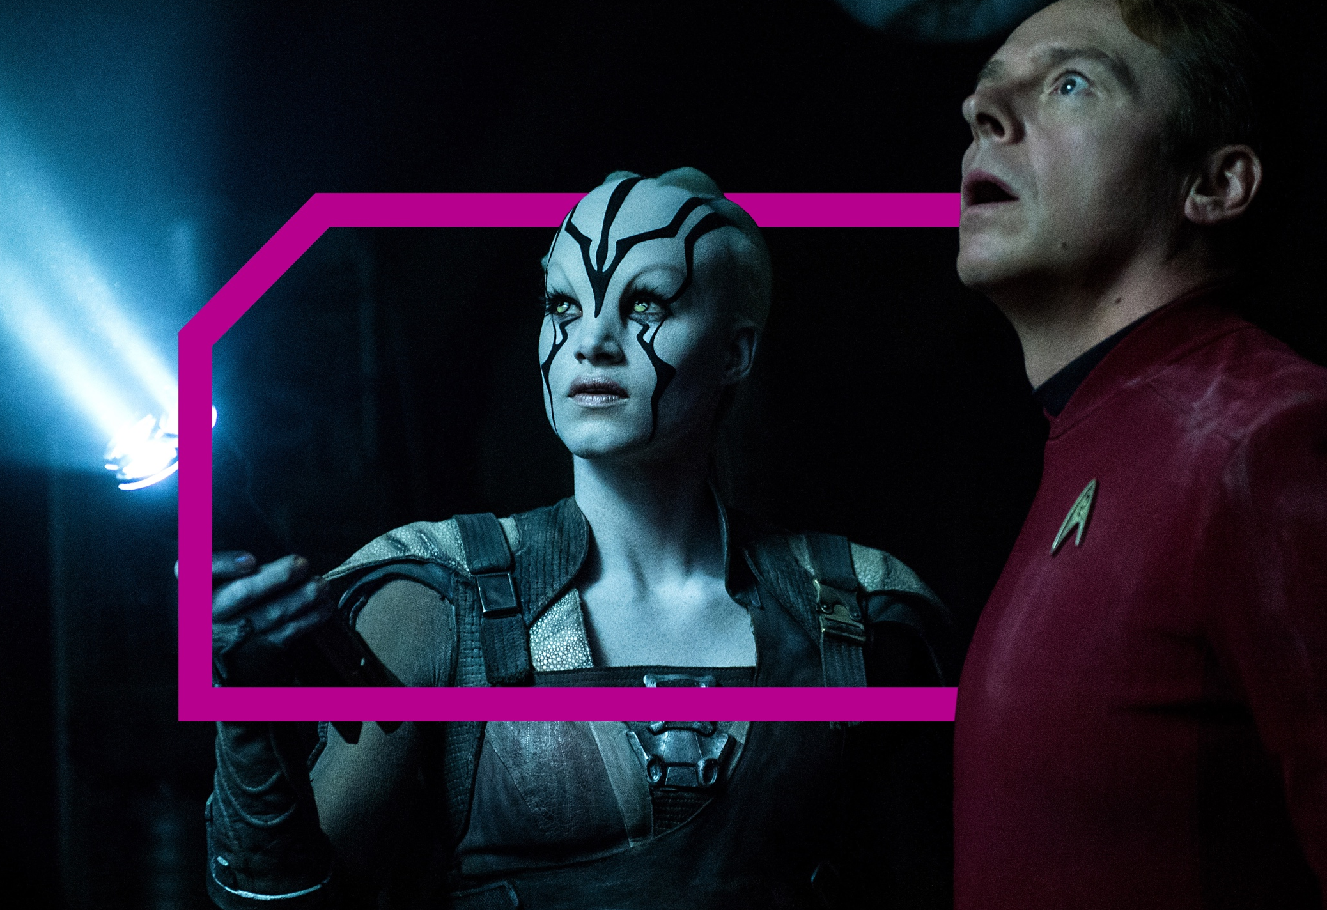
MAIN SHOPPER WITH children SPEND 3.7 HOURS PER DAY CONSUMING AV
Source: IPA TouchPoints 6

Slide 5
av consumption
How it breaks down for main shoppers with children
Live tv
  BBC, ITV,
  C4, Sky 1
Long
form vod
  Netflix, iPlayer,
  All 4 etc.
Short
form online
video
  YouTube,
  Facebook etc.
Average time per day
mswc
3 hours 17 minutes
19 minutes
4 minutes
Average time per day
16+ adults
3 hours 31 minutes
18 minutes
6 minutes
Source: IPA Touchpoints 6

Slide 6
FILM REMAINS A PASSION POINT
62%
…Used an online film service
in the past 3 months
CINEMA FUELS THEIR FILM HABIT FURTHER!
Source: FAME 2015

Slide 7
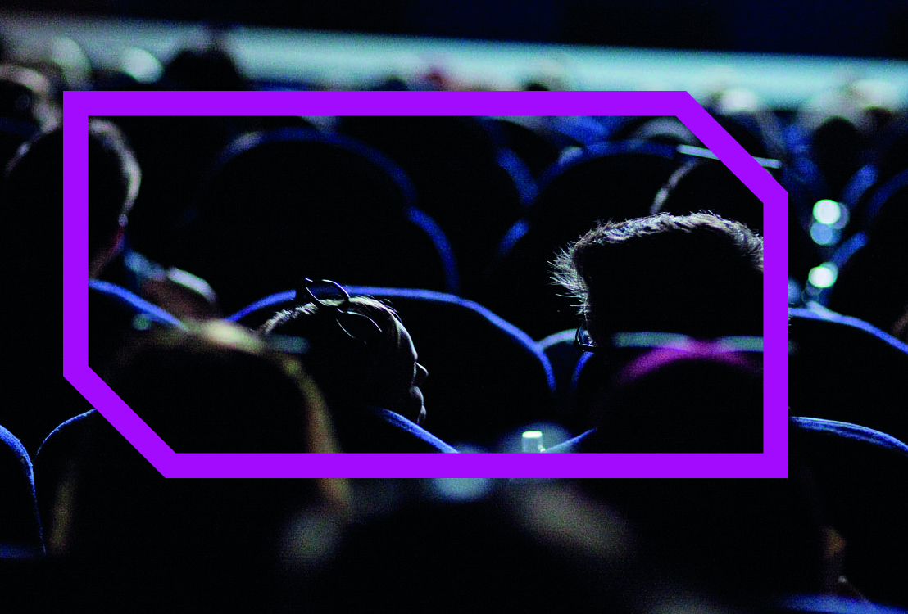
LET’S GO TO THE cinema WITH…
Main shopper with children

Slide 8
In the cinema foyeR
Here’s what they’re doing…
69%
2.9 average group sIze
Spent money on food/drink
60%
56%
Go with family
BROWSE THE INTERNET ON THEIR PHONE WHILE WAITING
Source: FAME 2015

Slide 9




What are they doing on their phones?
Posting on instagram
Updating their facebook status
Checking in on a social network
tweeting
54%
35%
34%
48%
interested IN DOING AT THE CINEMA
Source: FAME 2015

Slide 10
THE ADS & TRAILERS FORM PART OF THE EXPERIENCE
92%
Make sure they’re seated before
anything is on screen (ever)
Source: FAME 2015

Slide 11
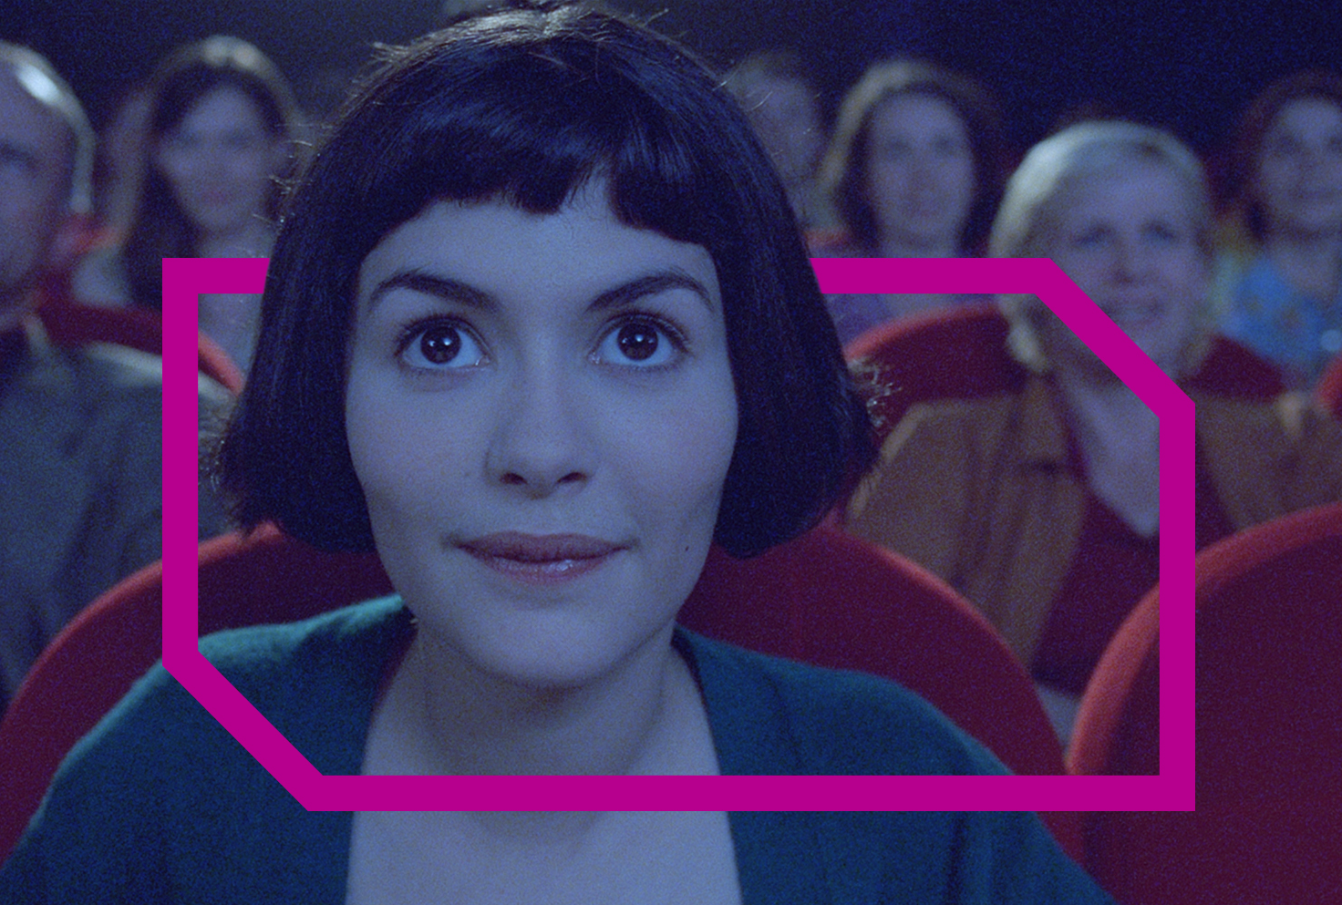
The big screen creates big emotions

Slide 12
Cinema creates positive emotions
More than any other AV channel
Live tv
Longform vod
cinema
Short online video
80%
58%
58%
58%
Positive emotions
Source: IPA TouchPoints 6.
% of all time spent consuming each media associated with positive emotions

Slide 13
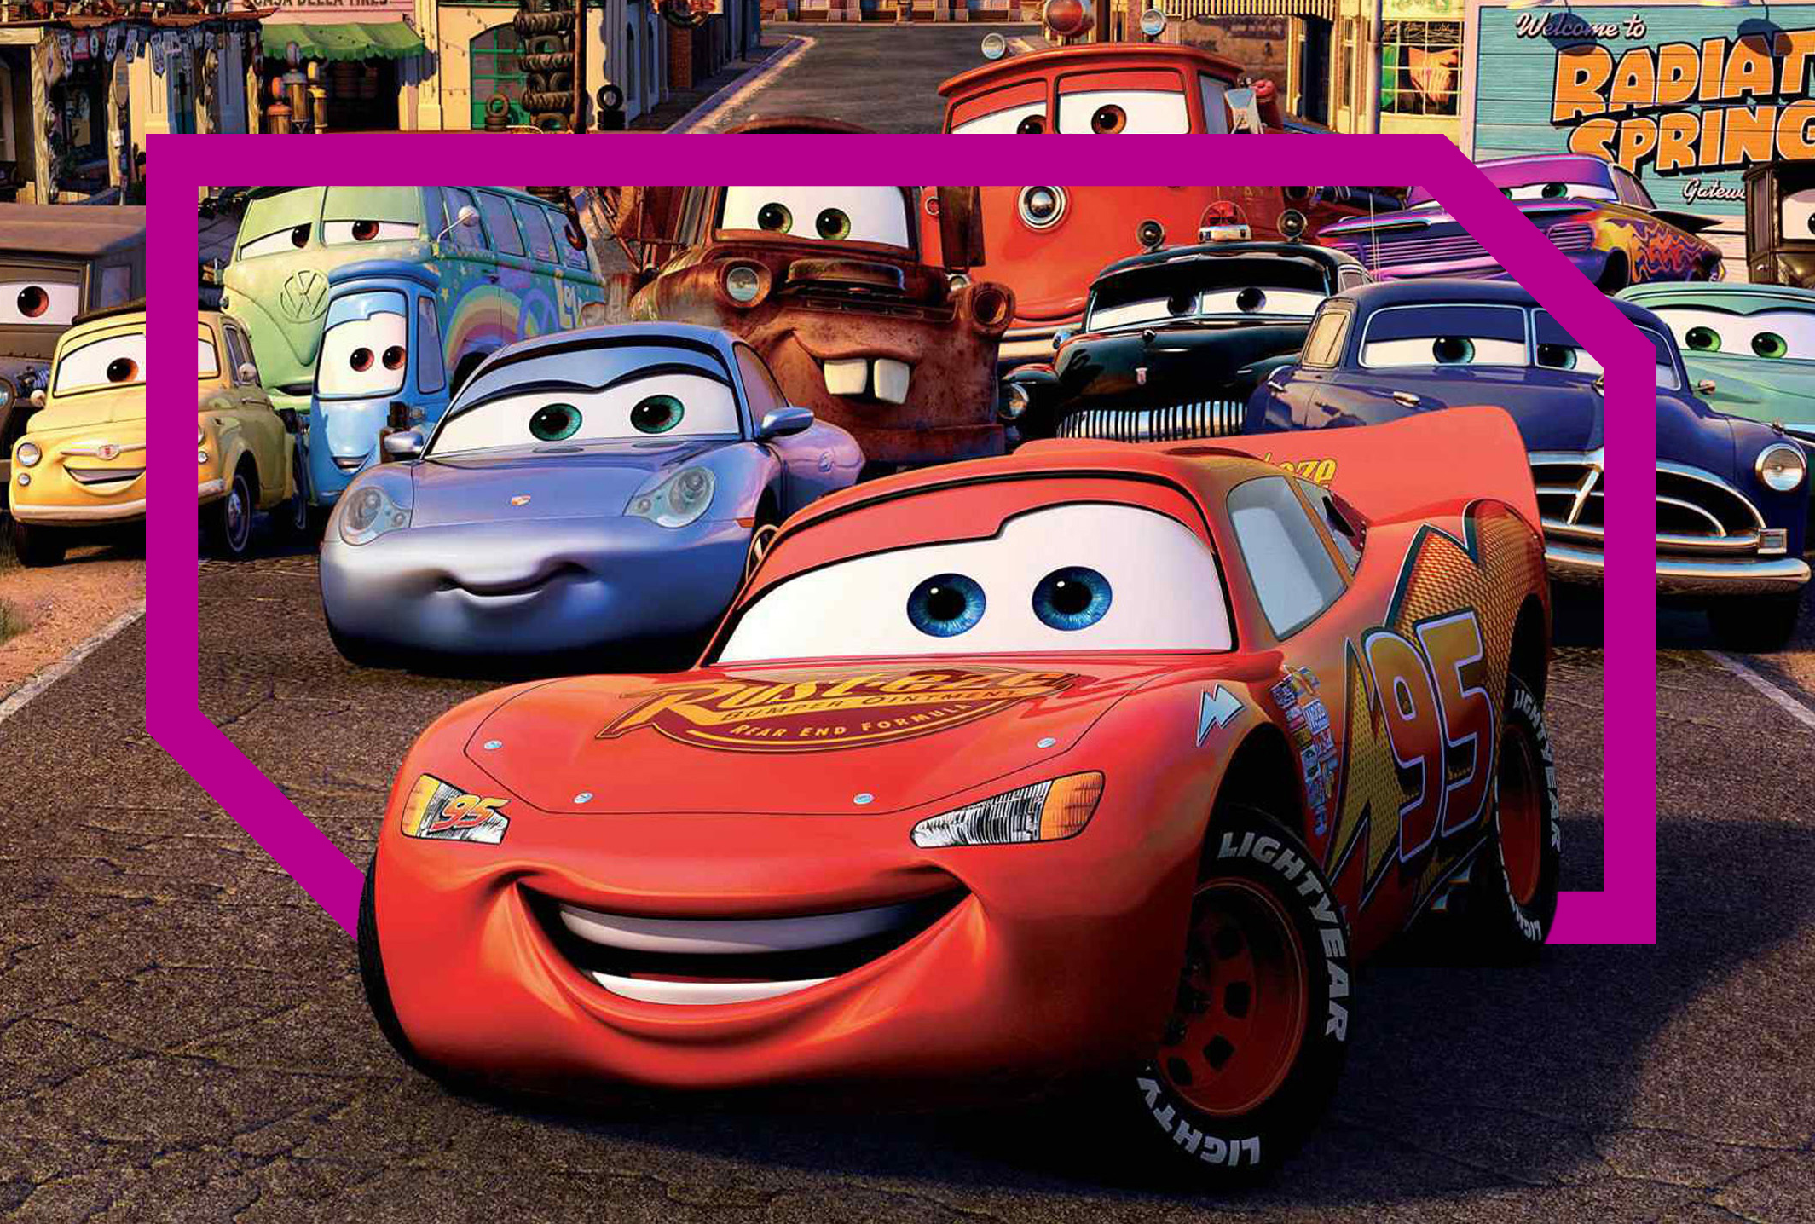
Main shopper with CHILDREN
HELP Drive the box office

Slide 14
MswC help drive the box-office…
54%
Go to the cinema within
a week of film opening
(Index: 111)
Source: FAME 2015

Slide 15
Why do MAIN SHOPPERS go to the cinema?
80%
79%
“A trip to the cinema lets me escape from the demands of everyday life”
(Index: 108)
“Cinema is a great way to spend quality time with friends/family/partner”
(Index: 110)
Source: FAME 2015. Base: Main Shoppers with children

Slide 16
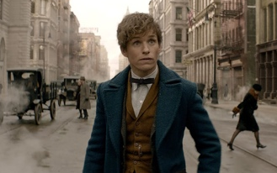


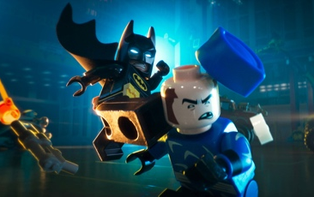


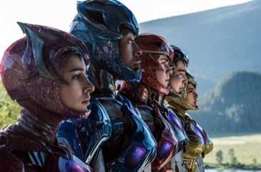
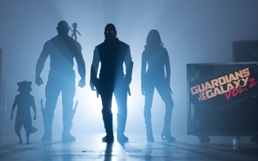
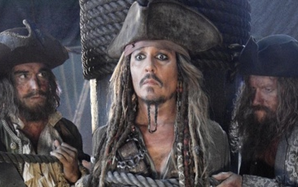

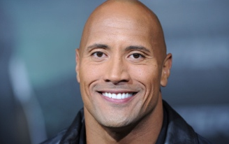

HOW TO REACH THEM
Top films for Main Shoppers with children in 2016/17
Action
adventure
animation
family
Superhero
Fantastic Beasts And
Where To Find Them
Moana
Beauty & The Beast
Lego Batman
Rogue One: A Star Wars Story
Trolls
Power Rangers
Guardians Of The Galaxy 2
Pirates Of The Caribbean
Despicable Me 3
Jumanji
Spiderman: Homecoming

Slide 17
After the film
Here’s what they do after the credits roll…
48%
22%
16%
Went for food
and/or drink
(Index: 109)
Went grocery shopping
(Index: 162)
Went non-grocery shopping
(Index: 141)
Source: FAME 2015. Activities do immediately after / on same day as cinema visit

Slide 18
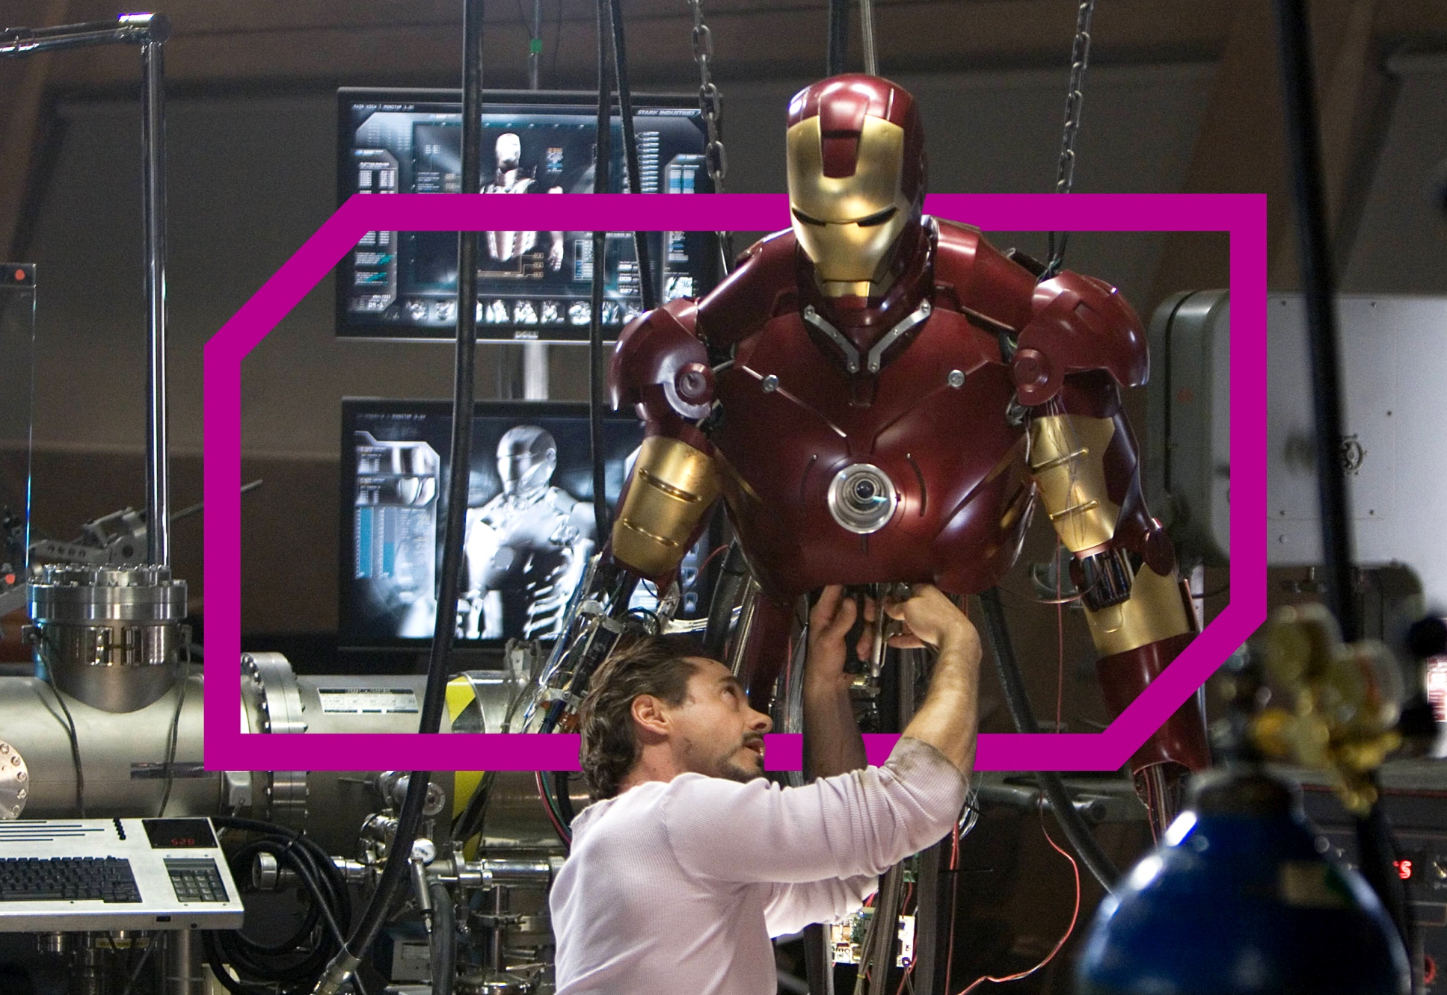
TOOLKIT

Slide 19
How to Buy Cinema
Reaching Main Shoppers with Children
AGP
Family agp
FILM PACK
Ratecard CPT
Ratecard CPT
Ratecard CPT
Ratecard CPT
£60
£34
£80
£100
Non-blockbuster
Blockbuster
Source: CAA Film Monitor Coverage &amp; Frequency 2015

Slide 20
Toolkit
AGP - Audience Reach – Main Shopper with Children
reach
Time period
Audience
(000’s)
Reach %
frequency
1 week
691
1940
3015
3748
4288
4707
5190
6388
6
17
26
33
38
41
44
56
1.00
1.43
1.83
2.21
2.58
2.94
3.46
5.63
1 month
2 months
3 months
4 months
5 months
6 months
12 months
Source: CAA Film Monitor Coverage &amp; Frequency 2015

