Slide 1
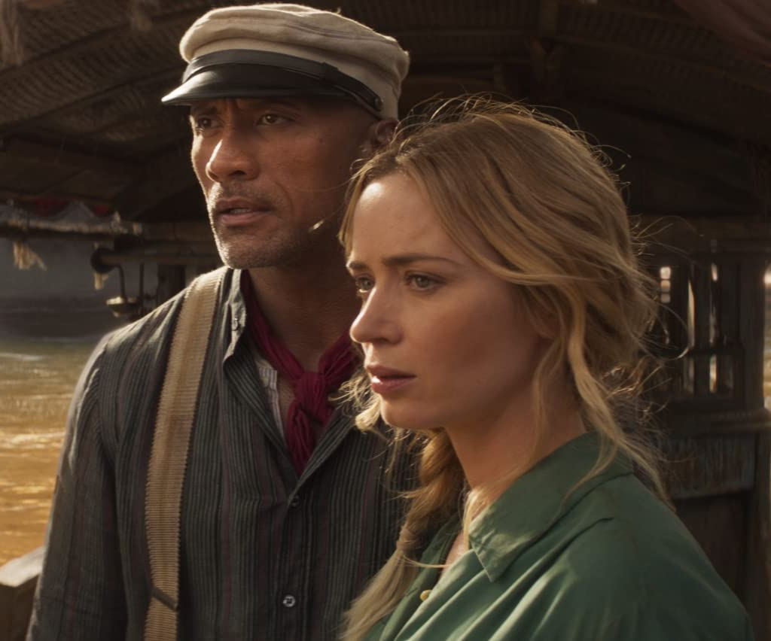
Jungle cruise
A classic Disney adventure gets the big-screen treatment
Release Date
30 July 2021
Cast
Emily Blunt, Dwayne Johnson, Jack Whitehall
Director
Jaume Collet Serra (The Shallows, Unknown)
Recommended if you like
Pirates Of The Caribbean, Jumanji: Welcome To The Jungle
Reasons to buy into
Two of the most likeable stars in Hollywood lead this new adventure based on the classic Disney ride.
Key audience info
16-34 Adults Index: 143
Est. DCM admissions
1m
Based on Disneyland's theme park ride where a small riverboat takes a group of travellers through a jungle filled with dangerous animals and reptiles, but something more supernatural lies beneath…
Plan your campaign

