Slide 1
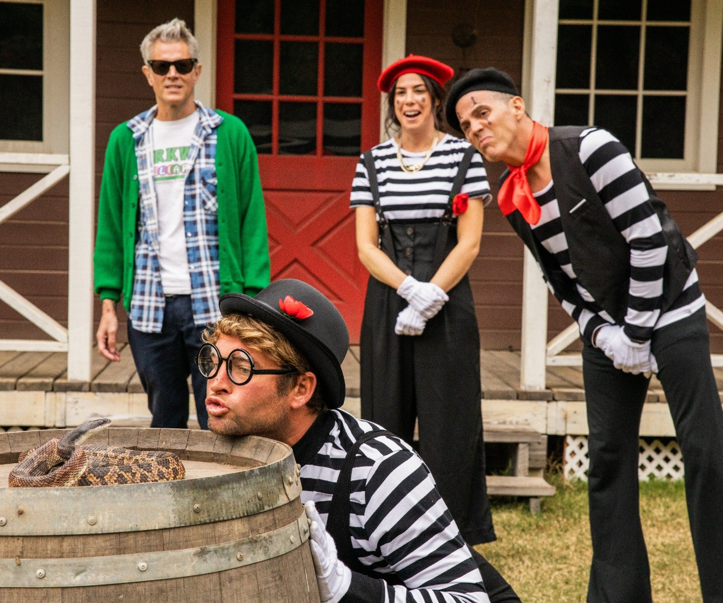
Jackass FOREVER
More hijinks with America’s craziest crew
Release Date
4 February
Cast
Johnny Knoxville, Steve-O, Shaquille O’Neal
Director
Jeff Tremaine (Bad Grandpa, Jackass 3D)
Recommended if you like
Bad Grandpa
Reasons to buy into
The Jackass series has proven a reliable comedy staple at the box office, taking a combined £18 million in the UK since 2003
Key audience info
16-34 Men Index: 398
Est. DCM admissions
257k
After ten years, the Jackass crew is back for their final crusade.
Plan your campaign

