Slide 1
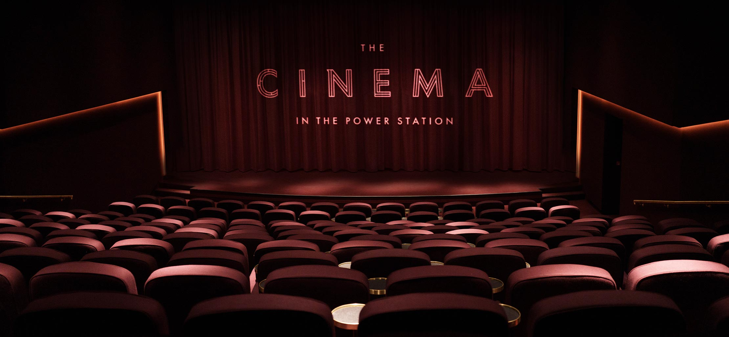
TURN YOUR PHONE OFF TAKEOVER
ACROSS OUR INDEPENDENT ESTATE
Notes:
All elements on this page (not including the logo) need to be 1cm apart

Slide 2
Media first – independent typo takeover
SUMMARY
Independent cinemas attract audiences who are not only passionate about film but also appreciate the personal, community-oriented atmosphere our independent cinemas provide.
Be the first brand partner to collaborate with our entire Independent estate and create the first co-branded Independent Turn Your Phones Off message. By aligning with these cinemas, your brand becomes part of a unique, boutique experience that appeals to a discerning audience.
A co-branded ident with our independent estate build a powerful connection with our upmarket audience, elevates your brand’s perception, and Capitalizing on the high impact / high attention cinema format.
KEY BENEFITS:
BRAND OBJECTIVES – AWARENESS & CONSIDERATION
Media First Opportunity
Independent Cinema offers a premium experience for a discerning, affluent audience.
CLICK HERE FOR CASE STUDIES
CLIENTS:
PRODUCTION | EXHIBITOR IDENT | CINEMAS | PREMIUM RATE
6-8 weeks | 30” | PICTUREHOUSE, THE LIGHT & INDY ESTATE | 40%

Slide 3
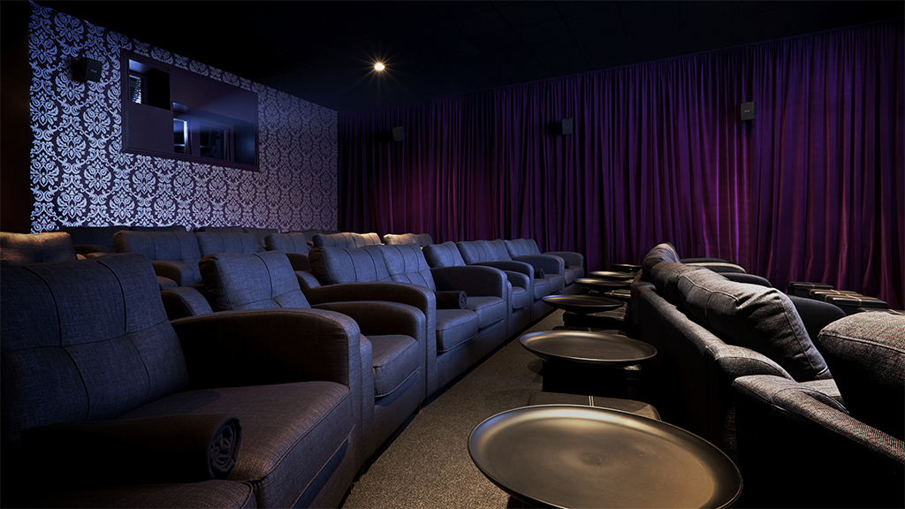
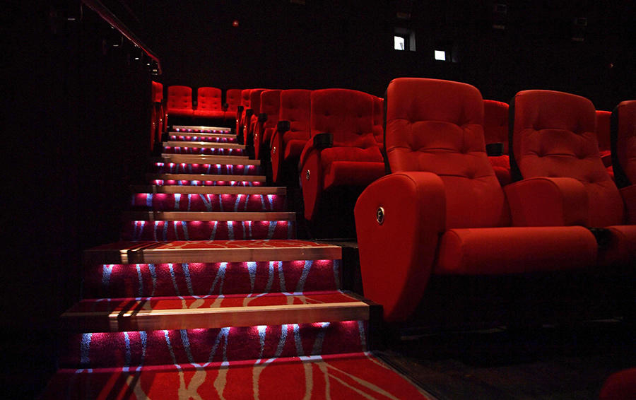
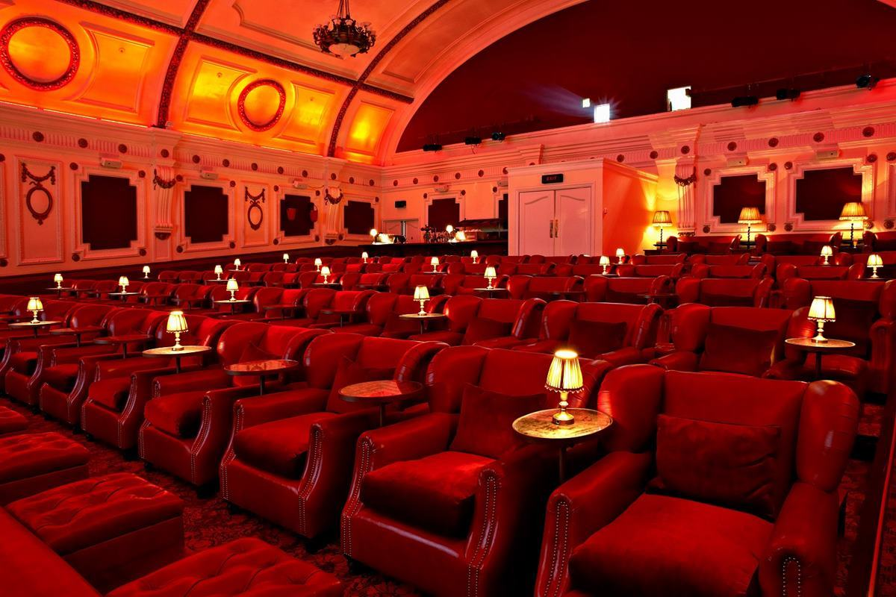
SOME OF OUR INDEPENDENT CINEMAS
Genesis Mile End
Nova, Woking
Cinema In The Power Station
Electric Portobello

Slide 4
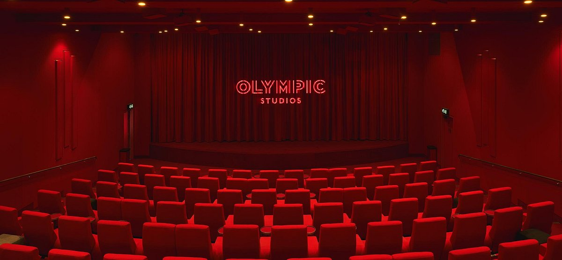
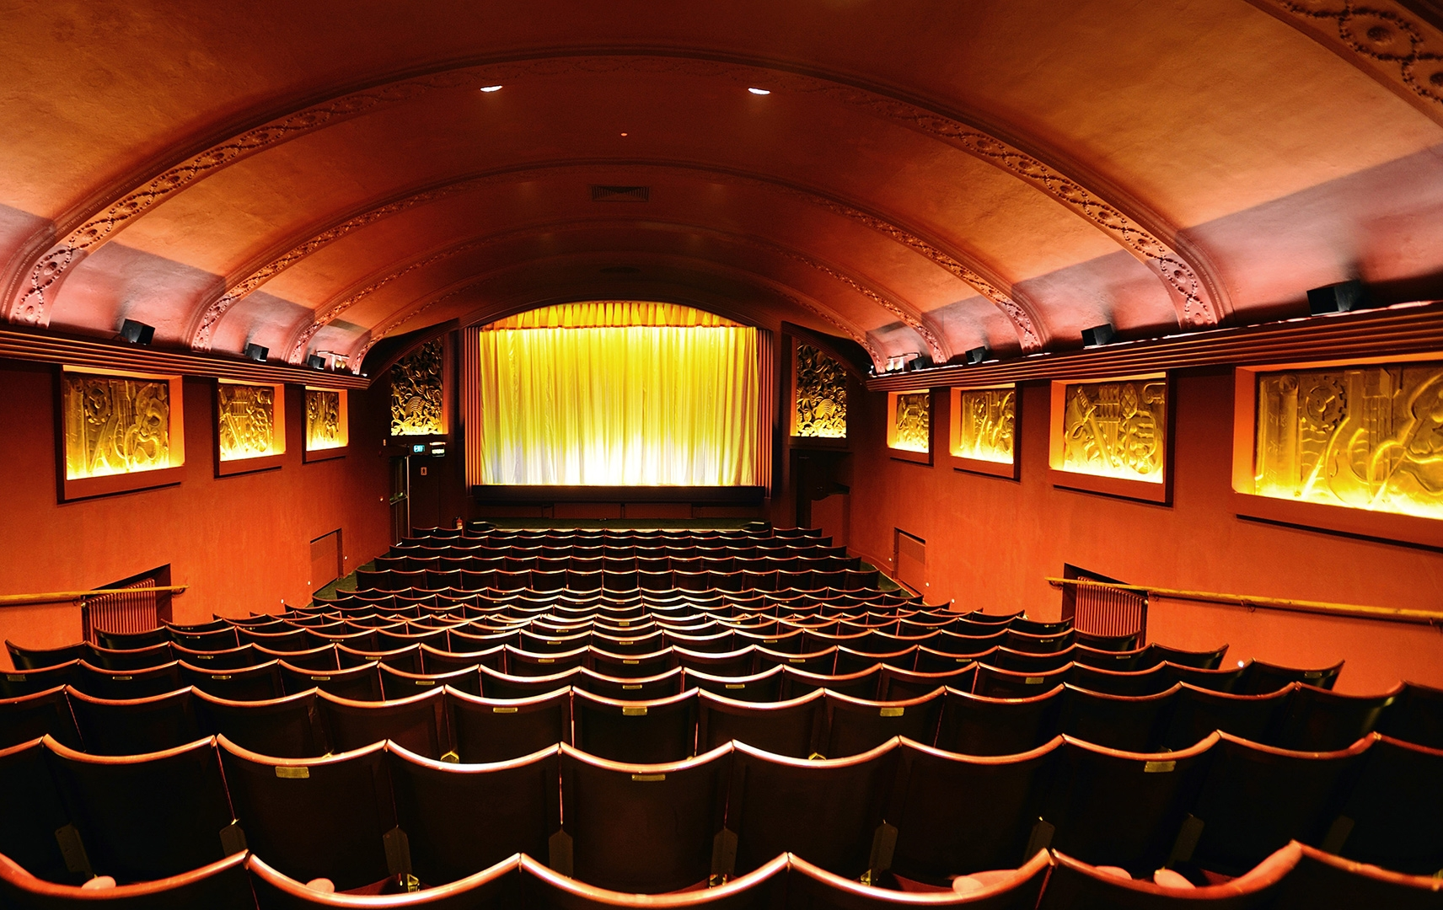
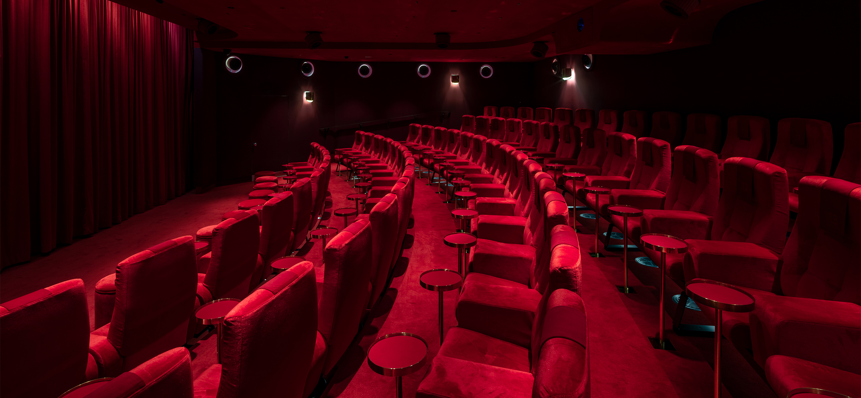
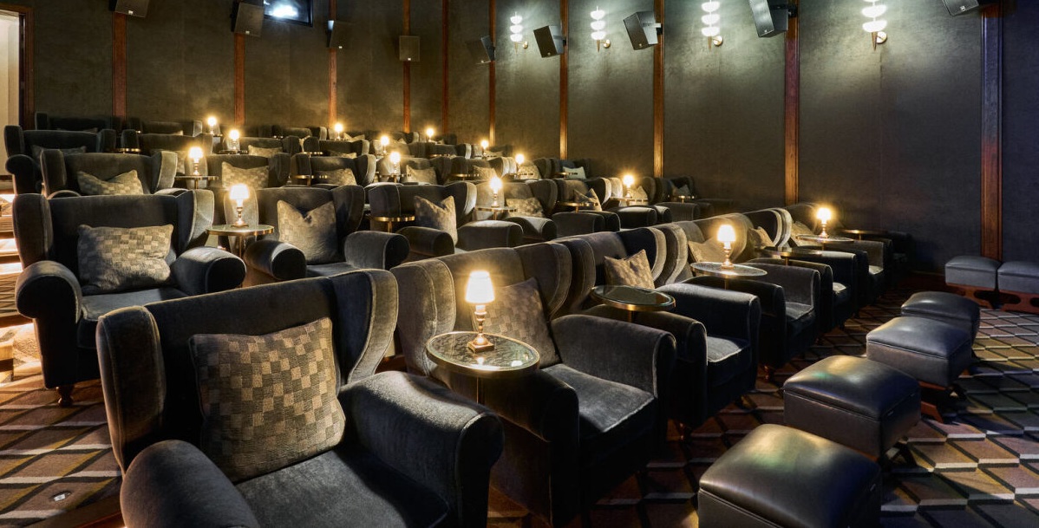
SOME OF OUR INDEPENDENT CINEMAS
Olympic Cinema, Barnes
Phoenix
Selfridges
White City, Soho House

Slide 5
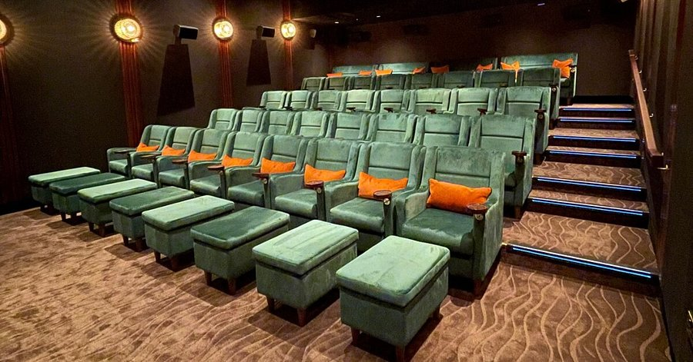
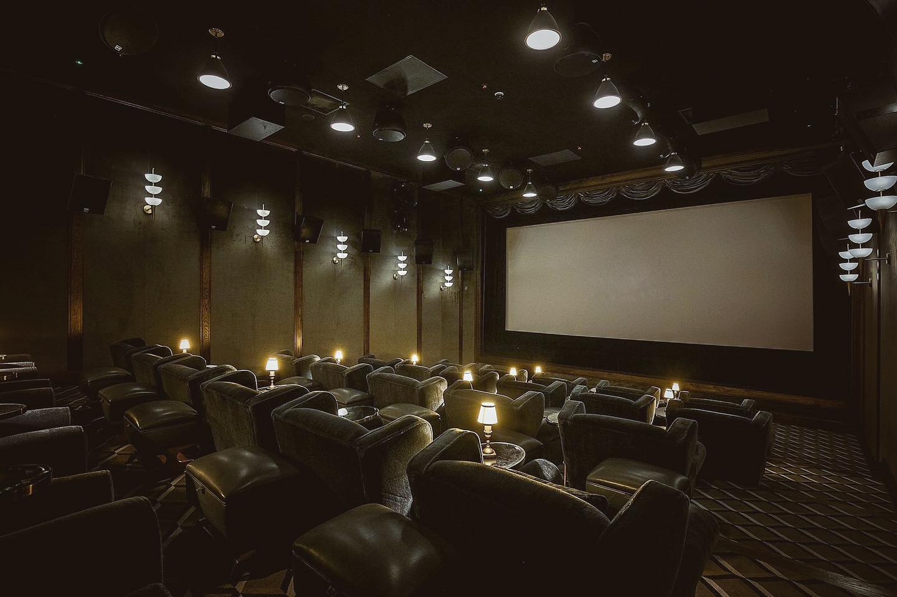
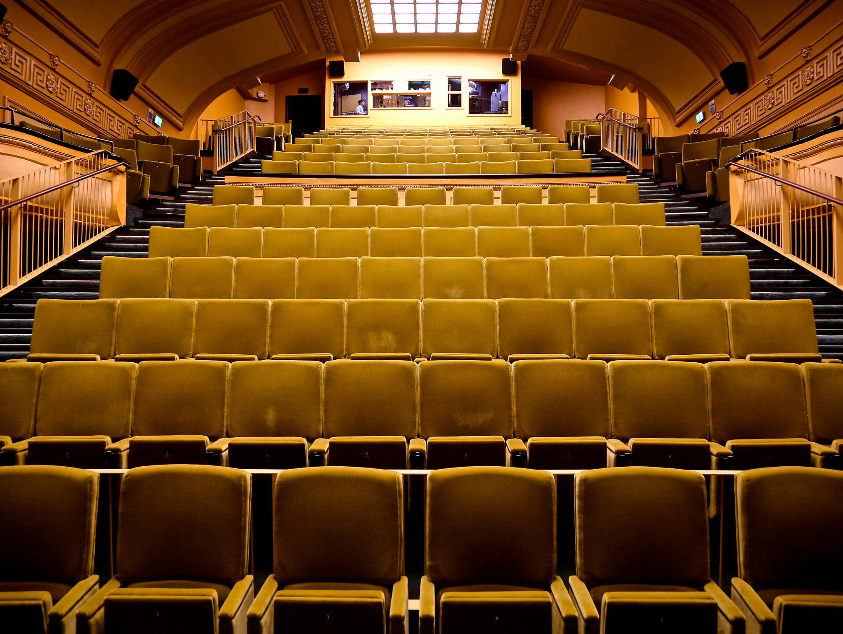
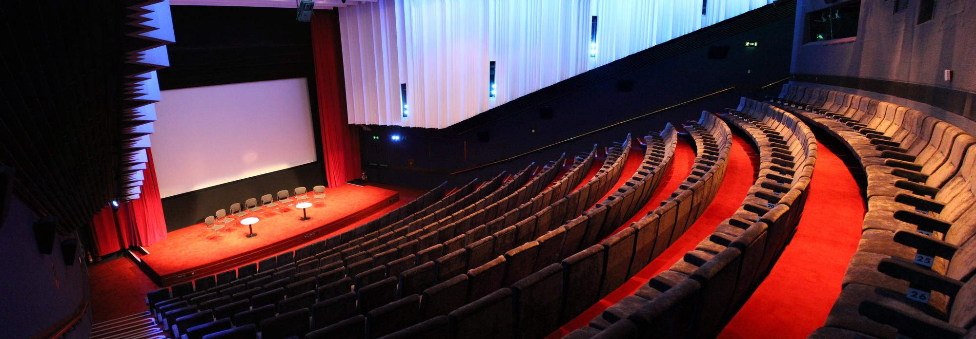
SOME OF OUR INDEPENDENT CINEMAS
Living Room, Chipping Norton
Living Room, Liphook
Regent Street Cinema
The Barbican

Slide 6
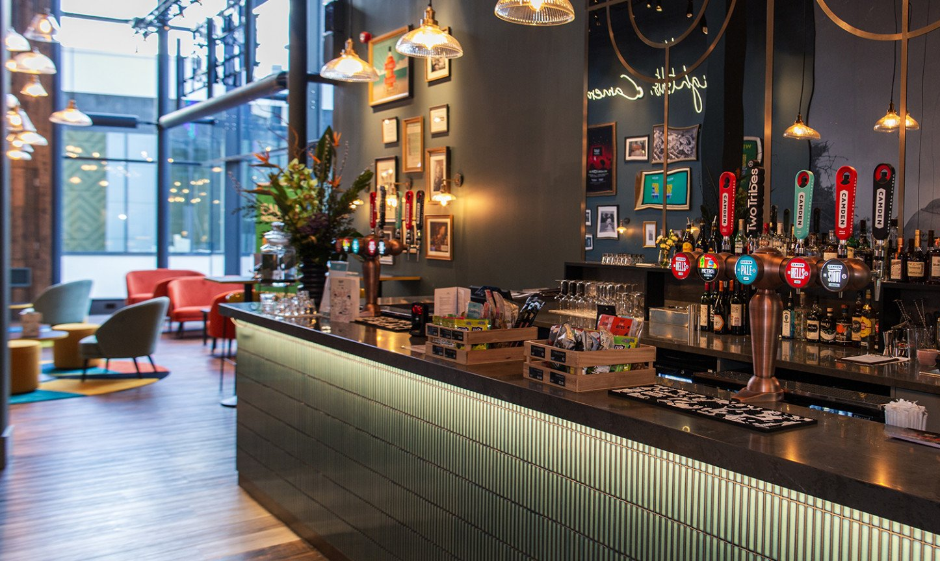
Thought starters for your brands
Create memorable moments across our independent estate
TRAVEL
ALCOHOL
FASHION/BEAUTY
Travel brands have the opportunity to tap into the audience’s desire for escape and experience, both on and off screen.
The ‘Turn Your Phone Off message’ is the perfect space for travel brands to encourage audiences to disconnect from everyday life, and embrace new journeys, whether that be on the screen or in the sky.
Alcohol brands can tap into this by aligning their product with moments of focus and enjoyment, where the audience is fully engaged with the film and the environment.
Alcohol is enjoyed in social settings where people want to be fully present, and this is the perfect opportunity to align with that moment.
Our Independent cinema gives brands the opportunity to engage a discerning, affluent audience.
Making it the perfect opportunity to amplify your brands premium credentials, connecting with the boutique cinema experience, and leaving a lasting impression.
Creative Example:
It’s time to sit back, relax and switch on flight mode, the film is about to start.
Creative Example:
It’s time to put down your phone and pick up your drink, the film is about to start.
Creative Example:
Turn off your phone and immerse yourself in the timeless art of cinema, where every detail matters.

Slide 7
THE DCM AD REEL – Exhibitor ident
TYPO is positioned in one of the most premium spots in the ad reel – just before the Gold Spot.
1.
DCM
OPENING IDENT 10”
2.
BRAND
ADS
3.
BRONZE
SPOT
4.
DCM
CLOSING
IDENT 15”
5.
SILVER SPOT
6.
FILM
TRAILERS
7.
Turn Your Phone Off Message
8.
GOLD
SPOT
9.
FILM
14.
FILM
Compliment the bespoke phones off message with a brand ad running at another point in the ad reel, either amongst the brand ads reel or in a premium position
Notes:
The line underneath the header should be 0.50cm away from the header
The sub header is 0.50cm beneath the line
The copy should then be 1cm away from the sub header
The main reel should be determined by blocks of grey with the parts you want to highlight using the reds within the DCM Studios palette

Slide 8
CONTEXTUAL RELEVANCE SUPERCHARGES CAMPAIGN EFFECTIVENESS
Meta-analysis of 22 recent cinema campaigns & 7 contextual/bespoke campaigns
Quality Brand Perceptions
Brand Consideration
+38%
+55%
+20%
+33%
Source: Differentology data bank. Meta-analysis consists of 22 campaigns and 7 bespoke campaigns.
Notes:
And research into our work with brands over recent year has demonstrated this.
The information in these charts has been taken from 22 recent cinema campaigns and 7 campaigns which have used bespoke content.
And the results are clear to see…
Standard Cinema advertising offers brands a way to boost key metrics.
But, there is an incremental benefit. An extra level brands can unlock through bespoke content

