Slide 1
HORROR
Why horror movies offer the perfect opportunity to target the hard-to-reach 16-24 audience

Slide 2
HORROR HAS HAD A RESURGENCE IN RECENT YEARS
Some of TV’s biggest hits have leant heavily on the horror genre
The Walking Dead
During its run it was consistently one of the highest rated scripted series on TV in America
American Horror Story
Consistently attracted some of Hollywood’s finest stars to the horror genre with Emmys, Golden Globes and SAG Awards as their reward
Stranger Things
It’s one of the most popular original Netflix shows and its cultural imprint was particularly demonstrated last summer with ‘Running Up That Hill’ returning to the charts after its use in the latest series.
The Haunting
These series encompass the films under the ‘Flanaverse’ from creator Mike Flanagan. Includes the series The Haunting of Hill House & The Haunting of Bly Manor

Slide 3
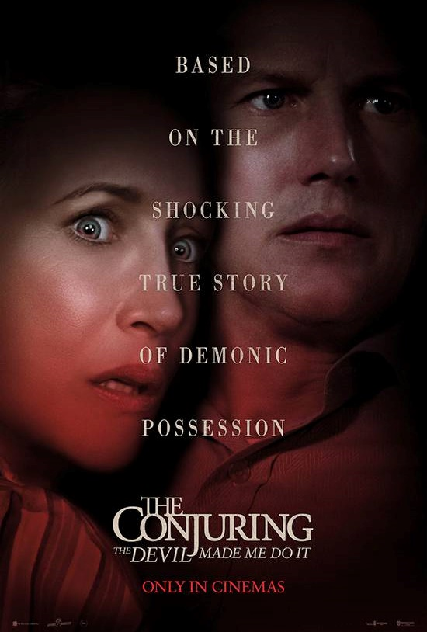
HORROR HAS BECOME BIG BUSINESS FOR HOLLYWOOD TOO
The genre turns big profits for film studios
Get Out
2017’s most profitable movie received an Oscar for director Jordan Peele who has become one of the hottest directors in Hollywood and influential directors in the modern horror scene.
It & It Chapter 2
One of the most successful horror film series of all time - It remains the biggest grossing horror film ever at the UK box office.
The Conjuring Universe
With multiple successful spin-offs from the original trilogy, The ‘Conjuring Universe’ films have grossed over $1billion worldwide
Smile
One of 2022’s surprise hits, Smile has become one of the top 10 horror films of all time at the UK box office. With a worldwide gross of $200m (off a budget of $17m) it’s a huge success for Paramount.

Slide 4
WE’VE SEEN SUBSTANTIAL INCREASE IN HORROR ADMISSIONS
Horror admissions have significantly increased across the last 7 years, taking a great proportion of box office, driven by successes including It, Get Out, Nope, Quiet Place, The Conjuring and Halloween universes.
*
Source: DCM Admissions. *2020 removed, only one major horror release due to pandemic closures

Slide 5
but HORROR ISN’T JUST ABOUT GORE
Horror movies are hugely rich and varied, often dealing with important cultural and social issues
Get Out
Racism in America
Us
The cultures of privilege and power in relation to the “American Dream”
Unfriended
Online/social media bullying
A Quiet Place
A metaphor about the terror of parenthood & wanting to protect your children
The Invisible Man
Abusive relationships and gaslighting
The Purge
Political allegory about government response to growing epidemic of violence

Slide 6
HORROR MOVIES SKEW HEAVILY 16-24
The majority of horror films profile over 50% 16-24 providing an opportunity to reach this young audience with limited wastage
Source: CAA Film Monitor

Slide 7
2023 horror film slate

Slide 8
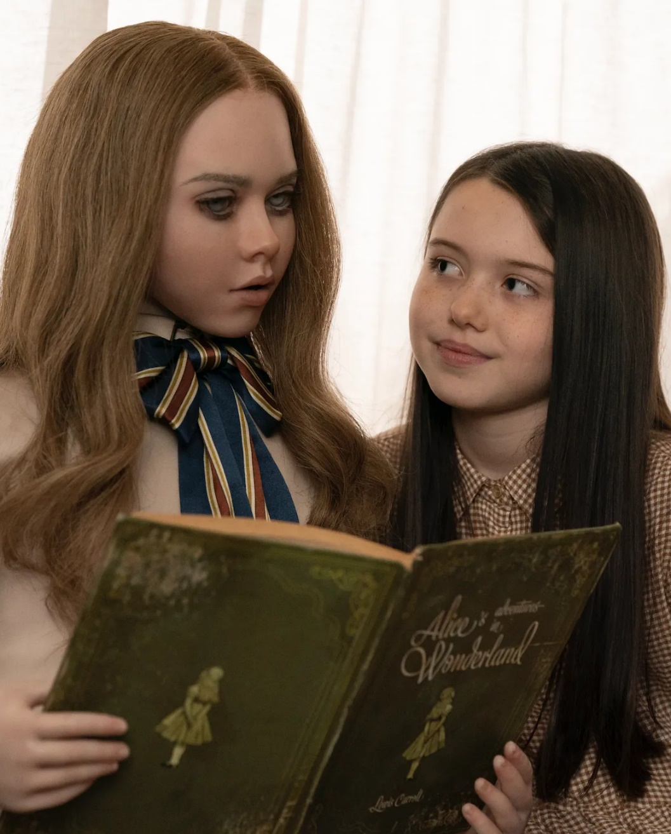
M3GAN
A modern take on the killer doll that looks set to capture cinemagoers attention
RELEASE DATE | EST. INDUSTRY ADMISSIONS | GENRE | HFSS BRANDS | ALCOHOL/GAMBLING BRANDS
13 January | 1m | Horror | Yes | Yes
SYNOPSIS
Gemma, a brilliant roboticist at a toy company who uses artificial intelligence to develop M3GAN, a life-like doll programmed to be a kid's greatest companion and a parent's greatest ally. After unexpectedly gaining custody of her orphaned niece, Gemma enlists the help of the M3GAN prototype - a decision that has unimaginable consequences
CAST
Allison Williams, Ronny Chieng, Violet McGraw
THE DCM TAKE
M3GAN is the latest entry in the ‘creepy doll’ sub-genre of horror that we’ve seen can deliver big box office success, as with 2014’s Annabelle. The film is produced by Jason Blum whose Blumhouse Productions is responsible for some of the genre’s biggest hits in recent years including the Paranormal Activity, Insidious, The Purge, Sinister and Get Out. When the trailer launch, the clip of M3GAN dancing clip went viral highlighting the real potential for this film to have a Smile-esque breakout on release. M3GAN is forecasted to deliver 5 16-34 TVRs so is a very efficient buy for accessing this sought-after, light TV viewing audience.
 | Adults (16+) | 16-34 Adults | 16-34 Women | ABC1 Adults | ABC1 Women
REACH | 1.9% | 4.8% | 5% | 2.3% | 2%
IMPACTS | 1,040,748 | 806,717 | 435,098 | 668,171 | 304,101
TVRS | 2 | 5 | 6 | 3 | 2
Source: DCM Planner, based on industry admissions

Slide 9
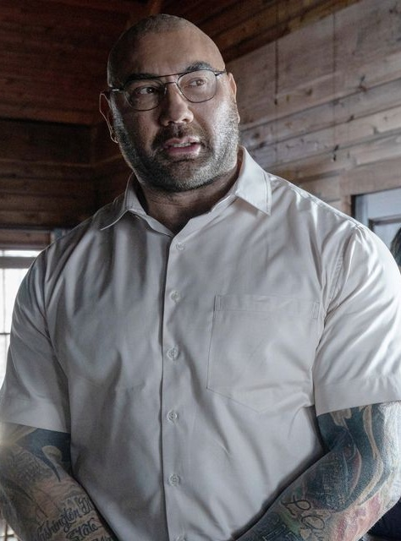
KNOCK AT THE CABIN
Upcoming apocalyptic psychological horror from M Night Shyamalan
RELEASE DATE | EST. INDUSTRY ADMISSIONS | GENRE | HFSS BRANDS | ALCOHOL/GAMBLING BRANDS
3 February | 660k | Horror | Yes | Yes
SYNOPSIS
While vacationing at a remote cabin, a young girl and her parents are taken hostage by four armed strangers who demand that the family make an unthinkable choice to avert the apocalypse. With limited access to the outside world, the family must decide what they believe before all is lost…
CAST
Dave Bautista, Rupert Grint, Jonathon Groff and Ben Aldridge
THE DCM TAKE
Plot-twist visionary M Night Shyamalan is back with his next enticing project which will no doubt not be quite what it first appears to be. Shyamalan – arguably most widely known for The Sixth Sense – continues to be prolific with his most recent successes including Glass (2019) & Split (2016), which both grossed over £10m at the UK box office. A director that never shies away from the absurd, audiences can expect to be taken on quite the ride with this latest film, an adaptation of the book ‘The Cabin At The End of the World’. As seen with Shyamalan’s previous films, we expect this film to deliver a predominantly 16-34 audience and provide brands with a highly efficient buy at major release CPT.
 | Adults (16+) | 16-34 Adults | 16-34 Men | ABC1 Adults | ABC1 Men
REACH | 1.3% | 3.1% | 2.8% | 1.5% | 1.6%
IMPACTS | 644,386 | 499,485 | 230,090 | 413,702 | 225,416
TVRS | 1 | 3 | 3 | 2 | 2
Source: DCM Planner, based on industry admissions

Slide 10
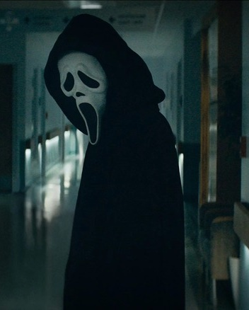
UNTITLED SCREAM SEQUEL
The sixth instalment in the Scream film series, a direct sequel to 2022’s Scream
RELEASE DATE | EST. INDUSTRY ADMISSIONS | GENRE | HFSS BRANDS | ALCOHOL/GAMBLING BRANDS
10 March | 950k | Horror | Yes | Yes
SYNOPSIS
The four survivors of the Ghostface killings leave Woodsboro behind and start a fresh chapter in New York City.
CAST
Courtney Cox, Dermot Mulroney, Melissa Barrera, Jenna Ortega, Samara Weaving, Hayden Panettiere
THE DCM TAKE
The Scream franchise returned last January after a 10-year hiatus, bringing the iconic Ghostface back for a new generation. The revived franchise enticed audiences back and was a box office success in the genre, grossing £8m at the UK box office and delivering just shy of 1m industry admissions.
The Scream franchise has been one of the most reliable since it re-defined the whole genre in 1996 and with this sequel coming quickly on the heels of last year’s film, audience anticipation will be high. Scream received an over-whelming positive reception, with a Rotten Tomatoes audience score of 82%, so we expect this sequel to deliver very similar admissions from a similarly profiling (66% 16-34) audience.
 | Adults (16+) | 16-34 Adults | 16-34 Men | ABC1 Adults | ABC1 Men
REACH | 1.9% | 3.9% | 3.7% | 1.9% | 2%
IMPACTS | 950,940 | 628,951 | 303,920 | 522,161 | 278,720
TVRS | 2 | 4 | 4 | 2 | 2
Source: DCM Planner, based on industry admissions

Slide 11
Upcoming 2023 horrors
Evil Dead Rise
Insidious 5
Untitled Exorcist Film
Untitled Saw Film
21 Apr 2023
7 Jul 2023
13 Oct 2023
27 Oct 2023

Slide 12
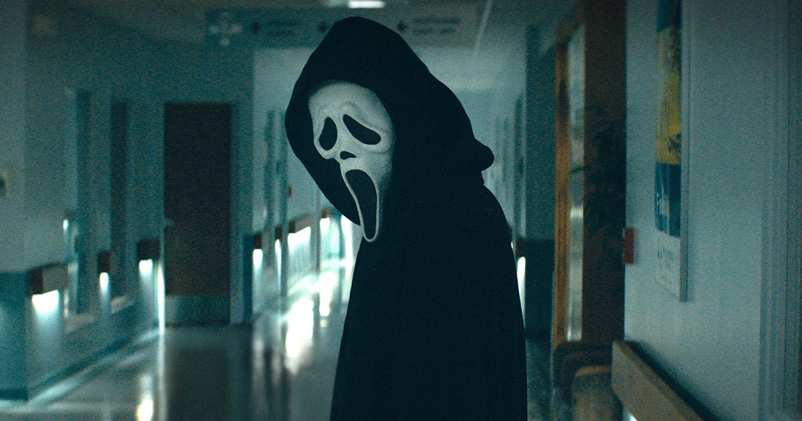
THE HORROR AUDIENCE
Early adopters, tech enthusiasts, console gamers
34% of Horror fans are planning to spend a lot or a moderate amount of money on a new smartphone in the next year
(Index 127)
Early Adopters:
Horror fans are 40% more likely
to ‘buy new products before their friends’
(Index 147)
58% ‘keep up to date with developments in technology’
(index 122)
51% ‘I love to buy new gadgets
and appliances’
(Index 136)
‘It is important my household is
equipped with the latest technology’
(Index 132)
61% own a gaming device & they’re 68% more likely to own a PS4, PS5 or Xbox One
43% agree that most of the time they wear sports clothes and trainers
(Index: 110)
4x more likely to own 9 or more TV subscription services than the avg. UK adult
Source: TGI Oct 2022
Target: People to have seen a horror film in the last 12 months. Index vs. average UK adult.

Slide 13
WHY BRANDS SHOULD EMBRACE THE HORROR GENRE
Advertisers are missing a trick – horror movies give them a chance to engage a key youth audience
Horror audiences are passionate and emotionally engaged
Horror films are an incredibly efficient way of engaging a young 16-24/34 audience
The horror audience are early adopters, tech enthusiasts & open to new brands

