Slide 1
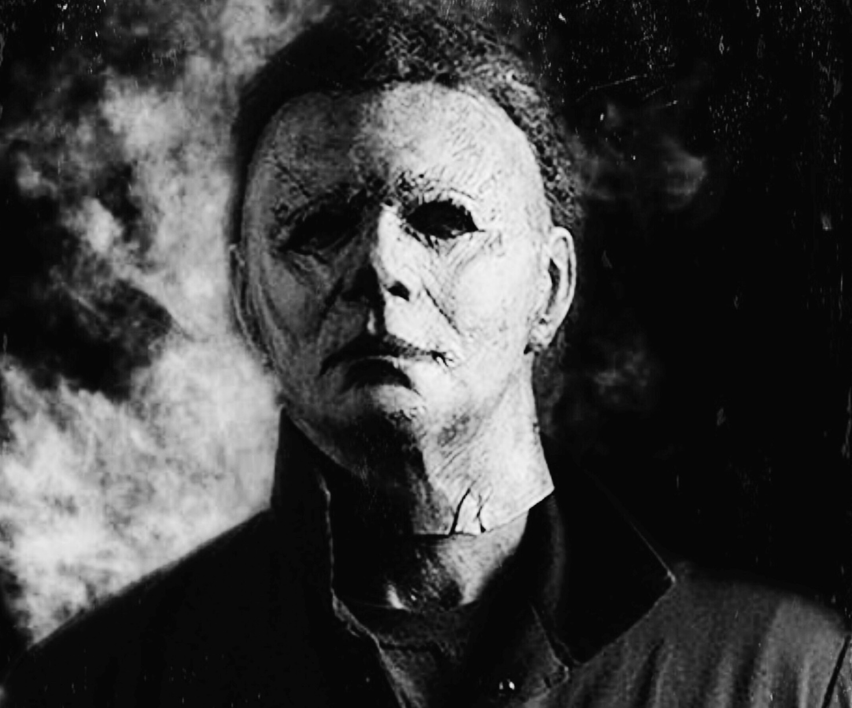
Halloween kills
Michael Myers is back
Release Date
15 October 2021
Cast
Jamie Lee Curtis, Judy Greer, Anthony Michael Hall
Director
David Gordon Green (Halloween, Pineapple Express)
Recommended if you like
Halloween
Reasons to buy into
The first film in the rebooted Halloween series was the most successful release of the franchise yet, taking £9 million at the UK Box Office.
Key audience info
16-34 Adults Index: 238
Est. DCM admissions
584k
The saga of Michael Myers and Laurie Strode continues in the next thrilling chapter of the Halloween series.
Plan your campaign

