Slide 1
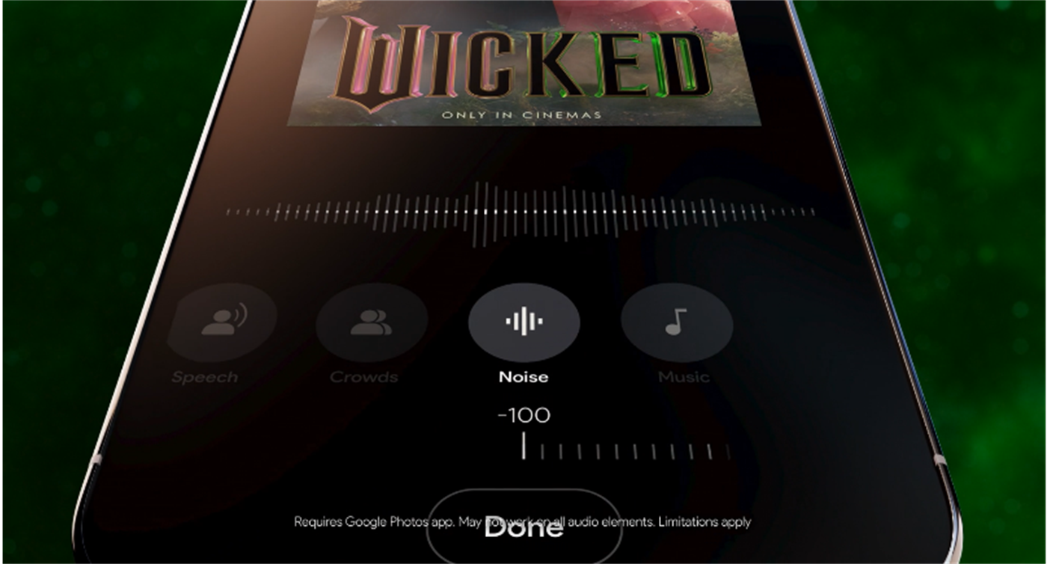
Google pixel 9: wicked typo
Turn Your Phone Off
Background
Google were looking to refresh their Google Pixel 9 Turn Your Phone Off message
Idea
DCM Studios created a bespoke Wicked TYPO creative for Google that is running exclusively in Wicked screenings. We have updated the original Google Pixel 9 Turn Your Phone Off message and included visuals and audio from the film.
>Click to Watch<
Campaign Details
Sector | Telecommunication | Media Agency | Mediacom
Target Audience | 18-29 | Creative Agency | DCM Studios
Package | Turn Your Phone Off | Duration | 30”

