Slide 1
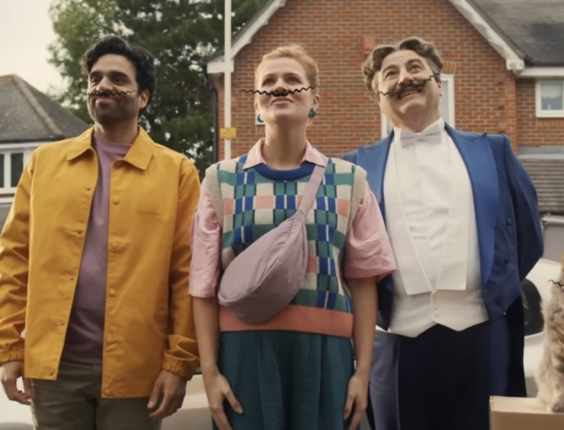
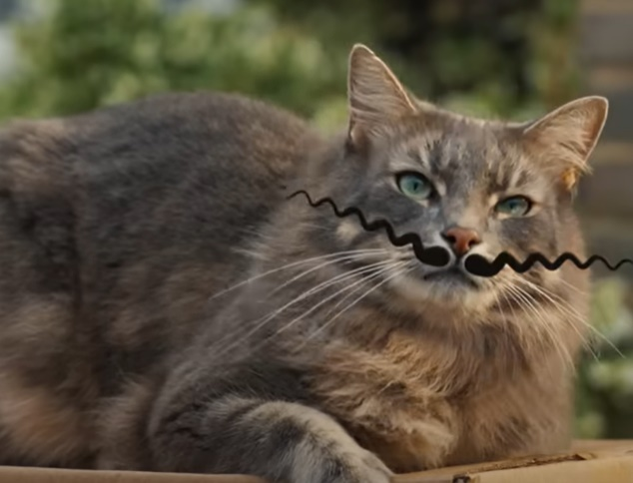
Go.Compare
DCM AWARDS NOMINEE
Best Use of Cinema (Small)
‘Feel the Tache’
Background
Go.Compare wanted to shift focus to enhancing brand consideration, while expanding its media mix to drive ROI.
Plan
Go.Compare launched the 'Feel the Tache' campaign on Boxing Day, strategically aligning itself alongside ABC1 skewing film releases during the Q1 2025 awards season.
Results
Adding cinema to the media mix contributed to strong campaign cut-through with ad recall +23% vs. the previous year’s campaign.
Cinema delivered a ROI of £5, proving it's performance benefits alongside its brand-building capabilities
Notes:
Source: DCM / Go.Compare

Slide 2


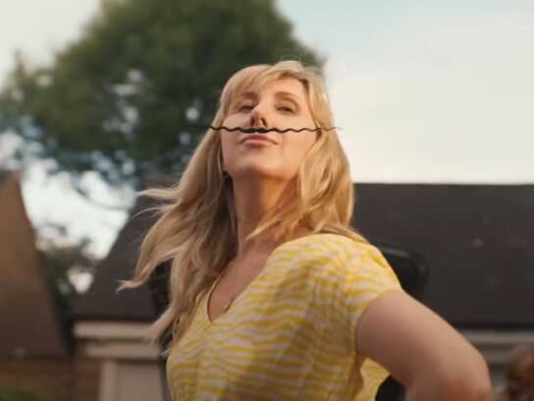
Go. Compare
DCM AWARDS NOMINEE: Best Use of Cinema (Small)
MEDIA AGENCY | TARGET | BUYING ROUTE | COPY LENGTH
Hearts & Science | ABC1 Ads | Film Packs | 30”
‘Feel the Tache’
BACKGROUND
Whilst being an already salient brand, Go.Compare wanted to shift the focus to enhancing brand consideration with a new creative launch. Typically running only in linear TV, Go Compare wanted to expand its media mix to drive short-term conversions and ROI.
PLAN
Cinema was identified as a powerful channel to build new memory anchors, so Go.Compare launched the 'Feel the Tache' campaign on Boxing Day, strategically aligning itself alongside ABC1 skewing film releases during the Q1 2025 awards season. The campaign also ran across TV, BVOD, SVOD, OOH, and YouTube to ensure the campaign would be unmissable at launch.
RESULTS
Cinema successfully contributed to both brand building and tangible performance for Go.Compare.
BOOSTED CONSIDERATION
Over a third stated Go. Compare as one of their first considerations when needing a price comparison website, +2% YoY.
STRONG RECALL
Adding cinema to the media mix contributed to strong campaign cut-through with ad recall +23% vs. the previous year’s campaign.
DELIVER ON ROI
Cinema delivered a ROI of £5, proving cinema's performance benefits alongside its brand-building capabilities and making it one of the top performing media channels.
Notes:
Source: DCM / Go.Compare

