Slide 1
Wednesday 2 - Sunday 13 March 2022
HEADLINE SPONSOR OPPORTUNITY

Slide 2
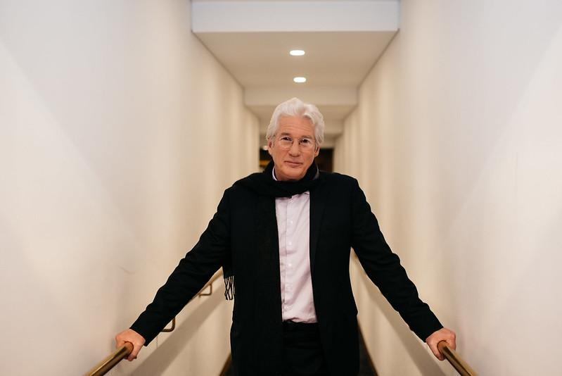
“The Academy Awards
are tonight? It was more
important to be here.”
Richard Gere, Actor

Slide 3
Glasgow Film Festival at a Glance
Success of 2020
43,147 Admissions
212 films (192 feature films)
380 film screenings
9 World Premieres
10 European Premieres
101 UK Premieres
40 Scottish Premieres
179 Volunteers
32% films directed or co-directed by women
20 venues across Glasgow
680 Delegates
124 Filmmaker Guests
Innovation of 2021
41,191 Admissions
10,977 views of free online events
70 Film Screenings
10 World Premieres
3 European Premieres
49 UK Premieres
80% films captions or subtitled
Launch of Glasgow Film At Home (online player)
34% films directed or co-directed by women
418 Delegates
70 Filmmakers in Q&As

Slide 4
Opening and Closing Galas Through the Years
Opening | Closing
2021
Minari | Spring Blossom
2020
Proxima | How to Build a Girl
2019
Mid90s | Beats
2018
Isle of Dogs | Nae Pasaran
2017
Handsome Devil | Mad to be Normal

Slide 5
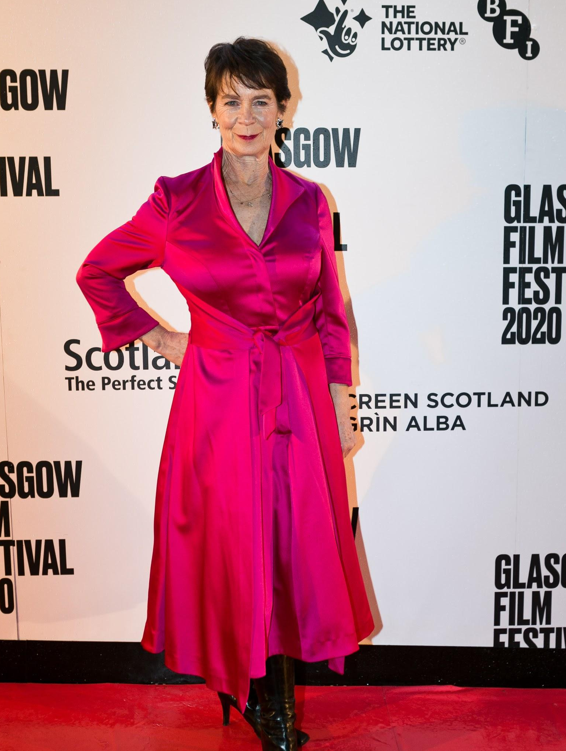
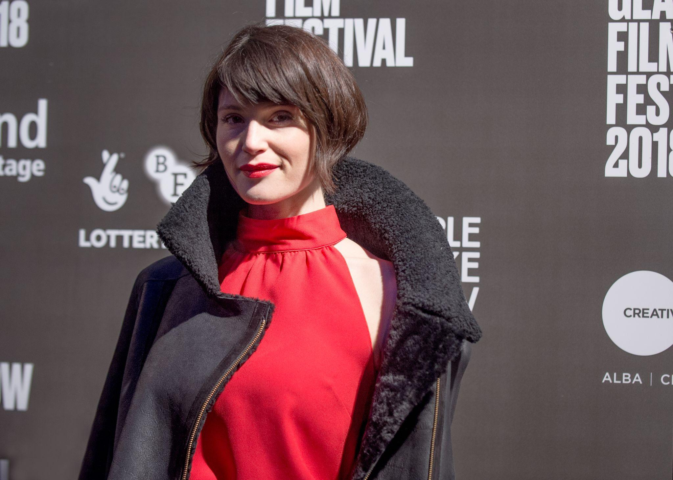
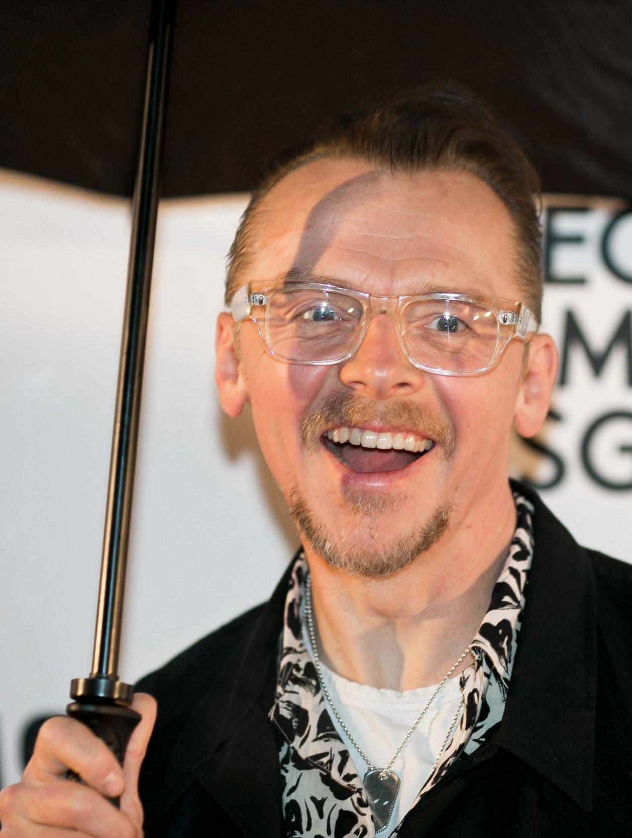
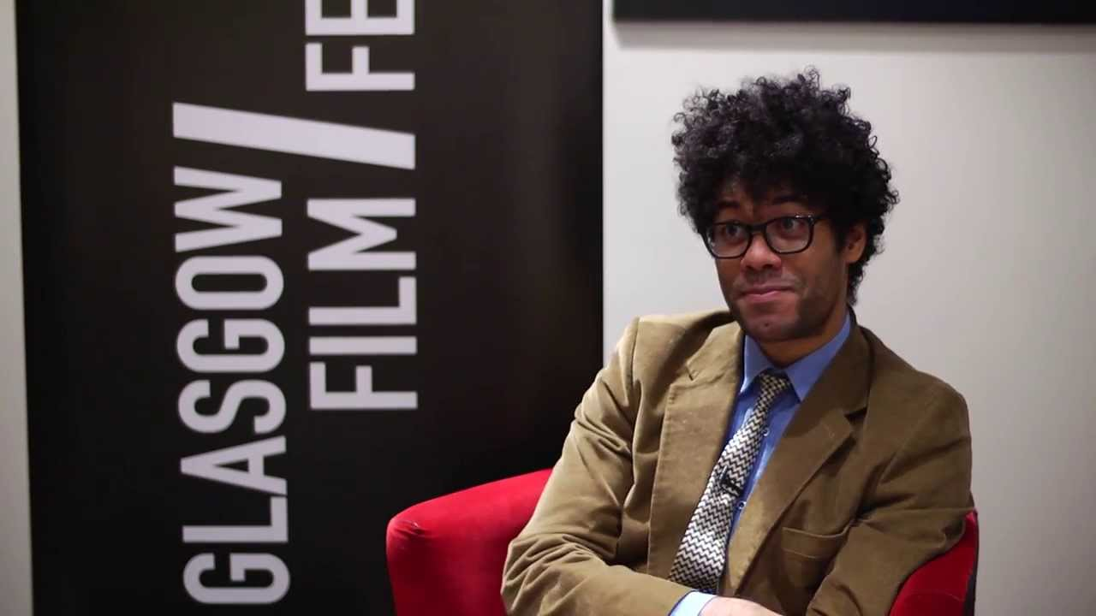
Special Guests Through the Years
Alan Rickman
Armando Iannucci
Ben Wheatley
Bill Paterson
Bo Burnham
Caitlin Moran
Celia Imrie
Claudia Lennear
Craig Roberts
David Tennant
Edith Bowman
Harry Shearer
Jack Reynor
James Earl Jones
Karen Gillan
Peter Mullan
Richard Ayoade,
Richard Dreyfuss
Richard Gere
Sir Michael Palin

Slide 6
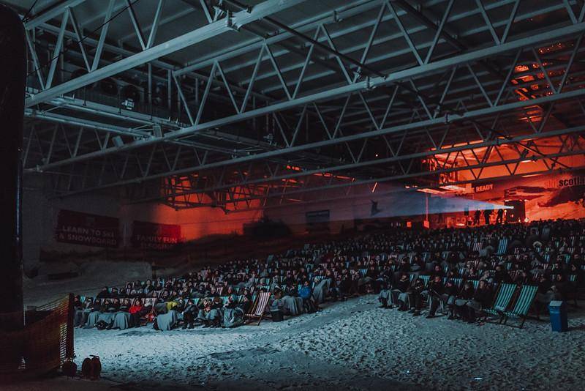
Special Events Through the Years
The Thing held on a ski slope
Con Air, the audience transported by bus to secret location with police wardens and taken to location with a plane
The Lost Boys at a theme park
Alien with laser tag pre film
Dawn of the Dead – zombie treasure hunt
Strictly Ballroom at Kelvingrove Museum
Die Hard, we created our own Nakatomi Plaza in Glasgow building
The Blair Witch Project at Mugdock Country Park
Internet cat video festival held at Gallery of Modern Art (GOMA)
*Due to uncertainties around COVID-19, Special Events will not take place at GFF22.

Slide 7
What We Can Offer / Our Reach
We’ll work with you to build an exciting presence across Glasgow Film Festival, tailored to you including branding, digital and social engagement, and media opportunities.
Branding
Branding opportunities across the festival including media wall, cinema, bars and online platform advertising
With exclusive on-screen content before all supported screenings
Online & Digital
A full integration across our social media with sponsored activity
35k followers, +5.7%
24k followers, +4.7%
11k followers, +19.4% Bespoke content in our newsletters
12,000 Subscribers
Engaging content for your website, and online player
105,000 website users GFF Website (January - March 2021)
113,000 website users GFAH (January - March 2021)
Media
Inclusion in press and tailored PR campaign across a range of print, broadcast and online media
1270 pieces of coverage in 2021 from across the UK with an estimated AVE of £2.6million
68% print, 25% radio, 7% TV

Slide 8
Our tribe – get to know our community of film fans
For our last in-cinema 2020 Festival:
35% were under 30
25-34 was our largest age group of attendees
48% of attendees were from Glasgow
38% of attendees came from across Scotland
14% came from further afield!
For our online 2021 Festival:
34% of audience under 35
Over 50% of our audience are from outside Scotland
GFF is inclusive - we have a diverse audience from the most to least affluent areas in Scotland Majority of our audiences come from areas with people from higher education, employed, high-salaried with more disposable income.
Industry Focus
Our Industry Programme is at the heart of the festival, creating a bustling hub of activity during the festival dates and continuing all year round. This is where we forge connections, share fresh new thinking and nurture the filmmakers of tomorrow.
Over 400 delegates will be in attendance at GFF22.

Slide 9
SPEAK TO YOUR DCM REP FOR MORE DETAILS

