Slide 1
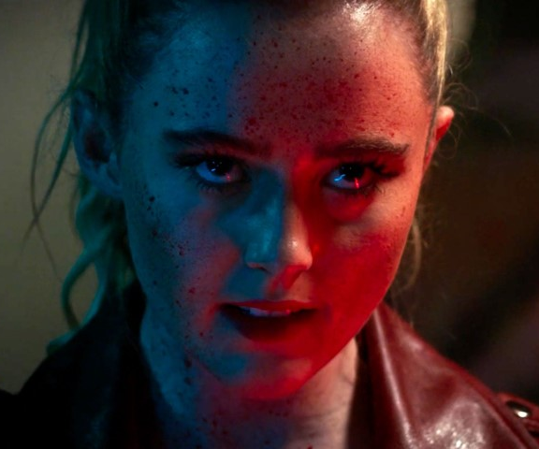
Freaky
Body swap goes body horror!
Release Date
2 July 2021
Cast
Kathryn Newton, Vince Vaughn, Alan Ruck
Director
Christopher Landon (Happy Death Day 2 U)
Recommended if you like
Happy Death Day 2 U
Reasons to buy into
A fun premise and a surprisingly twisted turn from Vince Vaughn makes this slasher-comedy the perfect seasonal alternative.
Key audience info
16-34 Adults Index:
Est. DCM admissions
105k
After swapping bodies with a deranged serial killer, a young girl in high school discovers she has less than 24 hours before the change becomes permanent.
Plan your campaign

