Slide 1

FAST AND FURIOUS 9
The return of one of cinema’s most successful franchises
This June, one of cinema’s most successful franchises is back on the big screen with its ninth instalment. Justin Lin, director of four of the biggest and best films in the franchise, returns alongside core characters Dominic Toretto (Vin Diesel), Letty Ortiz (Michelle Rodriguez) and Cipher (Charlize Theron). This is all set to be a huge hit with Fast & Furious fans and cinemagoers once again.
CAST
Vin Diesel, Charlize Theron, Michelle Rodriguez, John Cena, Helen Mirren
KEY STATS
The Fast & Furious franchise has grossed over £166m at the UK office with the last three instalments accumulating over 50%¹
Young, male audience – on average, the last 3 instalments profiled 34% 16-34 men
(244 index)²
EST. INDUSTRY ADMISSIONS
1.5m
REACH / IMPACTS / TVRs³
Adults (16+): 2.4% / 1.3m / 2.6
Men (16+): 3.0% / 779k / 3.3
16-34 adults: 5.3% / 879k / 5.8
16-34 men: 6.2% / 534k / 6.8
16-24 men: 7.4% / 383k / 10.2
Source: 1. IBOE. 2. Kantar TNS Film Monitor database. 1 + 2 include F&F 7, F&F 8 and Hobbs & Shaw.
3. CAA C+F Planner – predicted industry admissions.
RELEASE DATE: 24 JUNE 2021

Slide 2

Effectively reach young men with fast & furious
Big impact, low frequency – the majority of cover for advertisers is unique
16-34 adults
38%
Index 130
Women (16+)
59%
Index 129
ABC1 (16+)
72%
Index 150
Source: CAA C+F Planner. Predicted industry admission, May 2021

Slide 3
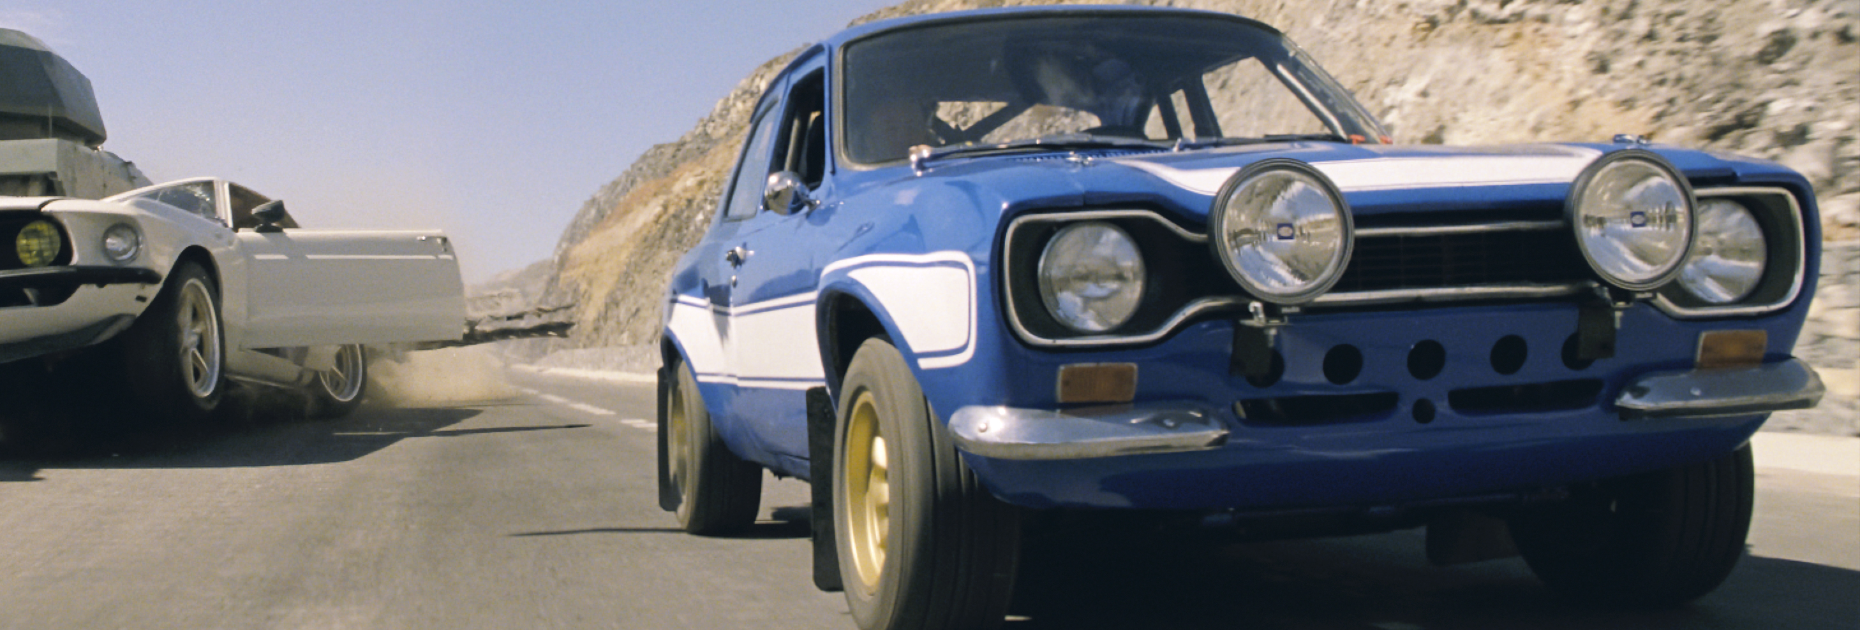
FOCUS ON MOTORS

Slide 4



Fast & Furious fans have a natural attraction to cars
Fans of the returning franchise are significantly more likely, than the average UK adult, to buy a new car in the next two years. They are in market for innovative and different cars that express their personality.
In market for innovation & difference¹
Product & brand matters²
Premium yet accessible³
Fast & Furious fans are 38% more likely
to buy a new car in the next two years
Agree ‘my car should express my personality’ (148 index)
Agree ‘I like innovative cars’ (145 index)
Buy a new car based on its innovation
(185 index)
Buy a new car based on its performance (157 index)
Buy a new car based on the company’s reputation (147 index)
(145 index)
(144 index)
(141 index)
Source: TGI Q1 2020. 1. Index vs. average UK adult. 2. Index vs. average UK adult.
3. Index vs. average UK adult intending to buy a car in the next two years. What brand do you intend to buy?

Slide 5

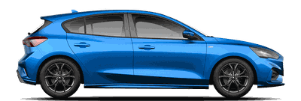
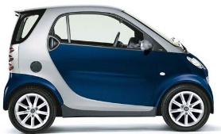

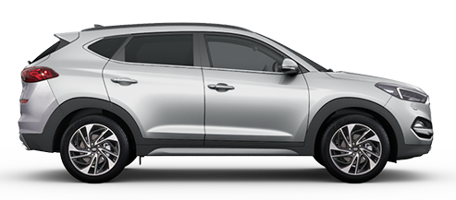
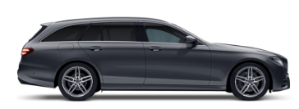
Fast & Furious fans have a natural attraction to cars
Fans of the retuning franchise are significantly more likely, than the average UK adult, to buy a Coupe or Saloon car in the next two years
Hatchback (99 index)
Coupe (152 index)
Micro (90 index)
Saloon (141 index)
SUV (82 index)
Estate (106 index)
Source: TGI Q1 2020. Index vs. average UK adult intending to buy a car in the next two years.

Slide 6
18% more likely to buy an electric car
in the next two years
Source: 118 index. Vs. average UK adult intending to buy a car in the next 2 years.

Slide 7
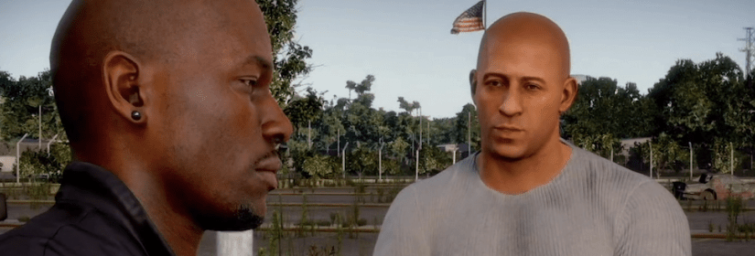
FOCUS ON TECH & GAMING

Slide 8
Fast and furious fans are tech savvy
In comparison to fans of Marvel and DC films, Fast & Furious followers are as passionate about new technology and more excited to
purchase new developments
Index line – average UK adult
Source: TGI Q1 2020. Index vs. average UK adult.

Slide 9
Fast and furious fans are passionate gamers
In comparison to fans of Marvel and DC films, Fast & Furious followers are more passionate about the gaming and new updates
in the industry
Index line – average UK adult
Source: TGI Q1 2020. Index vs. average UK adult.

Slide 10
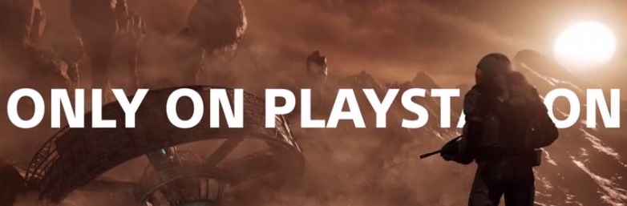
Gaming brands have benefited from Furious’ passionate audience
In 2017, PlayStation invested in a Fast & Furious 8 film pack, running across the opening week – results showed the advert resonated the franchise’s passionate audience, helping to drive purchase intent of PS4 and four different exclusive games.
PlayStation wanted to immerse audiences with gameplay content, driving recognition of how far the quality of videogames has come and showcase how it is at the forefront of gaming innovation.
The opening week of Fast & Furious 8 offered the perfect opportunity for PlayStation to tap into a blockbuster audience that would deliver their target 16-44 male audience who also over index for playing consoles and being passionate about new market developments.
Rather than running one copy showcasing a single game or a montage of upcoming titles, PlayStation wanted to fully showcase the breadth and quality of their exclusive ‘Only On PlayStation’ slate, running 4x30 ads in the reel for Horizon Zero Dawn, GT Sport, Farpoint and Wipeout.
+27%
Increased campaign awareness
Cinema exposed respondents were 27% more likely to be aware of recent PS4 advertising vs. non-exposed control
+29%
Key messages landed effectively
71% of cinema exposed respondents agreed ‘PlayStation has the best exclusive games’ 29% more likely than the non-exposed control group
+40%
Uplift in purchase intent
Those exposed to the cinema activity were 40% more likely to consider buying a PS4 and on average over twice more likely to buy one of the four exclusive releases
Source: Differentology campaign study 2017.

