Slide 1

Fast x
The return of one of cinema’s most successful franchises
RELEASE DATE | EST. INDUSTRY ADMISSIONS | GENRE | HFSS BRANDS | ALCOHOL/GAMBLING BRANDS
19 May | 2.4m | Action | Yes | No
SYNOPSIS
TBC
CAST
Vin Diesel, Jason Statham, Michelle Rodriguez, Jason Momoa, Brie Larson, John Cena
THE DCM TAKE
One of cinema’s most successful franchises is back on the big screen – over the last 21 years this series has grossed over £180m at the UK box office and has developed into a consistently entertaining and reliable hit.
The franchise unsurprisingly indexes towards a young male audience (Index: 250) and so naturally will be a great buy for tech, gaming and car brands. This film is released as the Premier League season is winding down and ahead of the UEFA Champions League final in June 2023 so will provide a great complement to other AV activity and extend reach among this core demo.
 | Adults (16+) | 16-34 Adults | 16-34 Men | ABC1 Adults | ABC1 Men
REACH | 3.7% | 8.1% | 9.5% | 3.5% | 4.5%
IMPACTS | 2,020,971 | 1,401,785 | 851,532 | 1,018,077 | 667,390
TVRS | 4 | 9 | 11 | 4 | 5
Source: DCM Planner, based on industry admissions

Slide 2
Effectively reach young men with fast X
With a strong young male profile, Fast X is forecast to deliver over 10 TVRs for 16-24 and 16-34 men
Source: CAA C+F Planner. Predicted industry admission, May 2021

Slide 3



Fast & Furious fans have a natural attraction to cars
Fans of the returning franchise are significantly more likely, than the average UK adult, to buy a new car in the next two years. They are in market for innovative and different cars that express their personality.
In market for innovation & difference¹
Product & brand matters²
Premium yet accessible³
Fast & Furious fans are 36% more likely
to buy a new car in the next two years
Agree ‘my car should express my personality’ (130 index)
Agree ‘I like innovative cars’ (133 index)
Buy a new car based on its innovation
(189 index)
Buy a new car based on how environmentally friendly it is (123 index)
Buy a new car based on the brand image (139 index)
(493 index)
(340 index)
(495 index)
Source: TGI GB Oct 2022. Target: Those who are fans of the Fast & Furious franchise and are intending to buy a car in the next year. Index vs. average UK adult

Slide 4




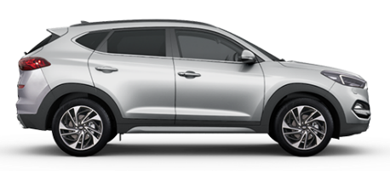
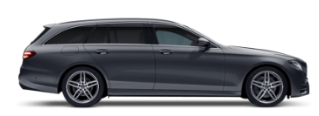
Fast & Furious fans have a natural attraction to cars
Fans of the retuning franchise are significantly more likely, than the average UK adult, to buy a Coupe or Saloon car in the next two years
Hatchback (322 index)
Coupe (547 index)
Micro (248 index)
Saloon (413 index)
SUV (440 index)
Estate (416 index)
Source: TGI GB Oct 2022. Target: Those who are fans of the Fast & Furious franchise and are intending to buy a car in the next year. Index vs. average UK adult

Slide 5
3x more likely to buy an electric car
in the next two years
Source: TGI GB Oct 2022. Target: Those who are fans of the Fast & Furious franchise and are intending to buy a car in the next year. Index vs. average UK adult

Slide 6
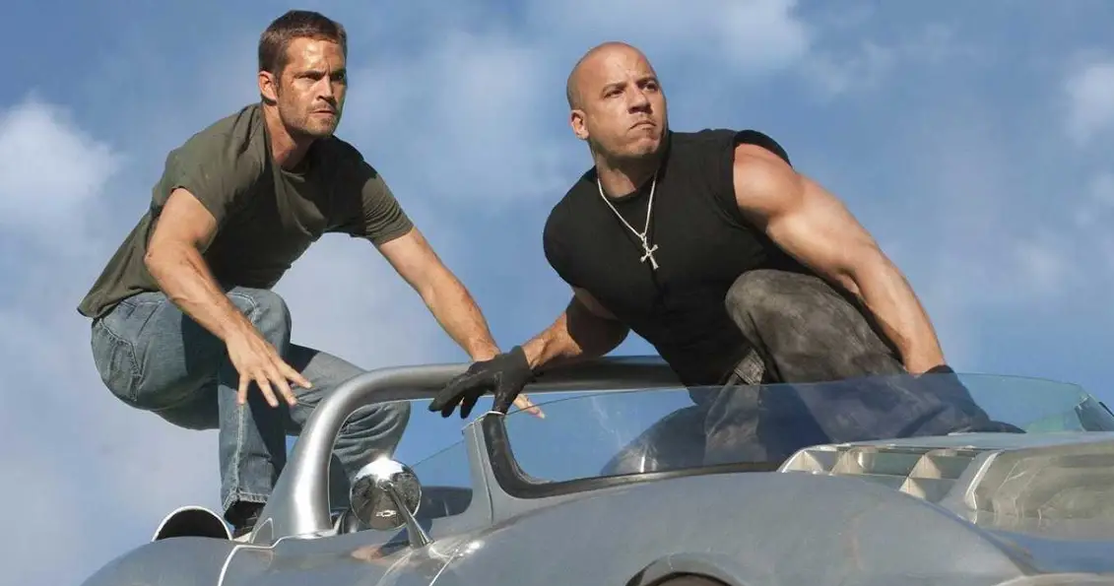
Fast & Furious fans are also big on gaming and tech
Category Insights
“I like to keep up with the latest news and developments in the video games industry”
Index: 153
56%
“I try to keep up with developments in technology”
Index: 120
51%
“I love to buy new gadgets and appliances”
Index: 136
Intend to purchase a games console
Index: 215
“My favourite pastime is playing video games”
Index: 149
64%
“I like to have technology that makes life easier at home”
Index: 120
33%
“It is important my household is equipped with the latest technology”
Index: 127
Intend to purchase personal smart tech or for the home
Index: 204
14 hours a week spent on gaming, which is 6 more hours than the average UK adult
Source: TGI GB Oct 2022, Those who are fans of the Fast & Furious franchise who are cinemagoers. Index vs GB average

Slide 7
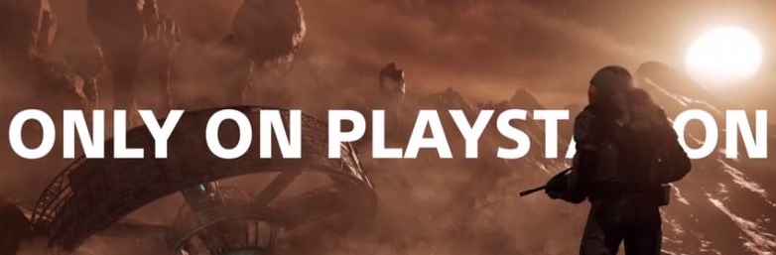
Gaming brands have benefited from Furious’ passionate audience
In 2017, PlayStation invested in a Fast & Furious 8 film pack, running across the opening week – results showed the advert resonated the franchise’s passionate audience, helping to drive purchase intent of PS4 and four different exclusive games.
PlayStation wanted to immerse audiences with gameplay content, driving recognition of how far the quality of videogames has come and showcase how it is at the forefront of gaming innovation.
The opening week of Fast & Furious 8 offered the perfect opportunity for PlayStation to tap into a blockbuster audience that would deliver their target 16-44 male audience who also over index for playing consoles and being passionate about new market developments.
Rather than running one copy showcasing a single game or a montage of upcoming titles, PlayStation wanted to fully showcase the breadth and quality of their exclusive ‘Only On PlayStation’ slate, running 4x30 ads in the reel for Horizon Zero Dawn, GT Sport, Farpoint and Wipeout.
+27%
Increased campaign awareness
Cinema exposed respondents were 27% more likely to be aware of recent PS4 advertising vs. non-exposed control
+29%
Key messages landed effectively
71% of cinema exposed respondents agreed ‘PlayStation has the best exclusive games’ 29% more likely than the non-exposed control group
+40%
Uplift in purchase intent
Those exposed to the cinema activity were 40% more likely to consider buying a PS4 and on average over twice more likely to buy one of the four exclusive releases
Source: Differentology campaign study 2017.

