Slide 1
Family audiences

Slide 2
FAMILIES love a trip to the cinema
Cinema remains a great option for families looking to spend time together outside the home, creating special shared experiences and memories for their children.
of families are cinemagoers, and they’re 21% more likely to be heavy cinemagoers
“The Cinema Is A Great Way To Spend Quality Time With Family”
(Index: 107)
“Going To The Cinema Allows Me To Have Some Well-Needed Time Out From My Day-To-Day Life”
(Index: 104)
Source: GB TGI Oct 2022. Mainshoppers who have children in the household.
Indexes vs. average GB adult

Slide 3
60%
6 in 10 parents of 0-4 year olds took them to the cinema in last six months - in line with 2019.
Source: FAME, conducted December 2021

Slide 4
Family ticket sales ALIGN WITH key HOLIDAY periods
Family ticket sales typically peak in alignment with school holidays at Easter, Summer and Christmas
Easter
Summer Holidays
Christmas
Source: DCM admissions cube, % of total annual family/adult ticket sales.

Slide 5
Frequent cinemagoing families feel more positive towards the cinema
Families love the cinematic experience, primarily for escapism and spending quality time with each other
60%
49%
63%
£29.69
You Can't Replicate The Cinema Experience On TV/Laptop/Tablet/Mobile
^{(Index: 106)}
I Am More Likely To Recommend Brands When Advertised At The Cinema Than In Other Places (e.g. TV, Social Media)
^{(Index: 154)}
A Trip To The Cinema Lets Me Escape From Everyday Life
^{(Index: 111)}
Spent on food/drink treats
£11 more than the average cinemagoer
59%
3x
62%
62%
Going To The Cinema Allows Me To Have Some Well-Needed Time Out From My Day-To-Day Life
^{(Index: 106)}
More likely to visit the cinema because their children were desperate to see the film
I Get Completely Absorbed Into The Story When I Watch A Film At The Cinema
^{(Index: 106)}
Films Are An Essential Part Of My Cultural Life
^{(Index: 120)}
Source: FAME 2021 Target: Mainshoppers who are heavy cinemagoers who have presence of children in the household Index vs the avg. UK adult

Slide 6
Puss in boots: the last wish
3 Feb 2023

Slide 7
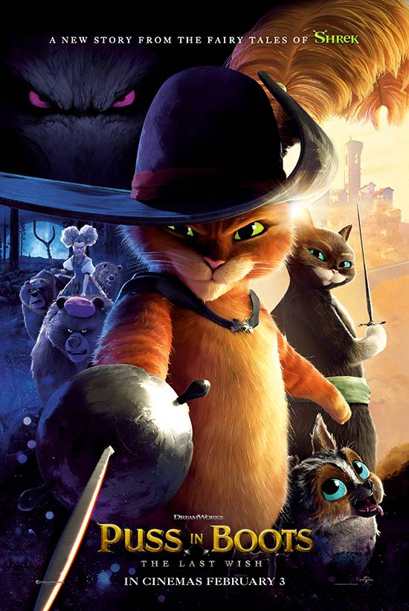
Puss in boots: the last wish
Everyone's favourite leche-loving, fear defying feline returns
RELEASE DATE | EST. INDUSTRY ADMISSIONS | GENRE | HFSS BRANDS | ALCOHOL/GAMBLING BRANDS
3 Feb | 2.5m | Animation | No | No
SYNOPSIS
Puss in Boots discovers that his passion for adventure has taken its toll: he has burnt through eight of his nine lives. Puss sets out on an epic journey to find the mythical Last Wish and restore his nine lives.
VOICE CAST
Antonio Banderas, Salma Hayek, Olivia Colman, Florence Pugh & Ray Winstone
THE DCM TAKE
DreamWorks have won the hearts of many families over the years with its acclaimed list of animated titles including Kung Fu Panda, Megamind, and Madagascar. One franchise towers above them all though – Shrek – one of the biggest animated franchises of all time, grossing almost £150m at the UK box office to date. With Puss In Boots: Last Wish, DreamWorks returns to the Shrek universe for the first time in over a decade.
The first Puss in Boots (2011) film grossed £16m in the UK and with rave reviews already coming in from critics for this title we’re expecting big things from Puss in Boots The Last Wish, with a release that is perfectly aligned to provide entertainment for families up and down the country during February half-term.
 | Adults (16+) | Main shoppers with children | 16-34 Adults | Children (7-15) | ABC1 Adults
REACH % | 3.1% | 4.8% | 2.7% | 14.3% | 3.5%
IMPACTS | 1.6m | 2.3m | 428k | 958k | 984k
TVRS | 3 | 5.2 | 3 | 16 | 4
Source: DCM Planner, based on industry admissions

Slide 8
Super mario bros
31 Mar 2023

Slide 9
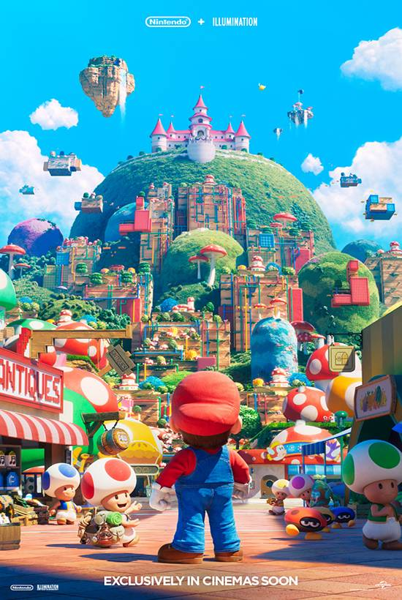
Super Mario bros
From Nintendo and Illumination comes a new animated film based on the world of Mario.
RELEASE DATE | EST. INDUSTRY ADMISSIONS | GENRE | HFSS BRANDS | ALCOHOL/GAMBLING BRANDS
31 Mar | 4.4m | Animation | No | No
SYNOPSIS
A plumber named Mario travels through an underground labyrinth with his brother, Luigi, trying to save a captured princess.
VOICE CAST
Chris Pratt, Anya Taylor-Joy, Charlie Day, Jack Black, Seth Rogen, Keegan-Michael Key
THE DCM TAKE
Super Mario Bros is one of the biggest selling video games of all time, gaining initial popularity in the 80s it has gone to sell over 380 million copies worldwide. Nintendo and Illumination Studios have collaborated for this new film adaptation, and with the latter responsible for the Despicable Me and Minions franchise, which has grossed a total of £115m to date, expectations are high for another huge family hit.
Releasing just in time for the Easter break, we expect this to still be delivering admissions deep into May and ultimately be one of, if not THE biggest family title of the year
 | Adults (16+) | Main shoppers with children | 16-34 Adults | Children (7-15) | ABC1 Adults
REACH | 4.9% | 7.9% | 7.2% | 23.2% | 4.5%
IMPACTS | 2.7m | 4.2m | 1.2m | 1.8m | 1.3m
TVRS | 6 | 9.3 | 8 | 29 | 5
Source: DCM Planner, based on industry admissions

Slide 10
The little mermaid
26 May 2023

Slide 11
The little mermaid
Nostalgic live-action remake starring the beloved Disney princess
RELEASE DATE | EST. INDUSTRY ADMISSIONS | GENRE | HFSS BRANDS | ALCOHOL/GAMBLING BRANDS
26 May | 4.4m | Family | No | No
SYNOPSIS
The youngest of King Triton's daughters, Ariel is a beautiful and spirited young mermaid with a thirst for adventure. Longing to find out more about the world beyond the sea, Ariel visits the surface and falls for the dashing Prince Eric. Following her heart, she makes a deal with the evil sea witch, Ursula, to experience life on land.
CAST
Halle Bailey, Jonah Hauer-King, Melissa McCarthy, Javier Bardem, Daveed Diggs and Awkafina
THE DCM TAKE
The last Disney live-action remake that released in cinema, Aladdin, was a smash hit with 4.2m DCM admissions. As the newest entry to this canon The Little Mermaid will be one of the best ways next year to reach families. The hype for the film was immediately evident after the release of the first trailer, with a plethora of positive responses online and many cute reaction videos going viral.
The Little Mermaid will no doubt be a priority title for Disney next year and given the last live-action remake with a female Disney princess was Beauty & The Beast (2017) grossed a spectacular £72m at the UK box office, expectations are high for another huge box office smash during the May half-term.
 | Adults (16+) | Main shoppers with children | 16-34 Adults | Children (7-15) | ABC1 Adults
REACH | 5.8% | 7.7% | 9.8% | 16.9% | 6.5%
IMPACTS | 3.3m | 4m | 1.8m | 1.2m | 2.0m
TVRS | 6.6 | 8.8 | 11.5 | 19.3 | 7.5
Source: DCM Planner, based on industry admissions

Slide 12
Elemental
16 June 2023

Slide 13
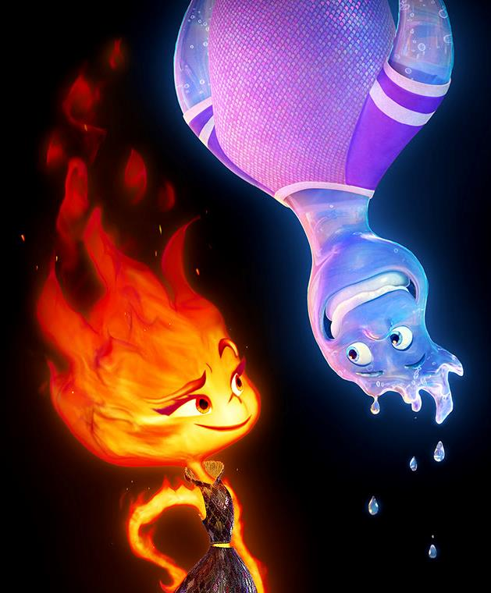
elemental
Pixar’s new heart-warming meet-cute
RELEASE DATE | EST. INDUSTRY ADMISSIONS | GENRE | HFSS BRANDS | ALCOHOL/GAMBLING BRANDS
16 June 2023 | 2.6m | Animation | Yes | No
SYNOPSIS
In a city where fire, water, land, and air residents live together, a fiery young woman and a go-with-the-flow guy are about to discover something elemental: How much they actually have in common.
VOICE CAST
Leah Lewis, Mamoudou Athie
THE DCM TAKE
Pixar are set to once again take us on a journey of the heart, mind, and soul, through a world of fantastical universes and adorable animated characters. Since bringing us Inside Out (2015), audiences have come to expect ground-breaking tales of self-love, courage, empathy, and following your dreams that make enormous impacts on audiences of all ages.
Following 2022’s Lightyear Pixar titles have returned to exclusive theatrical releases, so we expect excitement for a new original Pixar – the first since Onward in March 2020 – to be high among families, with the film receiving Pixar’s traditional mid-June release slot, teeing it up for a long run across the summer holidays.
 | Adults (16+) | Main shoppers with children | 16-34 Adults | ABC1 Adults
REACH | 3.2% | 4.8% | 4.7% | 4.2%
IMPACTS | 1.7m | 2.3m | 770k | 1.1m
TVRS | 3.5 | 5.2 | 5.0 | 4.5
Source: DCM Planner, based on industry admissions

Slide 14
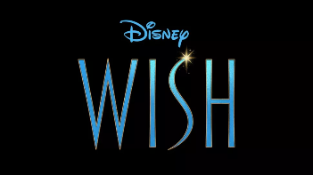
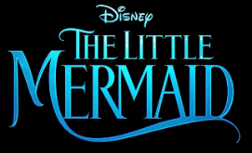
Family FILM SLATE 2023
Strays
JAN
FEB
MAR
APR
MAY
JUN
JUL
AUG
SEP
OCT
NOV
DEC
Mummies

Slide 15
MAIN SHOPPER WITH CHILDREN CINEMAGOERS
Category insights
158
Plan to buy a car
75%
Like to try out new food products
Index: 118
180
Planning to book a holiday or short break in the next year
186
‘I am tempted to buy products I’ve seen advertised’
2x
Plan to spend a lot of money on buying a new smartphone
3x
More likely to plan to buy a games console
190
Plan to buy new smart tech for the home
150
Plan to spend a lot of money going on holiday abroad
Source: TGI GB Oct 2022. Target: Mainshoppers who have presence of children in the household who are heavy cinemagoers. Index vs. average GB adult

Slide 16
WHAT CAN CINEMA ADD TO THE PLAN?
Research from Sky showcases how co-viewing an ad with family enhances content engagement and ad recall.
The value of reaching families together in a ‘shared viewing’ moment
+38%
+18%
=
+
Co-Viewing
Content
Engagement
Ad Recall
Source: BDRC Continental & Sky - Engagement Study with Households with Children 0-10.

Slide 17
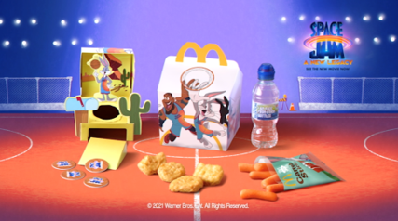
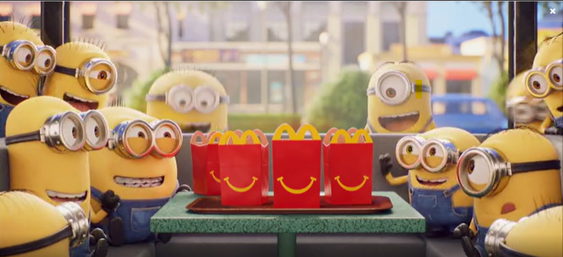
MCDONALD’S
Happy Meal
Sector | Target Audience | Package | Media Agency | Copy Length
Entertainment & Leisure | Families | Family AGP Bronze Spot | OMD UK | 30”
Background & Plan
Due to the changing media landscape with declining children’s TV consumption and increased restrictions around HFSS advertising, it was becoming more difficult to talk to Parents and Kids aged 4-7 about Happy Meal.
McDonald’s needed to find a solution that provided them with an environment they could reach dual viewing more effectively, reconnecting with families to drive nostalgia and remind them all the reasons why they love Happy Meal – and ultimately improve ROI.
DCM and OMD collaborated to create a long-term Bronze spot partnership that gave McDonald’s access to every family film – this would help establish a long-term association in cinema’s premium environment as well as also driving cut through within the ad reel.
McDonald’s ran various 30” creatives across the year to reflect the current in-store Happy Meal promotions and was featured in the reel ahead of titles including Space Jam: A New Legacy, Peter Rabbit 2 and The Croods 2.
Results
The Bronze Spot laydown worked incredibly well for McDonald’s delivering significant reach among its key parent + child audience as well as driving key brand metrics including awareness, perceptions and consideration.
Half of cinemagoers exposed to the ad reported that they had gone on to visit McDonald’s
61% of those that recalled the Happy Meal Bronze Spot ad went on to purchase a Happy Meal
Happy Meal was the first choice of those cinemagoers in market for fast food in the next week, and at significantly higher levels than amongst the control group
Source: McDonald’s Happy Meal DCM Awards Entry

Slide 18
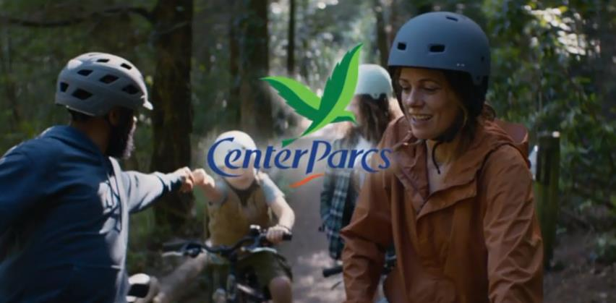
Center Parcs
‘This Is Family’
Background
On any given day 97% of rooms at Center Parcs are occupied – a real challenge for the brand when looking to further grow its revenue. Center Parcs’ solution was to increase the value of each customer and thus drive revenue without growth in penetration.
Idea
After re-evaluating its media strategy and insight, Center Parcs discovered its advertising had the greatest impact on parents when seen in co-viewing moments with the whole family.
In the modern fragmented media landscape, cinema continues to attract families by providing the perfect environment to escape and share in a quality experience together - an ideal moment for Center Parcs to tap into given it reflects its own proposition for families.
The family cinema trip allowed Center Parcs to engage families and shift brand metrics in the long-term and by pairing it with PPC would also help cinema drive short-term sales.
To maximise cinema’s capability as a performance channel, Center Parcs needed to increase its presence on the big screen by moving to an ‘always-on’ approach selecting efficient family focused films and upweighting budgets around key blockbusters including Christopher Robin and Mary Poppins Returns.
Results
The cinema activity exceeded all expectations for Center Parcs, going above and beyond annual targets to register a 4.9% increase in revenue year-on-year.
Moreover, cinema helped Center Parcs tackle its primary business challenge with the value of each customer visiting the holiday village increasing by 10%.
As a result of the positive impact, Center Parcs increased its cinema investment by 25% in 2019 with the campaign duration doubling from four to eight months.
Campaign Details
Sector | Travel & Transport
Target Audience | Families
Package | Family AGP
Creative Agencies | VMLY&R
Media Agency | Hearts & Science
Duration | 30-60”
Source: DCM Awards Case Study 2019.

