Slide 1
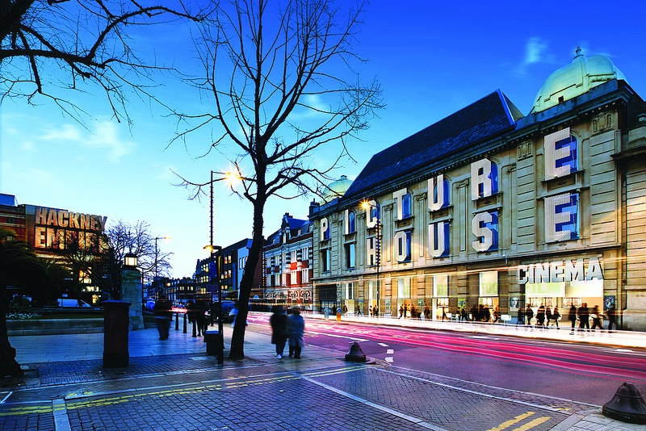
Christmas at picturehouse
Seasonal brand association with upmarket independent cinema
About Picturehouse Cinemas
Picturehouse Cinemas is the UK’s leading and most recognised independent cinema chain, with a presence in major cities nationwide.
The chain is synonymous with independent film, appealing to a more discerning, affluent and eclectic cinemagoer, while sites tend to be found in the heart of communities in city centre locations.
The Sponsorship opportunity
This Christmas, boutique cinema chain Picturehouse is bringing a range of themed features to the big screen, giving its ABC1 audience a chance to see their favourite Christmas titles on the big screen once again.
Christmas is a key period for Picturehouse, with admissions increasing steadily each week over the holiday. The season will feature an eclectic mix of classic Christmas related film titles, including Gremlins, It’s a Wonderful Life, Home Alone, Miracle on 34th Street and The Nightmare Before Christmas.
This sponsorship gives a brand the chance to bring these seasonal highlights to the Picturehouse audience by co-branding all communications in a variety of assets including digital, in foyer and, of course, on the big screen itself, with a 60” sizzle reel showcasing the fantastic films on offer.
A seasonal sponsorship opportunity at a top boutique cinema chain.

Slide 2
Christmas at picturehouse
Seasonal brand association with upmarket independent cinema
72%¹ of PH audience are ABC1 vs UK average of 54%².
19
Minutes average dwell time in foyer¹.
On Screen The sponsor will introduce and close the sizzle reel with 5” co-branded idents. The brand will also receive a 30” ad in all films at Picturehouse across the Christmas period.
Investment – Five weeks
Online
Joint branded logo on all Picturehouse cinema homepages, and in the weekly e-newsletters sent to all Picturehouse members.
Asset | Est. Impacts | Value (£)
5” co-branded idents either side of the sizzle reel | 411,550 | £5,000
30” ad in all films at Picturehouse (PH) across five weeks | 411,550 | £28,808
30” ad in the reel before all Christmas screenings (ie. those featured in the sizzle reel) | 16,800 | £2,000
Foyer: 1x quad poster in all PH foyers throughout the campaign | 411,550 + | £15,200
Online: co-branded MPU on all PH cinema homepages during campaign | 221,154 | £20,000
Online: Branded presence on two PH weekly e-newsletters during campaign (incl one solus) | 1,000,000 | £25,000
Total | 2,472,604 | £96,008
Production & Delivery | n/a | £8,237 net
Magazine
Co-branded presence in the Recommends magazine, one issue of which will come out during the campaign timeline. With a circulation of 410,000 per quarter it is distributed in both physical and digital formats and is a must have for any discerning film fan.
Extras
Foyer POS will highlight the sponsorship. Picturehouse will promote the sponsorship through its social media channels.
Christmas Period
Boxing Day is an incredibly popular day for cinema and this year it falls on a Saturday, which is normally our busiest, highest volume day of the week. The week between Christmas and New Year tends to be even stronger, with 23% more Admissions than the Christmas week itself³.
Five week package investment (promotional price):
£80,000 gross
Source: 1. CAA FAME Q4 2014. Base: 11+. Target: All respondents who have been to a Picturehouse cinema in the last six months. 2. GB TGI Q3 2015. Base: All respondents. Target ABC1. 3. DCM warehouse admissions 2013, 2014, 2015.
* All assets creative subject to cinema approval and restricted by availability.

