Slide 1
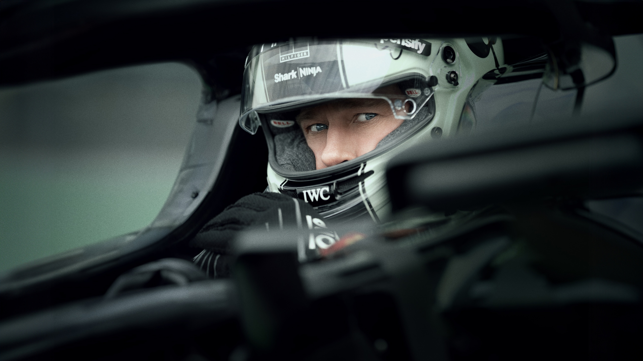

F1 PARTNERSHIP OPPORTUNITIES
INDENT TAKEOVER
BLIPVERTS

Slide 2
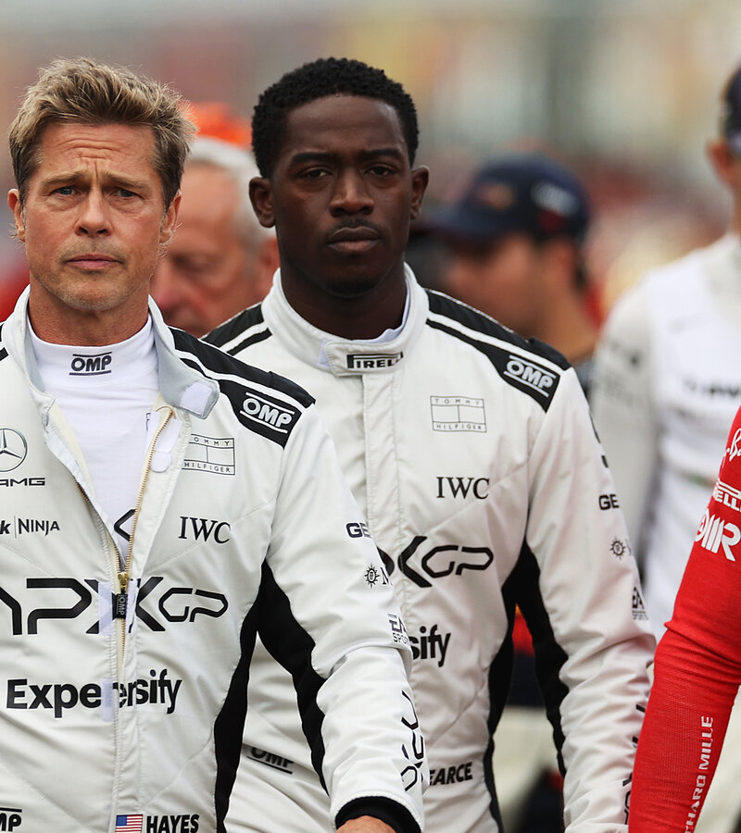
F1 FILM OPPORTUNITIES
Partnership Opportunity
With the approaching release of the highly anticipated Formula 1 film, exciting partnership opportunities are available for brands looking to align themselves with the prestige, high-octane excitement, and global influence of Formula 1.
Starring Brad Pitt and directed by Joseph Kosinski, this film is set to captivate audiences worldwide fostering global interest and engaging a fan base comprised of both film and Formula 1 fans.
With the film expected to generate widespread interest and attracting both dedicated F1 enthusiasts and mainstream moviegoers, Cinema serves as a unique and powerful platform for brands looking to engage with a passionate and diverse audience.
Secure premium on-screen presence with Ident Takeovers and Blipvert space still available, ensuring maximum visibility and association with this blockbuster event.

Slide 3






CREATING BESPOKE CONTENT HAS A POSITIVE IMPACT ON BRAND METRICS
Quality Brand Perceptions
Brand Consideration
+38%
+55%
+20%
+33%
Source: Differentology data bank.

Slide 4
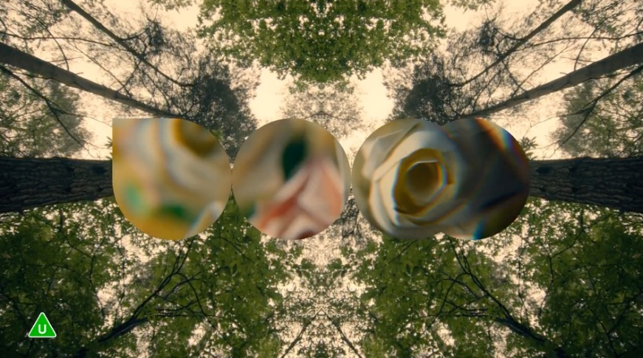
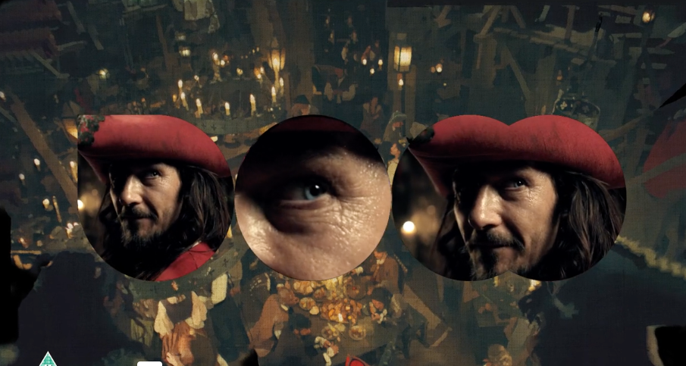
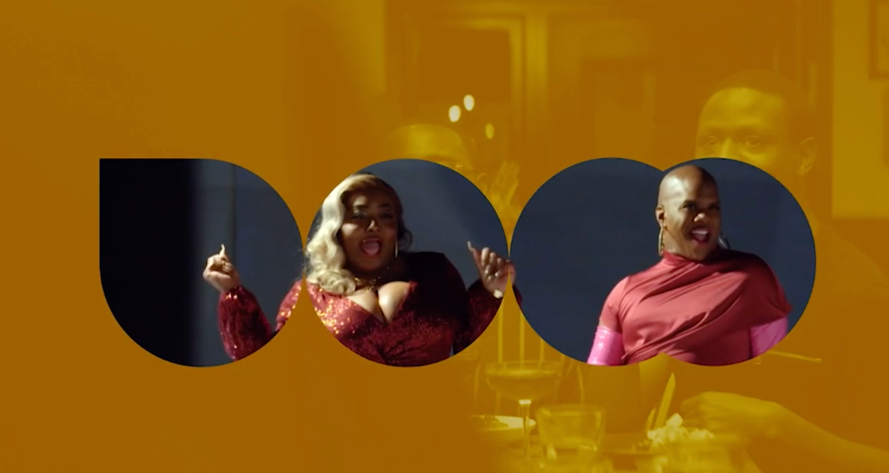
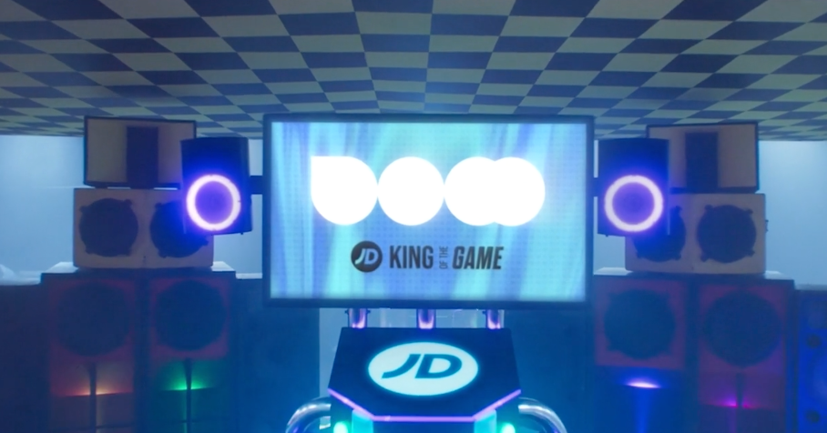






DCM IDENT TAKEOVER
SUMMARY
DCM Ident takeover is a unique chance to stand out even further in the ad reel, creating ownership of what is normally a standard and well- known cinema asset. We will work with brands to create a co-branded asset that will extend the narrative of the in-reel ad.
KEY BENEFITS:
BRAND OBJECTIVES - CONSIDERATION
DCM Idents bookend the beginning and end of the ad reel – giving your brand full ownership throughout the ad reel
Utilise the existing and iconic DCM to create collaborative message
Follow the theme of the film(s) the campaign features in, developing a contextually relevant narrative.
CLICK HERE FOR CASE STUDIES
CLIENTS:
PRODUCTION | OPENING IDENT | CLOSING IDENT | PREMIUM RATE
6-8 weeks (est) | 10” | 15” | 20%
Source: DCM Planner, based on industry admissions

Slide 5
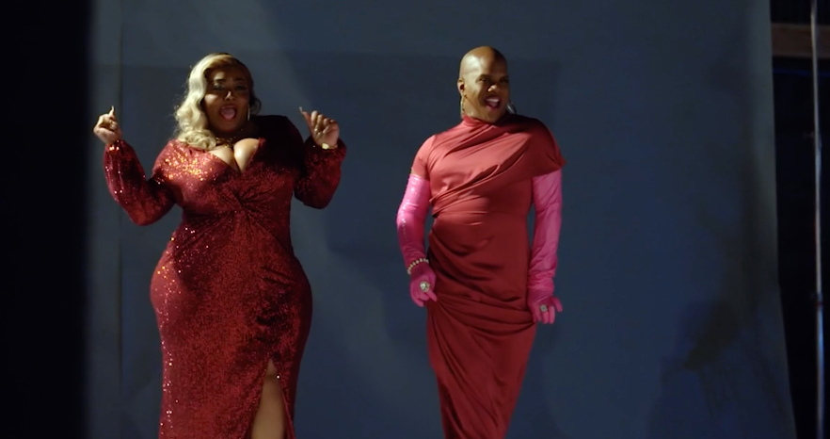
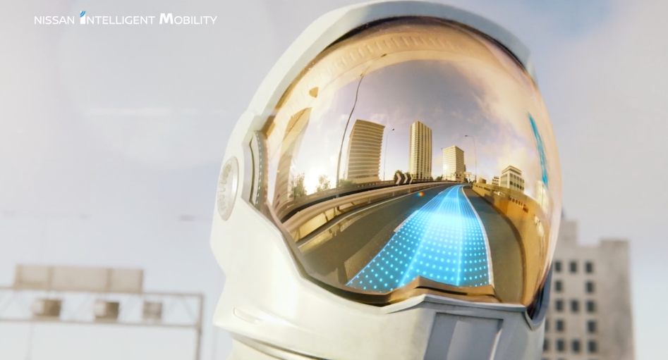
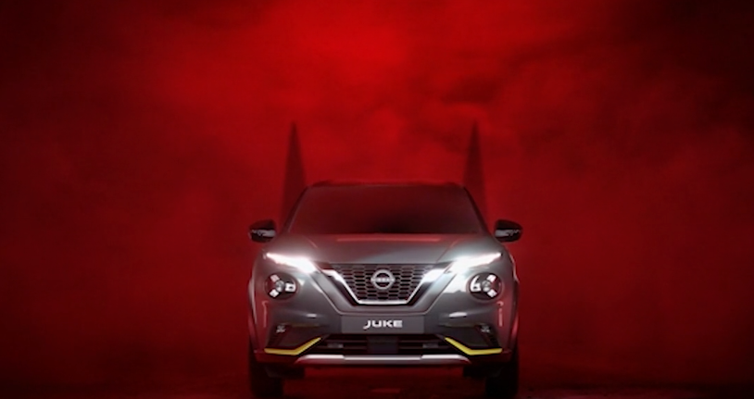




BLIPVERTS
SUMMARY
Blipverts are typically 10 seconds long and most likely there will be three of them throughout the ad reel to make the equivalent of one 30 second spot. Blipverts are often used to create excitement or intrigue about a new launch. They can be used to generate curiosity about what is to come and then are followed up by a 30-60” ad later on that provides more information.
KEY BENEFITS:
BRAND OBJECTIVES - AWARENESS
Disrupt the reel entirely and take cinema audiences on an unexpected journey with your brand.
Dominate the DCM ad reel and give brands full ownership.
Build awareness, deliver cut through and generate higher frequency
CLICK HERE FOR CASE STUDIES
CLIENTS:
PRODUCTION | BLIPVERT LENGTH | NO. BLIPVERTS
6-8 weeks (est) | 5”-10” | 2-5
Source: DCM Planner, based on industry admissions

Slide 6
THE POWER OF BLIPVERTS
Audience reaction to blipverts are very positive with cinemagoers rating them as more memorable and something they’re even more likely to pay attention to and act on.
Blipverts Statements - Top 3 ‘Strongly agree’ scores
68%
73%
67%
62%
Advertising in this format is more memorable than a typical cinema ad
Advertising in this format is more engaging than a typical cinema ad
I pay more attention to cinema advertising in this format
Advertising in this format would make me more likely to consider the brand or product being advertised than
typical cinema ads
Source: DCM Conducted by; Differentology, October 2022.
Results base: 18-54s. To what extent do you agree or disagree with these statements about ads shown in the blipvert format? (10-point scale).

