Slide 1
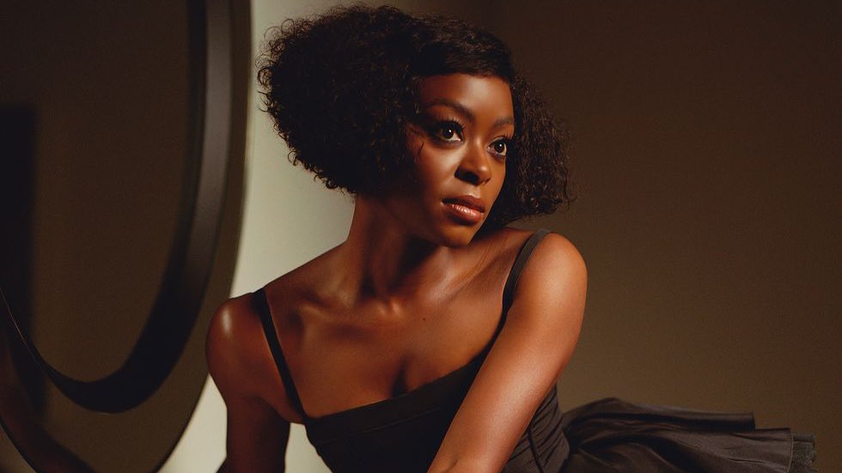

EMPOWERING WOMEN IN FILM
CINEMA PARTNERSHIP 2025
Notes:
All elements on this page (not including the logo) need to be 1cm apart

Slide 2

Empowering Women in film
This is a groundbreaking partnership dedicated to celebrating and empowering women in the film industry. This collaboration aims to highlights your brands premium credentials alongside recognising the invaluable contributions women have made in the world of cinema – both in front of the camera and behind it.
We’re experiencing a noticeable transformation across the film landscape where movies are headlined and directed by women that keep making an impact, culturally and economically. Whilst there’s still a way to go, this marks a very exciting time for your brand to be at the forefront of the changes.
In conjunction with a bespoke onscreen idents, a film season and events, your brand will sponsor a series of initiatives aimed at spotlighting the talents of female filmmakers, actors, and industry leaders.
Our work with brands in recent years has demonstrated that contextually relevant messaging unlocks disproportionate shifts in key brand metrics, allowing advertisers to make the most of their cinema campaigns. Empowering Women in film is new untapped opportunity for your brand to build a strong association with women in the film industry, add to the audience’s experience through bespoke content and support women even further in the world of film.

Slide 3
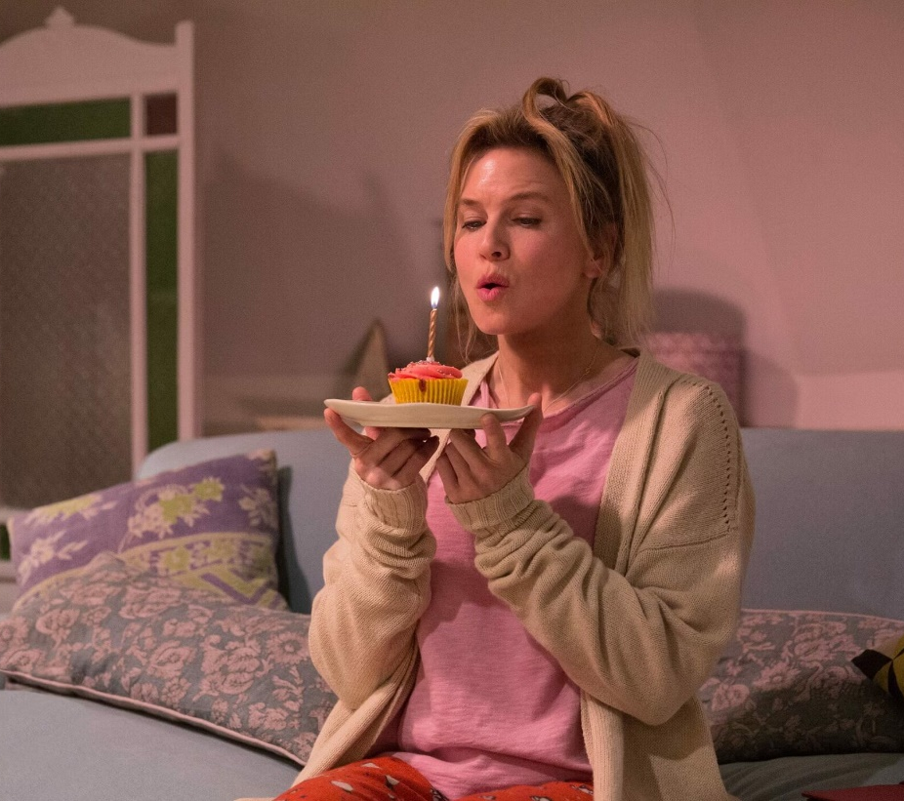

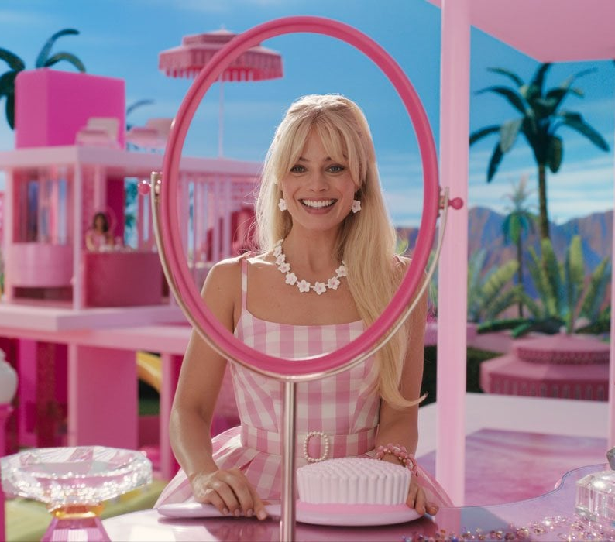
CINEMA IS THE BEST PLACE FOR BESPOKE CONTENT​
The perfect platform to shift perceptions of your brand, create fame, and to engage an upmarket audience
CELEBRATE FEMALE LEADS ACROSS BIG CULTURAL MOMENTS
TARGET AN ENGAGED
UPMARKET FEMALE AUDIENCE
AMPLIFY YOUR BRANDS PREMIUM CREDENTIALS

Slide 4
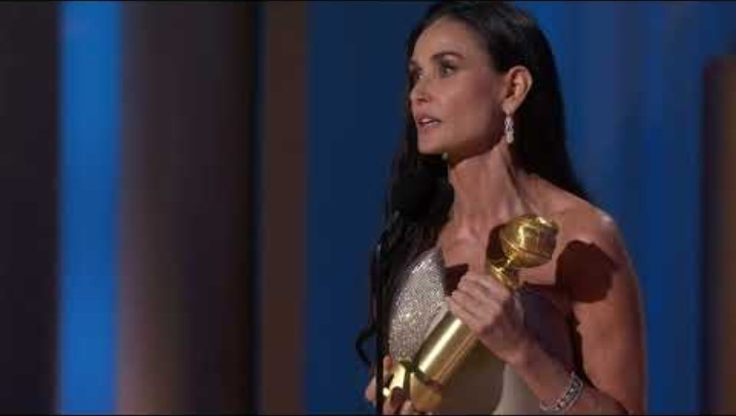

Slide 5
THE CURRENT LANDSCAPE
40%
The number of female characters in significant film roles (2023)
And whilst we strive for this % to increase we want to celebrate the women driving film success…

Slide 6



FROM BARBIE TO SWIFTIES, GIRLS DEFIED GRAVITY IN cinema 2023/4
All contributing in boosting the U.K. economy last year
£95.5m
UK Box Office
£43.6m
With the highest-grossing opening weekend for a movie musical adaptation.
4m
DCM admissions
£1.2bn
Globally, making Greta Gerwig the most successful Female director ever
5m*
DCM admissions to date – making it the third-highest grossing musical of all time.
#1
highest ever reported global animated opening weekend, surpassing The Super Mario Bros. Movie's previous record
*Set to finish on 5.6M DCM admissions

Slide 7
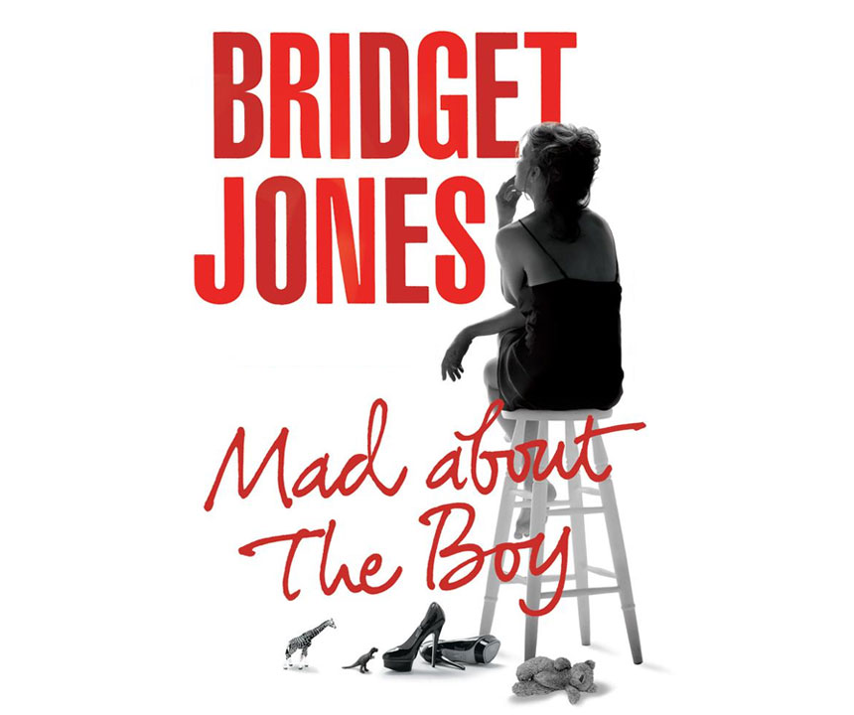
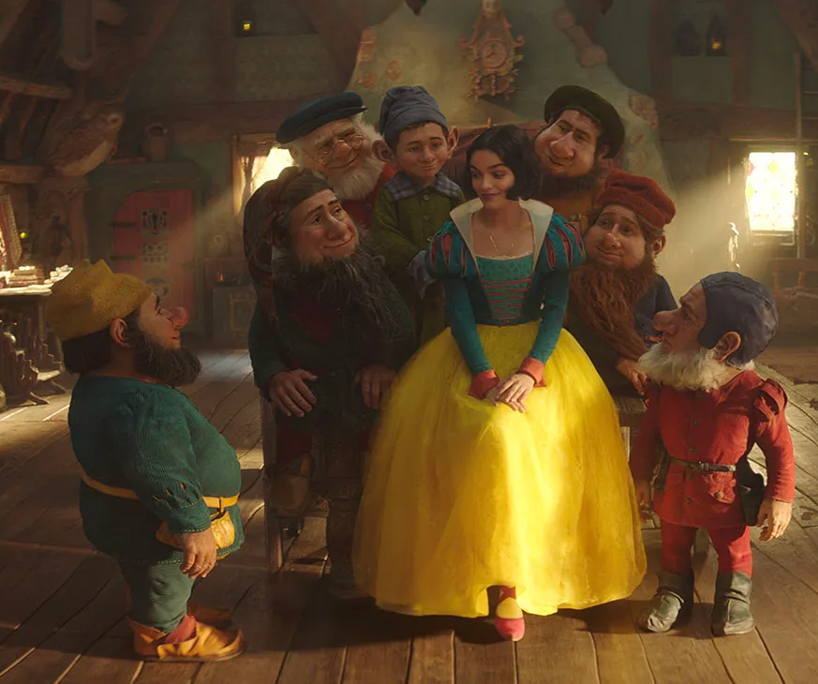
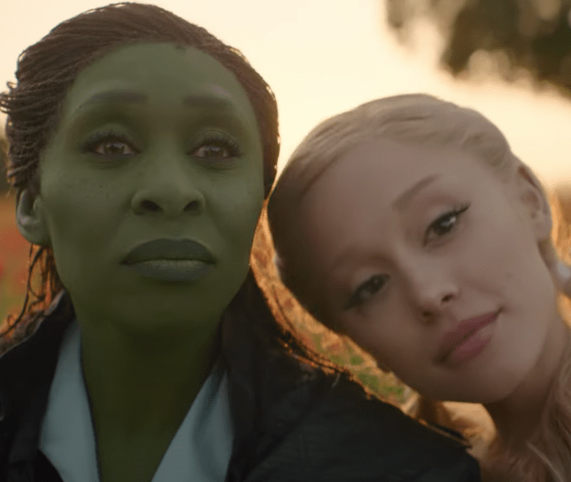
And 2025 has a host of iconic female leads to celebrate
Female characters and stories steeped in legacy, but also new leads set to take the big screen
BRIDGET JONES
SNOW WHITE
WICKED PART 2
The franchise is huge, average grossing has been £40m+ at the UK Box Office
Predicted audience profile: 84% Female
A film treasure, Snow White & the Seven Dwarfs was Disney’s first full length animated film released 1937 and was the highest grossing film of the time
Predicted audience profile: 64% Female
Wicked has become the highest grossing film adaptation of a musical. With anticipation for Wicked Part 2 to be even bigger.
Predicted audience profile: 68% Female

Slide 8
women are showing up to support these female led titles
72% FEMALE
THE AVERAGE AUDIENCE PROFILE ATTENDING FEMALE LED CINEMA TITLES
Source: Film Monitor Female Profile %

Slide 9
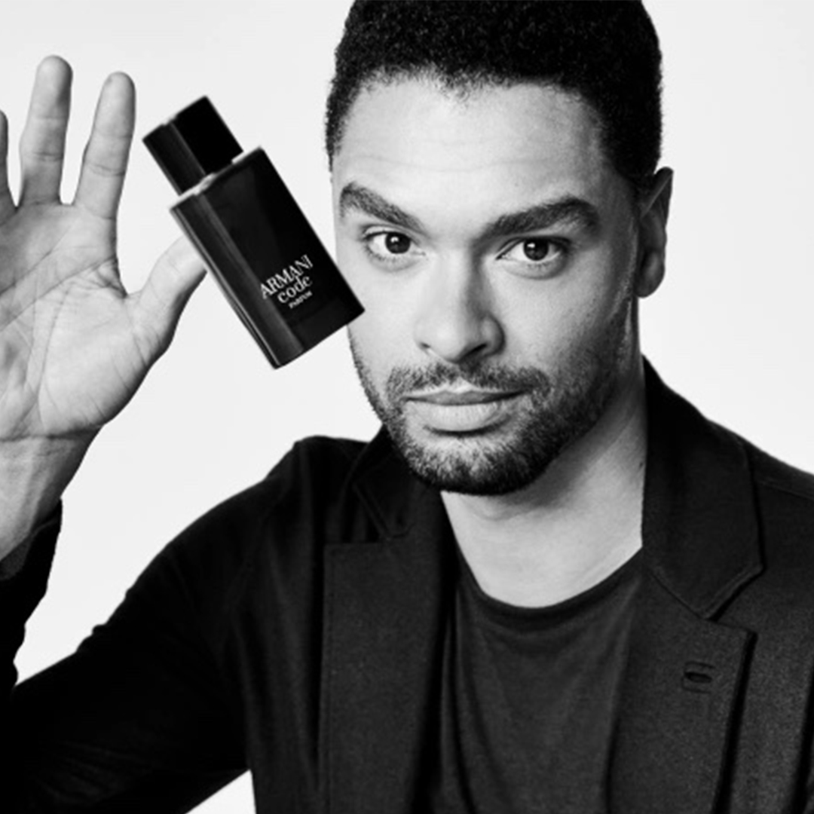
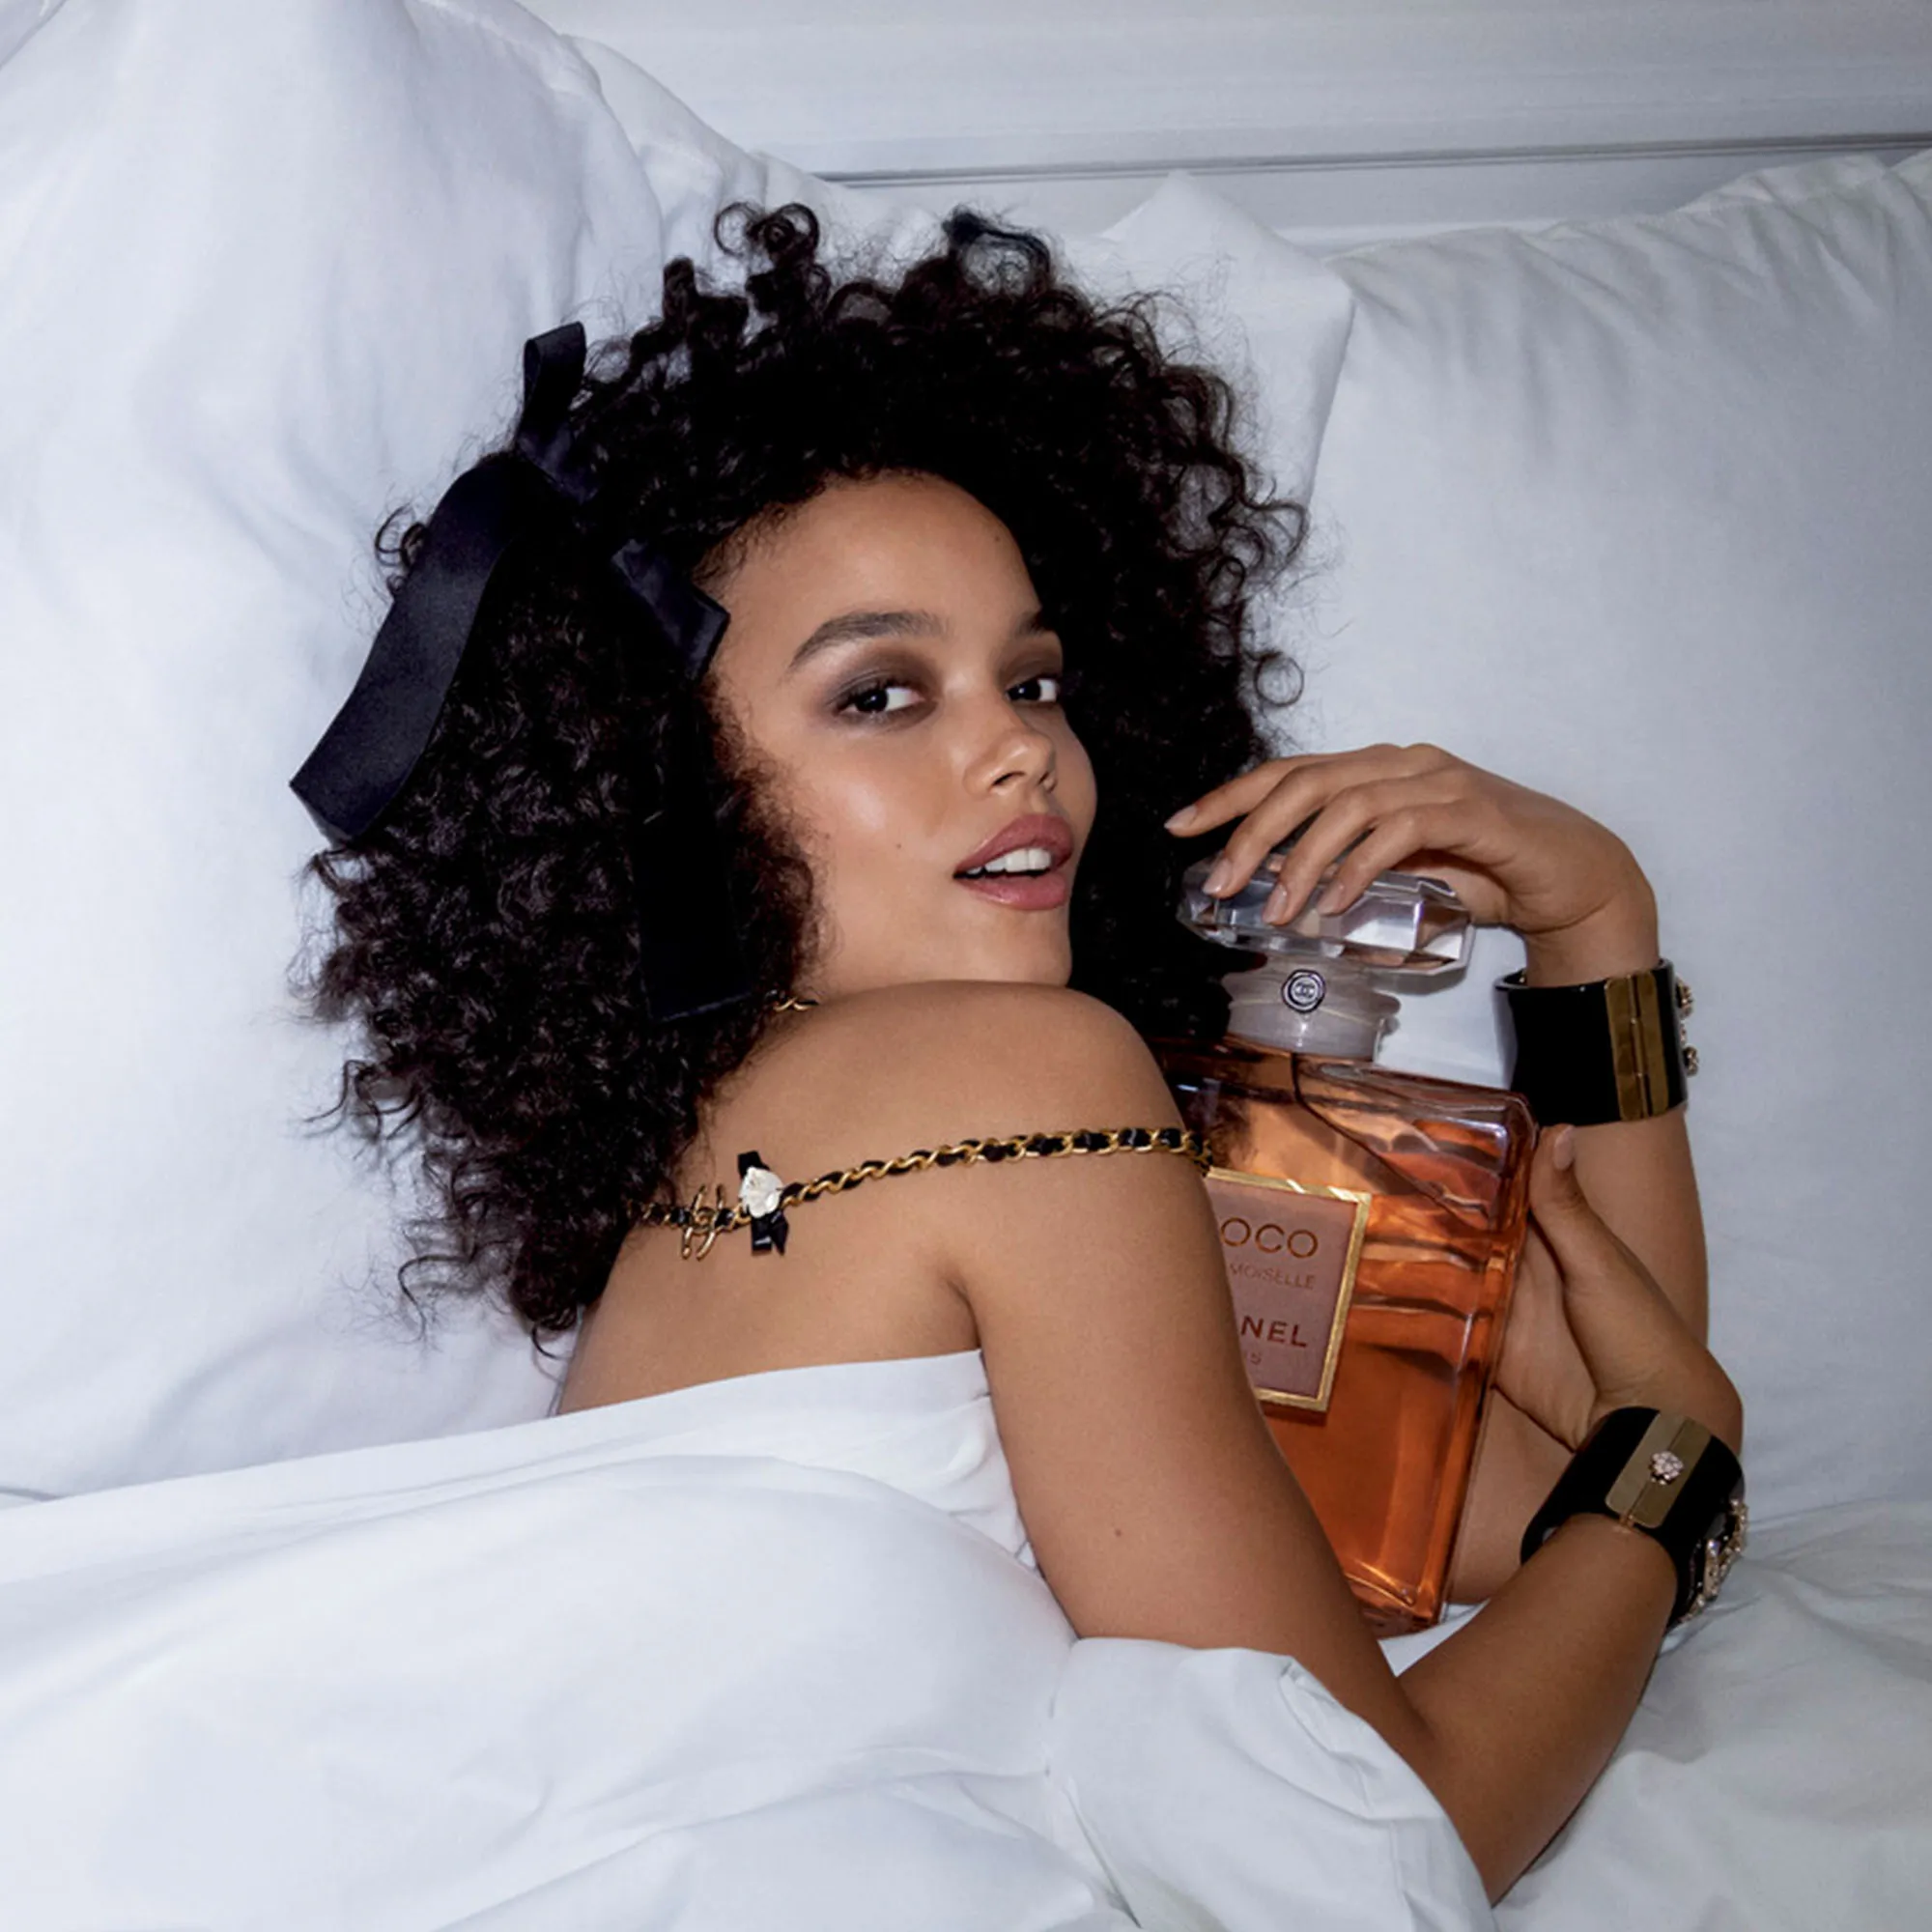


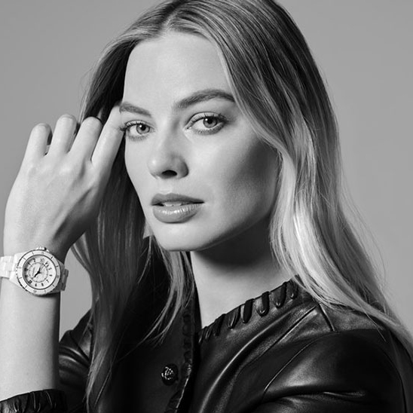


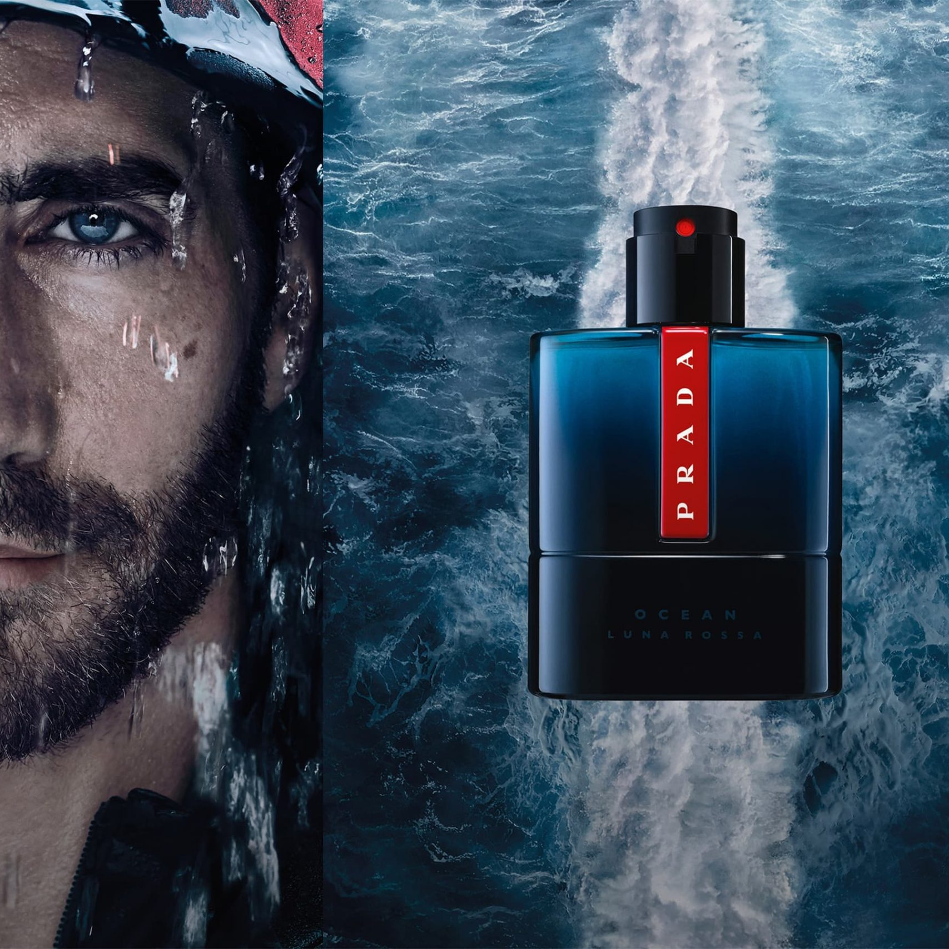
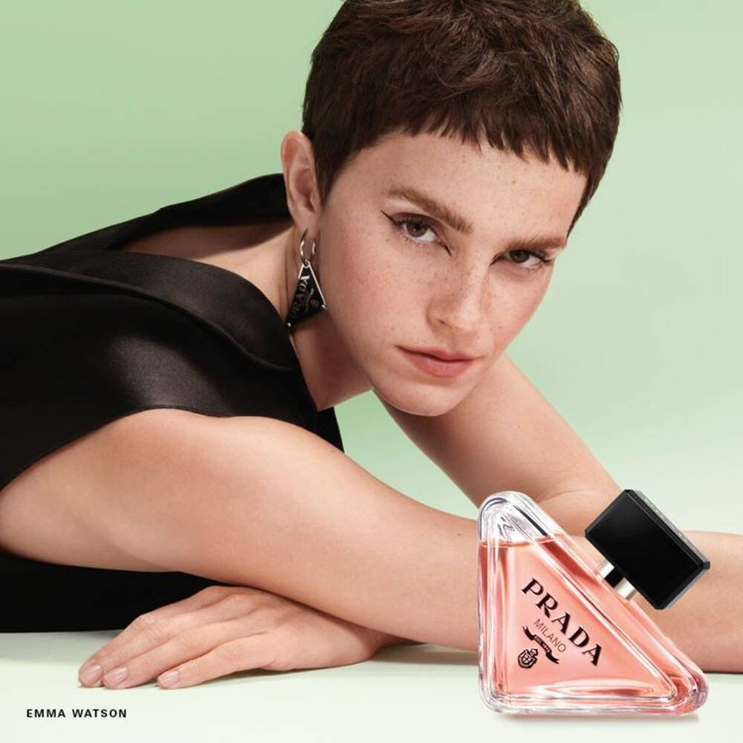

Big Screen Beauty
2024 has been a blockbuster year
Armani Code
Chanel Coco Mademoiselle
Chanel Bleu de Chanel
Chanel Chance
Chanel J12
Dec
Gold Spot: Kraven the Hunter
60”
Mar-May
Gold Spot: Drive Away Dolls
60”
Feb-Apr
Gold Spot: Argylle
60”
Jan-Mar
Gold Spot: Mean Girls
60”
May-Aug
Gold Spot: Fly Me to the Moon, Kinds of Kindness, Love Lies Bleeding
60”
Hugo Boss
Issey Miyake
Prada Luna Rossa Ocean
Prada Paradoxe
YSL Libre
Oct-Dec
Gold Spot: Venom: Save the Last Dance
60”
Sep-Oct
Film Pack: Beetlejuice Beetlejuice, Joker: Folie a Deux...
30”
Nov-Dec
Film Packs: Piece by Piece, Gladiator II & Red One
Jun-Aug & Nov-Dec
Film Packs: It Ends With Us & Wicked
20”
Nov-Dec
Film Packs: Gladiator II & Wicked
30”
Source: DCM

Slide 10
SECURE THE MOST DESIREABLE & AUDIENCE-EFFICIENT OPPORTUNITY IN 2025 THROUGH A LONGER-TERM LAYDOWN

Slide 11
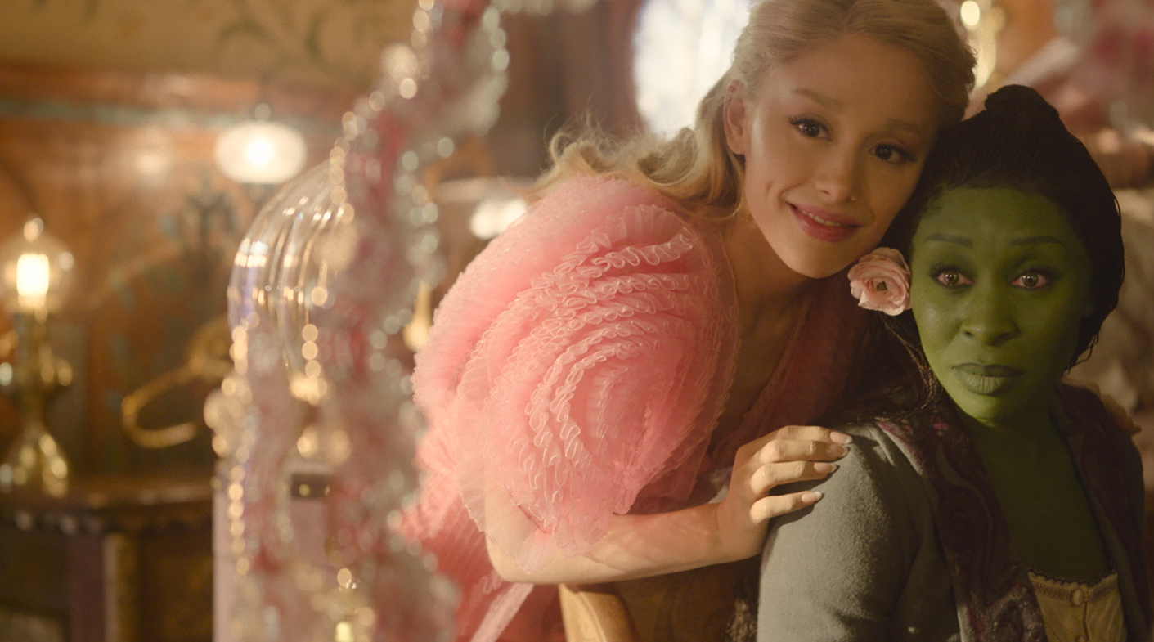
GENRE SPONSORSHIP
EMPOWERING WOMEN IN FILM
SUMMARY
We’re proposing a media first partnership for your brand to proudly champion women in film, forging a powerful connection with some of the most iconic female leads and inspiring voices and our female audience. By sponsoring women-driven storytelling on screen, the brand positions itself at the heart of a premium, emotionally resonant space to leave a lasting impression with our female audience.
Whether it's a major blockbuster captivating global audiences or a poignant independent gem, your brand will be the first brand to sponsor these iconic titles.
This collaboration is more than sponsorship - it’s a powerful statement. Your brand will celebrate their journeys and triumphs – whilst working closely with Picturehouse to support the next generation of women in film.
KEY BENEFITS:
BRAND OBJECTIVES – AFFINITY
A Genre Sponsorship would allow your brand to build a sense of ownership around some of the biggest properties in commercial entertainment in some of the most highly anticipated female roles.
Sponsorships will provide brands with a consistent voice in cinema across the year, with opportunities to run always-on, or for the campaign to be tailored to upweight during key periods of the year in line with your brands priorities.

Slide 12






Making your partnership budget work even harder
Meta-analysis of 22 recent cinema campaigns & 7 contextual/bespoke campaigns
Quality Brand Perceptions
Brand Consideration
+38%
+55%
+20%
+33%
Source: Differentology data bank. Meta-analysis consists of 22 campaigns and 7 bespoke campaigns.

Slide 13
THE DCM AD REEL
Bespoke ident to engage with our upmarket female audience
Co-branded DCM Opening & Closing Idents will create ownership in reel,
supported by your hero brand ad.
1.
DCM
OPENING IDENT 10”
2.
BRAND
ADS
2.
HERO
BRAND AD
3.
BRONZE
SPOT
4.
DCM
CLOSING
IDENT 15”
5.
SILVER SPOT
6.
FILM
TRAILERS
7.
Turn Your Phone Off Message
8.
GOLD
SPOT
9.
FILM
14.
FILM
The hero brand ad will run in the ad reel, book-ended by the idents, with the possibility to upgrade to premium positions for Fame in-reel
Notes:
ENGAGE AN UPMARKET AUDIENCE
Engage an ABC1 audience across a breadth of high quality titles.
The predicted ABC1 profile for the Awards Season package based on 8 awards hopefuls is 78%.
ALIGN WITH HIGH QUALITY CONTENT
Build an association between your brand and high quality, artistic and culturally significant moments in film.
The Awards Season represents the best in film, and is a powerful platform to shift perceptions of your brand.
THE PERFECT PLATFORM
Cinema’s ability to grab and hold attention is unmatched, which, combined with the impactful nature of the big screen means that cinema is the perfect platform to tell stories and build an emotional connection with your customers.

Slide 14

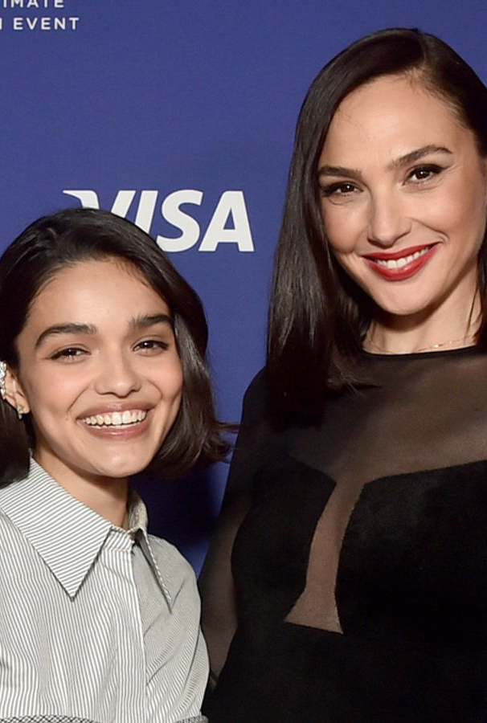
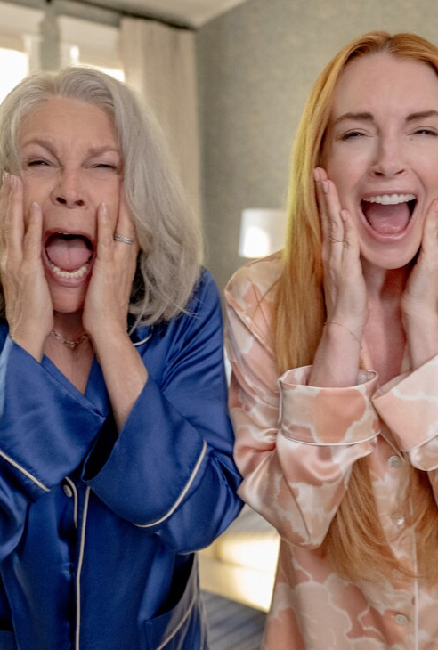
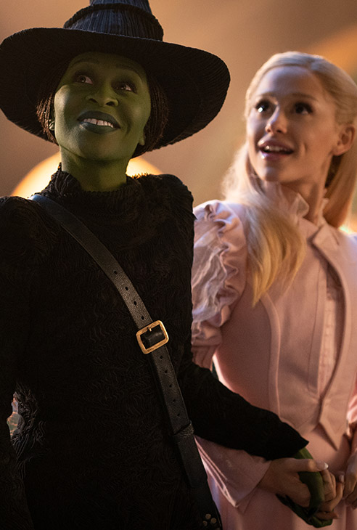
BIGGEST FEMALE LEADS IN 2025 INCLUDE…
2025 IS PACKED WITH SOME OF THE BIGGEST NAMES IN HOLLYWOOD
Bridget Jones Mad About A Boy
13 Feb 2025
Women 18-44 Index: 210
Snow White Live Action
21 March 2025
Women 18-44 Index: 183
Freakier Friday
8 August 2025
Women 18-44 Index: 237
Wicked Part 2
21 November 2025
Women 18-44 Index: 151

Slide 15
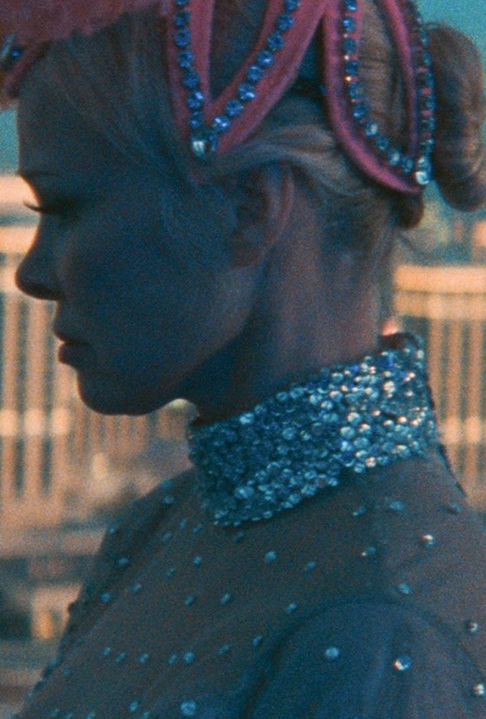


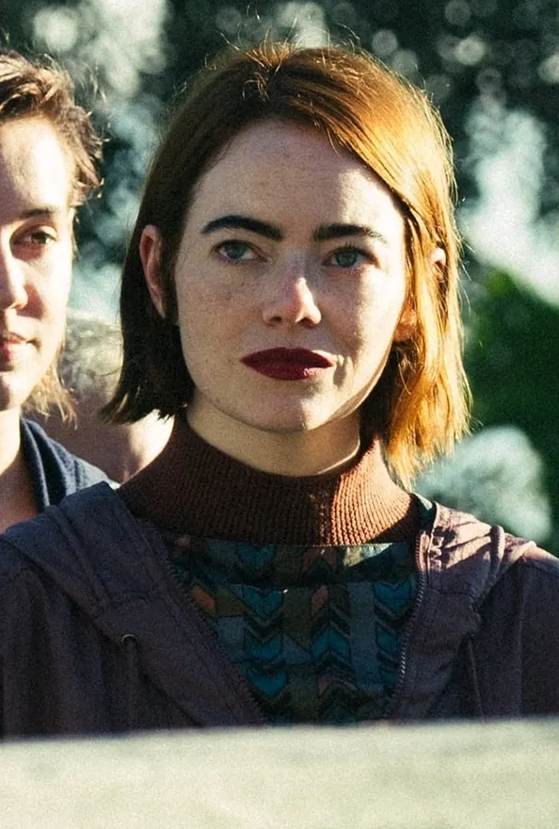
AND SMALLER TITLES THAT ARE PERFECT to hit your BULLSEYE AUDIENCE…
Focussing on titles that bringing in a significantly large female audience for your brand to connect with
The Last Showgirl
28 Feb 2025
Women 18-44 Index: 186
Woman in the Yard
28 March 2025
Women 18-44 Index: 174
A Big Bold Beautiful Journey
9 May 2025
Women 18-44 Index: 134
Bugonia
7 Nov 2025
Women 18-44 Index: 149

Slide 16
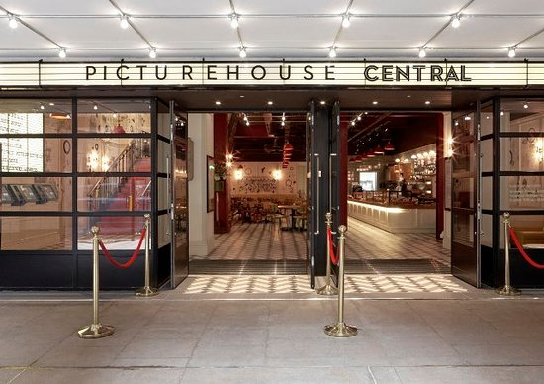
empowering women film season
PICTUREHOUSE COMMS
Partnering with Picturehouse will give your brand the opportunity to host more on the ground activity to strengthen their core partnership objective of empowering women in film. We’ll launch a dedicated, sponsored film season celebrating the contributions of women in cinema, behind the camera and in front of it.
This curated program will showcase classic and contemporary films featuring strong female leads, and directors highlighting stories of resilience, ambition, and creativity.
ONSCREEN:
GOLD SPOT IN ALL EMPOWERING FILM TITLES
OFFSCREEN COMMS:
  BLOG POST
NEWSLETTER
SOCIALS
EVENTS:
A NIGHT WITH YOUR BRAND
SAMPLING OPPORTUNITIES
SURPRISE AND DELIGHT PH AUDIENCE
Q&A AND WORKSHOPS TO SUPPORT LOCAL FEMALE TALENT ACROSS THE UK

Slide 17
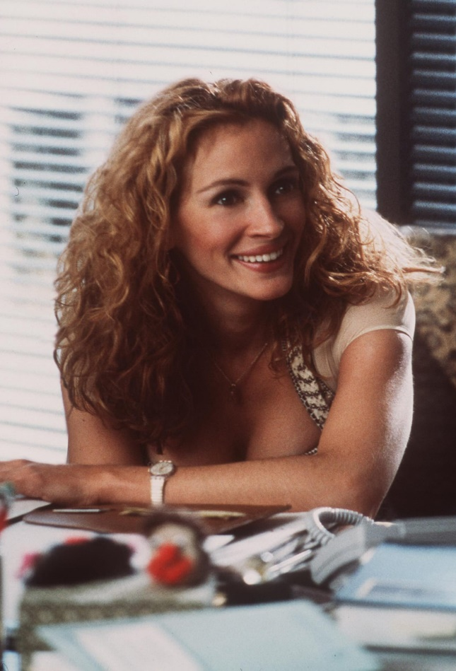
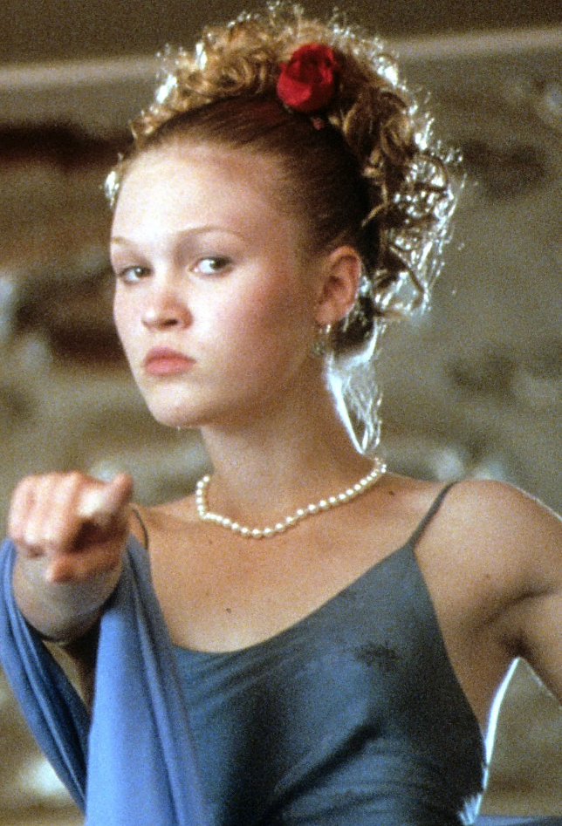
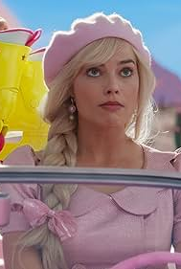

Titles with strong female leads…
EMPOWERING WOMEN FILM SEASON WILL RESONATE WITH YOUR TA
ERIN BROCKOVICH
10 THINGS I HATE ABOUT YOU
BARBIE
CHALLENGERS
*subject to PH approval

Slide 18
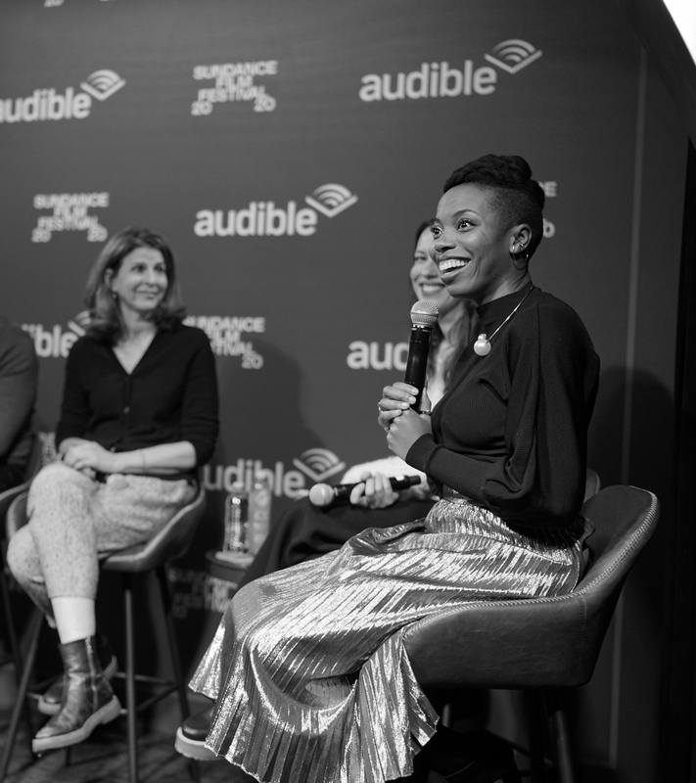
International women’s day event
BE PART OF THE CONVERSATION…
The partnership between your brand and Picturehouse Cinemas for promoting women’s stories and perspectives ‘Empowering Women In Film’ will be the perfect opportunity to launch on IWD.
This initiative focuses on amplifying female voices in film, providing a platform to showcase films that highlight the diverse experiences and perspectives of women.
Your brand will also play a big part of the conversation for Picturehouse’s annual IWD events – hosting both industry and public events across the week of IWD.
Events will be followed by a screening handpicked by Picturehouse for guests to enjoy, where we can host a Q&A session with your brand to discuss the importance of spotlighting Women In Film – all from a woman’s perspective.
This partnership aims to foster a space where women's stories are celebrated, offering more representation and visibility for female creatives.

Slide 19
Three tactics FOR your brand TO HARNESS THE POWER OF CINEMA
EMPOWERING WOMEN IN FILM BROUGHT TO YOU BY…
WOMEN IN FILM GENRE SPONSORSHIP
10” & 15” IDENT TAKEOVER AND BRAND AD IN FEMALE LED FILMS
PICTUREHOUSE WOMEN IN FILM SEASON
PICTUREHOUSE PARTNERSHIP & GOLD SPOT IN ALL TITLES
IWD EVENTS HOSTED BY PICTUREHOUSE
A PERSPECTIVE FROM WOMEN ALL AROUND THE INDUSTRY

Slide 20
THANK YOU!

Slide 21

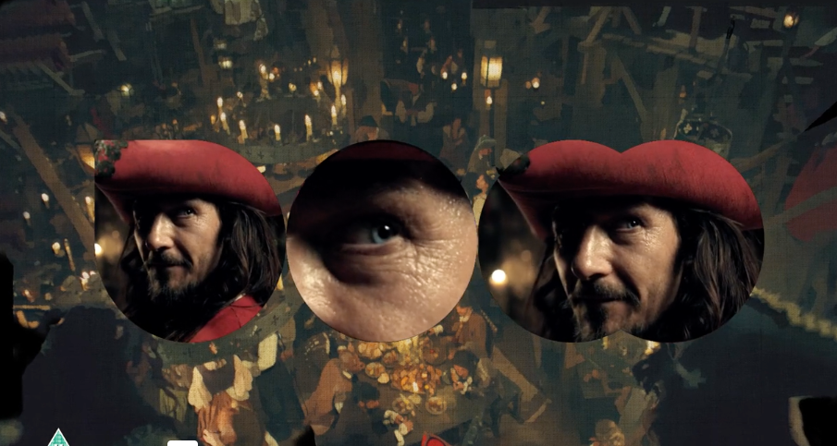
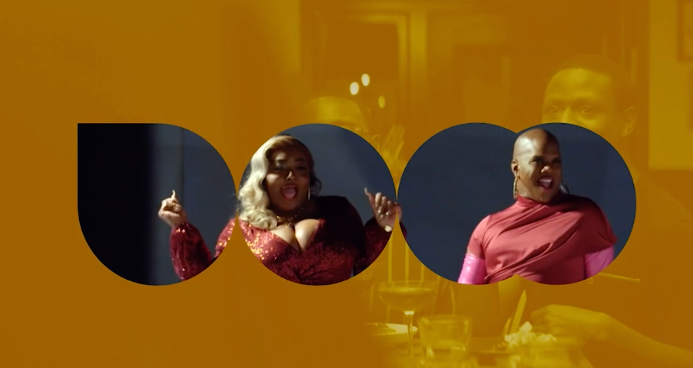
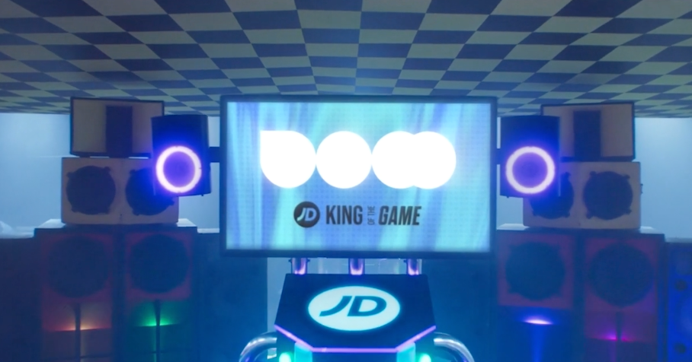





DCM IDENT TAKEOVER
SUMMARY
DCM Ident takeover is a unique chance to stand out even further in the ad reel, creating ownership of what is normally a standard and well- known cinema asset. We will work with brands to create a co-branded asset that will extend the narrative of the in-reel ad.
KEY BENEFITS:
BRAND OBJECTIVES - CONSIDERATION
DCM Idents bookend the beginning and end of the ad reel – giving your brand full ownership throughout the ad reel
Utilise the existing and iconic DCM to create collaborative message
Follow the theme of the film(s) the campaign features in, developing a contextually relevant narrative.
CLICK HERE FOR CASE STUDIES
CLIENTS:
PRODUCTION | OPENING IDENT | CLOSING IDENT | PREMIUM RATE
6-8 weeks (est) | 10” | 15” | 20%
Source: DCM Planner, based on industry admissions

