Slide 1
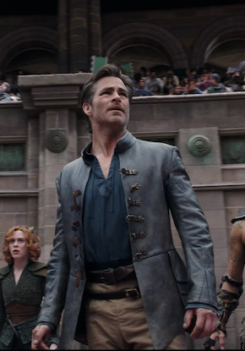
Dungeons & dragons: HONOUR AMONG THIEVES
An eclectic cast embark on a quest inspired by the fantasy role playing board game
RELEASE DATE | EST. INDUSTRY ADMISSIONS | GENRE | HFSS BRANDS | ALCOHOL/GAMBLING BRANDS
3 March | 1m | Action, Fantasy, Adventure | Yes | No
SYNOPSIS
A charming thief and a band of unlikely adventurers embark on an epic quest to retrieve a lost relic, but things go dangerously awry when they run afoul of the wrong people.
CAST
Chris Pine, Michelle Rodriguez, Rege-Jean Page, Justice Smith & Hugh Grant
THE DCM TAKE
While the fate of video game adaptations has been somewhat mixed historically at the UK box office, recent signs are promising with the success of Detective Pikachu, Sonic the Hedgehog 2 and Uncharted. Attention now turns to the one of the most famous fantasy board games being translated into a big-screen adventure epic. The cast is full of notable names recruited from other hugely successful big-screen franchises – Star Trek, Fast & Furious, Jurassic World – and its Rege-Jean Page’s first big-screen role since his breakout in Netflix’s Bridgerton. With a similar Spring release, Dungeons & Dragons: Honour Among Thieves will be hoping for some of the same success that Uncharted saw in 2021. The video game adaptation well out-performed DCM expectations, delivering 2.6m admissions (3x our original forecast) and 13 16-34 TVRs.
 | Adults (16+) | 16-34 Adults | 16-34 Men | ABC1 Adults | ABC1 Men
REACH | 1.8% | 3.6% | 6% | 2% | 3%
IMPACTS | 956k | 593k | 422k | 656k | 448k
TVRS | 2 | 4 | 6.5 | 2 | 3
Source: DCM Planner, based on industry admissions

Slide 2
DUNGEONS & DRAGONS HAS EXPERIENCED A RENAISSANCE IN RECENT YEARS
Originally published in 1974, the Dungeons and Dragons board game has deeply influenced media culture since its arrival and has experienced a resurgence in popularity in recent years thanks in no small part to its appearance in Netflix’s Stranger Things.
50m people have interacted with the game since its creation
D&D saw usage increase by +33% thanks to the Covid lockdowns
D&D’s demo is changing too: 40% of players are now under 25
Sources: The Telegraph and The Guardian

Slide 3
DUNGEONS & DRAGONS will attract YOUNG ABC1 mEN
Using the comparative film profile of Ready Player One, we can predict strong figures for the sequel for young males
Source: CAA Film Monitor

Slide 4
Young men are more receptive to ads in the cinema
In addition to being more likely to trust cinema ads compared to other media, in helping them make a purchase decision
2x
More likely
10%
More likely
21%
More likely
Agree they pay attention to ads in the cinema & find cinema ads useful in helping them make a purchase decision
Agree that they feel either excited, engaged or happy when watching ads in
the cinema
Agree “I am more likely to recommend brands when advertised at the cinema than in other places like TV or social media”
Source: FAME 2021 Target: 16-34 Men cinemagoers. TGI GB September 2022. Target: 16-34 Men cinemagoers. Index vs the avg. UK adult.

Slide 5
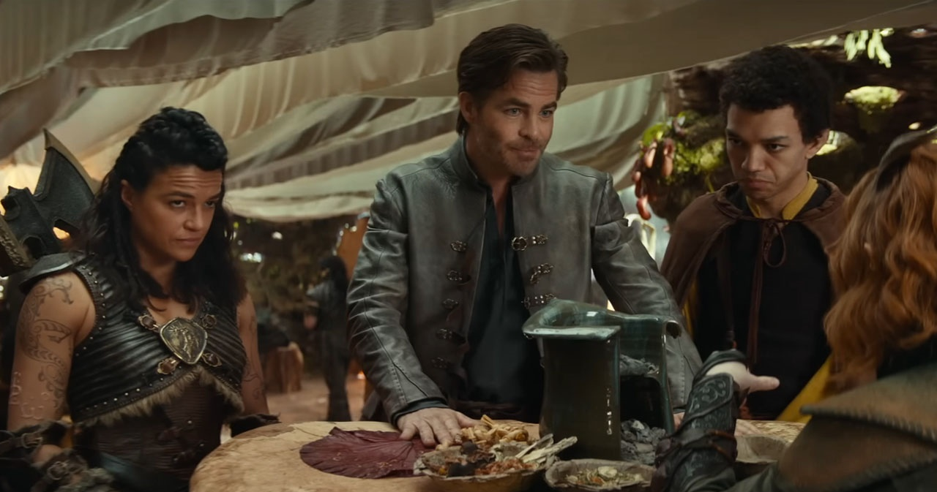
Brands can reach young men before they decide to purchase
Younger men are more likely to be inspired to buy products after watching their film, especially in groups of friends
2x
2x
60%
More likely to get fast food/takeaway immediately after
More likely to go online shopping immediately after
Go out for a meal
(Index: 184)
54%
68%
93%
Shop on the high street
Check mobile phone to browse or check social media
(Index: 142)
More likely to go to a pub/bar after visiting the cinema
Source: FAME 2021, 16-34 Men Index vs All Adults

Slide 6
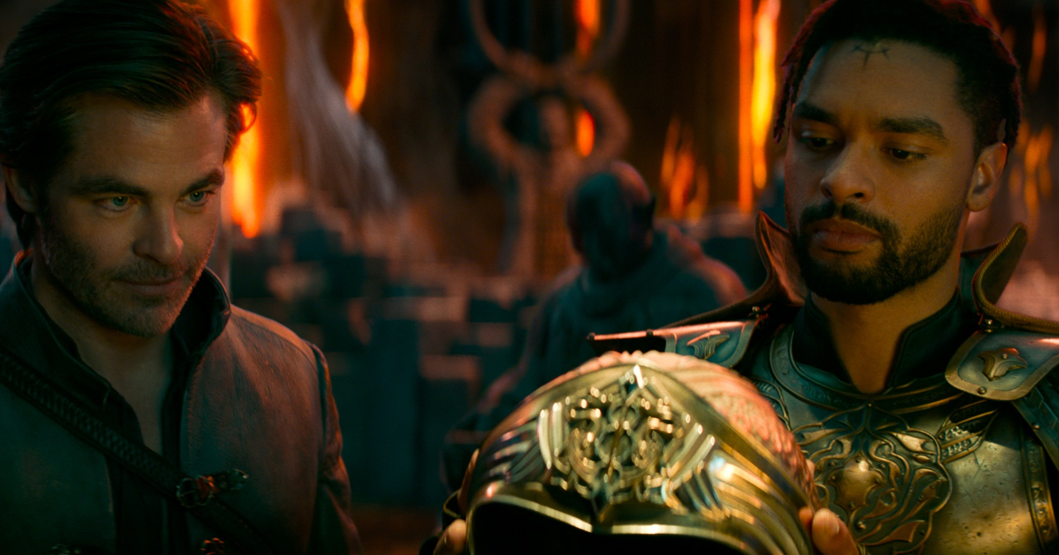
AUDIENCE SNAPSHOTS
Category insights
MOTORS
TECHNOLOGY
RETAIL
“I LIKE INNOVATIVE CARS”
Index: 186
“I TRY TO KEEP UP WITH DEVELOPMENTS IN TECHNOLOGY”
Index:146
“I’M TEMPTED TO BUY PRODUCTS I’VE SEEN ADVERTISED”
Index: 147
INTEND TO SPEND £45K OR MORE ON A CAR PURCHASE IN NEXT 24 MONTHS
Index: 219
“I LIKE TO HAVE TECHNOLOGY THAT MAKES LIFE EASIER AT HOME”
Index:120
“I REALLY ENJOY SHOPPING FOR CLOTHES”
Index: 112
INTEND TO BUY IN THE NEXT TWO YEARS
Index: 117
INTEND TO PURCHASE PERSONAL SMART TECH OR FOR THE HOME
Index: 130
“BUY NEW PRODUCTS BEFORE MOST
OF MY FRIENDS”
Index: 180
Source: TGI GB Oct 2022, 16-34 Men who are heavy cinemagoers. Index vs GB average

