Slide 1
DUNE
Notes:
Statements or numbers on this slide should be short and concise

Slide 2
dune
A legendary sci-fi novel gets an adaptation from a legendary sci-fi filmmaker
Over the last decade, Denis Villeneuve has become one of the best blockbuster filmmakers in the world and he’s proven particularly adept at sci-fi. His last two films, Arrival and Blade Runner 2049 are classics of the genre and he’s tackling a legendary sci-fi novel for his next project. Frank Herbert’s novel is about the son of a noble family entrusted with the protection of the most valuable asset and most vital element in the galaxy and features an absolutely stellar cast. This should be incredible.
CAST
Timothee Chalamet, Zendaya, Rebecca Ferguson, Oscar Isaac, Josh Brolin, Charlotte Rampling, Javier Bardem
KEY STATS
Denis Villeneuve’s last film was the major sci-fi epic Blade Runner 2049 which grossed £19.2m¹ in the UK.
Villeneuve’s recent films have been commercial and critical successes with both Arrival and Blade Runner 2049 winning Academy Awards.
EST. INDUSTRY ADMISSIONS
1.2m
REACH / IMPACTS / TVRs²
Men (16+): 2.9% / 744k / 3.1
ABC1 Men: 4% / 553k / 4.2
16-34 Men: 4.87% / 406k / 5.2
Source: 1. IBOE. 2. CAA C+F Planner – using comparative film information.
RELEASE DATE: 17 SEPTEMBER 2021

Slide 3
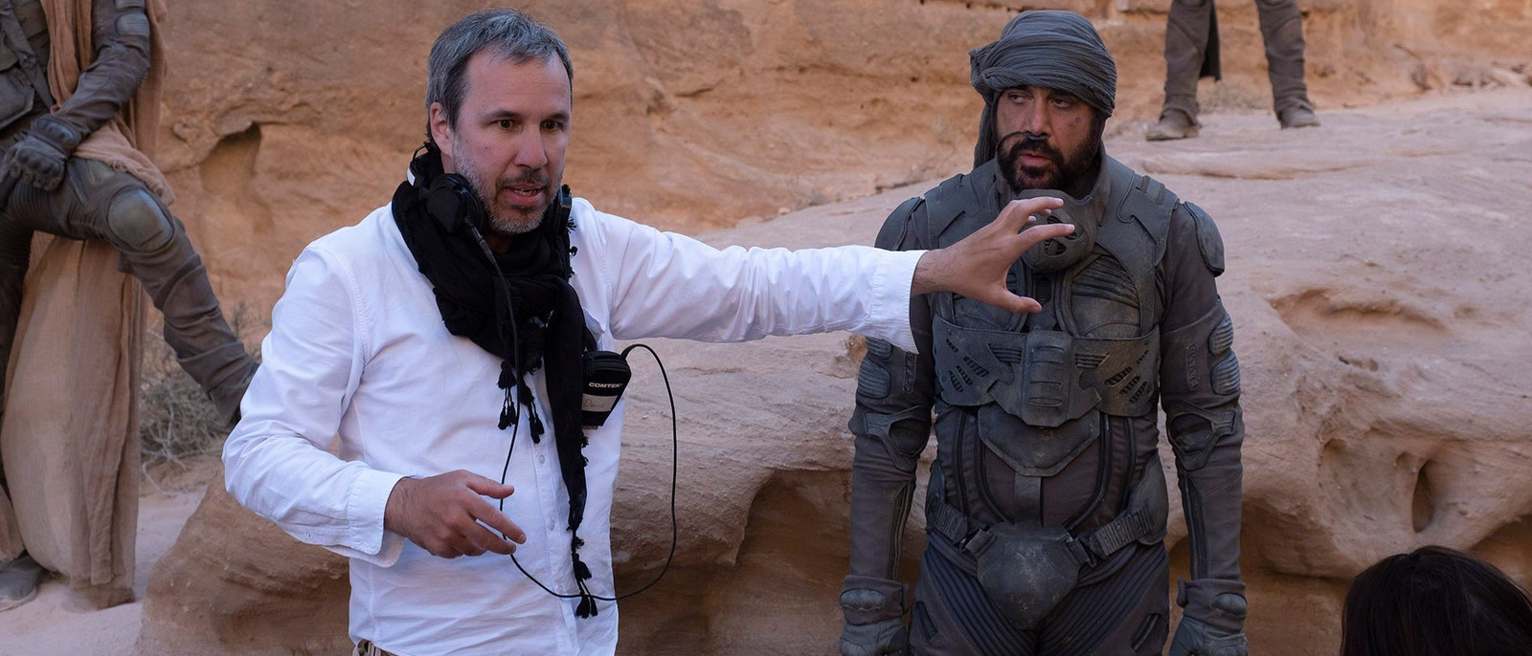
DUNE WILL BE A ‘MUST SEE on the BIG SCREEN’ SPECTACLE
Villeneuve is once again working with an Oscar-nominated cinematographer to create an immersive universe and it’ll be a film that demands the ‘big screen’ cinema viewing experience

Slide 4
DUNE WILL DELIVER A YOUNG, AFFLUENT MALE AUDIENCE
We expect Dune to mirror Villeneuve’s previous sci-fi movies in delivering a young-skewing affluent male audience and based on current forecasts estimate it’ll deliver over 5 16-34 Men TVRs
ARRIVAL
BLADE RUNNER 2049
Male | 64% | 67%
16-34 | 49% | 49%
18-44 | 57% | 61%
ABC1 | 71% | 67%
Source: CAA C+F Planner. Predicted industry admissions as of June 2021

Slide 5
SNAPSHOT: SCI-FI FANS
Dune’s audience of sci-fi fans are the ideal match for brands in the tech, motors, alcohol & restaurant/takeaway sectors.
TECHNOLOGY
MOTORS
ALCOHOL & FOOD
LOVE TO BUY NEW GADGETS & APPLIANCES
127
I LIKE DRIVING
131
LIKE TO TRY NEW DRINKS
123
TRY TO KEEP UP WITH DEVELOPMENTS IN TECH
126
LIKE INNOVATIVE CARS
126
WORTH PAYING MORE FOR GOOD QUALITY BEER
120
IMPORTANT MY HOUSE IS EQUIPPED WITH LATEST TECH
122
ALL NEWS CARS SHOULD BE ELECTRIC
124
REALLY ENJOY A NIGHT OUT AT THE PUB
120
LIKE INNOVATIVE HOUSEHOLD DEVICES/APPLIANCES
121
121
LIKE TO EAT TAKEAWAY MEALS
119
SPENT >£22.5k ON THEIR LAST CAR
LIKE TECH THAT MAKES MY LIFE EASIER AT HOME
118
INTEND TO BUY A CAR IN NEXT 12 MONTHS
115
ENJOY SPLASHING OUT ON A MEAL IN A RESTAURANT
115
Source: GB TGI May 2021, Sci-Fi: Type of film seen at cinema. Indexes vs. average GB adult

