Slide 1
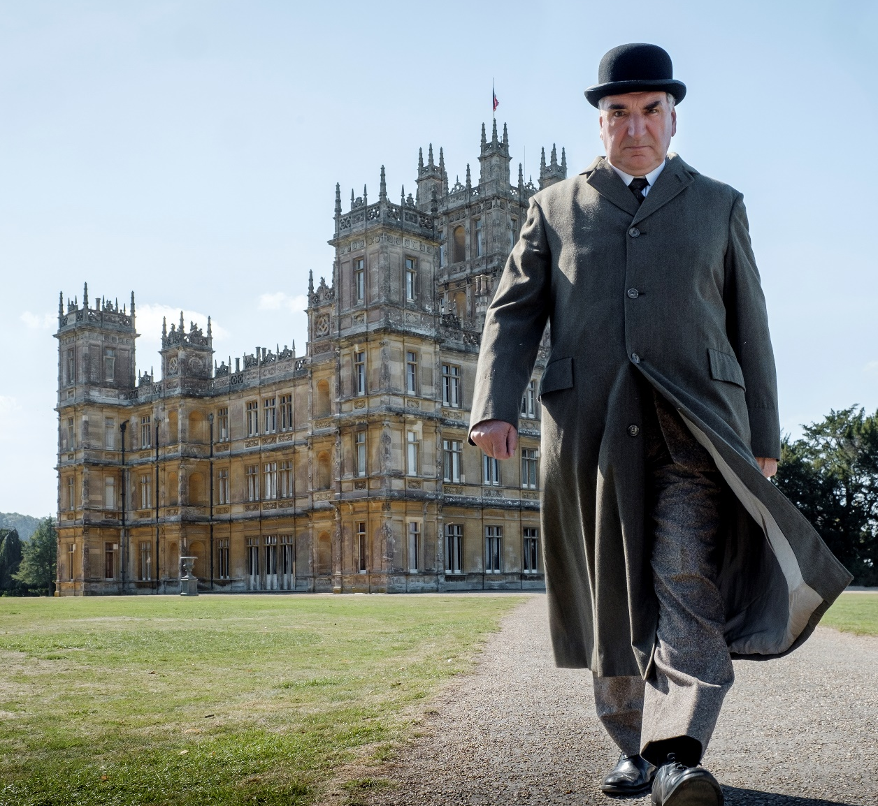
DOWNTON ABBEY: A NEW ERA
The Crawleys are back for another blockbuster cinema event
Having ventured to the big screen for the first time in 2019, the Crawley family return in 2022 inviting audiences to “the grandest escape of the year”. With Lady Violet having come into possession of a villa in the south of France, the family and their loyal attendants all step away from their English countryside estate and head for the sunny French Riviera.
This second film will take events right up to the very end of the 1920s and writer Julian Fellowes has promised that audiences can expect an “unashamedly feel-good film”.
CAST
Maggie Smith, Hugh Bonneville, Michelle Dockery, Hugh Dancy, Elizabeth McGovern,
Jim Carter and Dominic West
KEY STATS
The first Downton Abbey movie grossed £28m at the UK box office, making it the 10th biggest film of 2019.
EST. INDUSTRY ADMISSIONS
2.5m
REACH / IMPACTS / TVRs¹
All adults (16+): 4.4% / 2.5m / 5.2
ABC1 adults: 6.3% / 2.0m / 7.3
ABC1 women: 8.4% / 1.4m / 10.1
Source: 1. Industry Figures.
RELEASE DATE: 18 MARCH 2022

Slide 2
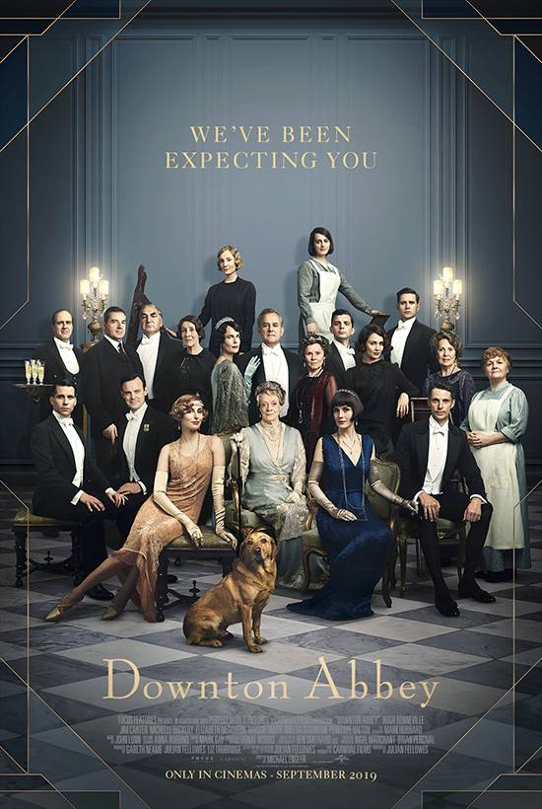
DowNton abbey: audience profile
The first film delivered a highly affluent, older female skewing audience
70% FEMALE
76% 45+
78% ABC1
47% AB
Source: Film Monitor

Slide 3
DOWNTON ABBEY: a new era – the most premium blockbuster of 2022
Based on the first film’s profile we expect over three quarters of the film’s audience to be ABC1 adults
Source: DCM Planner, profiles based on comparative titles from Film Monitor

Slide 4
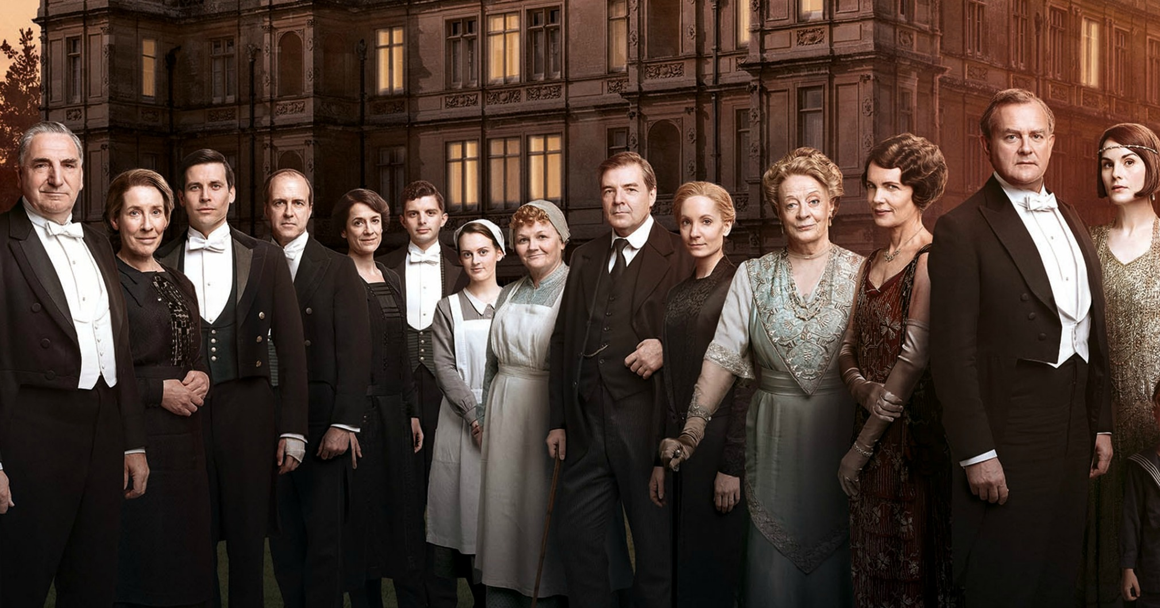
Downton fans are savers in the market for big purchases
Downton Abbey fans are in control of personal finances and save up before investing in important, high quality products
73% save up before buying for something
they really want
(Index 108)
64% are very good at managing money
(index 118)
62% agree it is important to be well insured for everything
(index 121)
£12,945 -
intended spend on next car
24% more than the average UK adult
intending to buy a car in the next year
‘I look for profitable ways to
invest money’
18% more likely than the average UK adult
60% agree it is worth paying extra
for high quality goods
(index 108)
54% enjoy planning holidays
(index 114)
8 in 10 buy new clothes based
on the quality of the product
Source: GB TGI Survey

