Slide 1
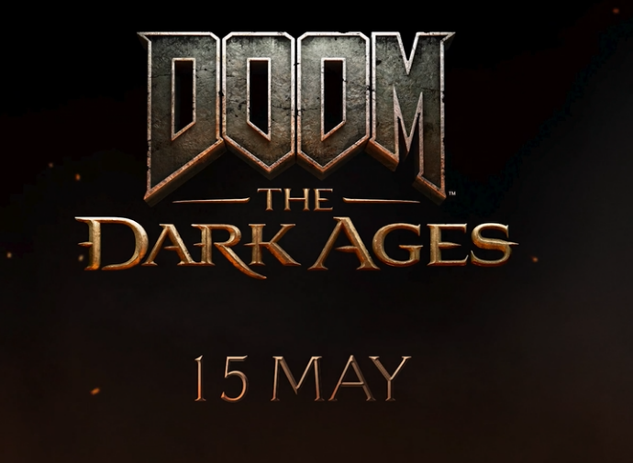
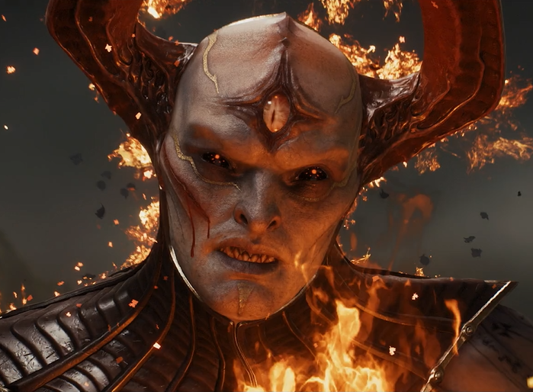
DOOM
DCM AWARDS NOMINEE
Best Use of Cinema (Small)
Background
As the next chapter in the iconic Doom franchise, the game needed a legendary launch. Whilst it was key to drive reach, on a tight budget, there was also a focus on maximising attention to deliver the biggest impact.
Plan
The centrepiece for the campaign was a 60” Silver Spot in Final Destination: Bloodlines, although a 30” creative also played in-reel for Until Dawn and Thunderbolts* - all titles chosen because they over-indexed for gaming adjacent audiences.
Results
Doom: The Dark Ages debuted at #1 in the charts on release and received huge accolades
Key uplifts across a range of metrics, particularly driven by positive increases in both consideration and purchase intent.
Notes:
Source: DCM Awards 2025 Doom Entry

Slide 2
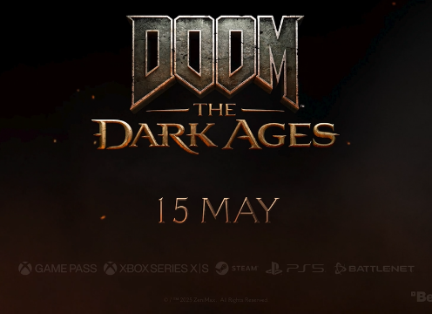


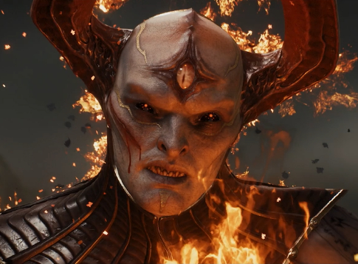
DOOM
DCM AWARDS NOMINEE: Best Use of Cinema (Small)
MEDIA AGENCY | TARGET | BUYING ROUTE | COPY LENGTH
Arena Media | Adults | Silver Spot and Film Packs | 30” & 60”
The Dark Ages – Stand & Fight
BACKGROUND
As the next chapter in the iconic Doom franchise, the game needed a legendary launch. Whilst it was key to drive reach, on a tight budget, there was also a focus on maximising attention to deliver the biggest impact. Cinema’s role was to better target gaming-interested audiences in an attentive environment, with the intention of driving consideration.
PLAN
The centrepiece for the campaign was a 60” Silver Spot in Final Destination: Bloodline, although a 30” creative also played in-reel for Until Dawn and Thunderbolts* which were all titles that over-indexed for gaming adjacent audiences. The creative was crafted to ensure that the games’ themes were displayed whilst also celebrating the games’ iconic music and visual spectacle – perfect for the cinema environment.
RESULTS
The campaign was a huge success, with Doom: The Dark Ages performing well commercially.
TOPPING THE CHARTS
Doom: The Dark Ages debuted at #1 in the charts on release and received huge accolades
BOOSTING KPIs
Key uplifts across a range of metrics, particularly driven by positive increases for both consideration and purchase intent.
Notes:
Source: DCM Awards 2025 Doom Entry

