Slide 1
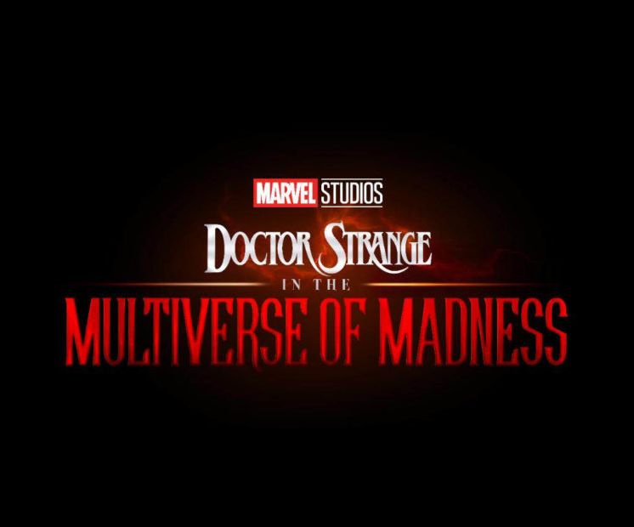
Doctor Strange in the Multiverse of Madness
The Marvel Universe is about to expand…
Release Date
25 March
Cast
Benedict Cumberbatch, Elizabeth Olsen, Rachel McAdams
Director
Sam Raimi (Drag Me To Hell, Spider-Man Trilogy)
Recommended if you like
Doctor Strange
Reasons to buy into
The first films was one of the biggest films of 2016, and the Marvel Cinematic Universe is a reliable staple for 16-34 audiences at the box office.
Key audience info
16-34 Adults Index: 215
Est. DCM admissions
2.3m
Plot currently unknown – a sequel to Doctor Strange and the TV show Wandavision.
Plan your campaign

