Slide 1
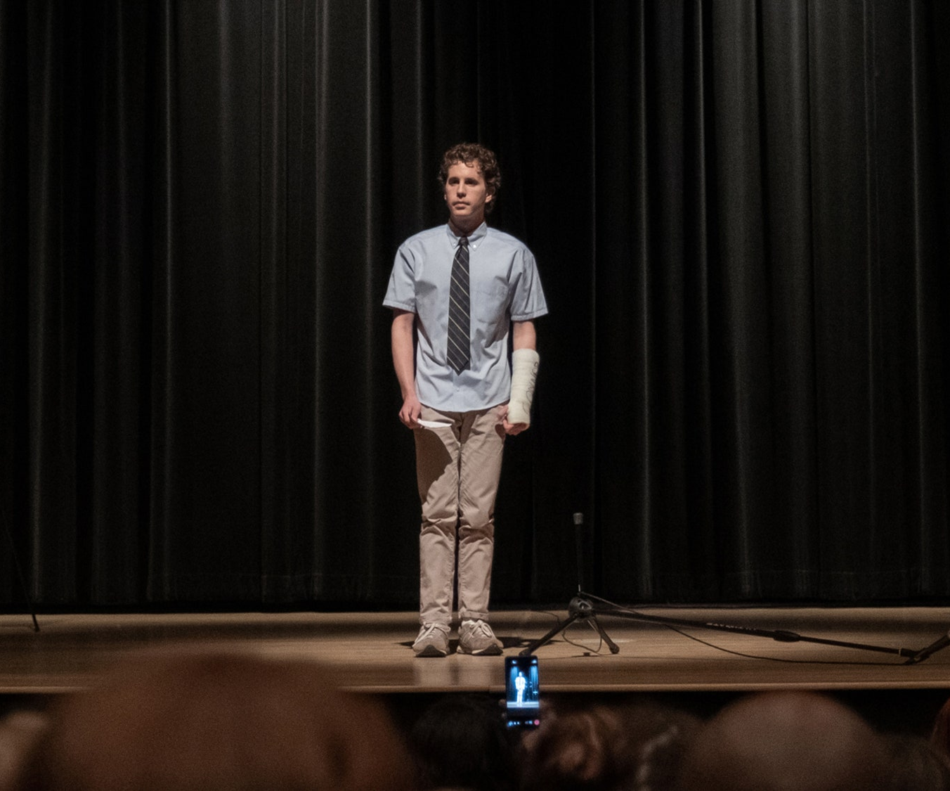
Dear Evan Hansen
A new story jumps from stage to screen”
Release Date
22 October 2021
Cast
Ben Platt, Julianne Moore, Kaitlyn Dever
Director
Stephen Chblosky (The Perks of Being a Wallflower)
Recommended if you like
La La Land
Reasons to buy into
The famous stage musical from 2015 is one of the most successful productions of all time, having taken $226 million
Key audience info
16-34 Women Index: 166
Est. DCM admissions
584k
Adaptation of the Tony and Grammy Award-winning musical about a high school student suffering from social anxiety, and his journey of self-discovery following the death of a classmate..
Plan your campaign

